Slide 1
Python for biological data
Curtis Huttenhower (chuttenh@hsph.harvard.edu)
Sagun Maharjan (smaharjan@hsph.harvard.edu)
Sharifa Sahai (sharifasahai@g.harvard.edu)
http://huttenhower.sph.harvard.edu/bst272

Slide 2
What’s Python, and why should I care?

Slide 3
What’s Python?
Simple and scalable programming language with large pre-existing library.
Low barrier-to entry: the easiest operations are easy.
High scalability: the most complicated operations are complicated (in a good way)!
Graphical, informal (Jupyter) and formal (command line) interfaces.
Great gateway drug:
Easy to get started and do the bare minimum for biology.
Or appropriate to keep going and really do complicated bioinformatics.

Slide 4
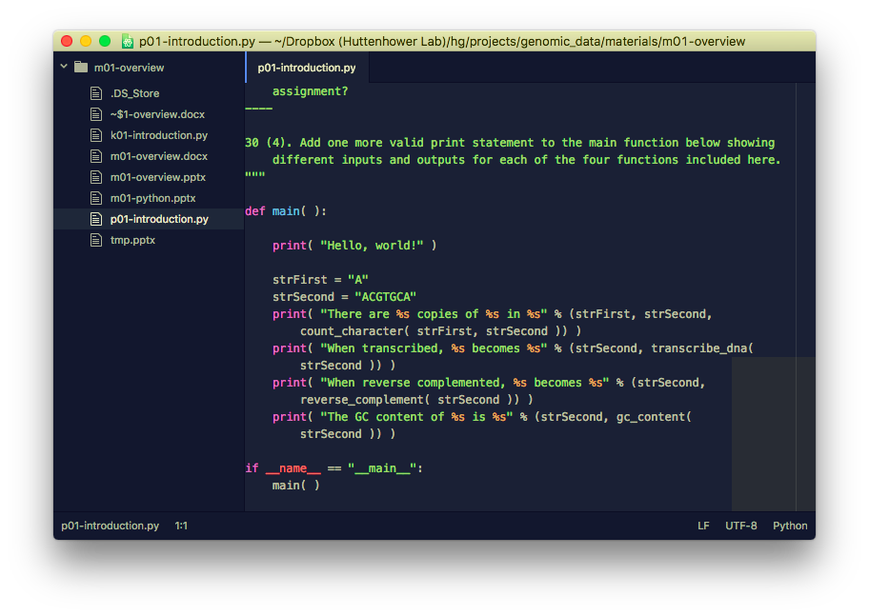
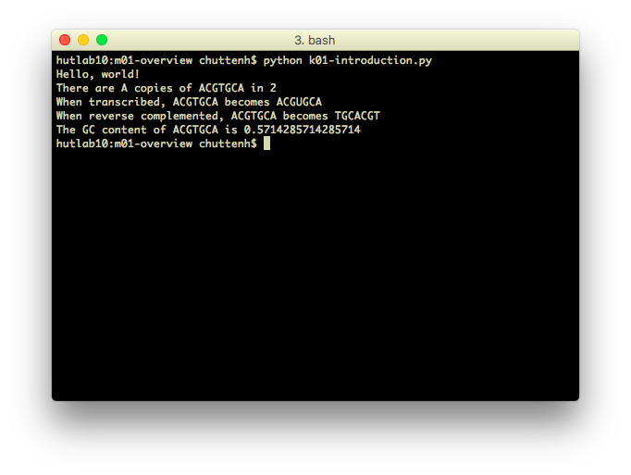
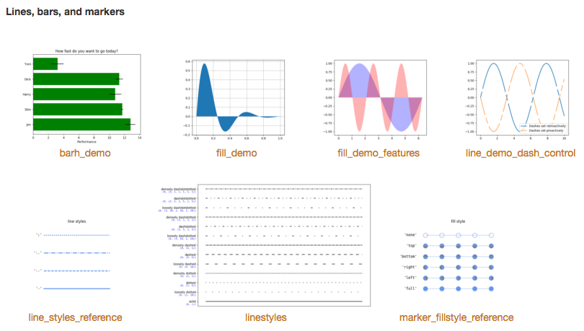
What’s Python?
Simple, clean programming language:
Easy to learn.
Widely used (in computational biology and otherwise).
Lots of tools already built in.
Provides an environment that:
Helps you think about data.
Can quickly get simple tasks done.
Like what?
Download lots of data at once.
Change and match formats.
Quality control or filter data.
Generate reports and visualizations.
Perform statistical tests reproducibly.

Slide 5
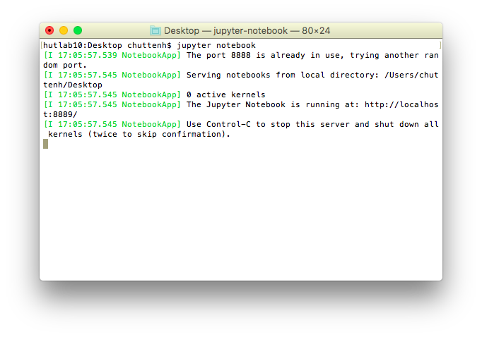
Jupyter
Jupyter (formerly IPython Notebook): web-based graphical interface to interactively run, visualize, and document Python snippets.
Not great for production-scale bioinformatics, but perfect for quick explorations and visualization.
Lets you type Python right into a web browser and get results immediately (with e.g. interactive graphics).
Anything you can do in Jupyter can be robustified as a command line version later if needed.

Slide 6
Python example: counting nucleotides
http://hplgit.github.io/bioinf-py/doc/pub/html/

Slide 7
Python example: machine learning
https://scikit-learn.org/

Slide 8
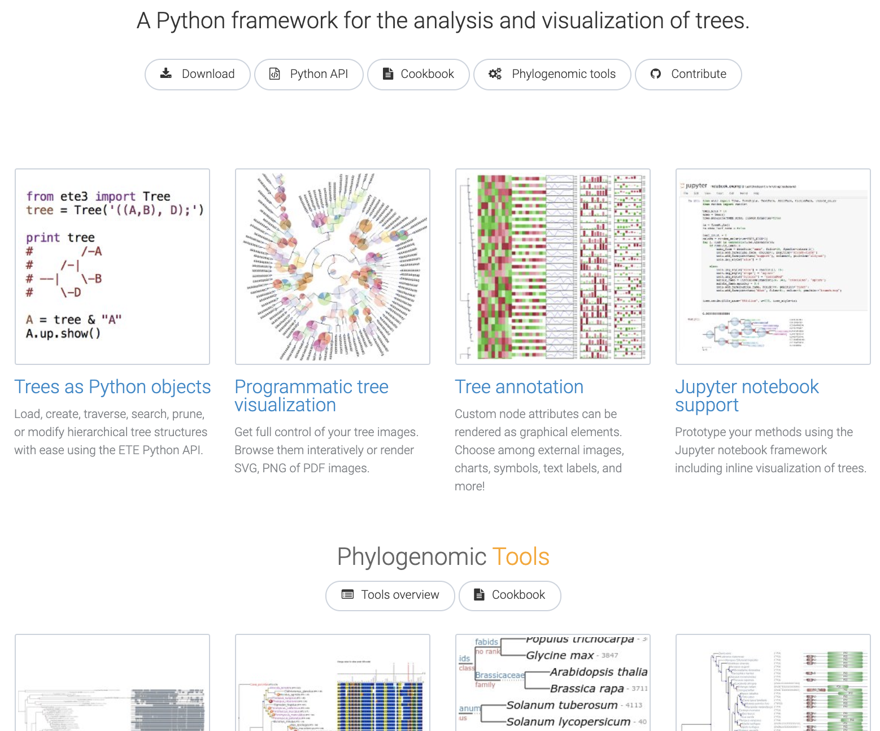
Python example: phylogeny
http://etetoolkit.org/

Slide 9
Python example: systems biology / biophysics
http://pysb.org/

Slide 10
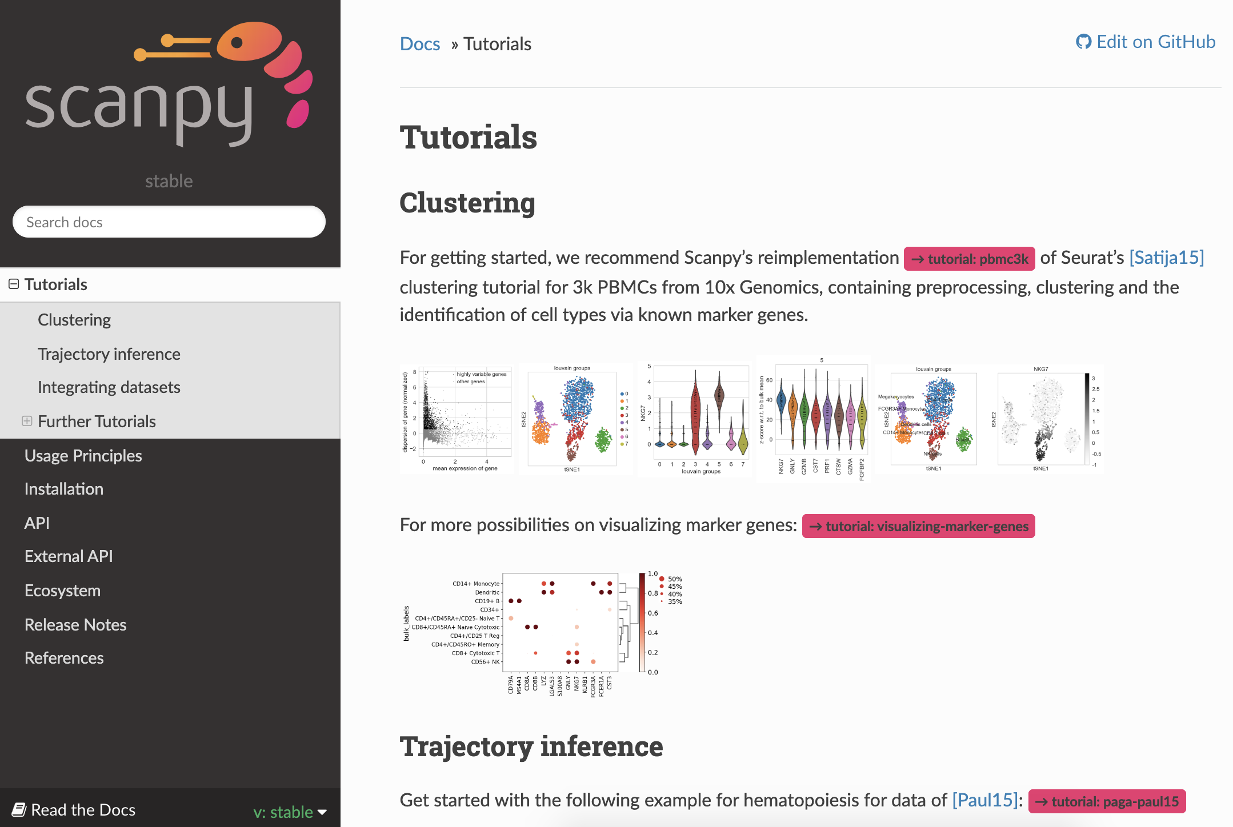
Python example: single-cell sequencing
https://icb-scanpy.readthedocs-hosted.com/

Slide 11
So why bother understanding Python?
Why not just use existing tools?
Like learning a foreign language:
You can get by with a phrasebook…
…but you’ll be a lot less confused and more efficient if you know the basics.
And computers are dumb, so you have to learn to be very precise.
It’s a very useful and flexible tool that enables new kinds of biology.
Pipetting isn’t research, but it’s impossible to do many types of research without understanding it and doing it efficiently and accurately.
Goals for this class:
Review the basic principles of how Python works.
Get you set up with a basic Python environment.
Try it out!
Plug you into documentation and resources for future work.
Assume that anything we cover is being oversimplified for the sake of time.

Slide 12
Python terminology and data

Slide 13
Python terminology
Interpreted language (not compiled).
Your programs are plain text files (not Word etc.) that describe data and instructions.
An interpreter reads them in, figures out what they mean, and (hopefully) does it.
Any programming language has a specific syntax.
Formatting conventions that allow the computer to read it precisely.
This includes capitalization, whitespace, indentation, symbols, operators, names…
Handful of important concepts that we’ll see soon:
Data, which can be stored in different locations using different types.
Instructions, which manipulate data and come in several forms.
Operators, which are simple instructions typically abbreviated using punctuation (=, +, <, etc.)
Functions, which are complex instructions typically given a specific name.
Keywords, other instructions built into the language.
Always read and think hard about error messages.
They can be hard to understand, but they usually tell you what went wrong!

Slide 14
Storing information: data and data types
Data are typically stored in variables, which are essentially named buckets.
The bucket contains the data, it’s not the data itself!
variable_name = "value"
In general, data must be of a specific type.
You can add two numbers, or concatenate two strings…
…but you can’t add a number to a string, or concatenate two numbers.
Many built-in data types in Python, but the simplest are:
Strings = sequences of characters surrounded by quotes: "This is a string."
Escape sequences use \ to represent special chars: "\t is a tab, \\ a backslash"
Integers = positive or negative whole numbers: 12345, -678
Floats = numbers with a decimal place: 12.345, -6.7e8
Booleans = binary values, True or False: True

Slide 15
Combining information: collection data types
What about combinations of multiple values?
Lists (or arrays or vectors) are sequences of zero or more ordered data (of arbitrary types):
Surrounded by []s, separated by ,s.
[]
[1, 2, 3]
["one", 2, ["three", [], 4]]
Accessed by integer index (starting at zero):
a = ["one", "two", "three"]
a[0] → "one"
a[2] → "three"
a[3] → ERROR
Have an intrinsic length that can be dynamically modified:
len( a ) → 3
a.append( "four" )
a → ["one", "two", "three", "four"]
len( a ) → 4
a[3] → "four"

Slide 16
Combining information: collection data types
Sets are collections of zero or more unordered, unique data (of arbitrary types):
Surrounded by {}s, separated by ,s.
{}
{1, 2, 3}
{"one", 2, ["three", {}, 4]}
Accessed by iteration – no intrinsic order – but can be combined intuitively:
{"one", "two", "two"} → {"one", "two"}
{"one", "two"} == {"two", "one"} → True
{"one", "two"} | {"two", "three"} → {"one", "two", "three"}
{"one", "two"} & {"two", "three"} → {"two"}
Have an intrinsic length that can be dynamically modified:
setOne = {"one", "two", "three"}
len( setOne ) → 3
setOne.add( "four" )
setOne → {"one", "two", "three", "four"}
len( setOne ) → 4
setOne.add( "four" )
setOne → {"one", "two", "three", "four"}

Slide 17
Combining information: collection data types
Dictionaries (or hashes or maps) are sets of zero or more key-value pairs:
A key must be any unique, simple data type; a value can be anything.
Surrounded by {}s, pairs separated by ,s, key-values separated by :s.
{}
{1:"one", 2:"two"}
{"one":1, "two":[[], []], 3:{"three"}}
Accessed by key (confusingly still using []s):
hash = {1:"one", "two":2}
hash[1] → "one"
hash["two"] → 2
hash["three"] → ERROR
Have an intrinsic length that can be dynamically modified:
len( hash ) → 2
hash["three"] = [[], [], []]
hash → {1:"one", "two":2, "three":[[], [], []]}
len( hash ) → 4
hash["three"] → [[], [], []]

Slide 18
Syntax and formatting
Python loves whitespace – you can’t see it, but the computer can.
In general, whitespace within a line doesn’t matter.
Within a line: just spaces.
At the end of a line: newlines and/or carriage returns, doesn’t matter.
Whitespace at the beginning of a line matters.
At the beginning of a line, spaces or tabs – either fine, but must be consistent (I recommend tabs).
Indentation in Python indicates blocks:
A block is a group of instructions associated with a particular environment.
Within a function, within a conditional, within a loop – keep an eye out for these later.
A side comment: external code can be included using import.
External code like this in Python is called a module – more on that later.

Slide 19
https://canvas.harvard.edu/courses/71191/quizzes/163004

Slide 20
Python control flow
Eric Franzosa

Slide 21
Python control flow
What if I don't want the computer to always do the same thing?
Or what if I want it to do something many times in a row?
Or for each data element in a collection?
Control flow refers to instructions that execute conditionally or repeatedly.
If-else keywords (instructions) choose between multiple operations.
For and while loops execute the same instructions repeatedly.
Although typically on different data each time.

Slide 22
The if-else conditional
Conditionals allow “flow of control” in our programs
“Do different things depending on qualities of the data given”
Structure of an if-else conditional in Python
if x:
# do this if x is True
else:
# do this if x is False
x above could be a variable storing True or False
More often x is a statement

Slide 23
Statements
iNum = 47 # read as “iNum gets 47”; not a statement!
iNum == 13 # ‘==’ tests for equivalence, different from assignment ‘=’
False
iNum != 13 # ‘!=’ is read ‘not equal to’
True
iNum > 13
True
iNum <= 46
False

Slide 24
Statements
hashPrices = {"Apple":1.29, "Banana":0.99, "Cantaloupe":3.59}
"Apple" in hashPrices # ‘in’ tests for membership among collections
True
"Pear" in hashPrices
False
"Grape" in "Grapefruit" # ‘in’ tests for substring relationship among strings
True

Slide 25
Logical operators
(1 < 2) and (3 > 1) # “and” returns “True” if both surrounding statements are True
True
("eric" in "America") and ("Eric" in "America")
False
(1 < 2) or (1 > 2) # “or” return “True” if at least one surrounding statement is True
True
("i" in "team") or ("fun" in "dysfunctional")
True

Slide 26
Logical operators
not (1 < 2) # “not” negates the truth value it is given, similar to “-1 * iNum”
False
not True or True # logical operators are evaluated left to right
True
not (True or True) # use parens to change order of operations
False
https://python-reference.readthedocs.io/en/latest/docs/operators/
(among many others…)

Slide 27
The while loop
The while loop provides a way to do something as long as a statement is true
Similar in spirit to a repeated if
We don’t need to be looping over fixed data to use while
while x:
# do this until x is no longer True

Slide 28
The while loop
iCount = 0
while iCount < 3:
iCount += 1
print( iCount )
1
2
3

Slide 29
The while loop (infinite version)
iCount = 0
while iCount < 4:
iCount += 1
print( iCount )
0
0
0
0
0
...

Slide 30
The for loop
Loops and collections go hand-in-hand
Enable executing a set of instructions on each element of a collection
This include collections that are simple counts, e.g. do something 10 times
Structure of a for loop in python
syntax
syntax
for x in y:
x = x + 1
print( x )
y is the data
(often a collection)
whose elements we
want to process
(one-at-a-time)
x is a variable that will store the element of y with which we are currently working
indented block of code
using current value of x

Slide 31
The for loop: basic example
for iNum in [0, 1, 2, 3]:
print( iNum )
0
1
2
3

Slide 32
The for loop: basic example
for iNum in [0, 1, 2, 3]:
iNum = iNum**2
print( iNum )
0
1
4
9

Slide 33
The for loop: range( )
for iNum in range( 0, 4 ): # consider the numbers from 0 to 3 (in increments of 1)
iSquared = iNum**2
print( iNum, iSquared )
0, 0
1, 1
2, 4
3, 9

Slide 34
The for loop: over a string in a variable
strGreeting = “hello, world”
for strChar in strGreeting:
strChar = strChar.upper( )
print( strChar )
“H”
“E”
“L”
...
print( strGreeting ) # the string we looped over is unchanged!
‘hello, world’

Slide 35
The for loop: enumerate( )
astrNames = [“Matt”, “Sarah”, “Jason”, “Michelle”]
for iPos, strName in enumerate( astrNames ): # enumerate returns position, value pairs
strName = “Dr. ” + strName
print( iPos, strName )
0, ‘Dr. Matt’
1, ‘Dr. Sarah’
2, ‘Dr. Jason’
3, ‘Dr. Michelle’

Slide 36
The for loop: changing a collection
aiPrimes = [2, 3, 5, 7, 11]
for iPos, iVal in enumerate( aiPrimes ): # enumerate returns position, value pairs
aiPrimes[iPos] = iVal**2
print( iPos, iVal, aiPrimes[iPos] )
0, 2, 4
1, 3, 9
2, 5, 25
...
print( aiPrimes ) # the list has changed!
[4, 9, 25, 49, 121]

Slide 37
The for loop: dict example
hashPrices = {“Apple”:1.29, “Banana”:0.99, “Cantaloupe”:3.59}
for strFruit in hashPrices:
print( strFruit, hashPrices[strFruit] )
‘Cantaloupe’, 3.59
‘Apple’, 1.29
‘Banana’, 0.99
When we supply a dict as data for a for loop, we loop over the keys of the dict, but not in any intuitive order!

Slide 38
The for loop: dict example
hashPrices = {“Apple”:1.29, “Banana”:0.99, “Cantaloupe”:3.59}
for strFruit, dCost in hashPrices.items( ):
print( strFruit, dCost )
‘Cantaloupe’, 3.59
‘Apple’, 1.29
‘Banana’, 0.99
.items( ) is a dictionary method that provides a shortcut for looping over key, value pairs
Still no sensible order though!

Slide 39
The for loop: sorted( )
hashPrices = {“Apple”:1.29, “Banana”:0.99, “Cantaloupe”:3.59}
for strFruit in sorted( hashPrices ):
print( strFruit, hashPrices[strFruit] )
‘Apple’, 1.29
‘Banana’, 0.99
‘Cantaloupe’, 3.59
The function sorted( ) yields the sorted keys of hashPrices
hashPrices isn’t changed in this process (still unordered dict)

Slide 40
Putting it together
c_dBudget = 3.00 # “c_” indicates a constant; shouldn’t change as program runs
hashPrices = {“Apple”:1.29, “Banana”:0.99, “Cantaloupe”:3.59}
for strFruit, dCost in hashPrices.items( ):
if dCost > c_dBudget:
print( strFruit + “s”, “are too expensive!” )
else:
print( “I can afford a(n)”, strFruit )
‘Cantaloupes are too expensive’
‘I can afford a(n) Apple’
‘I can afford a(n) Banana’

Slide 41
break will exit a loop early
c_dBudget = 3.00
hashPrices = {“Apple”:11.29, “Banana”:10.99, “Cantaloupe”:13.59}
for strFruit, dCost in hashPrices.items( ):
if dCost > c_dBudget:
print( dCost, “for a”, strFruit, “? I’m not shopping here anymore” )
break
else:
print( “I can afford a(n)”, strFruit )
‘13.59 for a Cantaloupe? I’m not shopping here anymore’

Slide 42
Python functions

Slide 43
Manipulating information: instructions and functions
Functions are the most important type of instruction.
Operators and keywords tend to be special but very specific.
A function is exactly like a recipe or a protocol:
It takes zero or more inputs, of different types (called arguments or parameters).
It produces zero or more results (referred to as a return value).
There’s a difference between running a function and writing one.
Just like a recipe – having it in the book doesn’t actually do anything until you run it.
In Python, a function is called by writing its name followed by parentheses and arguments.
function_name( )
function_name( argument1, argument2, argument3 )
argument1.function_name( argument2, argument3 )
New functions are written using the def keyword…

Slide 44
Functions
Anatomy of a function definition:
syntax
syntax
syntax
def function_name( ):
# actions to perform
return None
indented block of code
Default “empty” piece of data
Statement defining
What the function returns

Slide 45
Function example: trivial
def simple_function( ):
iRet = 1 + 1
return iRet
simple_function( ) # function call denoted by ( )s
2
iNum = simple_function( )
print( iNum )
2
simple_function( )**2 # functions return data, which we can directly act on
4

Slide 46
Functions with arguments
Functions receive data via arguments, act on that data, and then return a processed result
In this way, functions act as “mini” programs: taking input, providing output
Arguments of the function
def function_name( x, y, z ):
# actions to perform using x, y, z
return None

Slide 47
Function example: one argument
def square( iNum ):
iRet = iNum * iNum
return iRet
square( -5 ) # function call denoted by ( )s
25
square( ) # this will create an error
TypeError: square() takes exactly 1 argument (0 given)

Slide 48
Function example: multiple arguments
def count_occurrences( aCollection, Query ):
iCount = 0
for Item in aCollection:
if Item == Query:
iCount += 1
return iCount
count_occurrences( [0, 1, 0, 1], 1 )
2
count_occurrences( range( 5 ) ) # this will create an error
TypeError: count_occurrences() takes exactly 2 arguments (1 given)

Slide 49
Function example: changing collections
Arguments are passed “by reference”
This means that collection data can be changed in the body of a function
def negate_numbers( aNumbers ):
for iPos, Value in enumerate( aNumbers ):
aNumbers[iPos] = -1 * Value # aNumbers points to original data passed in!
return aNumbers
aiIntegers = [1, -1, 0, 3]
negate_numbers( aiIntegers )
[-1, 1, 0, -3]
print( aiIntegers ) # original data in variable aiIntegers have changed!
[-1, 1, 0, -3]

Slide 50
Function example: changing collections
Simple data types are not changed:
def square( iNum ):
iNum **= 2
return iNum
iFive = 5
square( iFive )
25
print( iFive ) # original data in variable iFive has not changed!
5

Slide 51
How can I possibly remember all of this?

Slide 52
Don’t!
Google is your friend.
https://docs.python.org/3/tutorial/
https://docs.python.org/3/reference/
https://python-reference.readthedocs.io/
https://www.w3schools.com/python/
https://www.learnpython.org/
https://www.codecademy.com/learn/learn-python
And more that we’ll see during the lab…

Slide 53
https://canvas.harvard.edu/courses/71191/quizzes/163006

Slide 55
Function example: keyword arguments
def my_range( iStop, iStart=0, iStep=1 ): # keyword arguments denoted by “=”
aiRange = []
iCurrent = iStart
while iCurrent < iStop:
aiRange.append( iCurrent )
iCurrent += iStep
return aiRange
my_range( 5 ) # iStop required and provided; keyword arguments will use defaults
[0, 1, 2, 3, 4]
my_range( 5, iStep=2 ) # override the keyword iStep with a different value
[0, 2, 4]
my_range( 5, 2 ) # tricky: “2” will slide into iStart; better to be explicit!
[2, 3, 4]

Slide 56
Notes about arguments
Positional (non-keyword) arguments must precede keyword arguments
def function1( a, b, c, x=1, y=“2”, z=False ): #WORKS
def function2( a, x=1, b ): #WON’T WORK
Keyword arguments pull “double duty”
CAN have a default value
MUST have a default value
Default value can be overridden when function is called
Be careful when using collections as default values
def function3( a=[] ): #DOESN’T WORK AS EXPECTED

Slide 57
Function example: collection default
def append_one( aList=[] ): # this will create problems
aList.append( 1 )
return aList
append_one( aList=[-2, -1, 0] ) # override default
[-2, -1, 0, 1]
append_one( ) # use default
[1]
append_one( ) # use default
[1, 1] huh?

Slide 58
Function example: collection default
def append_one( aList=None ): # better
if aList is None:
aList = []
aList.append( 1 )
return aList
append_one( aList=[-2, -1, 0] ) # override default
[-2, -1, 0, 1]
append_one( ) # use default
[1]
append_one( ) # use default
[1] ok

