Slide 1
Even more Python for biological data
Curtis Huttenhower (chuttenh@hsph.harvard.edu)
Sagun Maharjan (smaharjan@hsph.harvard.edu)
Sharifa Sahai (sharifasahai@g.harvard.edu)
http://huttenhower.sph.harvard.edu/bst272

Slide 2
Questions on PS1?
Questions on PS2?

Slide 3
Imports, NumPy, and SciPy

Slide 4
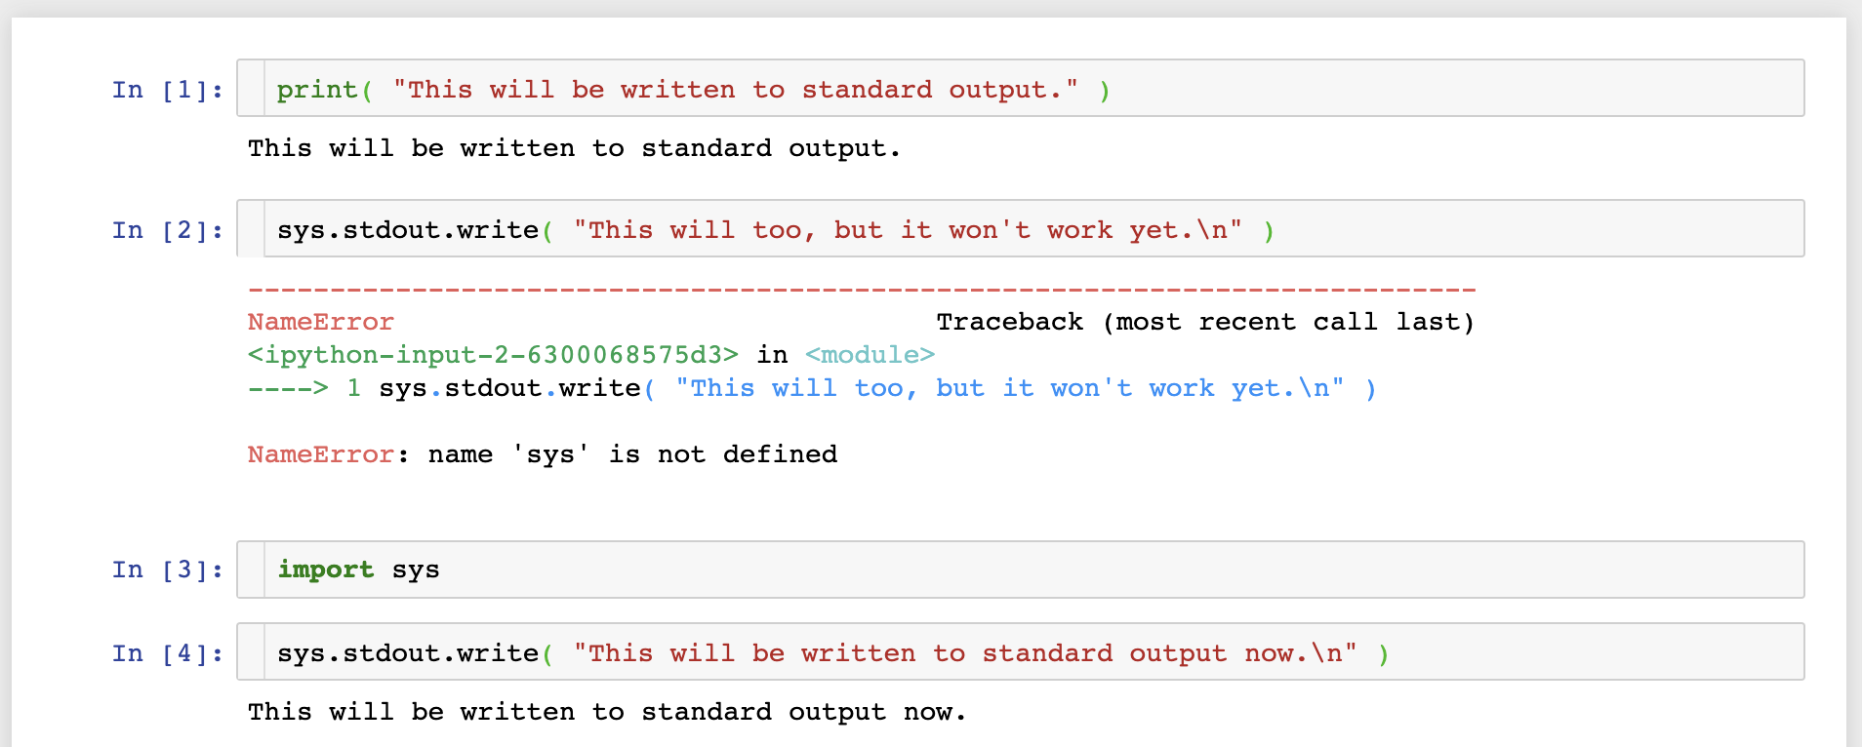
import and modules
The import keyword makes prewritten code (and sometimes data) from an external module (or library) available to use.

Slide 5
Modules and the standard library
Python has many, many modules available by default in its standard library.
https://docs.python.org/library/
sys: basic system interface (stdio, command line, etc.)
csv: native CSV, TSV, and Excel file manipulation
re: regular expressions (fancy text pattern manipulation)
random: many types of random number generation
doctest: quick, comment-based code documentation and testing
argparse: write your own command line interface and parameters
logging: pretty interface for debugging and data validation
math: basic math operations (more on this soon)
gzip: compressed file manipulation (also zipfile etc.)
urllib: online data retrieval
unittest: fancier code testing interface
threading and multiprocessing: parallel processing interfaces
Many, many, many more!

Slide 6
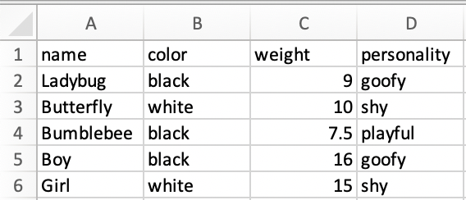
csv (and cats)
🐞
🦋
🐝

Slide 7
Conda and PyPI
In case these aren't enough, there are multiple standard mechanisms for getting even more pre-written modules.
Conda is the most modern and high-quality.
https://docs.anaconda.com/anaconda/packages/pkg-docs/
Written to support the Anaconda Python distribution.
Now used for lots of (often curated) packages.
The Python Package Index (PyPI) is almost as good.
https://pypi.org/
Slightly older, but much larger.
Many tools that you might want to use are already available on one of these.

Slide 8
NumPy, SciPy, and the SciPy stack
The "SciPy stack" refers to a set of interdependent modules (a software stack) used for scientific computing in Python.
All made to play nicely with Jupyter (or more so vice versa).
numpy: low-level library for very efficient vector and matrix operations
scipy: high-level library for scientific data storage and manipulation
Pandas: high-level library for structured data (table, series) manipulation
matplotlib: low-level library for making figures and plots
seaborn: high-level library for making even prettier figures and plots
Plus a few more that we won't worry about…
And even more importantly, they play nice with others.

Slide 9
NumPy
NumPy defines a world of arrays and matrices.
Although a matrix is just an array with two axes.
[1, 2, 3] is an array with one axis (of length 3).
[[1, 2, 3], [4, 5, 6]] is an array with two axes (of lengths 2 and 3, respectively).
NumPy arrays (technically ndarray) look a lot like lists, but they're not.
Although they generally implement a very similar interface.
And with SciPy / Pandas, you probably won't often use them directly anyhow.

Slide 10
NumPy

Slide 11
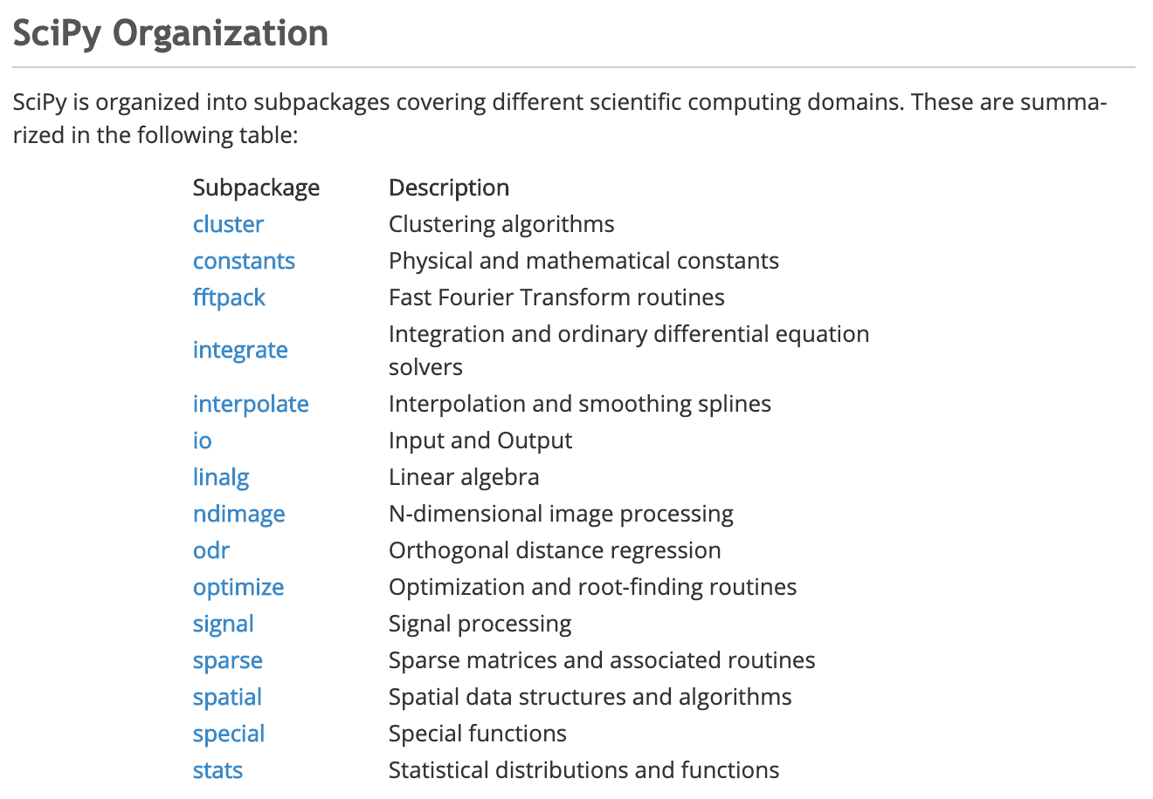
SciPy
SciPy contains a much larger sub-library of numerical computing modules, most of which I essentially never use directly.
Except for scipy.stats
Again, these are often used behind the scenes by other tools.

Slide 12
scipy.stats

Slide 13
scipy.stats

Slide 14
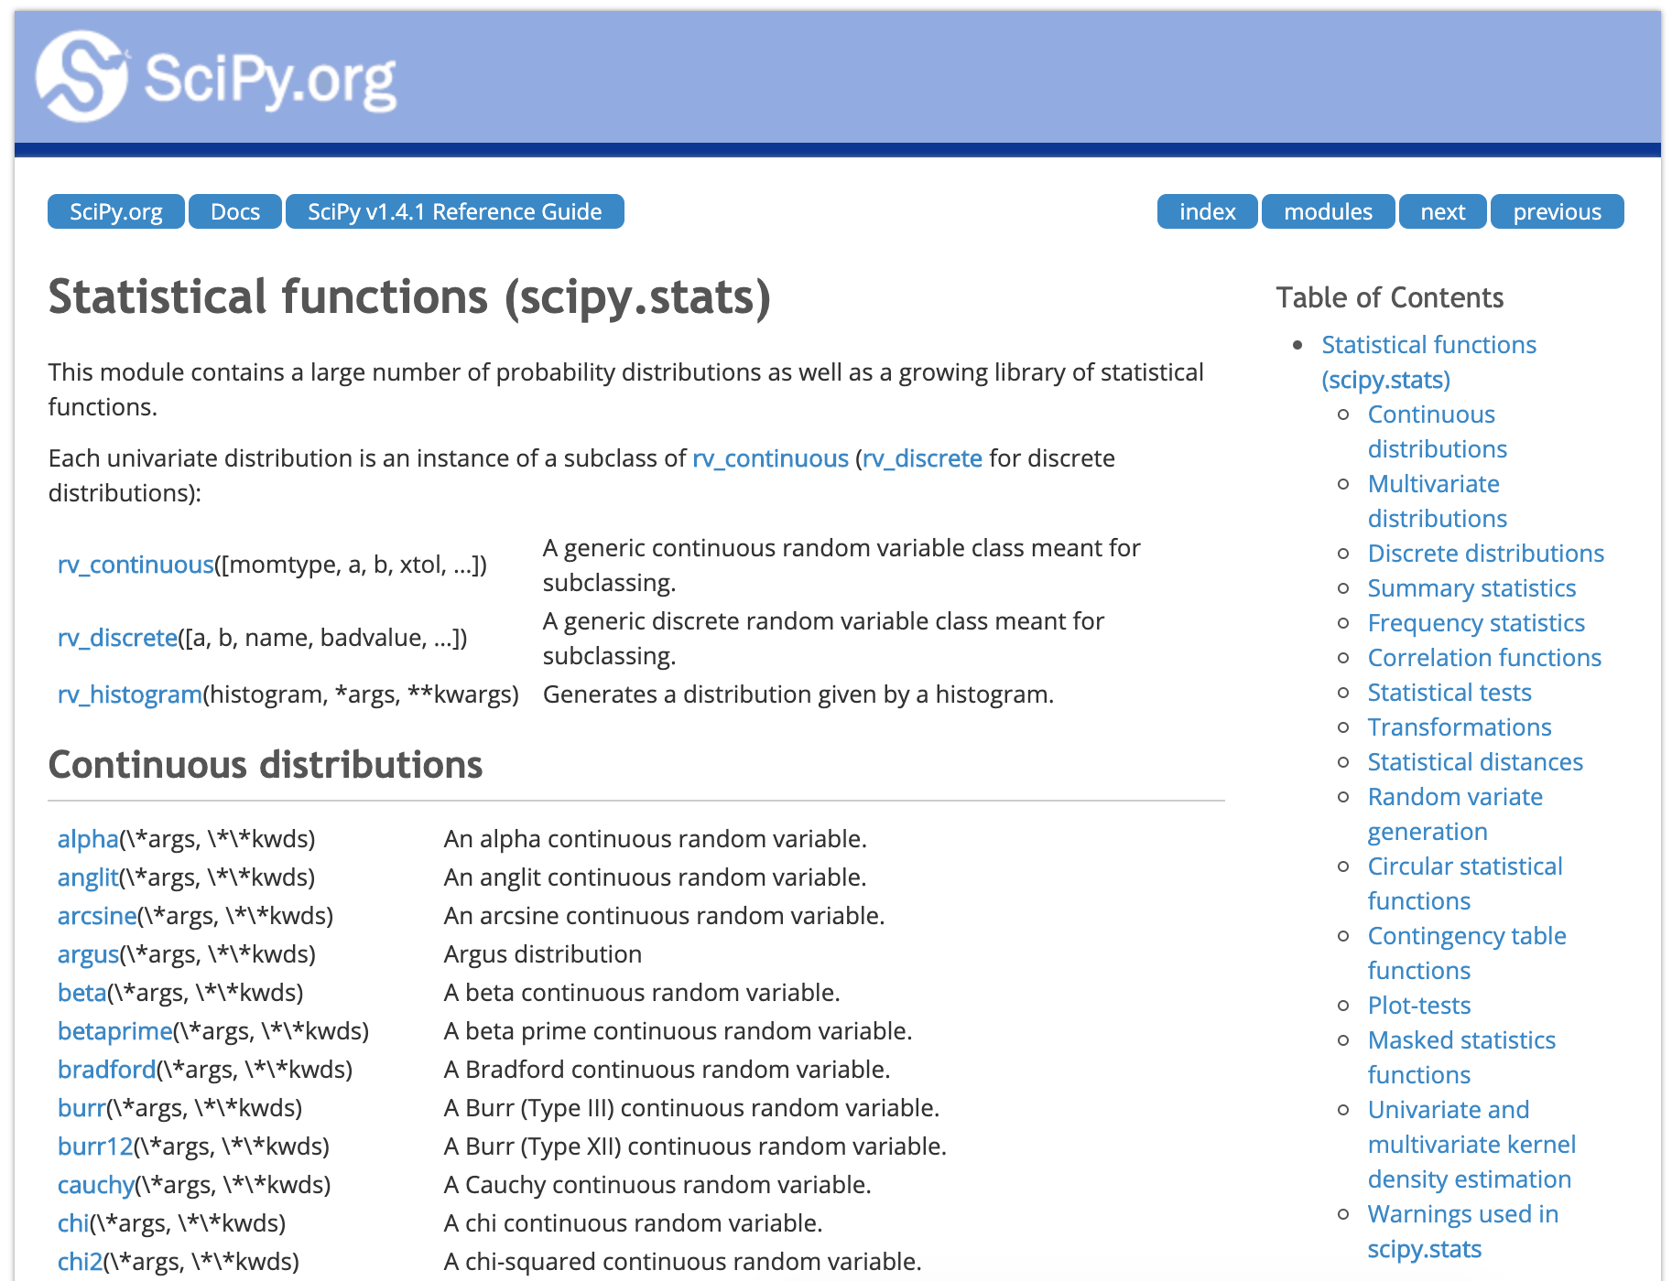
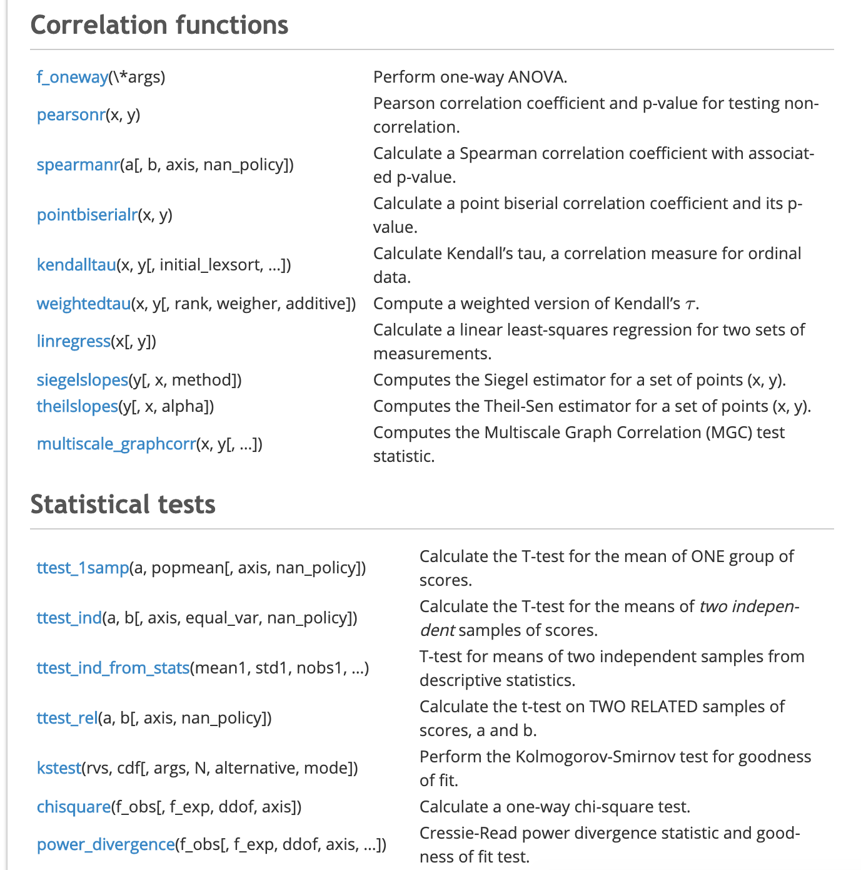
scipy.stats

Slide 15
https://canvas.harvard.edu/courses/71191/quizzes/163816

Slide 16
Pandas

Slide 17
Pandas
Pandas provides a more sophisticated data structure layer over NumPy to handle annotated sequential and/or tabular data of mixed types (including missing values).
DataFrame is the main data type.
Equivalently captures:
Ordered list of records, each with the same fields of fixed types.
A matrix with mixed data types and row/column annotations.
An R data.frame.
Made up of Series.
Which are annotated NumPy arrays.
Which in turn are just fancy lists.

Slide 18
DataFrame

Slide 19
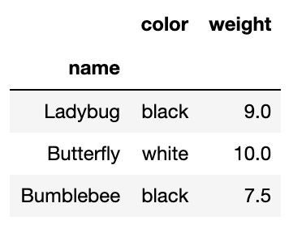
DataFrame

Slide 20
DataFrame

Slide 21
DataFrame

Slide 22
DataFrame

Slide 23
DataFrame

Slide 24
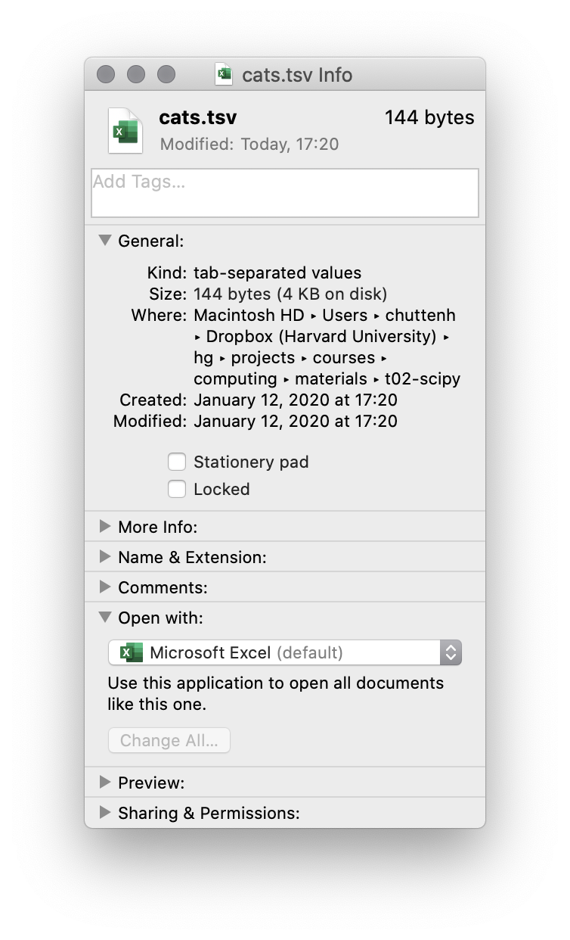
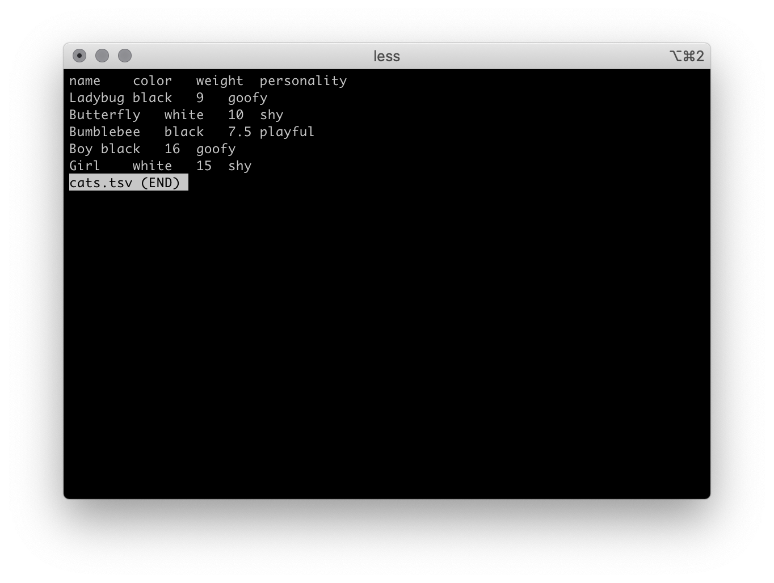
DataFrames from files

Slide 25
DataFrames from files

Slide 26
matplotlib and Seaborn

Slide 27
matplotlib (and pyplot)

Slide 28
matplotlib

Slide 29
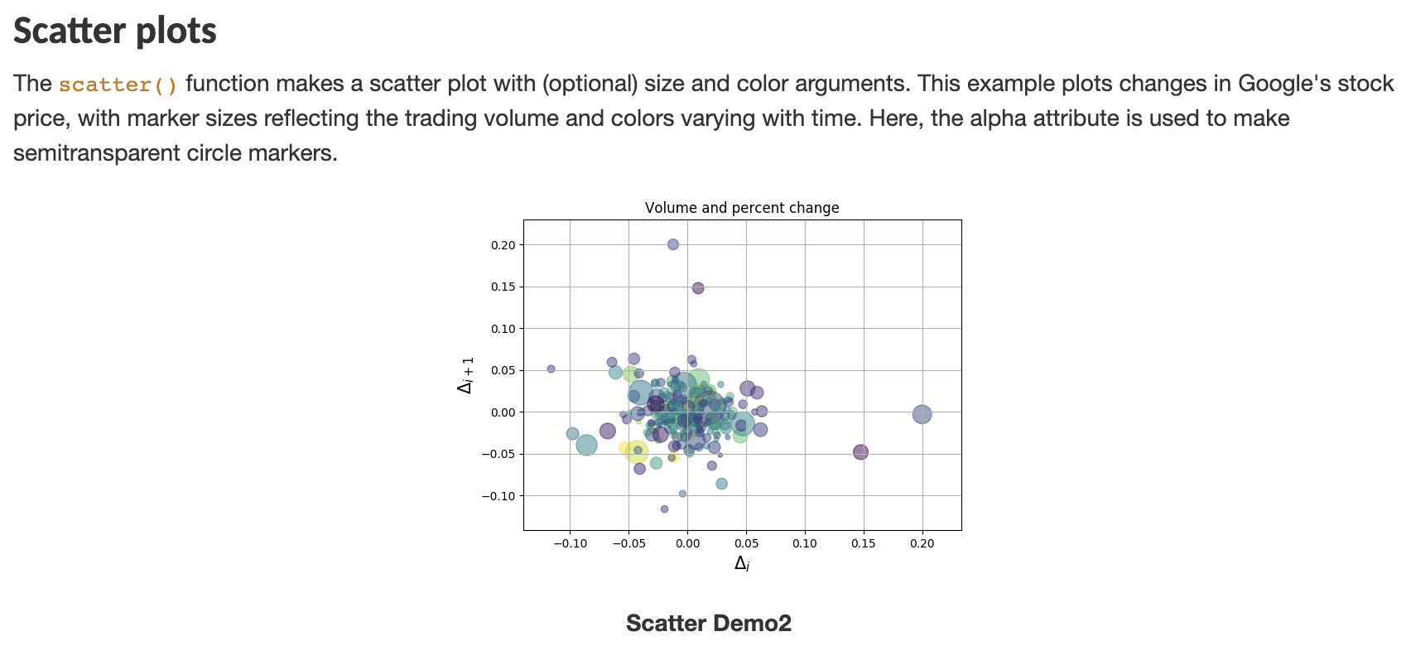
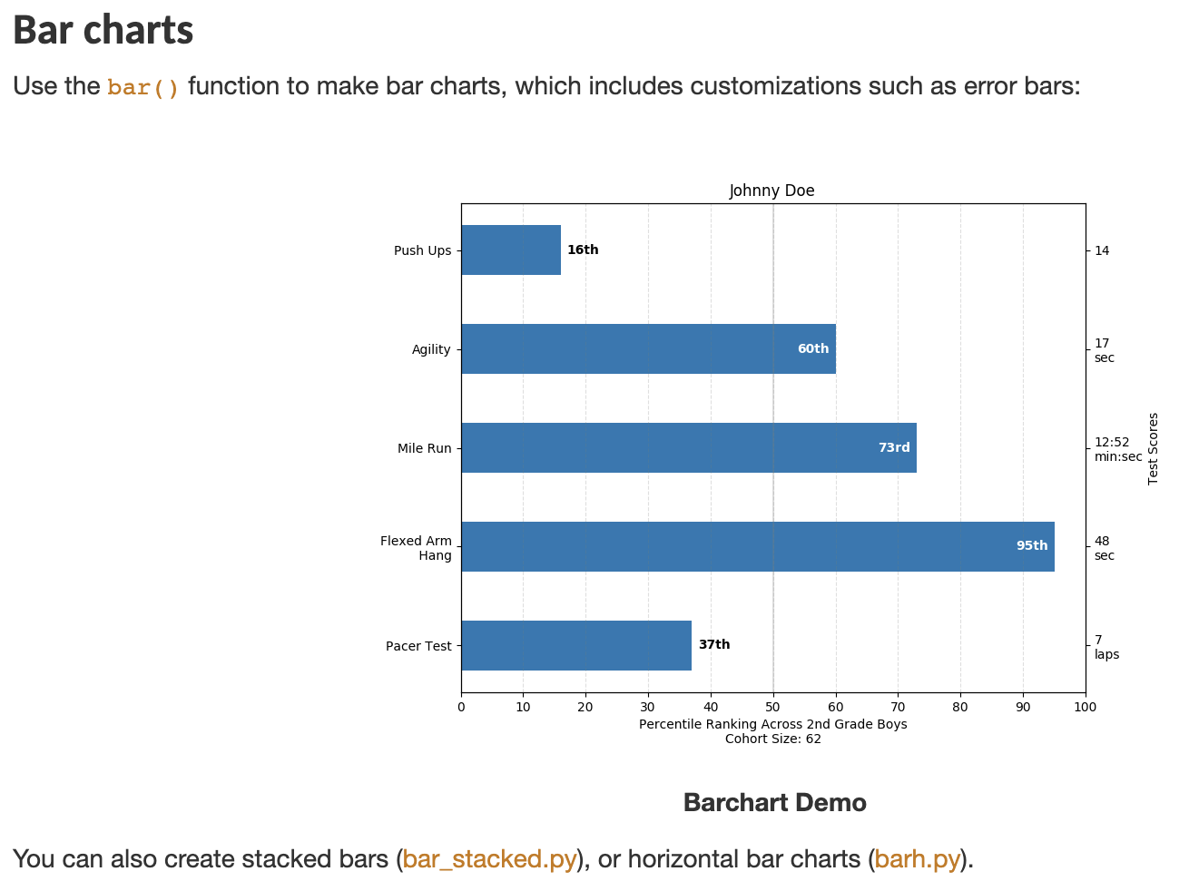
matplotlib

Slide 30
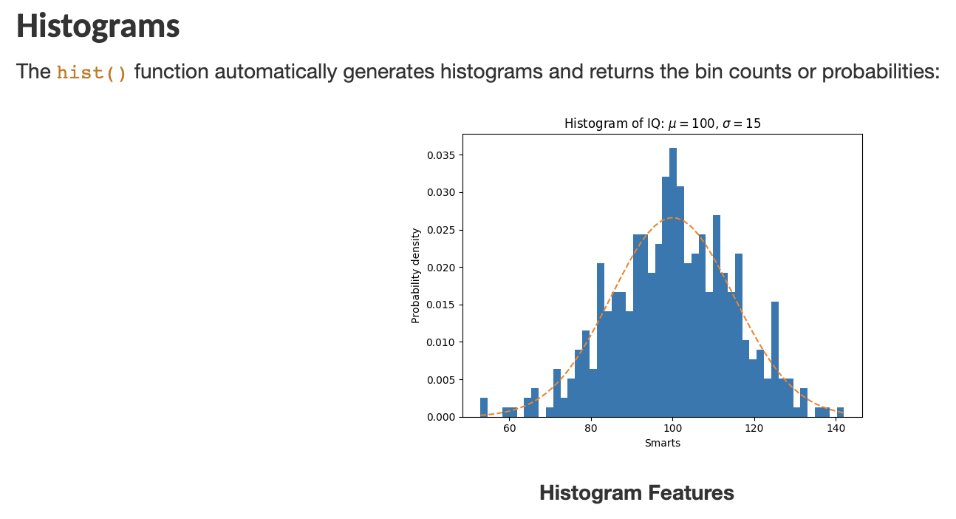
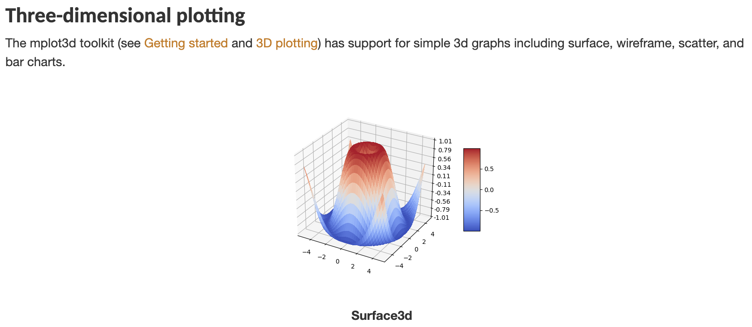
matplotlib

Slide 31
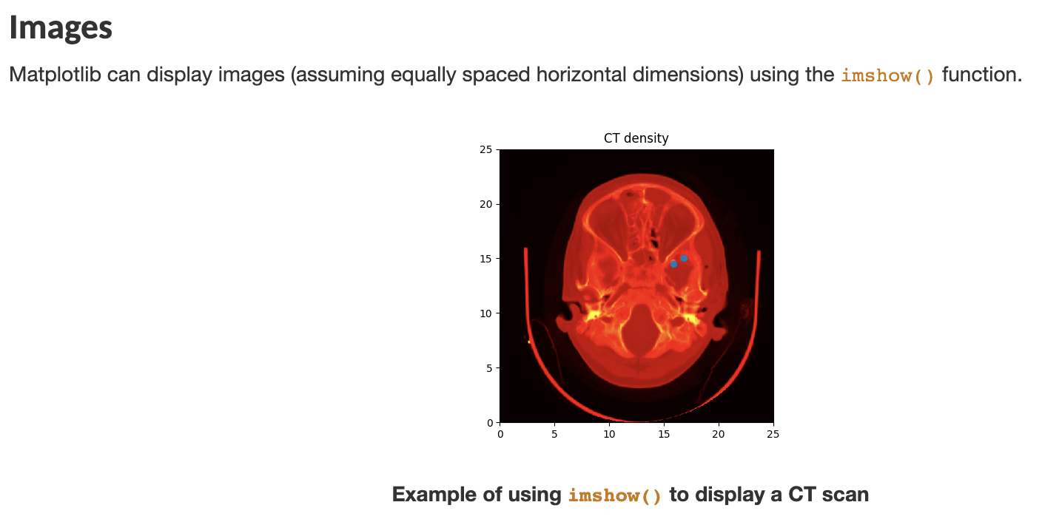
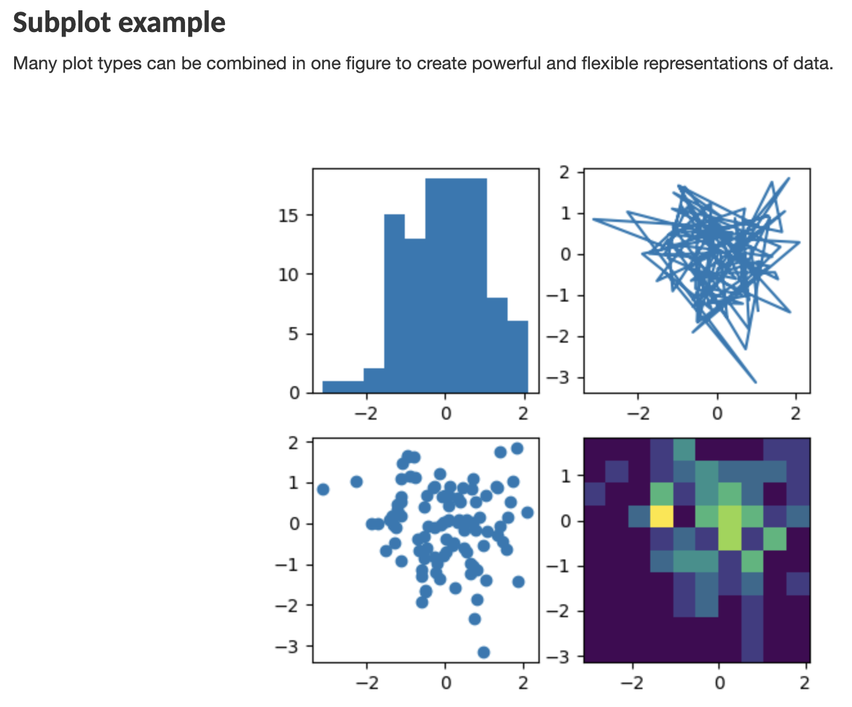
matplotlib

Slide 32
matplotlib examples

Slide 33
matplotlib examples

Slide 34
Seaborn

Slide 35
Seaborn examples

Slide 36
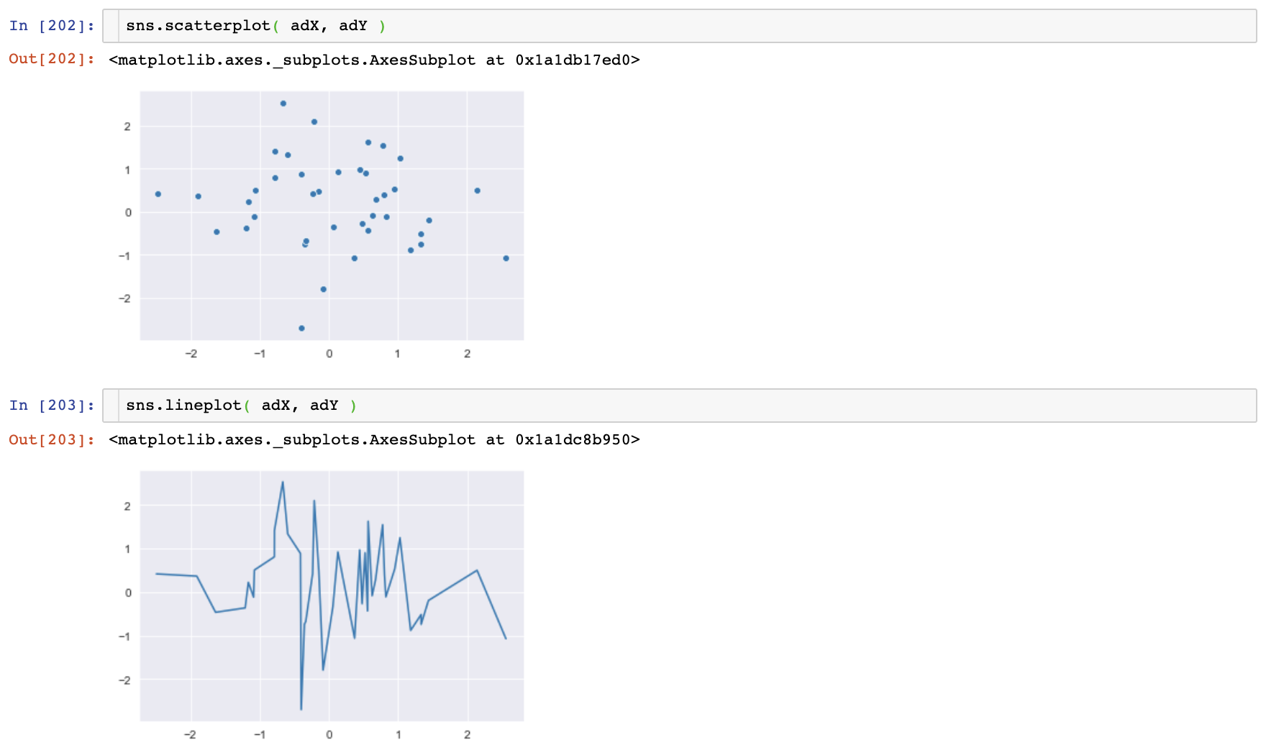
Seaborn examples

Slide 37
Seaborn examples

Slide 38
Seaborn examples

Slide 39
Seaborn ad nauseum

Slide 40
How can I possibly remember all of this?

Slide 41
Don’t!
Google is still your friend.
https://www.scipy.org/
https://docs.scipy.org/doc/numpy/user/quickstart.html
https://www.scipy.org/getting-started.html
https://pandas.pydata.org/pandas-docs/stable/getting_started/index.html
https://www.shanelynn.ie/using-pandas-dataframe-creating-editing-viewing-data-in-python/
https://matplotlib.org/tutorials/introductory/usage.html
https://matplotlib.org/gallery/index.html
https://seaborn.pydata.org/tutorial.html
https://seaborn.pydata.org/examples/index.html
And more that we’ll see during the lab…

Slide 42
https://canvas.harvard.edu/courses/71191/quizzes/163817

