Slide 1
R, R Studio, and R Markdown
Curtis Huttenhower (chuttenh@hsph.harvard.edu)
Sagun Maharjan (smaharjan@hsph.harvard.edu)
Sharifa Sahai (sharifasahai@g.harvard.edu)
http://huttenhower.sph.harvard.edu/bst272

Slide 2
Questions on PS2?
Questions on lab 3?

Slide 3
What's R, and why should I care?

Slide 4
What's R?
Statistical data analysis and viz. environment with large pre-existing library.
It's also a programming language, but for the purposes of this class, you'll probably use it that way less often.
Developed more organically as a collection of statistical algorithms.
With data management tacked on and gradually improved later (ongoing).
Graphical, informal (R Studio) and formal (command line) interfaces.
As mentioned earlier, tends to be a complementary tool:
Command line is good for basic data manipulation.
Python is good for complicated data manipulation, machine learning, and simple stats.
And structural data visualization.
R is good for complicated stats.
And statistical data visualization.

Slide 5
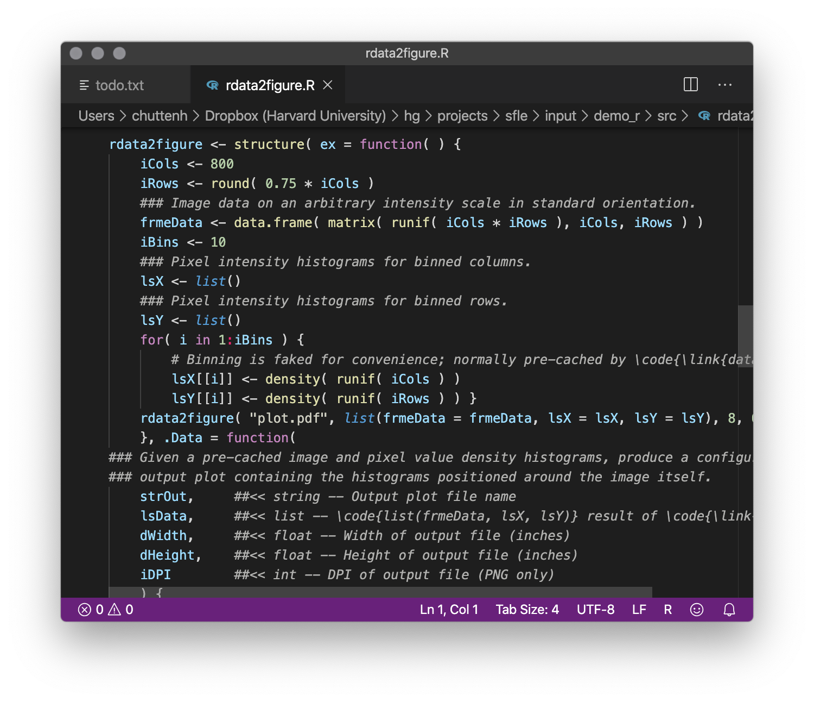
What's R
Powerful numerical data environment.
Relatively easy to learn the basics.
Widely used (in computational biology and otherwise).
Lots of tools already built in.
Provides an environment that:
Helps you perform sophisticated numerical data analysis and build statistical models.
Can quickly get simple tests done.
Like what?
Association testing in many different types of experimental designs.
Cross-sectional, repeated measures, NxN, factorial, nested, continuous or categorical values…
Bayesian and other hierarchical modeling.
Complex numerical operations (e.g. data normalization or batch correction).

Slide 6
R example: Bioconductor

Slide 7
R example: limma for differential expression

Slide 8
R example: seurat for single cell 'omics

Slide 9
R example: curatedMetagenomicData

Slide 10
R terminology and data

Slide 11
Storing information: data and data types
Data are still stored in variables, which are still named buckets.
variable_name <- "value"
In general, data must be of a specific type.
You can add two numbers, or concatenate two strings…
…but you can’t add a number to a string, or concatenate two numbers.
Many built-in data types in R, but the simplest are equivalent to Python:
Strings = sequences of characters surrounded by quotes: "This is a string."
Escape sequences still use \ to represent special chars: "\t is a tab, \\ a backslash"
Factors = strings that can only take on limited categorical values (more later).
Integers = positive or negative whole numbers: 12345, -678
Floats = numbers with a decimal place: 12.345, -6.7e8
R considers both of these to be numeric.
Booleans = binary values, TRUE or FALSE: TRUE
You'll sometimes see these abbreviated (validly) to T and F

Slide 12
Combining information: collection data types
R collection data types are subtly-to-substantially different from Python!
Vectors are sequences of zero or more ordered data…
Of the same simple type! Numerical, string, boolean, or factor.
Surrounded by c()s, separated by ,s, displayed using []s, accessed using [[]]s.
You can also access vector elements using [] – more on that later…
c() → []
c(1, 2, 3) → [1, 2, 3]
c("one", "two", "three") → ["one", "two", "three"]
Nesting R vectors will not work. Instead, they'll be concatenated / flattened.
c(c(1, 2), 3) → [1, 2, 3]
Combining elements of different types will not work. Instead, they'll be converted to strings:
c(1, "two", FALSE) → ["1", "two", "FALSE"]

Slide 13
Combining information: collection data types
Vectors are still accessed by integer index, ***starting at one***:
a <- c("one", "two", "three")
a[[1]] → "one"
a[[3]] → "three"
a[[4]] → ERROR
Still have an intrinsic length that can be dynamically modified:
length( a ) → 3
a[[4]] <- "four"
a → ["one", "two", "three", "four"]
append( a, "five" ) → ["one", "two", "three", "four", "five"]
a → ["one", "two", "three", "four"]

Slide 14
Combining information: collection data types
Factors are a special type of string that takes on discrete values.
e.g. "yes", "no", "maybe"
Typically used in vectors (since just one value is boring).
Behaves like a string with limited allowed values.
Created using factor, written with Levels and no "s.
Although you still need to use "s to test specific values.
Examples:
factor("a") → a Levels: a
k <- factor(c("a", "b", "c", "b", "a"))
k → [a, b, c, b, a] Levels: a b c
k[[1]] → a Levels: a b c
k[[3]] == "c" → TRUE

Slide 15
Combining information: collection data types
Lists are sequences of zero or more ordered data of arbitrary types…
…and with optional keys (always have integer indices).
If given, key=value pairs are annotated using =s and without quotes.
Sort of a mashup of a Python list with a dictionary.
Surrounded by list()s, separated by ,s, displayed and accessed using [[]]s.
You can also access list keys using $s, but I'll avoid it in this class.
Examples:
list(1, "two", FALSE) → [[1, "two", FALSE]]
l <- list(first=1, second="two", FALSE)
l → [[1$first, "two"$second, FALSE]]
l[[1]] → 1
l[["first"]] → 1
l[["second"]] → "two"
l[[3]] → FALSE
l[[4]] → ERROR
l$first → 1 (although I dislike this syntax)
length( l ) → 3
names( l ) → ["first", "second", ""]

Slide 16
Combining information: collection data types
Data frames (denoted data.frame) are essentially Pandas data frames.
Again equivalently captures:
Ordered list of records (rows), each with the same fields (columns) of fixed types.
A matrix with mixed data types and row/column annotations.
In R, a data frame is a list of (column) vectors of the same length.
Columns are ordered and, optionally, named (like a list).
All elements in a column are of the same type (like a vector).
Every R data frame has:
Ordered rows of the same length, with integer indices and optional names.
Ordered columns of the same length and type, with integer indices and names.
Correspondingly, a current number of rows and columns.

Slide 17
Combining information: collection data types
Collection data types in R can all be sliced using [].
Works more or less like [:] slices in Python.
Except that : works almost but not quite the same way to denote ranges!
Always returns a collection of the same type: vector, list, or data.frame.
Examples:
c(1, 2, 3)[1] → [1]
c(1, 2, 3)[1][1] → [1]
c(1, 2, 3)[2:3] → [2, 3]
c(1, 2, 3)[2:5] → [2, 3, NA, NA]
list(1, "two", FALSE)[1] → [[1]]
list(1, "two", FALSE)[-1] → [["two", FALSE]]
list(1, "two", FALSE)[-1][[2]] → FALSE
list(1, "two", FALSE)[-1:-2] → [[FALSE]]

Slide 18
data.frame

Slide 19
data.frame

Slide 20
data.frame

Slide 21
data.frame

Slide 22
data.frame

Slide 23
data.frame

Slide 24
data.frame

Slide 25
data.frame

Slide 26
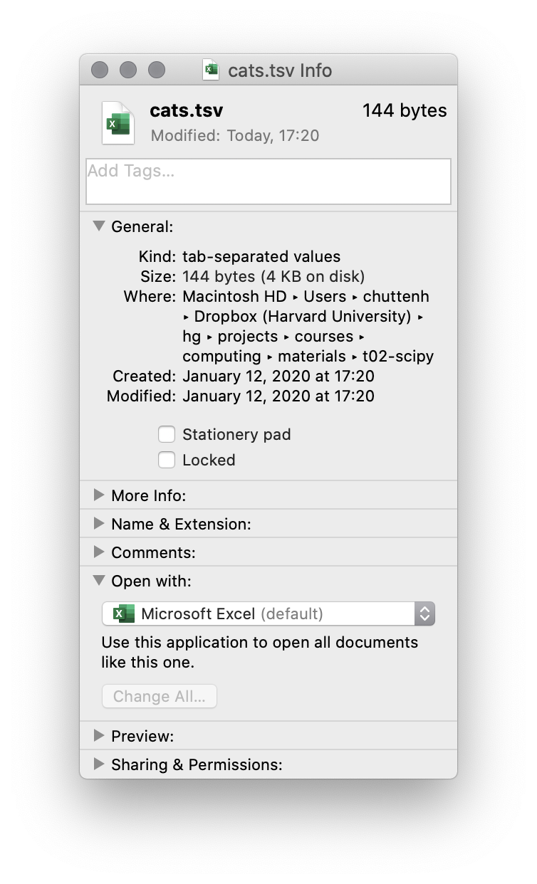
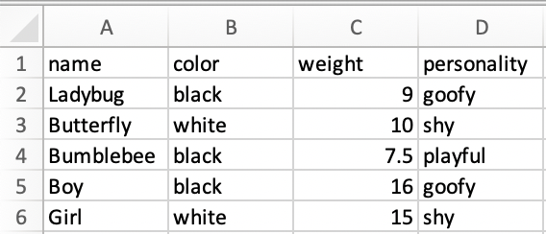
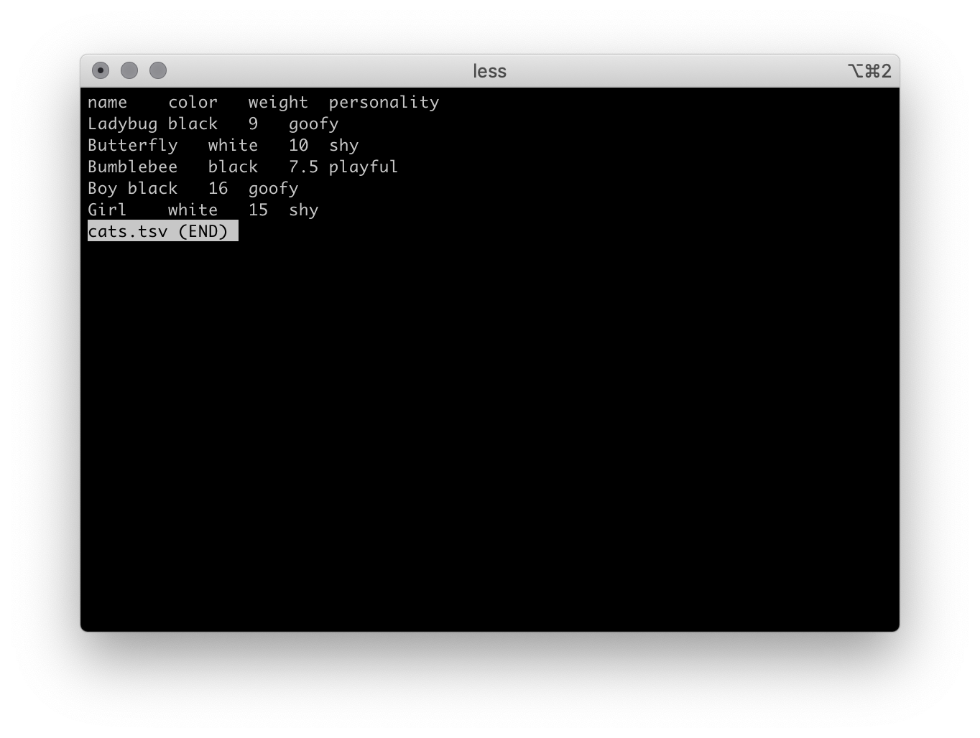
Data frames from files

Slide 27
Data frames from files
Note that R has a read.table, but it will usually not do what you want it to…

Slide 28
Data frames from files
Of all the ugly old cruft in R, strings defaulting to factors is perhaps the cruftiest…

Slide 29
Syntax and formatting
R doesn't care about whitespace, ever – hooray!
However, please use it consistently so you can read your code.
Blocks in R are denoted using {}s.
Otherwise they work the same way to define loop / function / etc. environments.
External code can be included using library.
And interestingly, R includes its own Conda/pip equivalent: install.packages

Slide 30
R functions

Slide 31
Calling R functions
You've already been calling R functions, and they're basically like Python:
function_name( argument1, argument2, named_argument = argument3 )
Note that R does not have . arguments.
Instead, it tends to use . as a stand-in for space.
Like Python uses _.
e.g. you can interpret read.delim like the name read_delim in Python.

Slide 32
Defining R functions
The basic idea is the same, the syntax is just a little different.
function_name <- function( arg1, arg2 ) {
# do stuff here
return( NULL )
}
This is like def
This is like :
Requires () in R
This is like None

Slide 33
Defining R functions

Slide 34
R control flow, conditionals, and loops

Slide 35
The if-else conditional
The basic idea is the same, the syntax is just a little different.
if( x ) {
# do stuff here
} else {
# do alternative stuff here
}
Requires () in R
This is like :

Slide 36
The while loop
The basic idea is the same, the syntax is just a little different.
while( x ) {
# do stuff here
}
Requires () in R
This is like :

Slide 37
The for loop
The basic idea is the same, the syntax is just a little different.
for( x in y ) {
# do stuff here
}
Requires () in R
This is like :

Slide 38
However…
R strongly discourages using loops whenever possible.
Instead, iteration is often performed using apply functions.
Also called comprehensions.
Input a collection, transform each element, and return a new transformed collection.
Actually, Python has these too – and they're nice! – we just haven't seen them yet…
apply for data frames (by row or by column).
lapply for lists.
sapply for vectors.
And others that are more complicated…

Slide 39
Iteration via apply

Slide 40
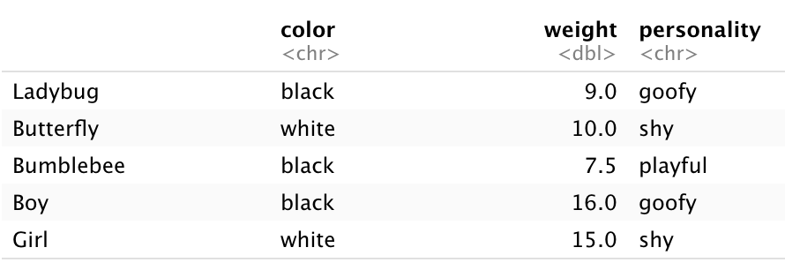
Iteration via apply

Slide 41
https://canvas.harvard.edu/courses/71191/quizzes/164520

Slide 42
R statistics and graphics

Slide 43
R statistics
A lot of the same material as scipy.stats is built in.
When in doubt, search the documentation!

Slide 44
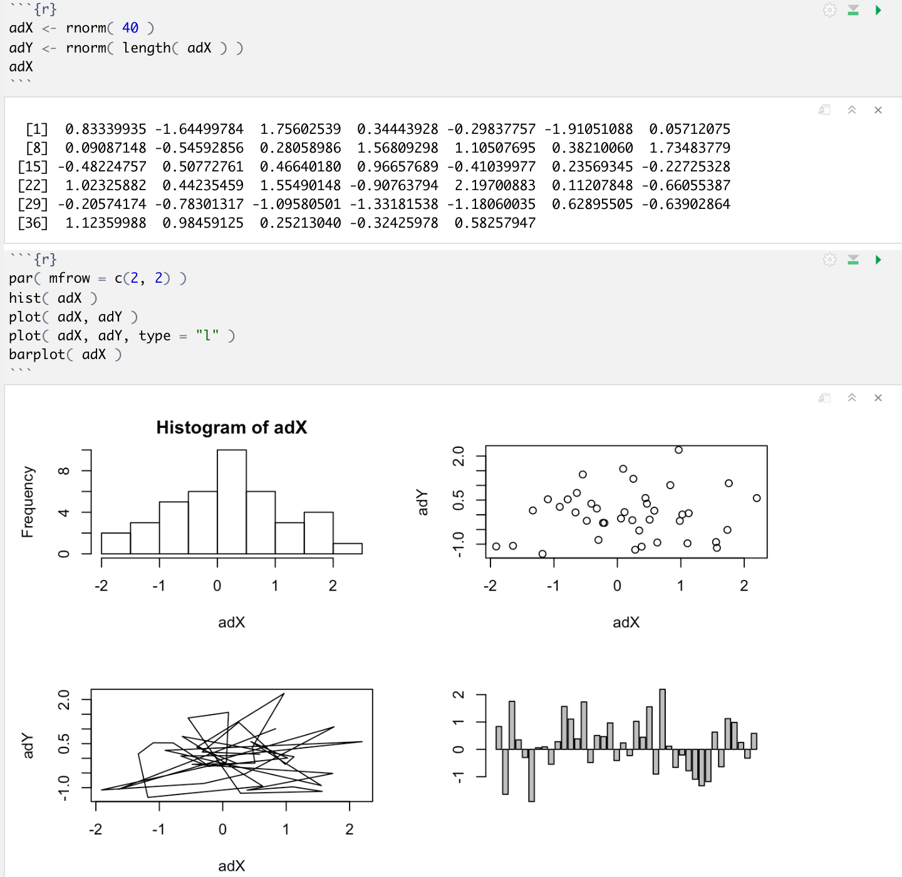
R graphics
A lot of the same material as matplotlib is built in.
When in doubt, search the documentation!

Slide 45
R libraries, CRAN, and Bioconductor

Slide 46
Using and obtaining existing R libraries
R libraries (or packages) are equivalent to Python modules.
And are accessible (if installed) using the library method.
CRAN – the Comprehensive R Archive Network – is like PyPI.
Huge! Uncurated.
Installable using install.packages(c("package", "names", "here"))
Bioconductor is like Conda.
Also large, but not quite as large. Reasonably curated.
Provides common infrastructure used by biological software ecosystem.
Installable using:
if( !requireNamespace( "BiocManager", quietly = TRUE ) )
install.packages( "BiocManager" )
BiocManager::install( "package" )

Slide 47
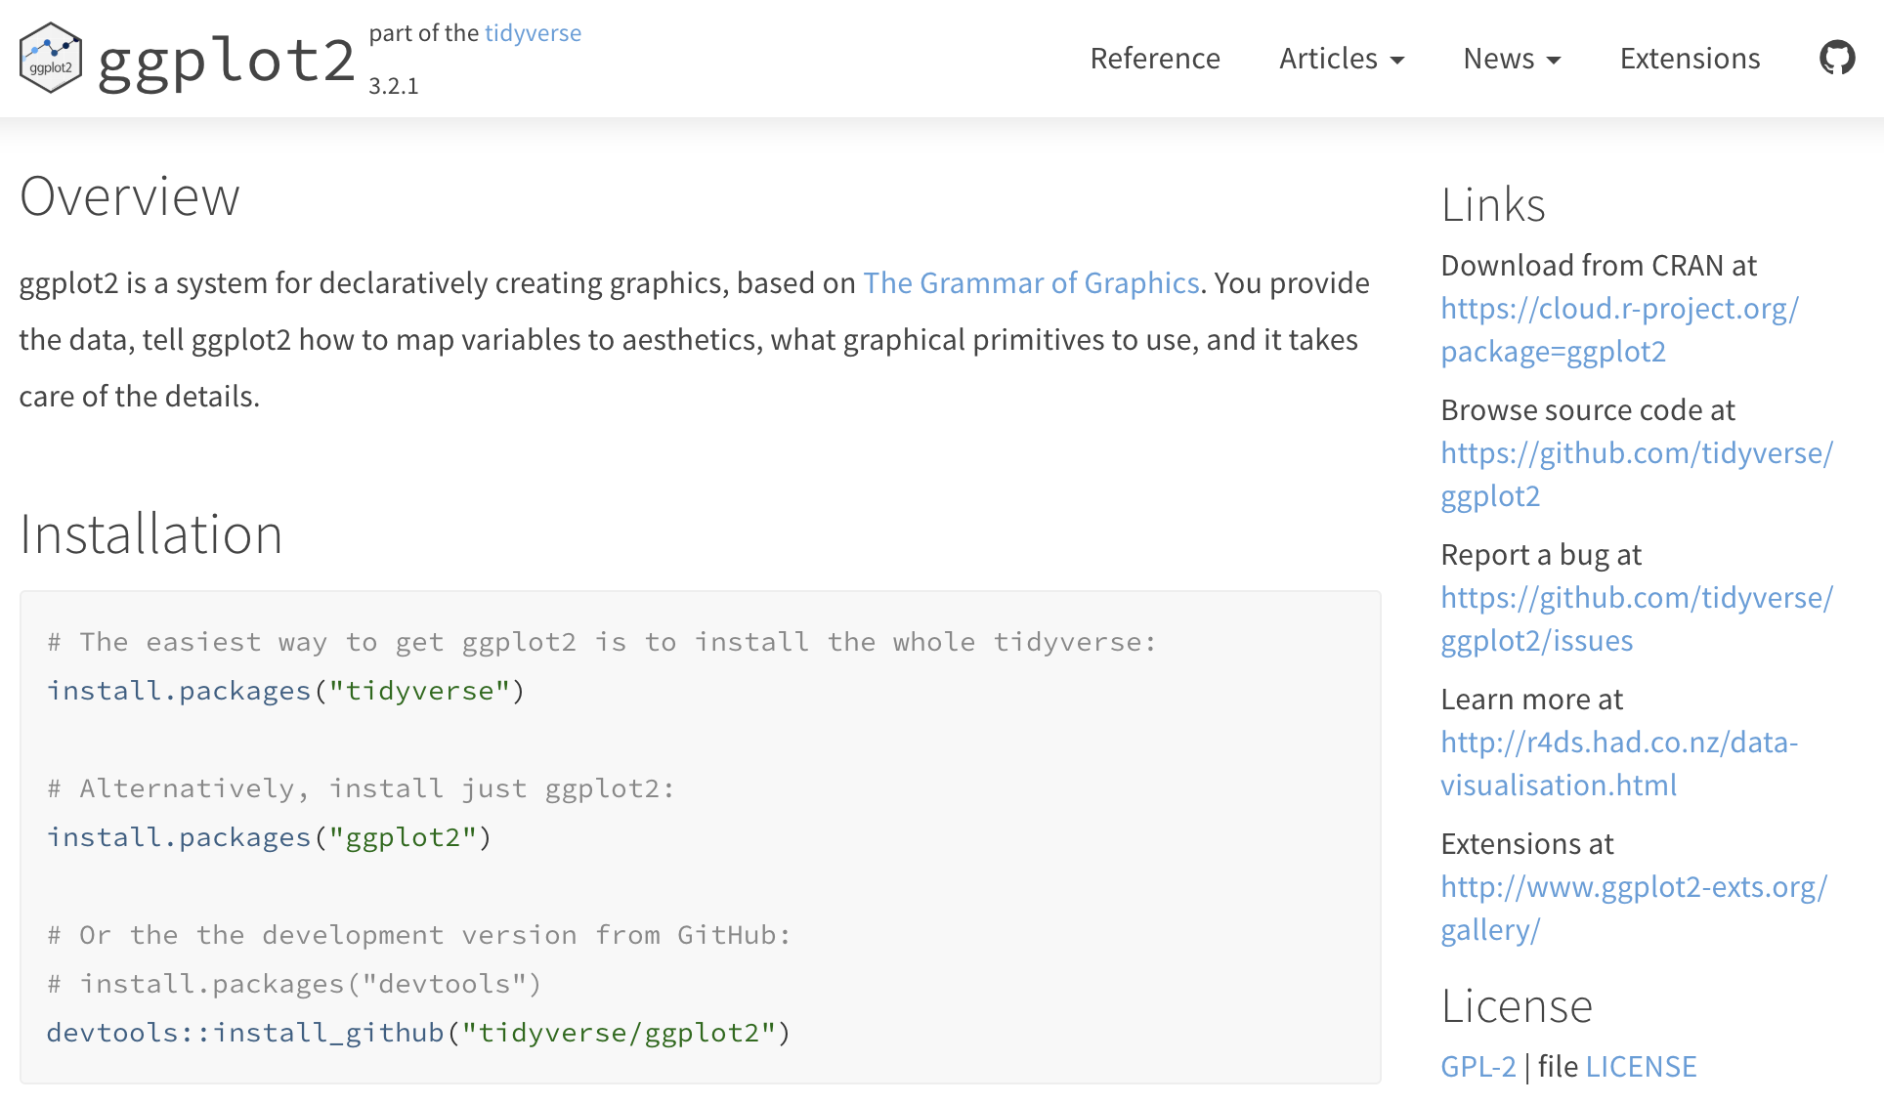
ggplot2
The ggplot2 library is roughly equivalent to Seaborn (with weird syntax).
Install using install.packages( "ggplot2" ) the first time.
The load in any code using library(ggplot2)

Slide 48
ggplot2

Slide 49
ggplot2

Slide 50
ggplot2

Slide 51
ggplot2

Slide 52
ggplot2

Slide 53
ggplot2 ad nauseum

Slide 54
R Studio and R Markdown

Slide 55
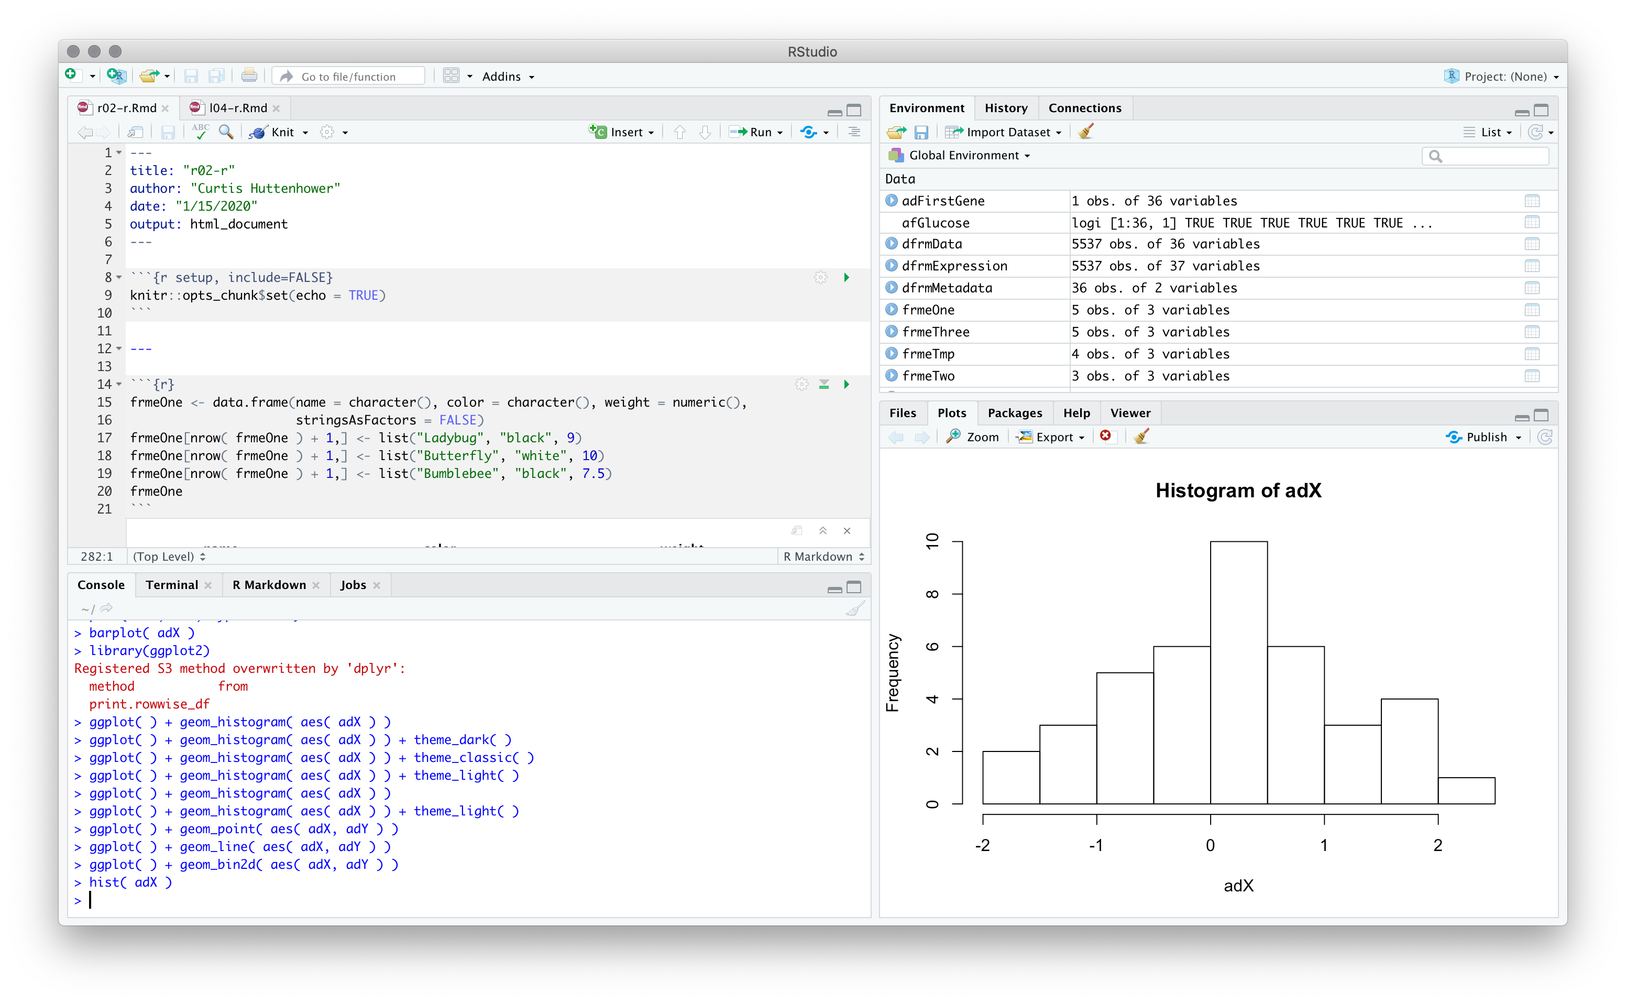
R Studio
R Studio works a bit like Jupyter.
Lets you interactively type R, inspect variables, see plots.

Slide 56
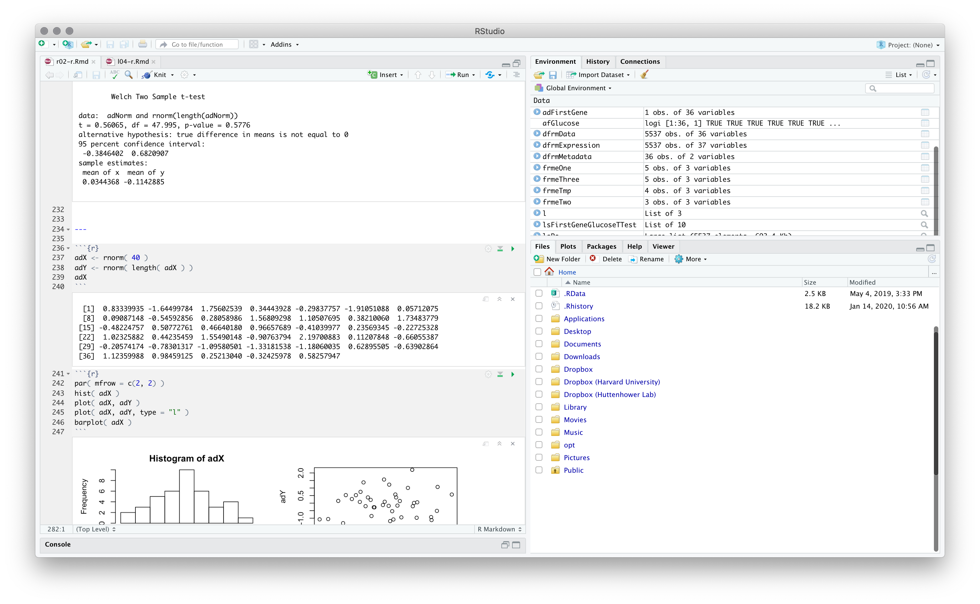
R Markdown
R Markdown extends R Studio by interleaving descriptive text and R chunks.
R Studio can in turn then edit and execute chunks one by one, inline.
Basically just like Jupyter cells.
Means you essentially never have to work directly at the R console.

Slide 57
R Markdown
An R Markdown (Rmd) file combines plain text and R chunks.
The plain text can be formatted using Markdown – hence the name…
This can be knit into an HTML or PDF document containing text and R results – but we usually won't.
R chunks are delineated as ```{r} <code here>```
You can run the current chunk using:
Command-Shift-Return on Mac, Control-Alt-c on Windows.
Or use buttons, or use menus.
Just like Shift-Return or the Run button in Jupyter.

Slide 58
How can I possibly remember all of this?

Slide 59
Don’t!
Google is still your friend.
https://cran.r-project.org/
https://www.bioconductor.org/install/
Make sure to follow the instructions here the first time…
https://www.statmethods.net/
https://www.tutorialspoint.com/r/index.htm
http://www.r-tutor.com/
https://www.r-graph-gallery.com/
http://r-statistics.co/Top50-Ggplot2-Visualizations-MasterList-R-Code.html
https://cran.r-project.org/doc/contrib/Paradis-rdebuts_en.pdf
https://cran.r-project.org/doc/contrib/Seefeld_StatsRBio.pdf
https://datacarpentry.org/semester-biology/nav/course-materials/
And more that we’ll see during the lab…

