Slide 1
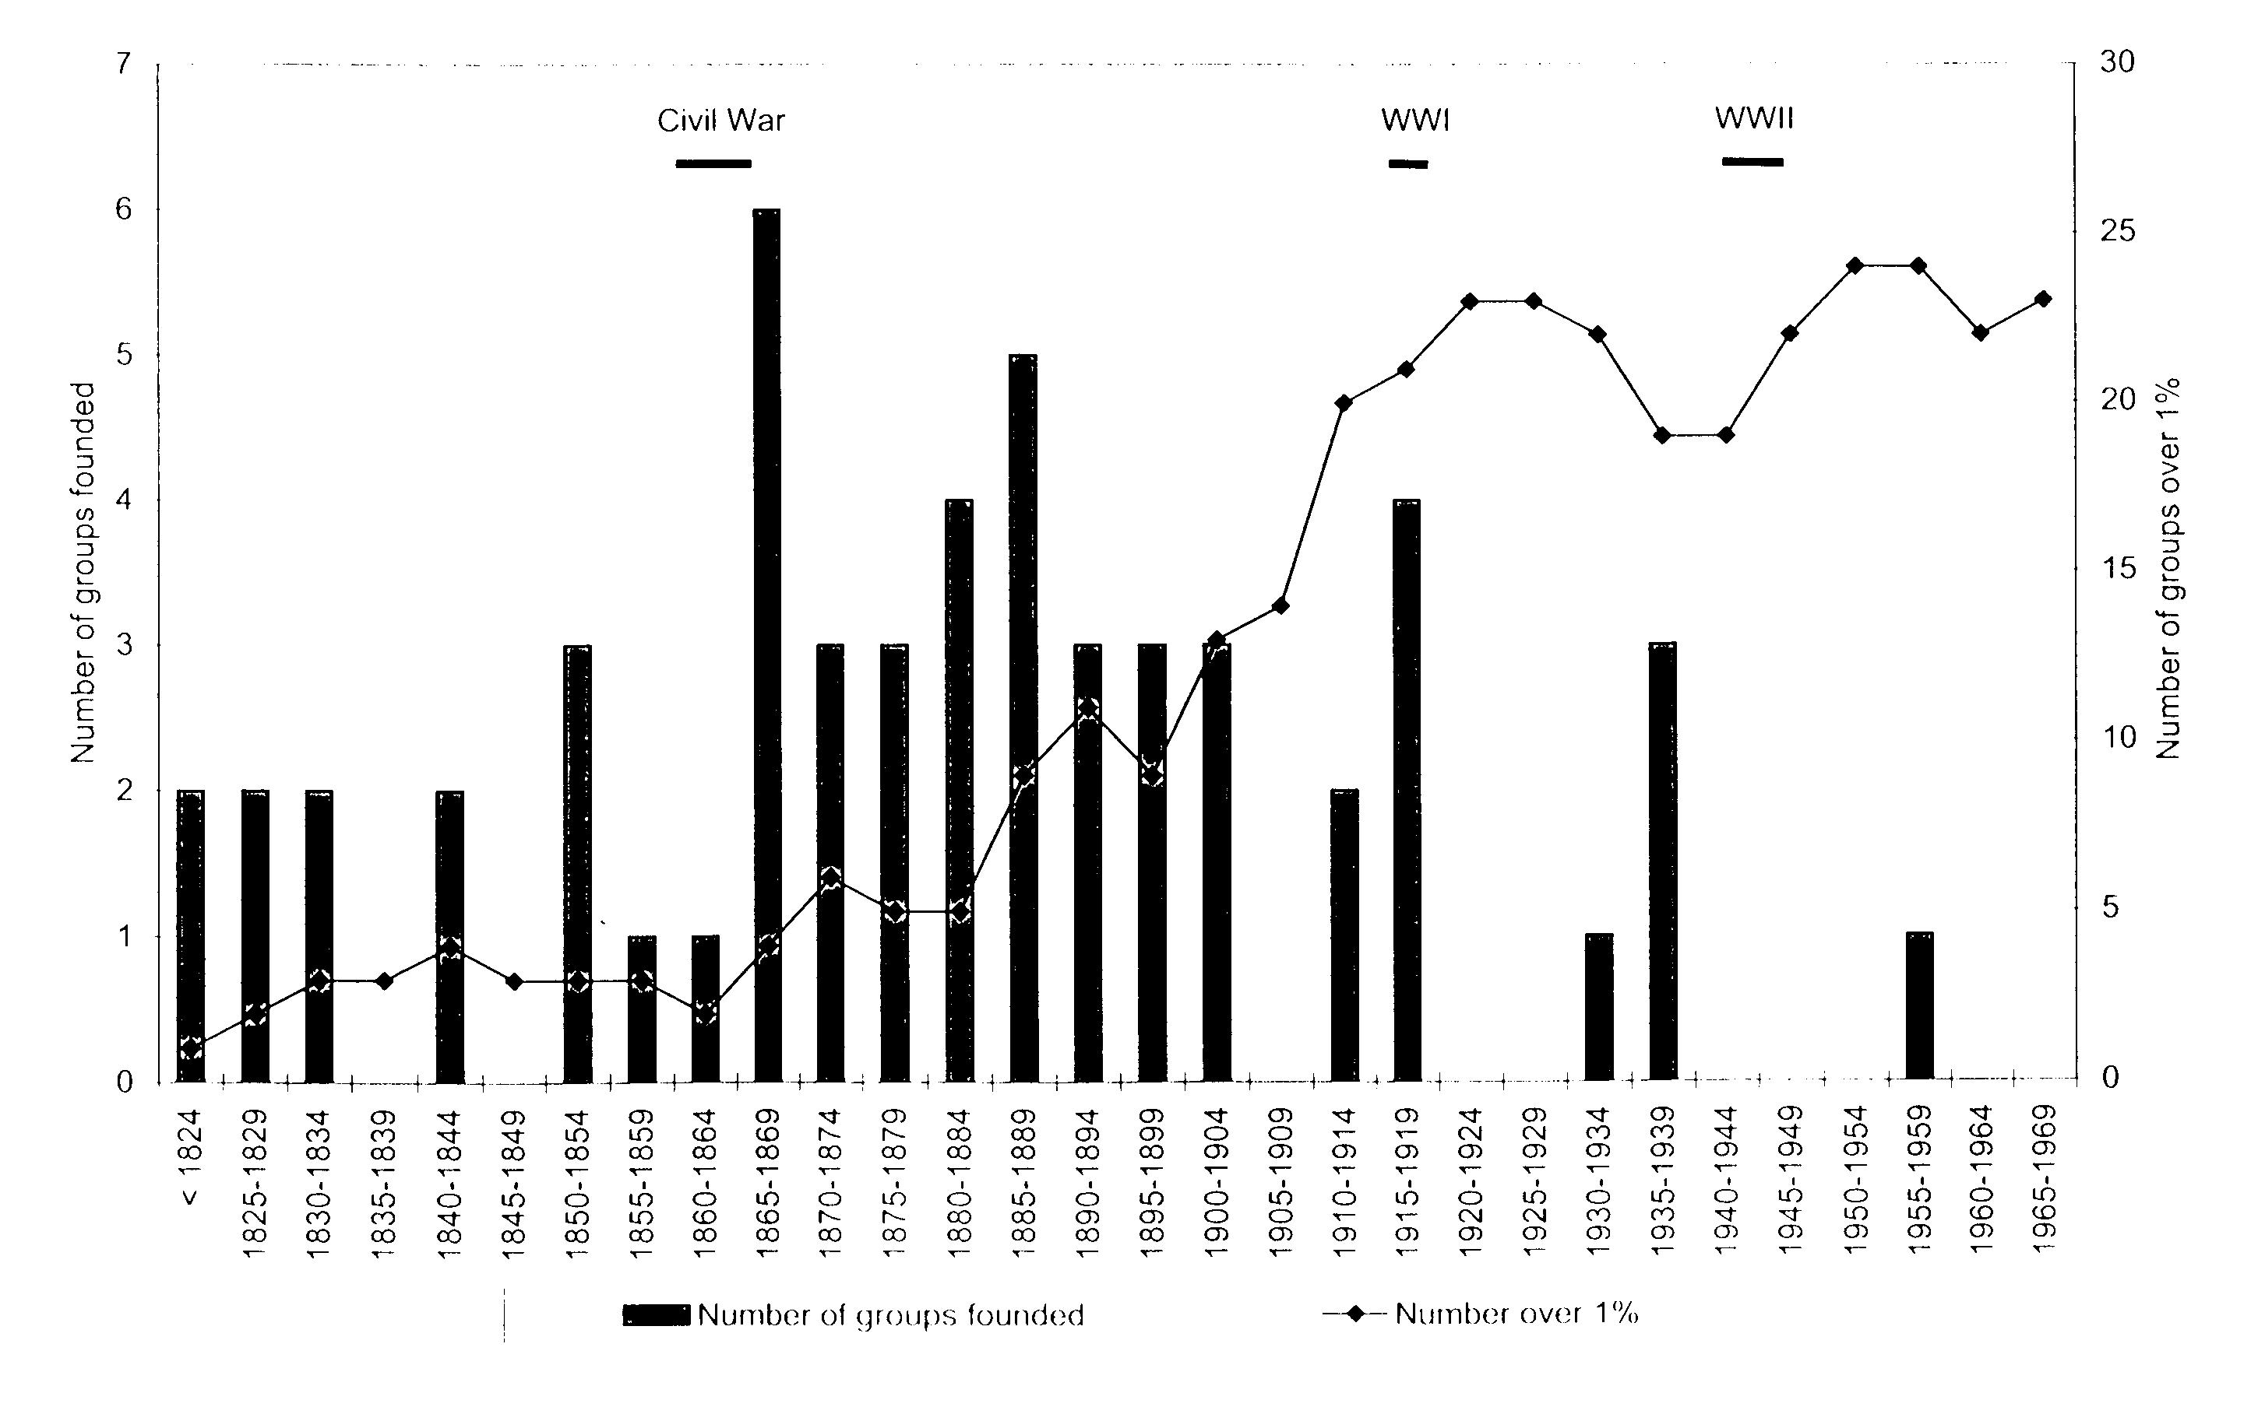
FOUNDINGS AND CUMULATIVE INCIDENCE OF VERY LARGE U.S. MEMBERSHIP ASSOCIATIONS

Slide 2
