Slide 1
Poverty and Government Policy
Gen Ed 1092
Lecture 10
10-7-2020

Slide 2
Outline
History of the War on Poverty
From AFDC to TANF and EITC
Age and Poverty
Policies that reduce poverty
What can reduce poverty going forward?

Slide 3
But First!
A short quiz.

Slide 4
Poverty Amidst Affluence
1962 Michael Harrington The Other America
20 to 25% of Americans lived in poverty
How could this be in a country showing so much economic growth and prosperity?

Slide 5
1963-1968
November 22, 1963 President Kennedy assassinated
January 8, 1964 Johnson’s State of the Union declares war on poverty

Slide 6
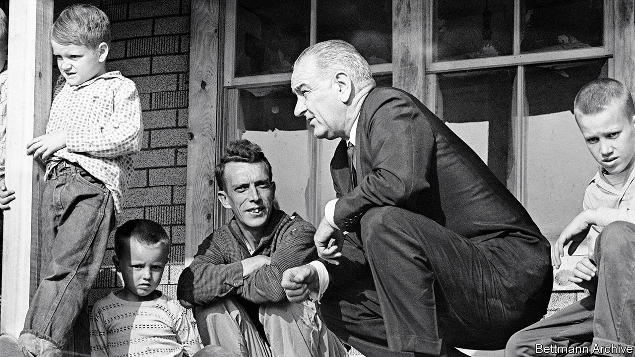
1964 President Johnson visits Martin County KY

Slide 7
War on Poverty
Many Americans live on the outskirts of hope—some because of their poverty, and some because of their color, and all too many because of both. Our task is to help replace their despair with opportunity. This administration today, here and now, declares unconditional war on poverty in America. I urge this Congress and all Americans to join with me in that effort. It will not be a short or easy struggle, no single weapon or strategy will suffice, but we shall not rest until that war is won. The richest Nation on earth can afford to win it. We cannot afford to lose it.
President Lyndon B. Johnson, State of the Union Address, January 8, 1964

Slide 8
1964
July 2, 1964 Civil Rights Act signed into law
August 20, 1964 Economic Opportunity Act
  Community Action Agencies
  Head Start, Job Corps, Community Health Centers, Upward Bound, Neighborhood Youth Corps, VISTA, Legal Services, Federal Work Study Programs
August 31, 1964 Food Stamp Act creates a permanent national program

Slide 9
1964-1965
November 3
  Johnson wins a landslide victory. 2/3 majority in House and Senate
April 11, 1965
  Elementary and Secondary Education Act distributes funding to schools with low income students
April 26
  Manpower Act job retraining
July 14
  Older Americans Act
    Caregiver support, nutritional and social services

Slide 10
1965-1966
July 30
  Medicaid and Medicare signed into law
August 6
  Voting Rights Act
August 10
  Housing and Urban Development Act
November 8, 1966
  Higher Education Act
    Federal loans—Guaranteed student loans

Slide 11
1966-1968
September 30
  Amendments to Fair Labor Standards Act
    Increased minimum wage from $1.25 to $1.60
    Extended coverage to public schools, nursing homes, laundries, and construction and farm workers
October 11, 1966
  Child Nutrition Act
    Increased funding for lunches, began breakfast program
January 2, 1968
  Social Security Amendments
    Dramatically increased Social security benefits

Slide 12
Lasting Legacies
New era of direct federal involvement in schools, hospitals, labor markets and neighborhoods.
Most well documented successes.
  Rapid decline in elderly poverty
  Provision of universal health care coverage to the elderly (Medicare)
  Health care for the very poor (Medicaid)

Slide 13
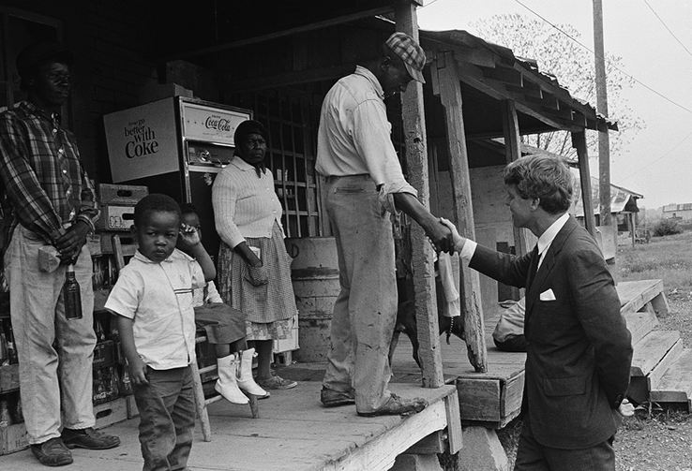

Slide 14
Growth in AFDC
Between 1964 and 1976 the number of Americans getting cash assistance nearly tripled from 4.2 million to 11.3 million.
Partly driven by the National Welfare Rights Organization. Behind court decisions that struck down discriminatory state rules that prevented single mothers, especially black single mothers from getting welfare.
  E.g. man in the house rules, white glove rules.

Slide 15
AFDC
Until 1996 single mothers were eligible for AFDC.
Each state had its own AFDC program, with the federal govt paying about half the cost in rich states and far more in poor states.
Each state had to follow federal eligibility requirements and no state could turn away eligible applicants

Slide 16
Welfare “dependency”
Welfare was reduced or eliminated if you worked.
By 1970s the rise in female single headed households was apparent, and concentrated among African Americans.
Ronald Reagan found a “welfare queen” who he featured in his 1980 run for President. A Cadillac driving, African American woman in Chicago who collected 115,000 dollars a year in fraudulent welfare payments.
The typical welfare recipient was white, but not in the public perception.

Slide 17
Argument against welfare
Charles Murray 1984 Losing Ground
Pay women to stay single and have babies and more of them will do so. Pay them not work and they become dependent.
Bill Clinton, even when he was Arkansas Governor was a leader in the requirement to make welfare recipients work.
By the time George H W Bush left office in 1992 welfare caseloads were 13.8 million, 4.5 million adults and 9.3 million dependent children.

Slide 18
AFDC to TANF
1996 AFDC was replaced with TANF
States still get federal money to cover part of TANFs cost but they have more leeway to decide what to do with the money.
They can divert the money to pay for financial aid for college students or pre-kindergarten programs.
States also have complete freedom to decide what people have to do to qualify for benefits and retain them.

Slide 19
TANF
In 1996 TANF caseload was 4.4 million families
In 2018 it was 1.2 million families

Slide 20
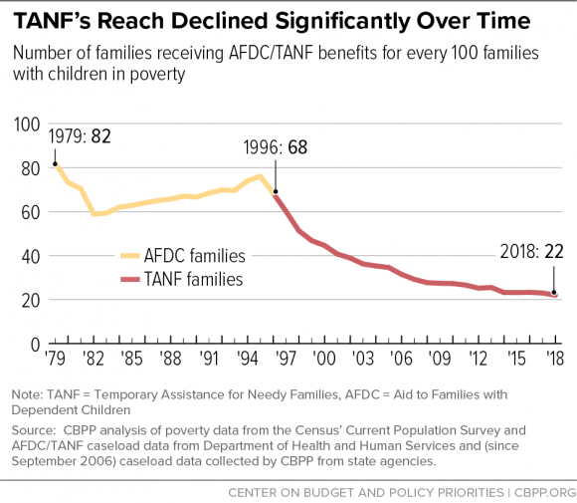

Slide 21
TANF
TANF benefits are below two-thirds of the federal poverty line in all 50 states
TANF benefits are below 20% of the poverty line in 18 states
In the median state in 2020 a family of 3 received $486 per month.

Slide 22
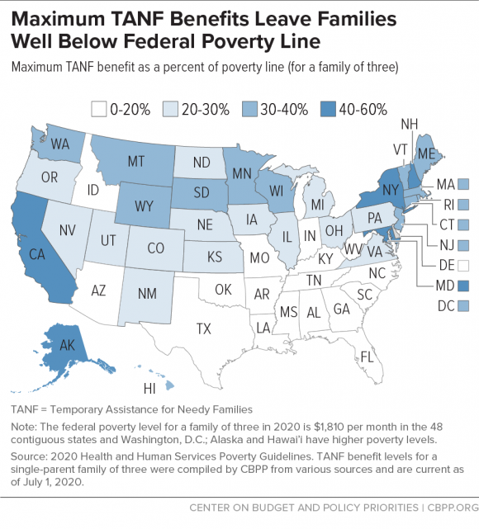

Slide 23
Ronald Reagan
My friends, some years ago, the federal government declared war on poverty, and poverty won. Today, the federal government has 59 major welfare programs and spends more than $100 billion a year on them. What has all this money done? Too often it has only made poverty harder to escape. Federal welfare programs have created a massive social problem. With the best of intentions, government created a poverty trap that wreaks havoc on the very support system the poor need most to lift themselves out of poverty—the family. Dependency has become the one enduring heirloom, passed from one generation to the next, of too many fragmented families.

Slide 24
Did Poverty Win?

Slide 25
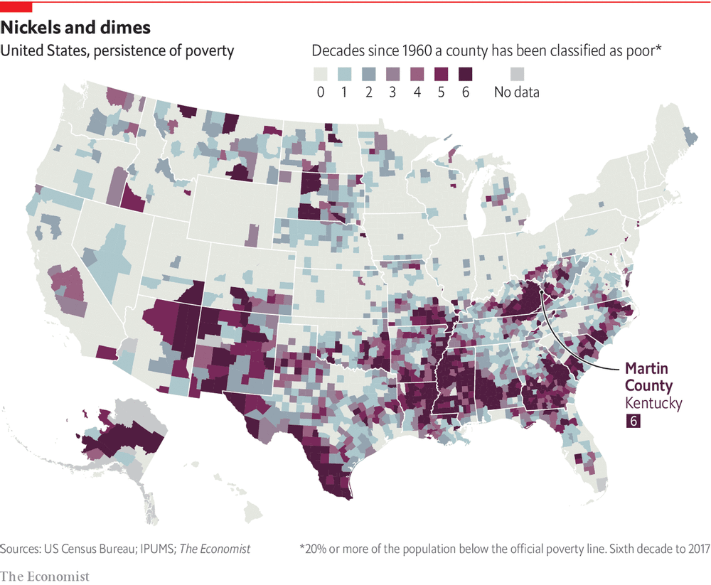

Slide 27
Poverty Demographics after the War on Poverty
Most poor are in their prime working years
Far fewer elderly are poor
Child poverty fell but then has remained high

Slide 29
Poverty Demographics
Poverty among blacks has fallen sharply
  In 1966 41.8% of blacks were poor. By 2015 it was 24.1%
Poverty among Hispanics was first measured in 1972 when it was 22.8%. In 2015 it is 21.4%
Poverty among white non Hispanics was 11.6% in 2015.

Slide 30
Demographics of Poor People
42% of the population in poverty are white, 22% are black and 28% are Hispanic.
Poor are disproportionately urban and rural, with suburbs growing most quickly.

Slide 31
Programs that Reduce Poverty
Social Security
Tax Credits (EITC and Child Tax Credit)
Food assistance (SNAP)
Housing Assistance (Section 8 vouchers, public housing)
Supplemental Security Income (SSI) (for people with disabilities)

Slide 32
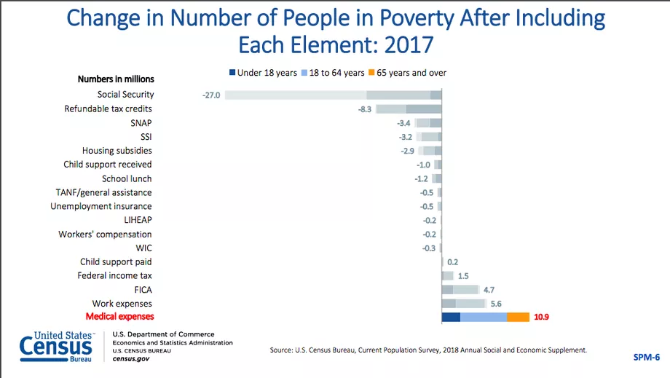

Slide 34
EITC Earned Income Tax Credit
EITC was designed to “make work pay”
Instead of giving parents more help when they could not find work, the new system gave more help when they find and keep a steady low wage job.
The tax credit is refundable, meaning that you can get the credit as tax refund if you pay less federal income tax than the credit.

Slide 35
EITC
Working families with incomes below $41,400 to $56,000 (depending on marital status and the number of children).
Working families with no children and incomes below $15,570 (or $21,370 for married couple) can receive a small amount
In 2018 over 22 million people in every state received the EITC

Slide 36
Child Tax Credit
It is worth up to $2000 per eligible child (under age 17)
It includes a refundable component--When filing taxes for 2019, under the 2017 tax law, working families can receive a refund equal to 15 percent of their earnings above $2,500; this refund can be worth up to $1,400 per child.
For example, a single mother with two children who earns $14,000 in 2019 could receive 15 percent of $11,500, or $1,725, as a refund.

Slide 37
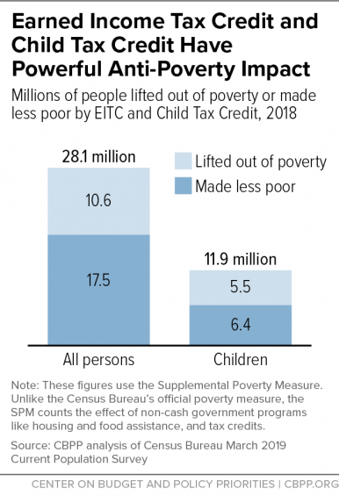

Slide 38
SNAP aka Food Stamps
The first food stamp program ran from 1939-1943.
The program we know was established in 1964
Served 44.2 million people with 66.5 billion in benefits in 2016
Vital to survival of poor families

Slide 39
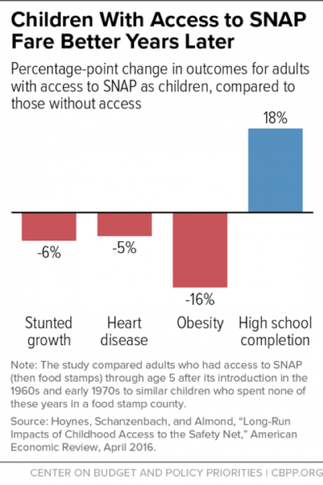

Slide 40
Politics of Food Assistance
Food Stamps Act of 1964 passed with overwhelming Democratic support from urban and rural areas. Most Republicans were originally opposed, though most later joined Congressional support coalitions.
This program is administered by the U.S. Department of Agriculture, and the politics behind it has long been a “log roll” in which Congress regularly renews food stamps along with farm supports.
As the GOP has moved toward the right, the party has become more suburban and rural representation has declined in Congress.
Now GOP conservatives want to redefine Food Stamps as pure welfare, transfer the program to a new welfare department, cut cash benefits or turn them into in-kind food boxes, and impose new regulations on beneficiaries. Agriculture bills stall in Congress amid intra-GOP splits.

Slide 41
Supplemental Security Income (SSI)
People 65 or older, or blind disabled children and adults.
2016 benefit amount for individuals was $773 per month, $1,000 for couples.
Instituted in 1972, administered by Social Security
At a cost of $58 billion, SSI was the second-largest means-tested cash assistance program in 2016, behind the Earned Income Tax Credit.

Slide 42
Women and Infant Children (WIC), 1972
WIC is a nutrition program that benefits pregnant women, new mothers and young children (under 5) who are poor and who are at nutritional risk.
About 7.3 million people participated in WIC in 2016, at a total food cost of $3.6 billion.

Slide 43
Measuring Poverty
Our absolute poverty measure does not take into account government transfers.
Using the supplemental poverty measure shows expansion of the EITC helped reduce child poverty.

Slide 46
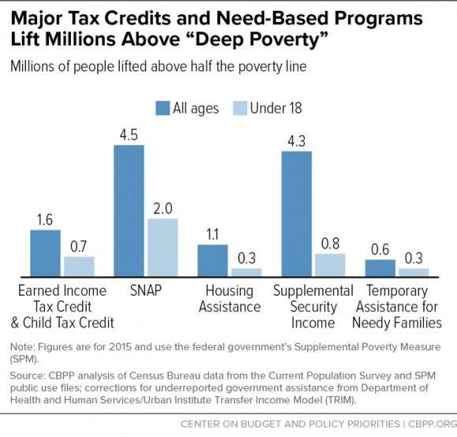

Slide 47
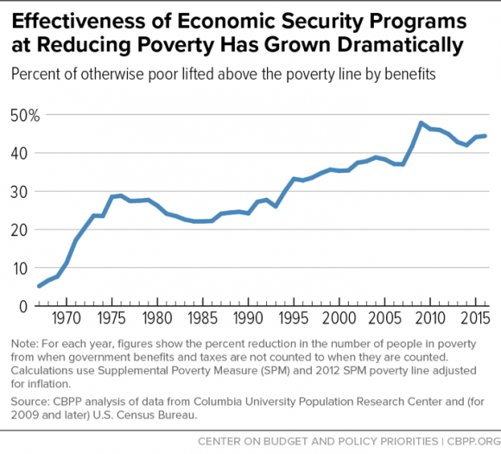

Slide 48
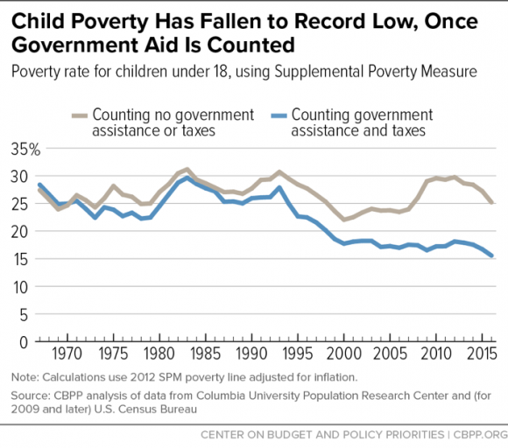

Slide 49
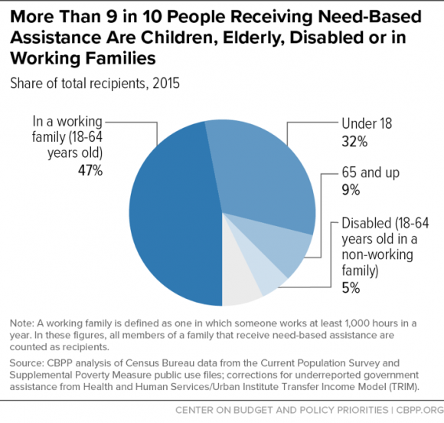

Slide 50
Edin and Schaefer
Extreme poverty doubled between 1996 and 2012.
Inequality has risen among the poor.
Half of today’s offically poor families are doing better than those we counted as poor in the 1960s
The poorest of the poor are worse off than they were in 1969
Extreme poverty is concentrated in adults who do not work and thus get no aid.

Slide 51
Defining Extreme Poverty
A single mother with two children was officially poor in 2011 if she reported an annual income below $18,123.
World Bank counted third world families as poor if they lived on under $1.90 a day.
For a single mother of two Edin and Shaefer defined them as extremely poor if they lived under $6.00 a day. The official poverty rate would be under $50.00 a day.

Slide 52
Measurement Issues
The estimates in $2.00 a day almost never include the value of food stamps, rent subsidies, or EITC refunds for work during the previous calendar year.
Including those resources reduces the estimated prevalence of extreme poverty among households with children from 1.7% to 1.1% in 1996 and from 4.3% to 1.6% in 2011.
The growth of EITC refunds and noncash benefits offsets about four fifths of the decline in extremely poor families pretax money income between 1996 and 2011.

Slide 53
Even with aid, the poor suffer
Before COVID poor families were on the edge.
The working poor are hit hard when employment vanishes.
The US reduces market based poverty less than most other countries

Slide 54
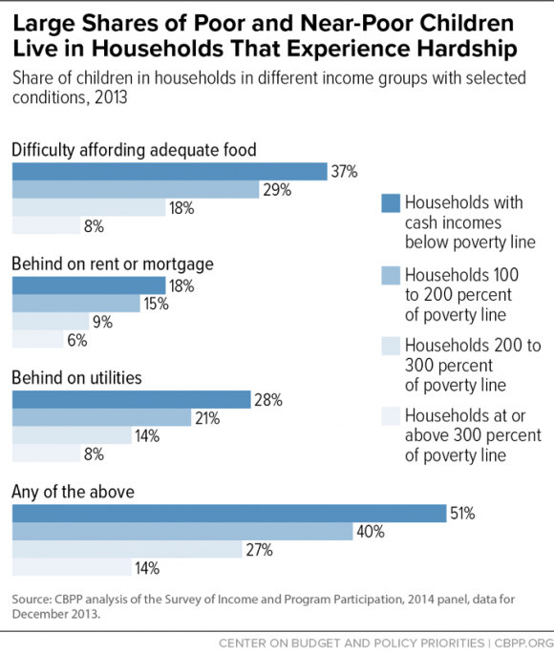

Slide 55
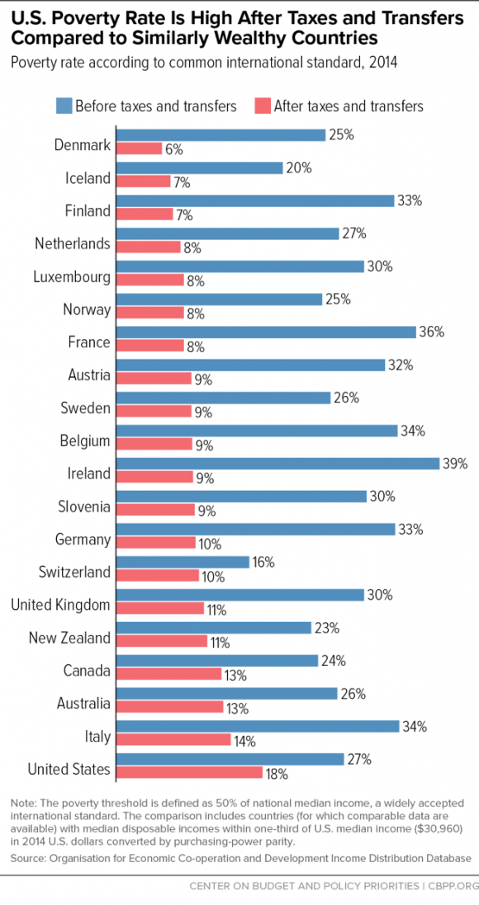

Slide 56
Working Poor
Nearly 1 in 4 workers are paid below-poverty level wages, about the same as in 1973.
24% of workers in 2016 were paid hourly wages too low to lift a family of four above the poverty line even if the worker worked full time all year.
This is where the US is an outlier. We have SO MANY low wage jobs compared to Europe.

Slide 57
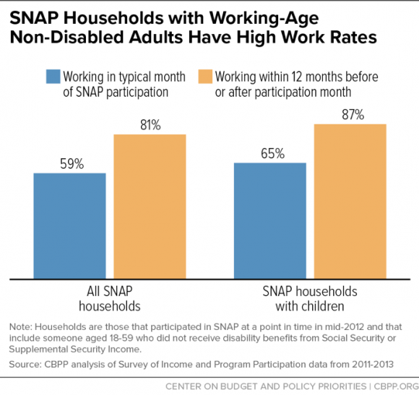

Slide 58
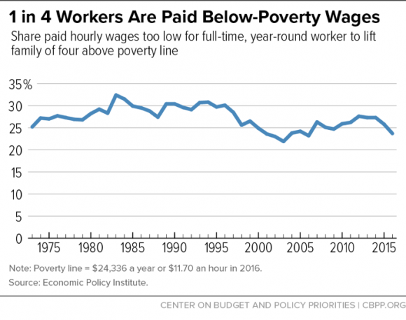

Slide 59
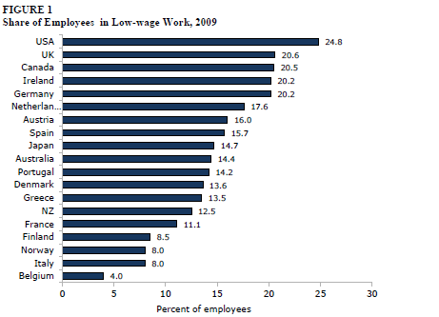

Slide 60
Other Differences across countries
No paid vacation in US (the only country)
  In US 50% have no paid vacation
In all five European countries employees are guaranteed sickness benefits for short or long term illness, with benefit duration of at least six months.
77% of low wage US workers have no paid sick leave.
In 2008 more than half (54%had no employer health care and 37% had no health care at all)

Slide 61
Poor in US International Comparisons
Life expectancy
  In 2000 the life expectancy in the poorest decile of counties in the US was 74.7 years, comparable to Albania, Lebanon and the United Arab Emirates.
  Race and education life expectancies show very large gaps.

Slide 62
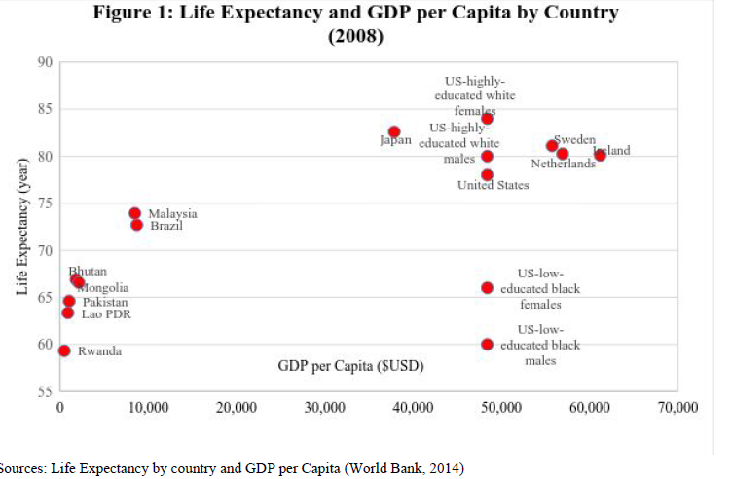

Slide 63
Infant Mortality Rates
The IMR is the number of infants who die before age 1 per 100,000 live births. In 2013 the US IMR was 5.9.
The US ranks 55th in the world in IMR.
The cross country differences are driven by tremendous within country differences in the US
White college educated women look like Europe.

Slide 64
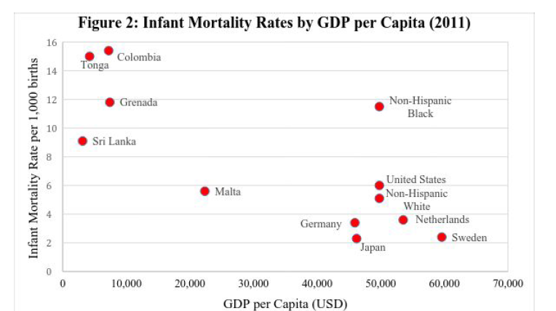

Slide 65
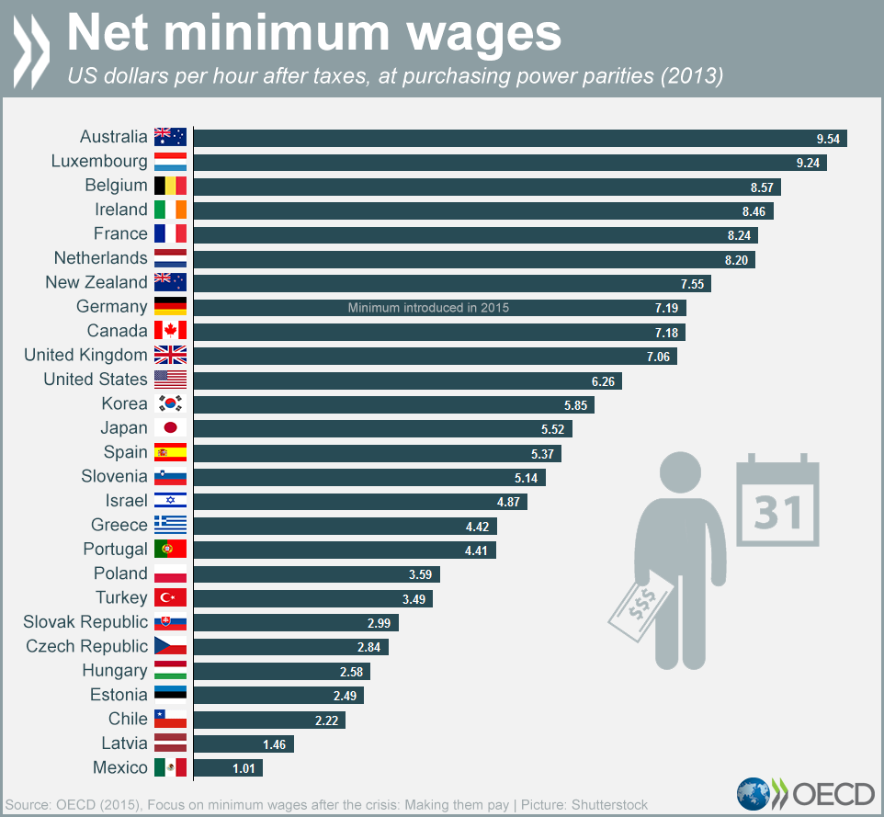

Slide 66
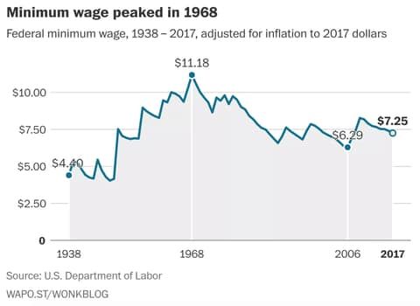
For liberals the declining value of the minimum wage has been an increasing focus.

Slide 67
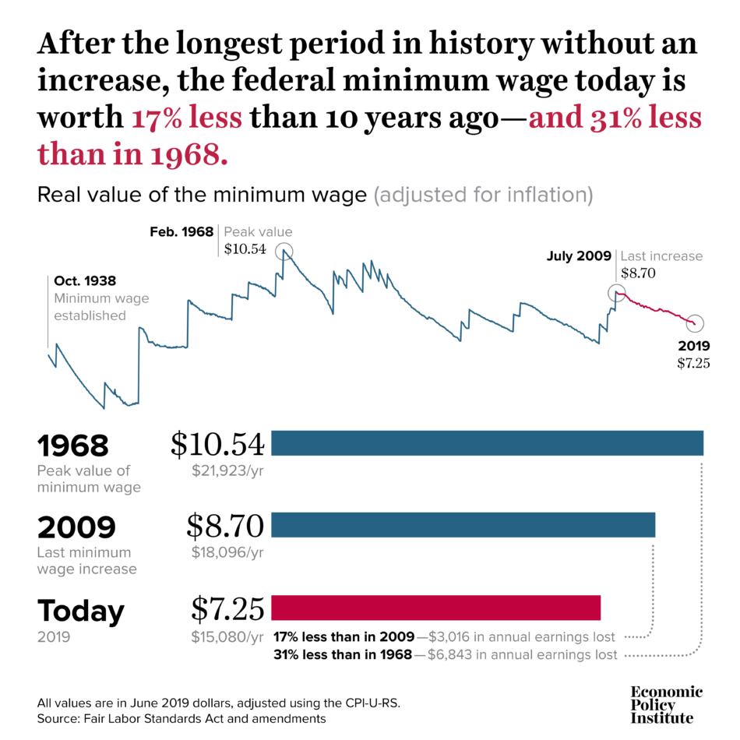

Slide 68
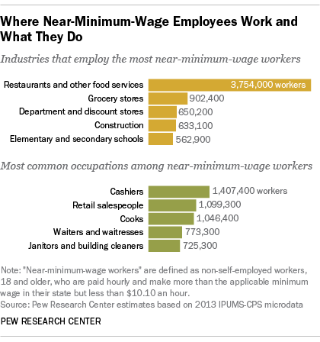

Slide 69
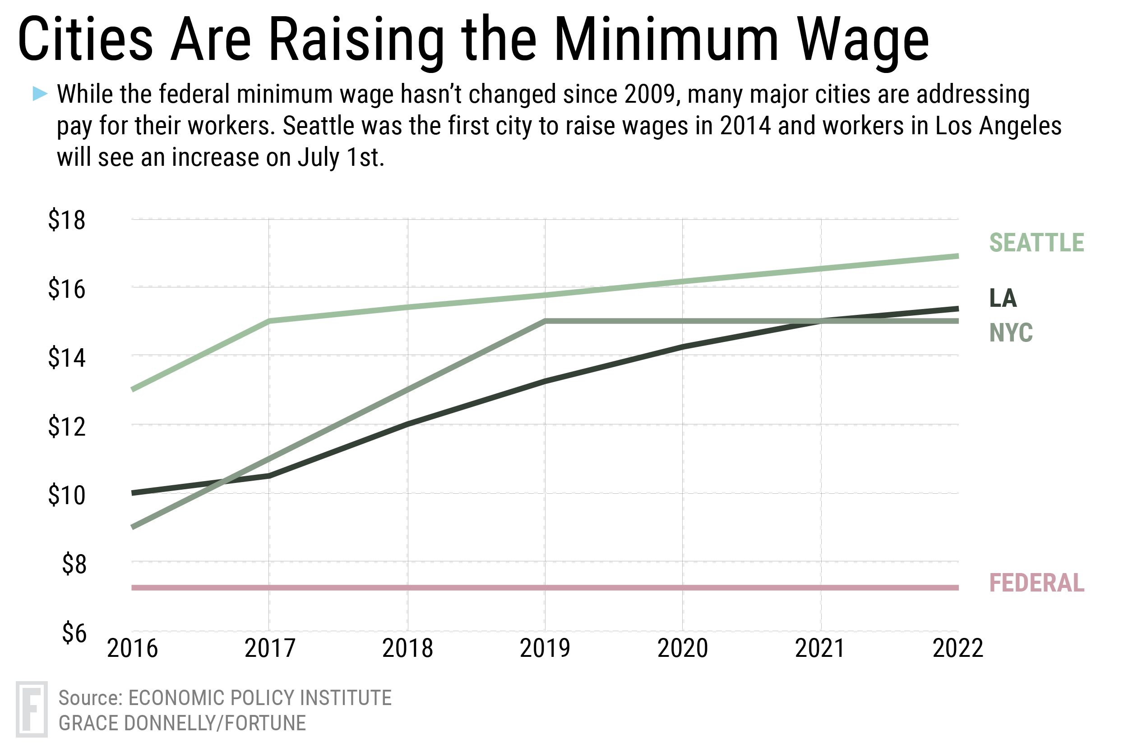

Slide 70
FIGHTS OVER LOCAL MINIMUM WAGE MANDATES
Before 2012, only five localities raised minimum wages independently in their states. After that, dozens of cities and counties mandated minimum wage increases.
Progressive coalitions including unions and advocacy groups championed these increases.
Opponents led by the American Legislative Exchange Council (ALEC) have responded at the state level – where conservative-dominated legislatures have passed preemption laws repealing/blocking local minimum wage increases (for example, in Alabama, Idaho, and North Carolina).

Slide 71
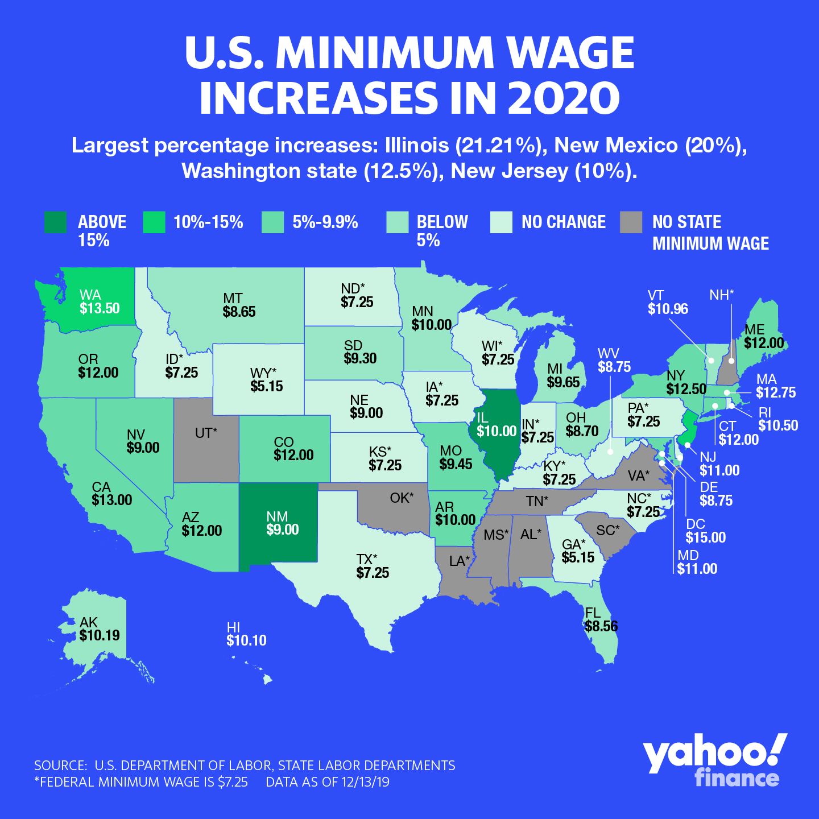

Slide 72
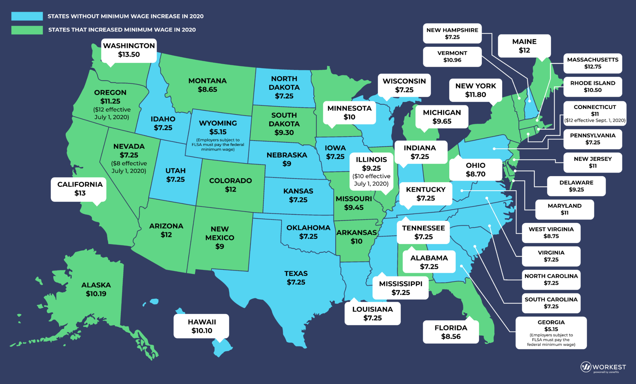

Slide 73
AMERICAN LEGISLATIVE EXCHANGE COUNCIL
Model Bill “Living Wage Mandate Preemption Act” (2013)
Summary
The Living Wage Mandate Preemption Act repeals any local “living wage” mandates, ordinances or laws enacted by political subdivisions of the state. It also prohibits political subdivisions from enacting laws establishing “living wage” mandates on private businesses, including those businesses that have service contracts with and/or receive financial assistance from such political subdivisions of state government.
This legislature finds and declares that:
(A) Economic stability and growth are among the most important factors affecting the general welfare of the people of this state….
(B) Mandated wages comprise a major cost component for private enterprises, and are among the chief factors affecting… economic… growth…
(C) Local variations in mandated wage rates threaten many businesses with a loss of employees to areas which require higher mandated wage rates, threaten many other businesses with a loss of patrons… and are therefore detrimental to the business environment of the state…..
(D) In order for businesses to remain competitive and yet attract and retain the highest possible caliber of employees, private enterprises in this state must be allowed to function in a uniform environment with respect to mandated wage rates; and
(E) Legislated wage disparity…creates an anticompetitive marketplace that fosters job and business relocation.

Slide 74
RESEARCH FINDINGS ON MINIMUM WAGE INCREASES
2010 study of “Minimum Wage Effects Across State Borders” by A. Dube, T. Lester, and M. Reich at UC Berkeley looked at employment levels from 1990 to 2006 in every pair of neighboring U.S. counties with different minimum wage levels. Study found that higher minimum wages did not lead to hiring reductions or to shifts of jobs to neighboring lower-wage counties.
2016 National Employment Law Project study of seven decades of trends found no correlation between federal minimum wage increases and adverse employment trends (using various indicators). Overall employment usually increased, and periods of decline were due to overall economic downturns.
Study by Michael Reich (UC Berkeley) found that phased in repeated minimum wage hikes in San Francisco did not hurt employment.
CAVEAT: available studies measure the impact of gradual hikes in steps, not big upward increases in the minimum wage floor.

Slide 75
Children in Poverty: What Works?
https://www.nap.edu/catalog/25246/a-roadmap-to-reducing-child-poverty
NAS Report on how to cut child poverty in half.

Slide 76
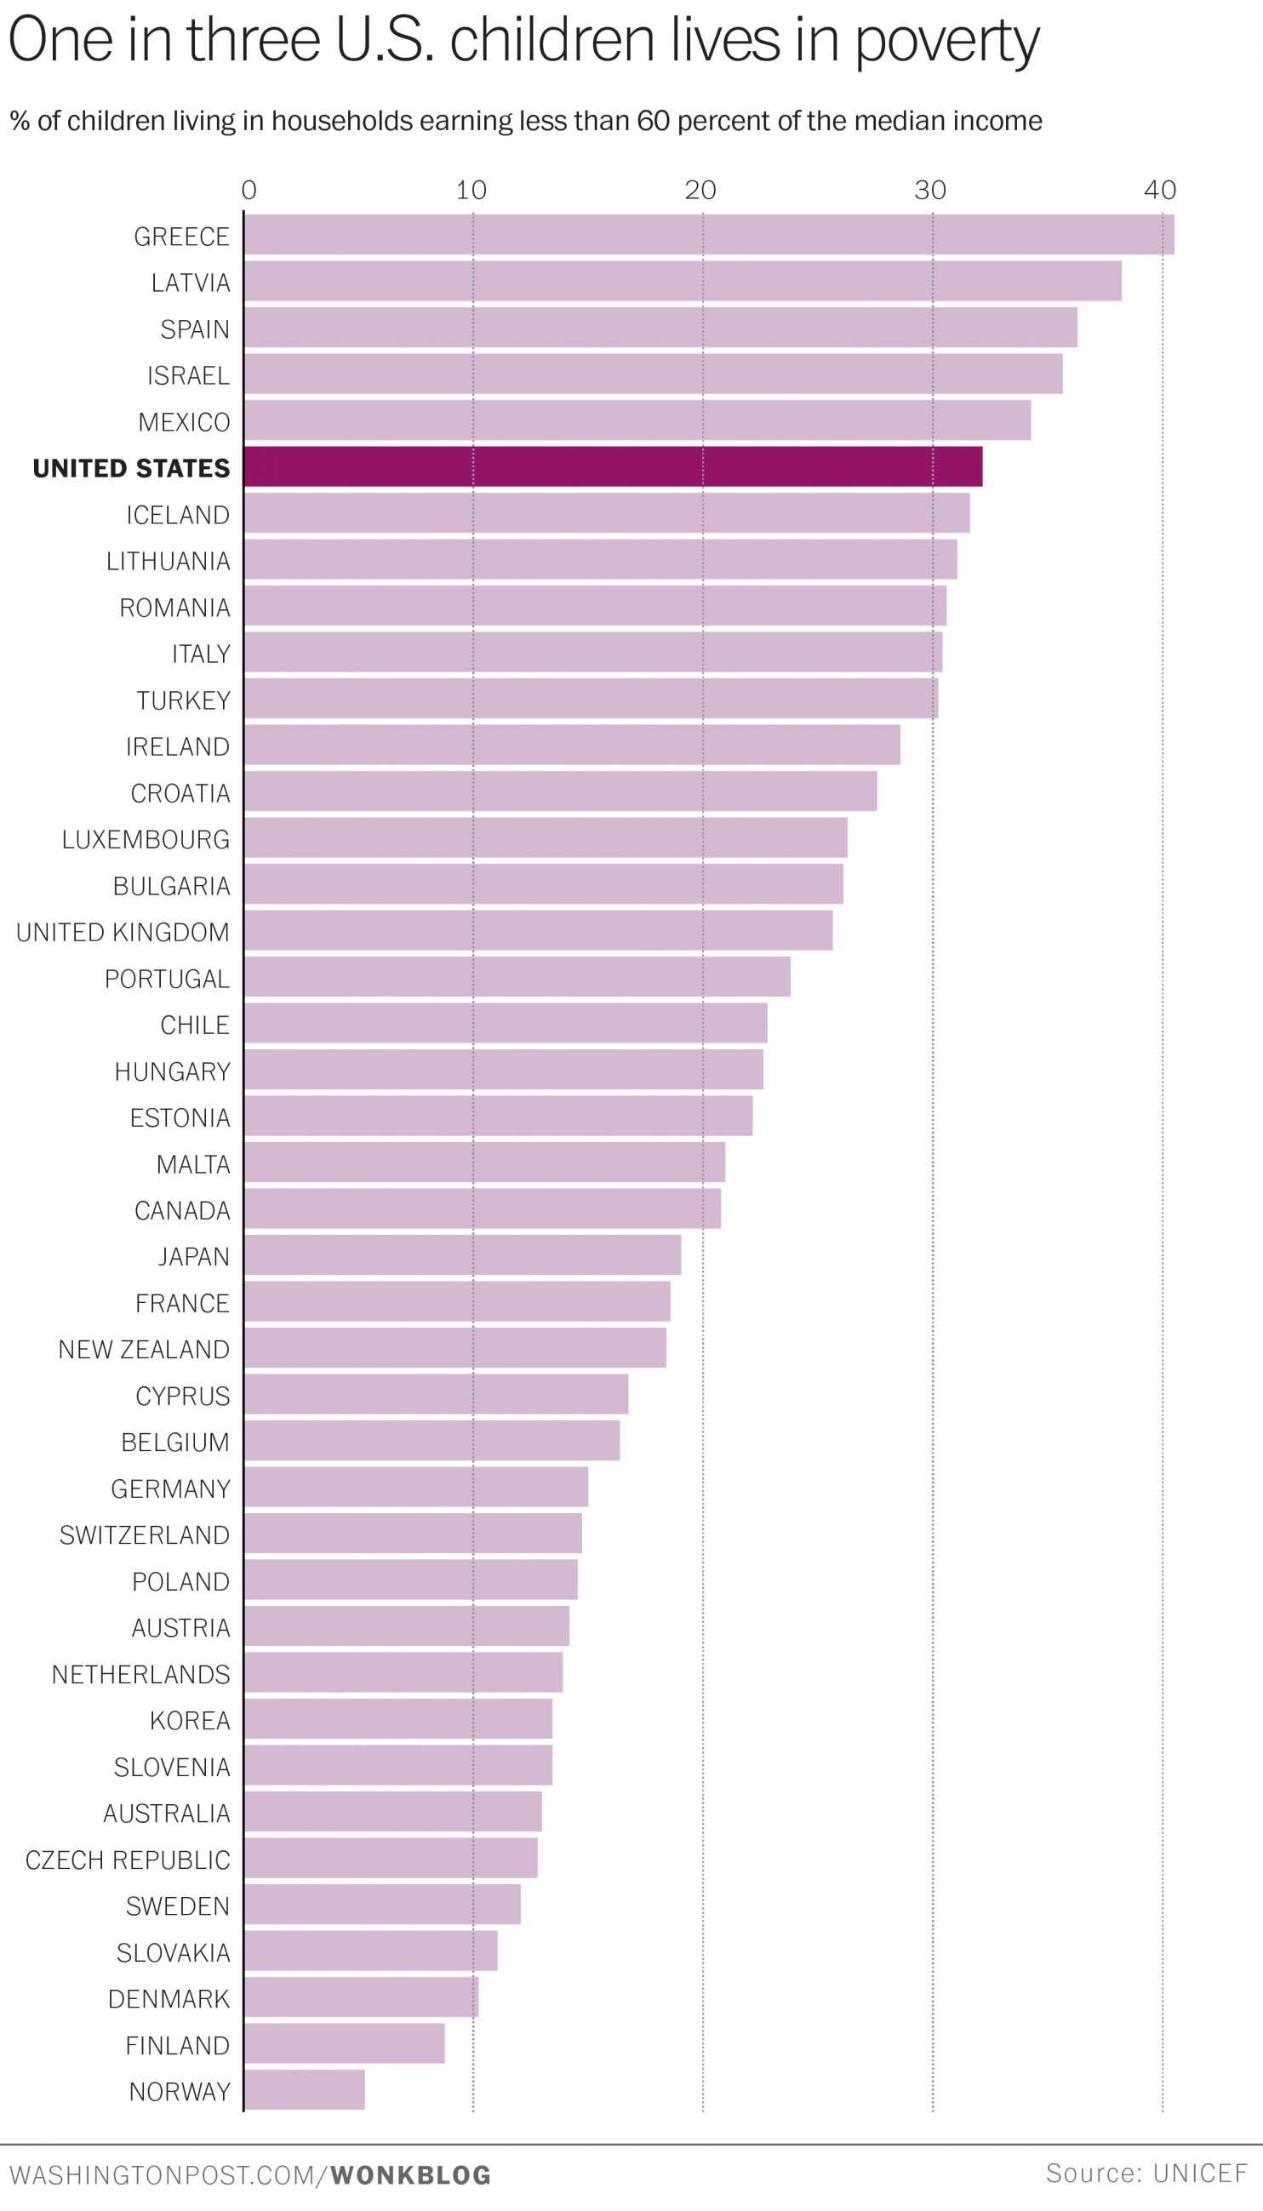

60% of US median income is $31,000 annually.

