Slide 1
Conflicts about Supports for
Working Families and Health Reform
Theda Skocpol
Lecture 11. October 14, 2020

Slide 2
TODAY’S LECTURE
New kinds of social policy debates responding to changes in families and work
Health insurance battles in the United States and the Affordable Care Act of 2010
  What the law tries to do
  Prolonged implementation
  Conflicts over Medicaid expansion in the states
  Why the ACA has been front and center for the Tea Party and the anti-Trump resistance
ObamaCare under President Trump and the stakes in 2020
Sum up current big picture for U.S. social policy

Slide 3
From 1935 to 1970, idealized (middle-class) family structure assumed a father working for wages and a mother doing caregiving for children and other family members.
Family norms as well as realities have shifted across income strata: more single-parent households and two-wage-earner families with children or other dependents.
Social policy debates have shifted too:
Encourage/support low-wage work – via EITC, min wage floors
New programs to help families/women combine wage-work and caregiving – such universal early childhood education/care, family and medical leave benefits

Slide 4
Proposals for universal subsidized early childhood education or day care are emerging in the USA, but most recent action has followed two other paths:
Government regulatory mandates requiring employers to provide, at their own expense, either paid sick days or options for employees to take weeks/months of family and medical leave without losing their jobs.
Paid family and medical leave benefits – a new form of social insurance funded by small, regular payroll contributions to allow employees to take extended time off for care of newborns or elderly or sick relatives, with portions of their wages/salaries replaced.

Slide 5
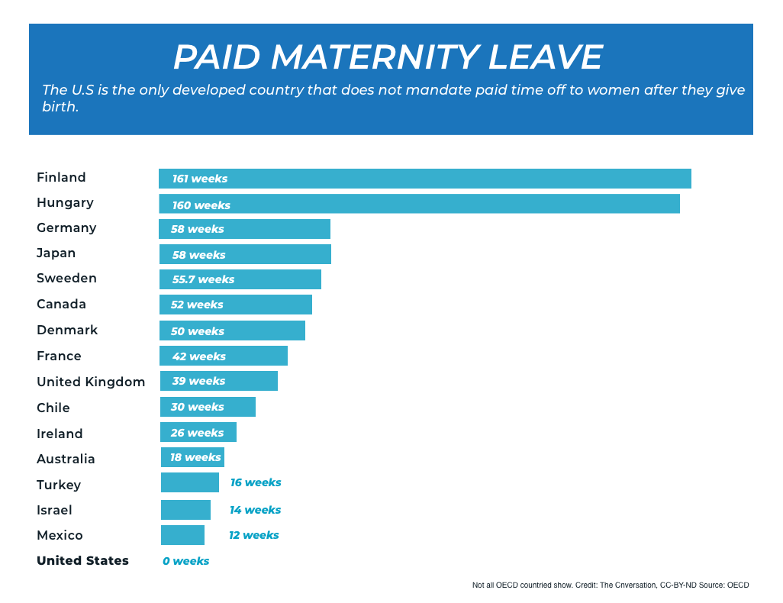

Slide 6
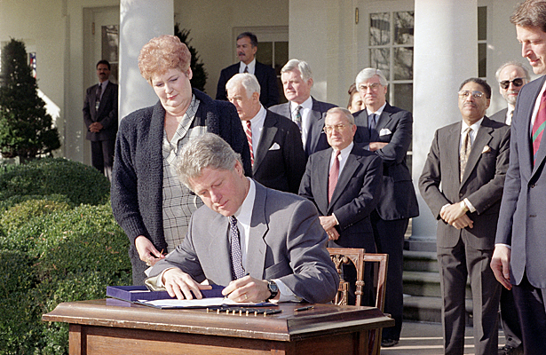
On February 5, 1993, President Bill Clinton signed the Family and Medical Leave Act – the most significant new U.S. social legislation prior to the Affordable Care Act of 2010.

Slide 7
FAMILY AND MEDICAL LEAVE since 1993
The 1993 federal law mandated up to 12 weeks of job-protected unpaid leave for newborns, adoptees, family medical care own medical needs, applicable to workers at large companies with 50 or more employees.
Many major companies and nonprofits voluntarily offer paid leave to some or all employees – but many companies do not.
Some states have mandated more generous unpaid leave rights and, recently, some mandate paid leave.
The 1993 federal law did little to reduce inequalities, because managers, professionals, and public-sector unionized workers have been much more likely to use unpaid leaves or have paid benefits than low-wage workers (who disproportionately work for small businesses).

Slide 8
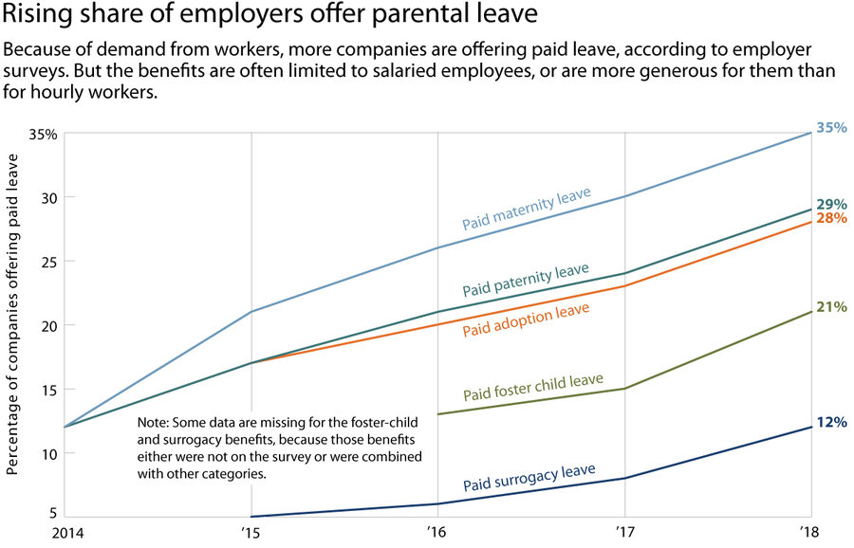

Slide 9
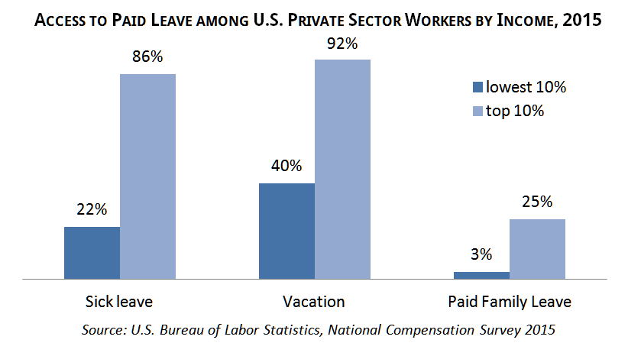

Slide 10
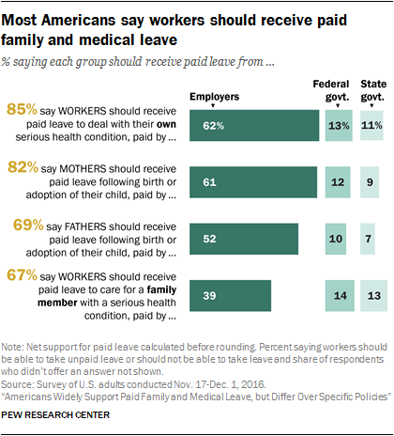

Slide 11
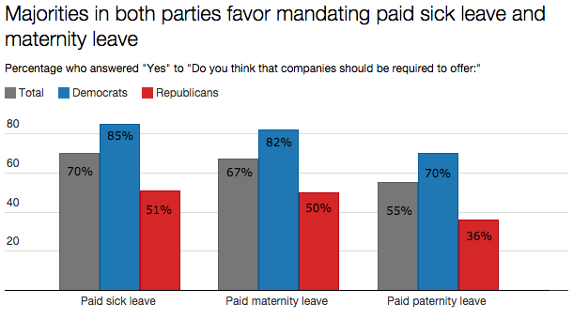
Source: Huffington Post/YouGov poll, early 2015.

Slide 12
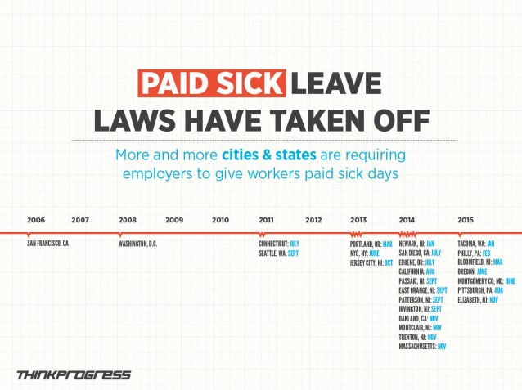
Beyond wage increases, employers can be mandated to give sick days to their employees

Slide 13
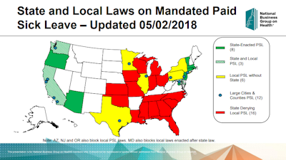

Slide 14
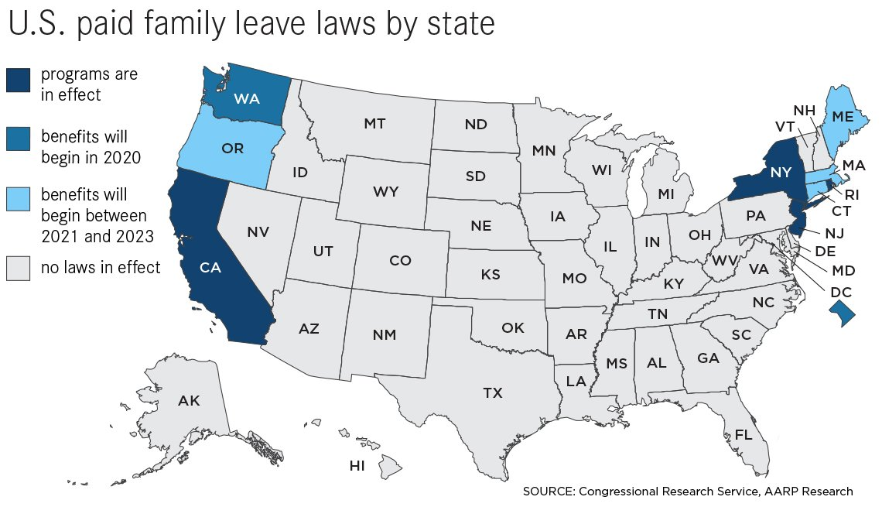
Some U.S. states have made family and medical leave more equal by enacting paid leave social insurance laws

Slide 15
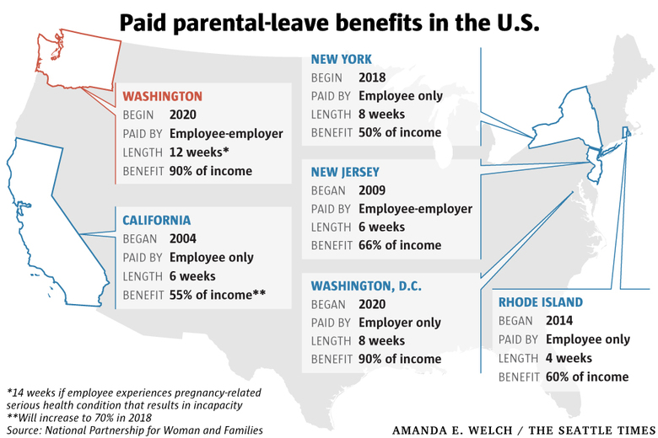

Slide 16
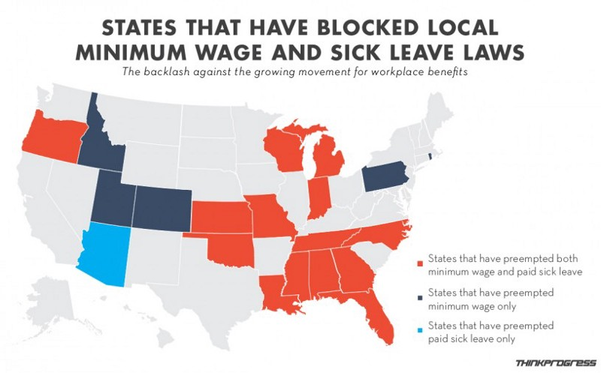
As with minimum wage laws, many GOP legislatures not only refuse to enact statewide paid sick leave mandates but also “preempt” local paid leave ordinances.

Slide 17
Another key family support is health insurance – which almost all industrialized and many developing nations have expanded to all or most citizens. Some use taxes to deliver or pay for coverage; others use regulations and subsidies to expand and supplement private insurance.
Since early 1900s, most US proposals failed, until…
Tax subsidies for private insurance from 1940s
Public insurance repeatedly defeated until Medicare for elderly and Medicaid for some of very poor in 1965
Clinton health reform defeated in 1994, Obama’s Affordable Care Act finally enacted on partisan lines in 2010.

Slide 18
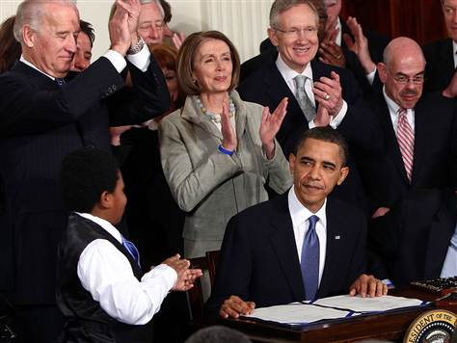
On March 23, 2010, President Barack Obama signed into law the Patient Protection and Affordable Care Act

Slide 19
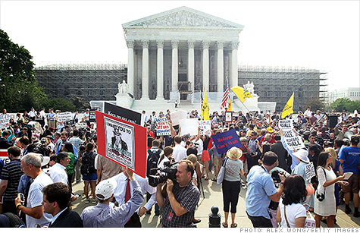
After two years of continuing public controversy and legal challenges from 26 states, the Supreme Court upheld the core provisions of Affordable Care on June 28, 2012

Slide 20
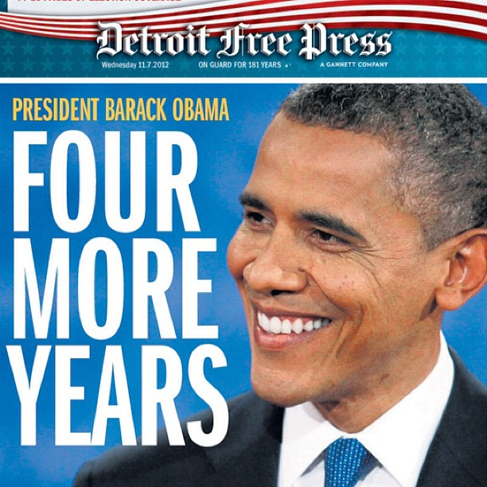
President Obama’s reelection on November 6, 2012 ensured that Affordable Care would survive through the initial stages of implementation.

Slide 21
U.S. Health System Before 2010
After 1970s, private insurance increasingly expensive, with rapidly rising health care costs – and growing numbers of nonelderly Americans without insurance.
Health insurance coverage skewed toward the elderly (Medicare) and the very poor (Medicaid), and to regularly employed middle and upper income citizens whose employers offer tax-subsidized coverage.
Why does insurance matter? Improves access to regular preventive care and care for chronic health problems, reduces worries about bankruptcy, and improves mental health. Some studies suggest significant improvements in physical health and longevity.

Slide 22
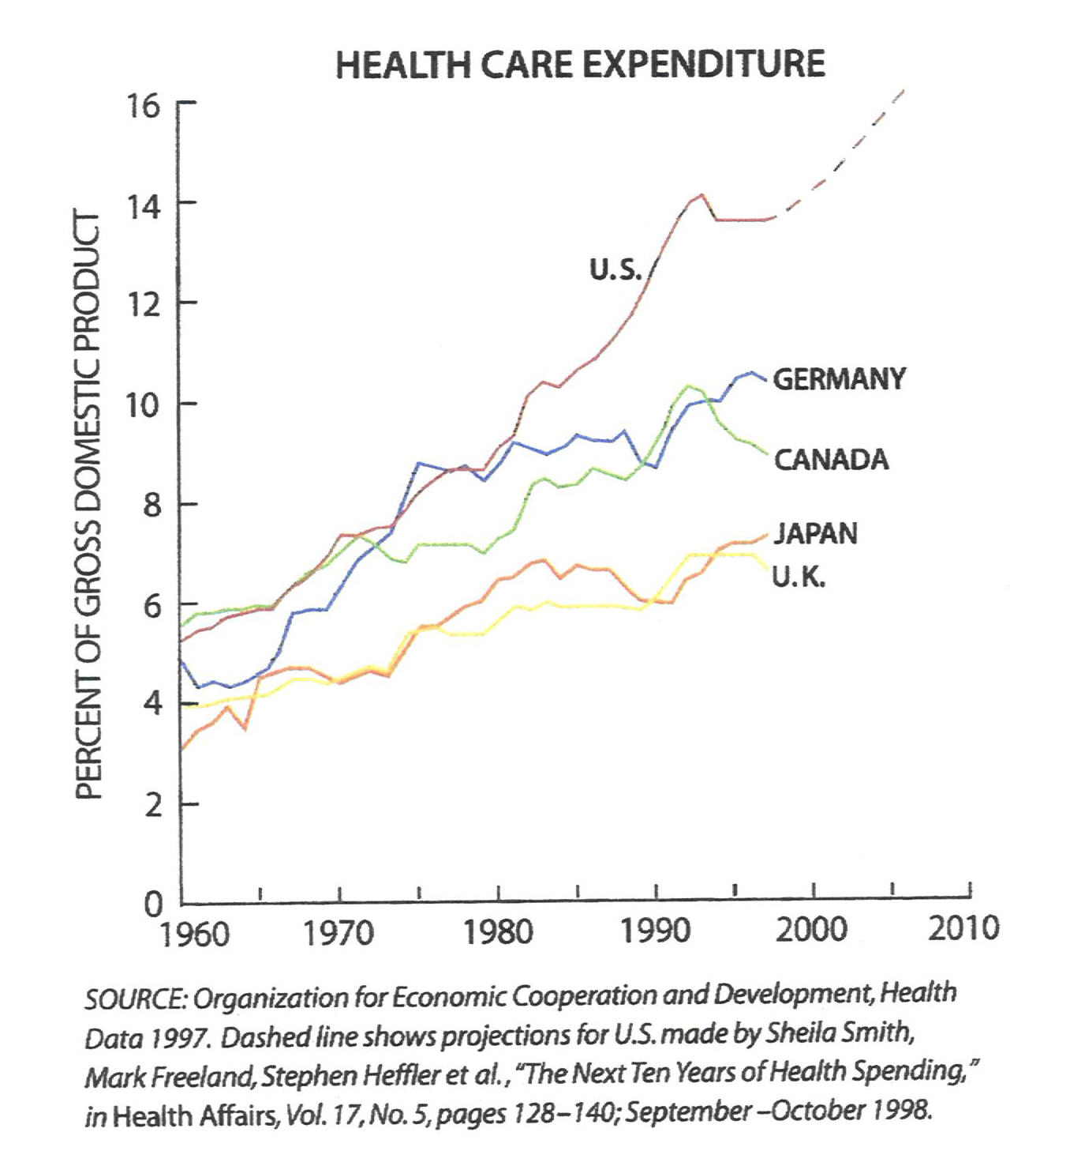
The U.S. health care system had very high -- and steeply rising -- costs.
Source: SCIENTIFIC AMERICAN (April 1999), p.36.

Slide 23

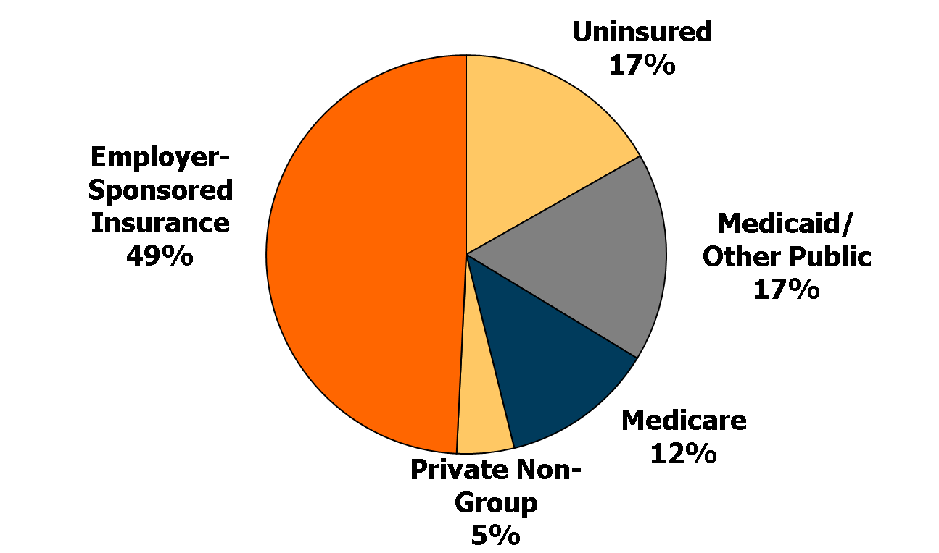
Health Insurance Coverage in the U.S., 2009
Total = 303.3 million
NOTE: Includes those over age 65. Medicaid/Other Public includes Medicaid, CHIP, other state programs, military-related coverage, and those enrolled in both Medicare and Medicaid (dual eligibles). SOURCE: Kaiser Commission on Medicaid and the Uninsured and Urban Institute estimates based on the Census Bureau's March 2010 Current Population Survey.

Slide 24
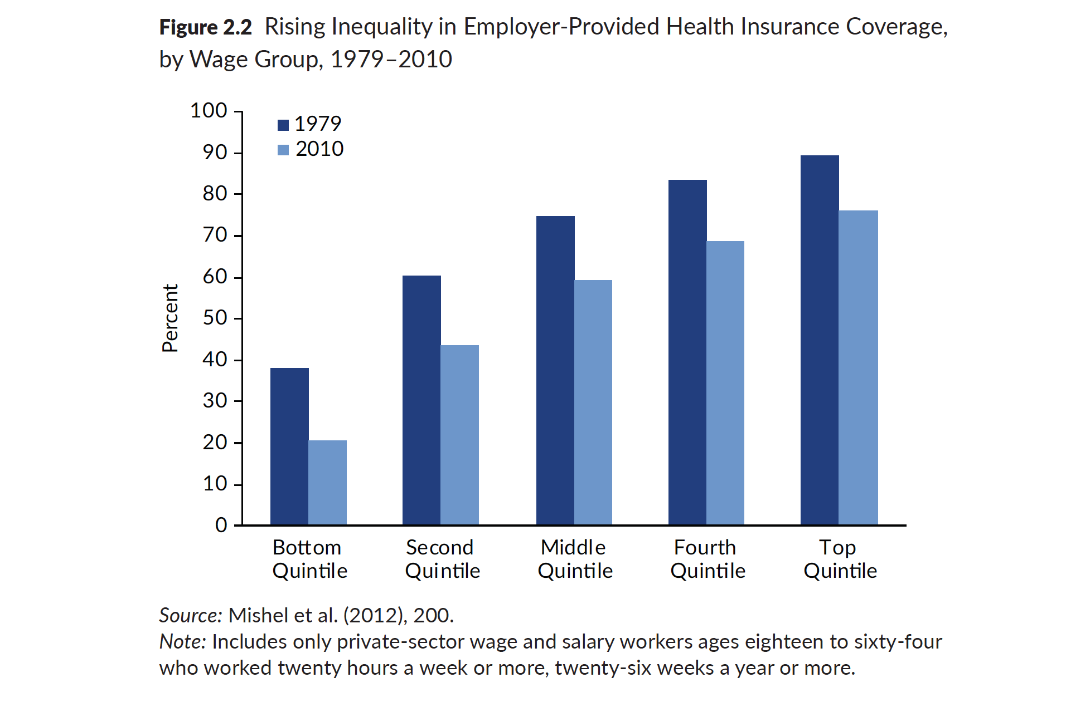

Slide 25
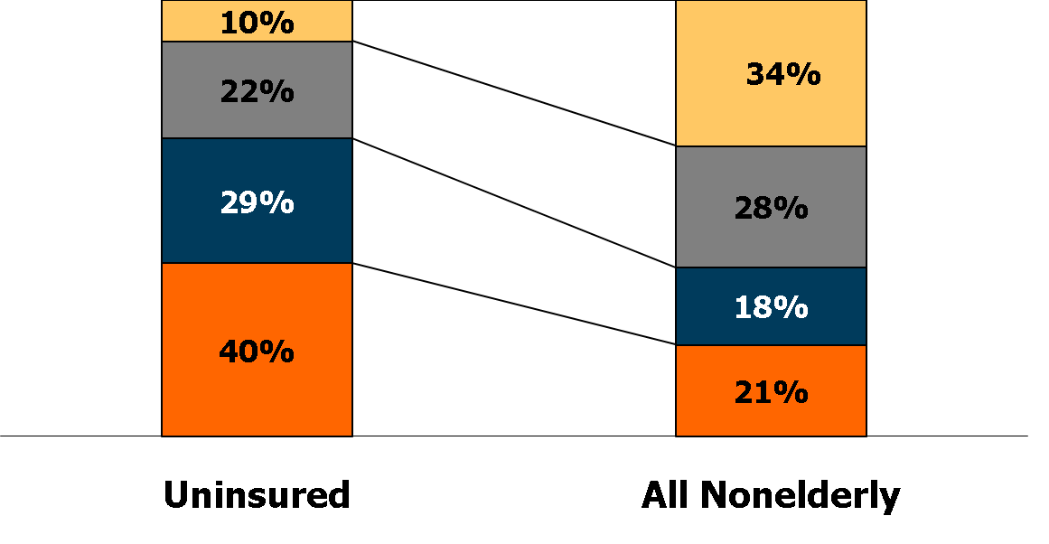
Uninsured Nonelderly vs. All Nonelderly, by Family Poverty Level, 2009
400% +
200% - 399%
100% - 199%
Under 100%
50.0 Million
264.7 Million
NOTES: Data may not total 100% due to rounding. The Federal Poverty Level for a family of four in 2009 was $22,050 (according to the U.S. Census Bureau’s poverty threshold). Family size and total family income are grouped by insurance eligibility.
SOURCE: Kaiser Commission on Medicaid and the Uninsured/Urban Institute analysis of 2010 ASEC Supplement to the CPS.
Notes:
Changed to 400%

Slide 26
HOW DID THE UNITED STATES DEVELOP THIS KIND OF HEALTH CARE SYSTEM?
Campaigns for government-subsidized and publicly guaranteed universal health insurance coverage repeatedly failed.
Instead, government and private institutions ended up subsidizing employer-provided private insurance, the construction of acute-care facilities, and high-tech medicine.
Private, fee-for-service physicians carved out leverage as the key actors in an intricate institutional system.

Slide 27
Patient Protection and Affordable Care Act of 2010
New rules of the game for insurance companies: make profits but cannot exclude sick people or those expected to become sick.
Make insurance available affordable for most American citizens: expansions of Medicaid and new subsidies for small businesses and for lower and lower-middle income people to buy plans.
Each state establishes a regulated insurance exchange, on which plans are listed and can be compared by potential purchasers. Federal government sets up exchanges if states do not.
Improvements in basic Medicare coverage, but cuts in high-end plans and slightly higher taxes for richest beneficiaries.
New coverage for young people: parental insurance until age 26; expansions of Medicaid and subsidies to buy private plans.
PAID FOR by taxes on wealthy and health care businesses.

Slide 28
Targeted Coverage Expansion Under Affordable Care Act
Federal Poverty Level
400%+
Employer-Sponsored Insurance
139-399% (Subsidies)
Uninsured
<139% (Medicaid)
Medicaid*
Private Non-Group
266 M Nonelderly
* Medicaid also includes other public programs: CHIP, other state programs, Medicare and military-related coverage. The federal poverty level for a family of three in 2012 is $19,090. Numbers may not add to 100 due to rounding.
SOURCE: KCMU/Urban Institute analysis of 2011 ASEC Supplement to the CPS.

Slide 29
ObamaCare Implementation Challenge
Spread out 2010-2018, leaving citizens unaware of key benefits and allowing opponents time to obstruct.
Some national funding streams are set by law and HHS Secretary has considerable regulatory authority, BUT…
Each of the fifty U.S. states makes pivotal decisions:
  Set up exchanges? If not, federal fail-safe.
  Accept the expansion of Medicaid? Supreme Court in 2012 sparked ongoing polarized political battles by removing federal disincentives for states that refused expansion.

Slide 30
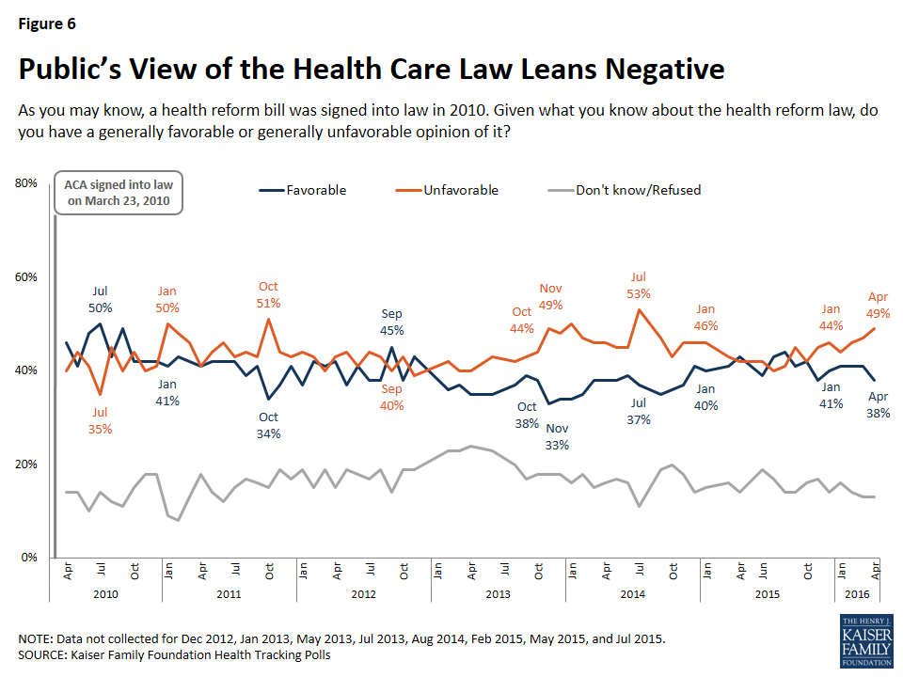
As law was implemented amid continued partisan fighting, public opinion moved negative

Slide 31
State Medicaid Expansion Decisions by late 2015
(Louisiana adopted the expansion in January 2016)
VT
ME
WA
NH*
MT**
ND
MN
OR
MA
SD
WI*
NY
ID
MI*
CT
RI
WY
PA*
NJ
NE
IA*
OH
DE
NV
IL
IN*
MD
CA
UT
CO
WV
VA
KS
MO
KY
DC
NC
AZ
TN
NM
OK
AR*
SC
MS
AL
GA
AK
TX
LA
FL
HI
Adopted (30 states plus DC)
Not adopting (20 states)
NOTES: **MT has passed legislation adopting the expansion; it requires federal waiver approval. *AR, IA, IN, MI, PA and NH have approved Section 1115 waivers. Coverage under the PA waiver went into effect 1/1/15, but it is transitioning coverage to a state plan amendment. WI covers adults up to 100% FPL in Medicaid, but did not adopt the ACA expansion.
SOURCE: “Status of State Action on the Medicaid Expansion Decision,” KFF State Health Facts, updated July 16, 2015.
http://kff.org/health-reform/state-indicator/state-activity-around-expanding-medicaid-under-the-affordable-care-act/

Slide 33
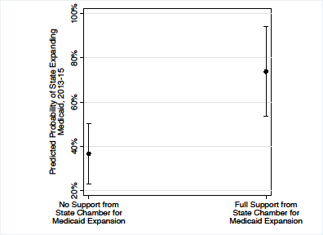
Chamber Support and Medicaid Expansion

Slide 34
Conservative Networks Fight Medicaid Expansion
American Legislative Exchange Council organizes lawmakers, private sector firms, and conservative activists to draft and promote model bills.
State Policy Network links free-market think tanks and media operations in all fifty states. Within this network, the Florida-based Foundation for Government Accountability took the lead in making presentations, writing OpEds, doing polls and media blitzes across many states.
Americans for Prosperity, Koch-sponsored, federated organization, coordinates media, activist events, and lobbying in policy campaigns.

Slide 35
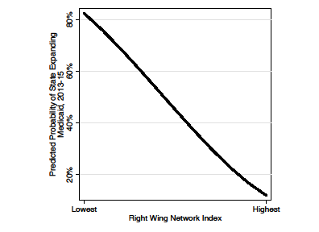
Right-Wing Network Strength and Medicaid Expansion

Slide 36
Effects?
Evidence that the Affordable Care Act, especially in Medicaid expansion states, not only expands coverage but also limits cost increases and helps low-income Americans get continuous care and avoid ruinous costs.

Slide 37
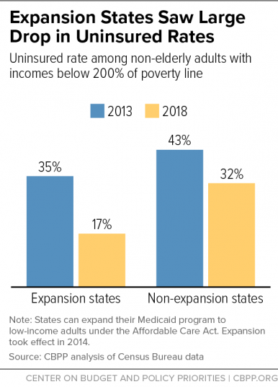

Slide 38
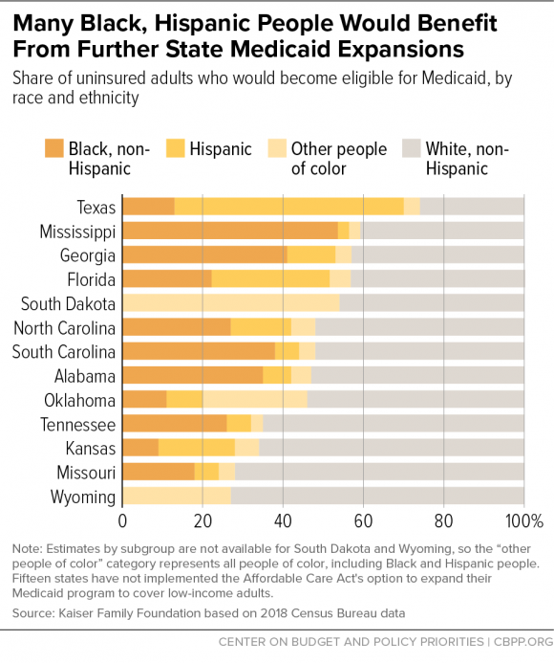

Slide 39
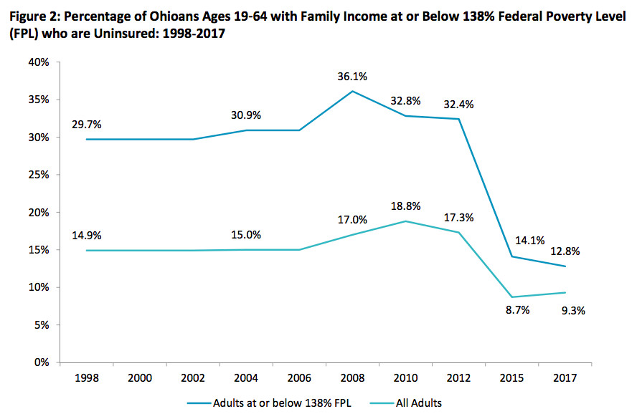
After Ohio Governor Kasich forced the expansion of Medicaid for the near poor (>$21,000 for a family of three), the uninsured rate fell from 32.4% to 12.8%.
Further Ohio results:
Medicaid coverage makes it easier for people to work or look for work.
Covered people are less likely to have medical debts.
More three in ten report better health since coverage (six in ten the same); and more get opioid treatments.
Most who leave Medicaid do so because their incomes increased, they got jobs, or obtained coverage in other ways.
VOX, Aug. 30, 2018

Slide 40
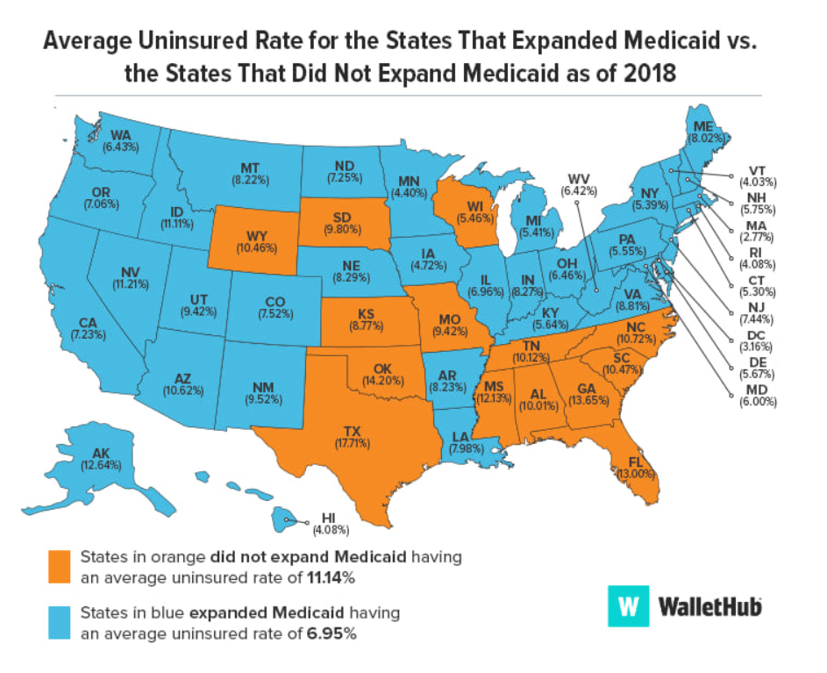

Slide 41
Not just state-level Medicaid expansion, but the entire Affordable Care Act, has remained at the center of partisan and ideological conflicts since 2009.
Conservative Republicans oppose a new tax-funded entitlement for lower-income and middle-income families.
Tea Partiers and Trump enthusiasts (mostly mistakenly) see “ObamaCare” as a benefit for immigrants.

Slide 42
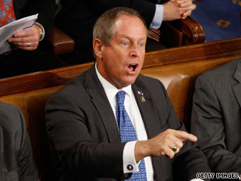
CNN Politics September 9, 2009
appearance of President Obama at Joint Session of Congress
Rep. Wilson shouts, 'You lie' to Obama during speech
South Carolina Rep. Joe Wilson shouted "you lie" after President Obama denied the health care plan would cover illegal immigrants.
[Video clip here]

Slide 43
Democrats remained on political defense through 2015.
But after implementation and once Trump/GOP made repeal an actual threat in 2017, they turned to vigorous defense and pushback – with the grassroots 2017 resistance movement in the lead.
Activist originated referenda continued to push GOP-led states to expand Medicaid coverage – in 2018 in Nebraska, Idaho, and Utah.

Slide 44
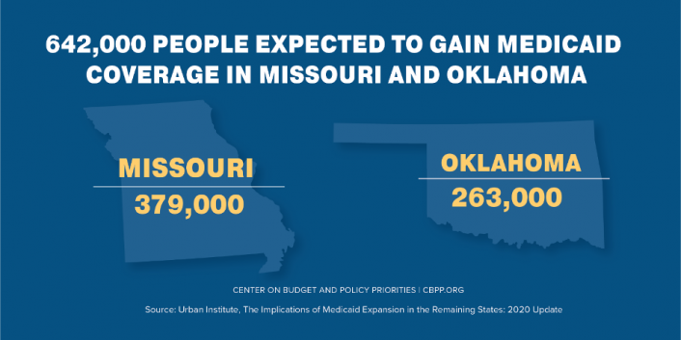
And further referenda in 2020….

Slide 45
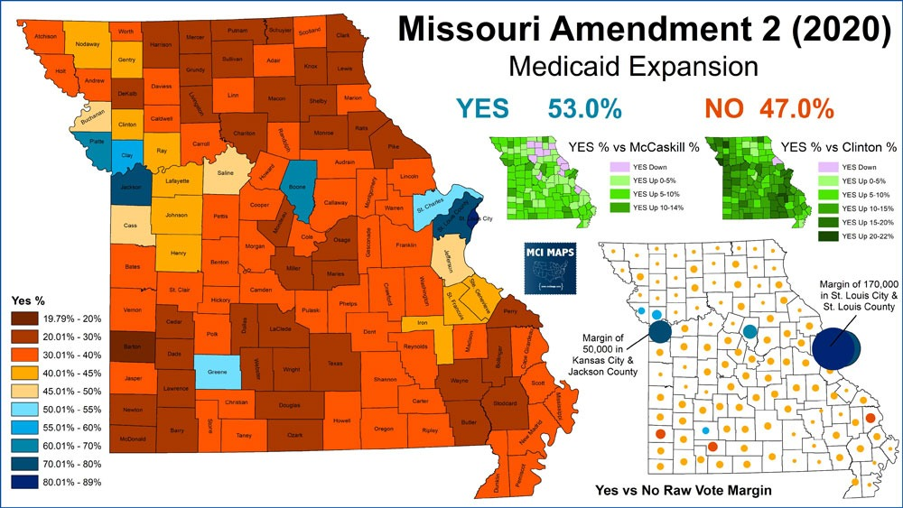

Slide 46
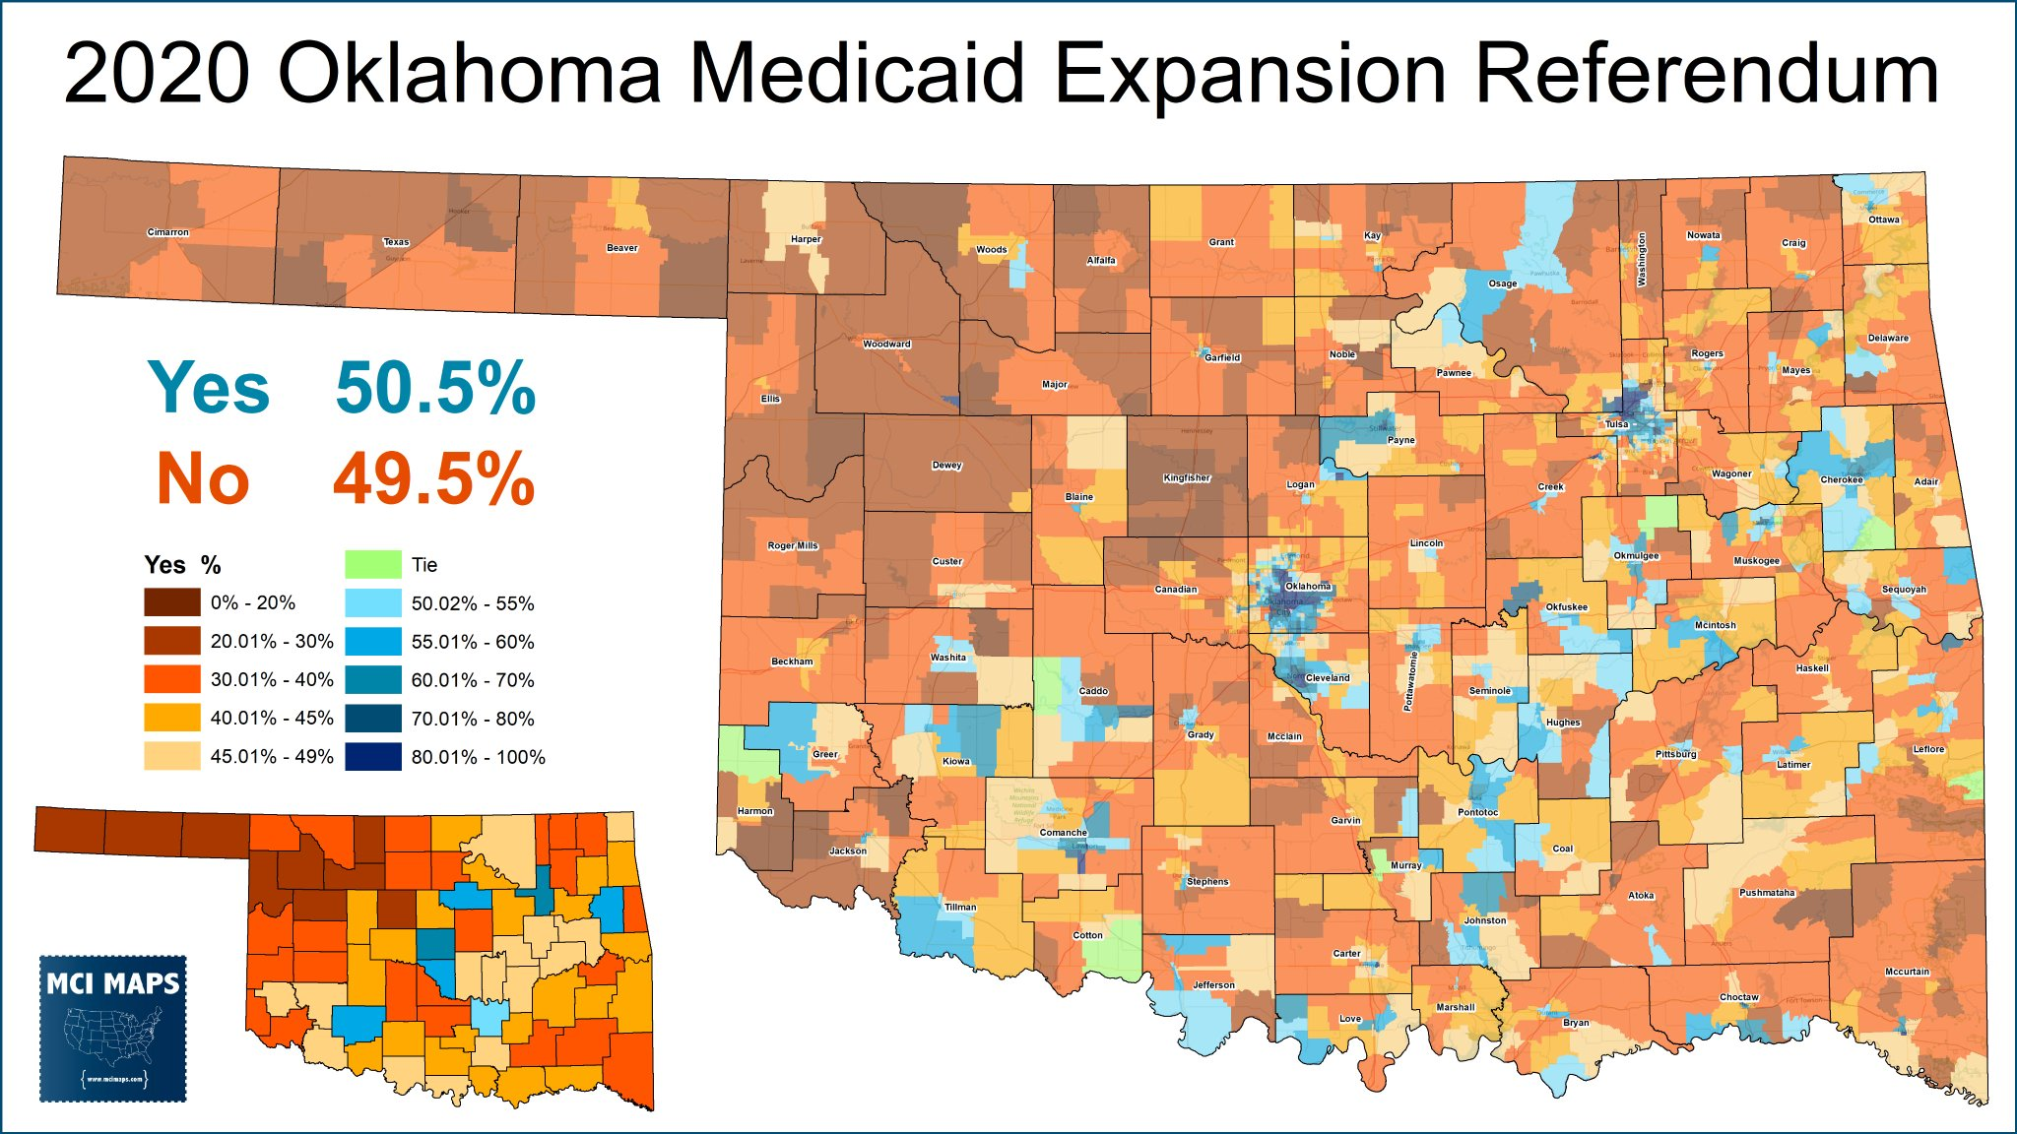

Slide 47
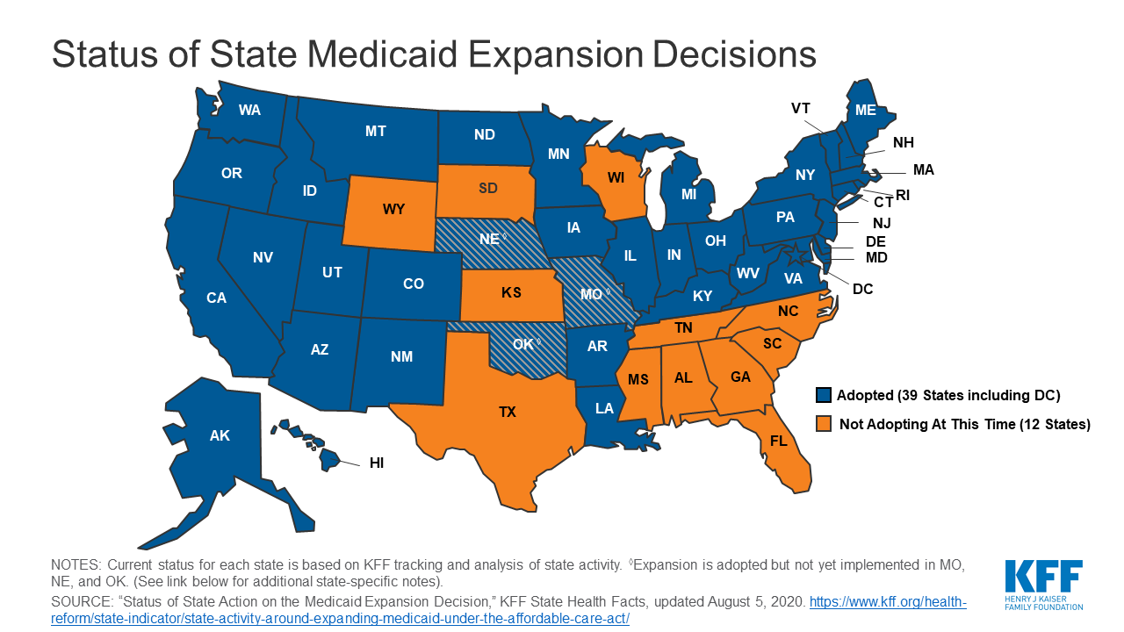
By now, there are just 12 states refusing expansion.

Slide 48
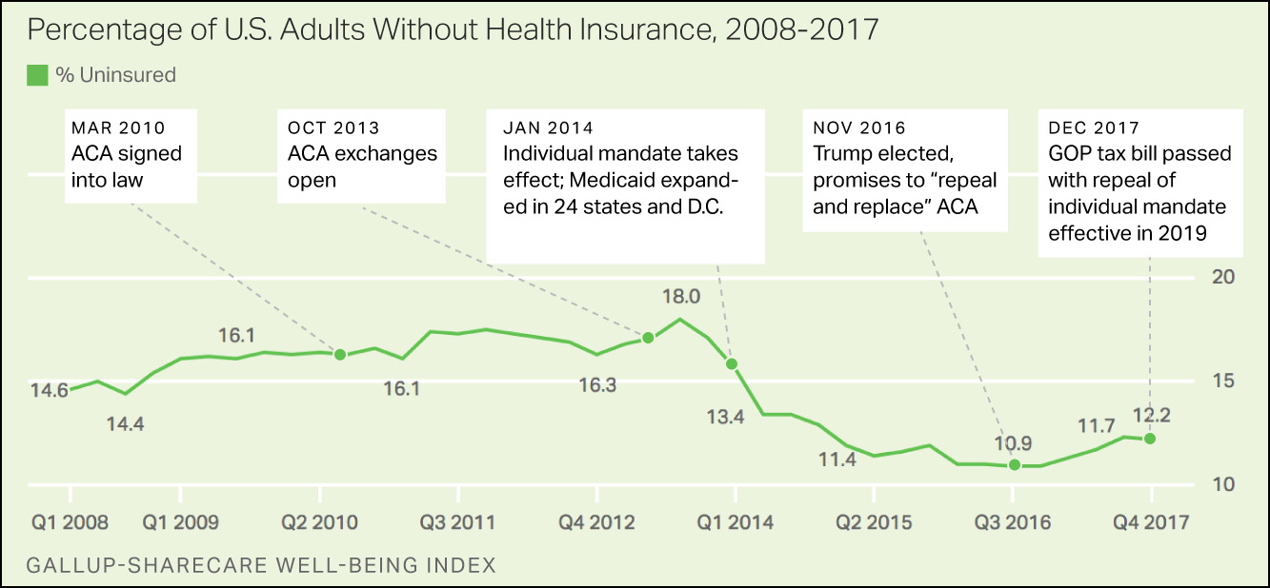
Although ACA repeal failed and was dropped by the GOP Congress after 2017, the Trump administration has used regulations to modify and weaken ACA coverage.

Slide 49
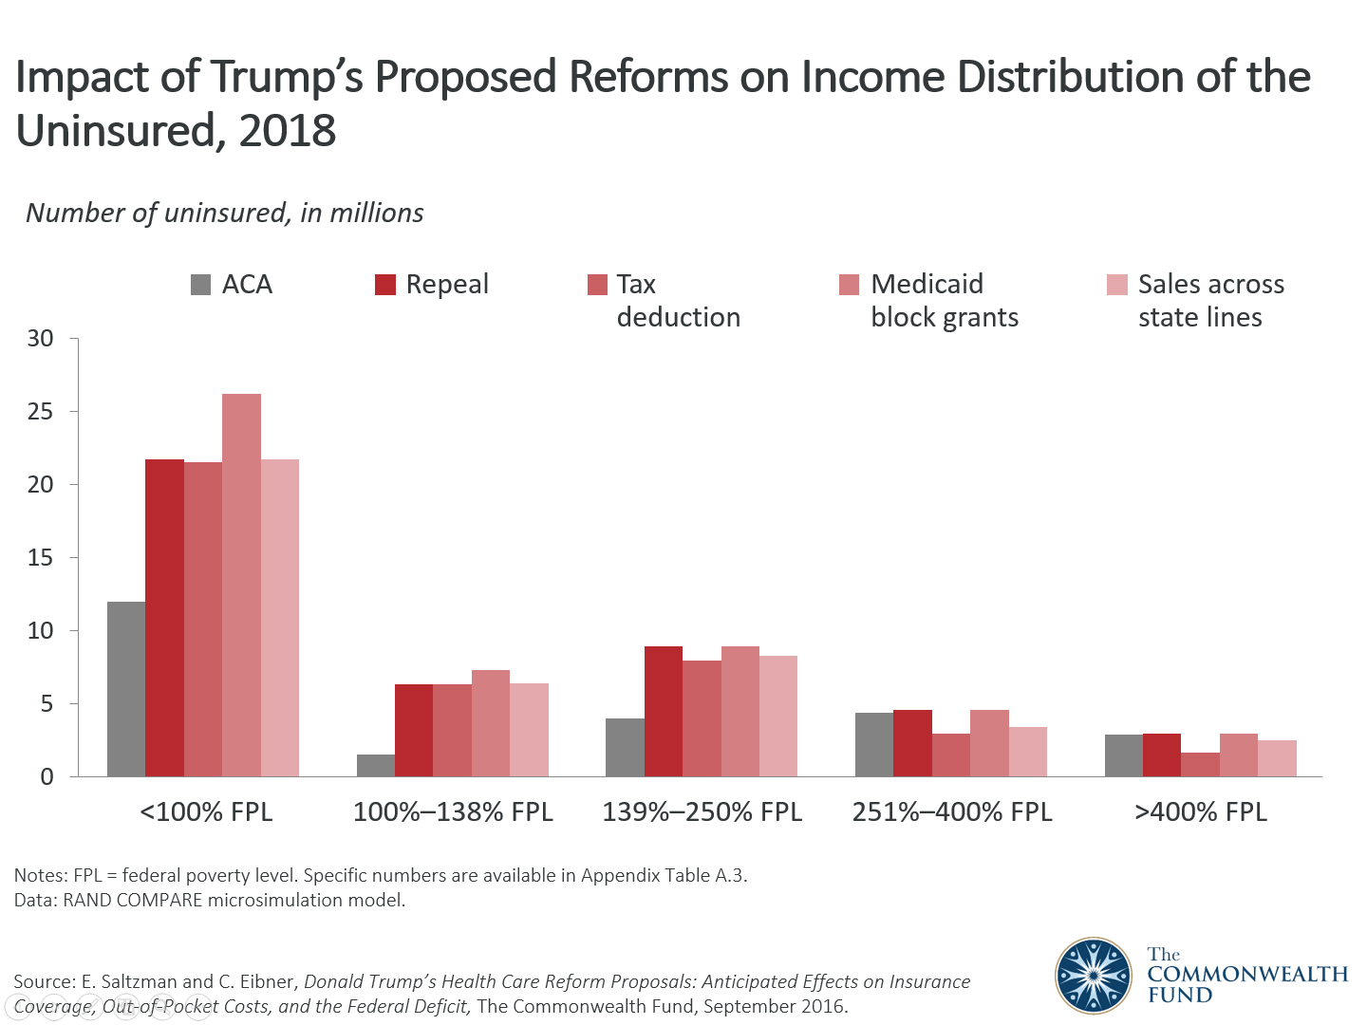

Slide 50
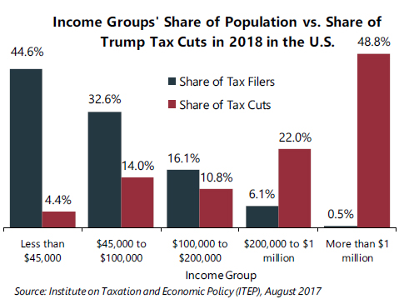
The most important legislative initiative of the Trump/GOP was the 2017 $2.3 trillion tax cut that increased projected deficits and U.S. income inequality

Slide 51
LATE 20th/ 21st CENTURY SOCIAL TRENDS
and the EMBATTLED U.S. WELFARE STATE
Social support/ direct spending increasingly tilted toward the elderly – with the exception of the Affordable Care Act, the most redistributive new social program in decades
Total social expenditures and tax reductions remain tilted toward top earners and investors
Wages for most workers have stalled or fallen
Job security and employee benefits have eroded
Tensions between family life and work have grown for working parents and their children
Partisan splits and polarization block most Congressional efforts to update policies or create new social supports for working families – and ObamaCare remains controversial, along with programs like Food Stamps aimed at helping the poor.

Slide 52
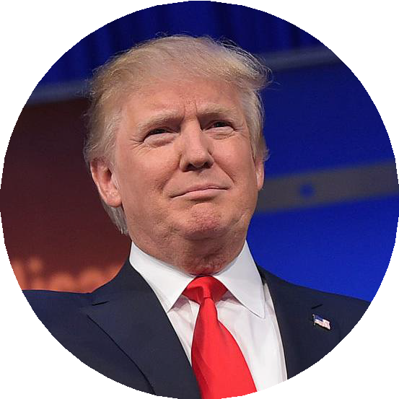


Trump’s Health Record: At a Glance
Supported repeal of the Affordable Care Act (ACA) and supporting lawsuit to
overturn entire law
Proposed changes to cap and limit federal funding for Medicaid and limit Medicaid eligibility
Restricted access to reproductive health services
Trump's Record
Reduced insulin costs for some Medicare beneficiaries, effective 2021; proposed other ways to reduce drug prices (most have not been implemented)
Made changes to immigration policy to restrict entry of individuals who are likely to use Medicaid and certain other public programs
Signed federal COVID-19 emergency relief legislation; has delegated primary
responsibility for COVID-19 to states

Slide 53
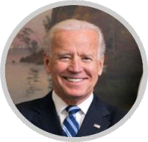


Biden’s Health Proposals: At a Glance
Retain and strengthen the ACA and create a new public option, and increase the number of people eligible for subsidies and enhance subsidies
Retain ACA Medicaid expansion
Provide option to enroll in Medicare at age 60
Increase health insurance coverage options for immigrants
Biden's Proposals
Reduce prescription drug costs
Enhance funding for long-term care
Restore and expand reproductive rights
Expand federal COVID-19 emergency relief; put federal government in charge of the COVID-19 response

