Slide 1
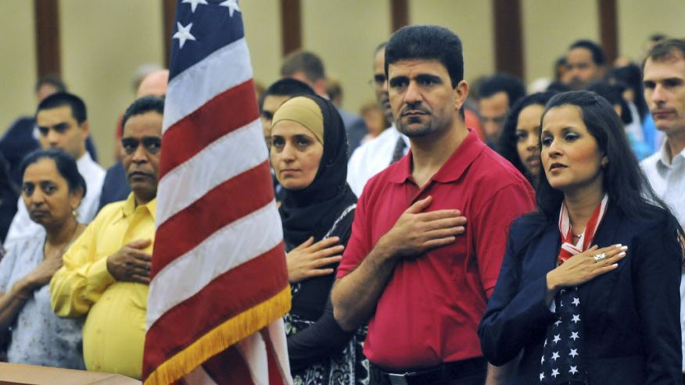

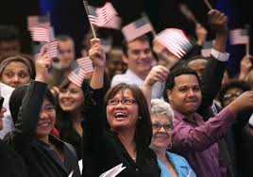
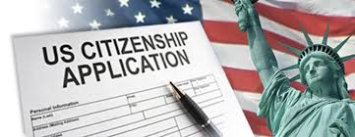
Gen Ed 1092
Lecture 23: 11/30/2020

Slide 2
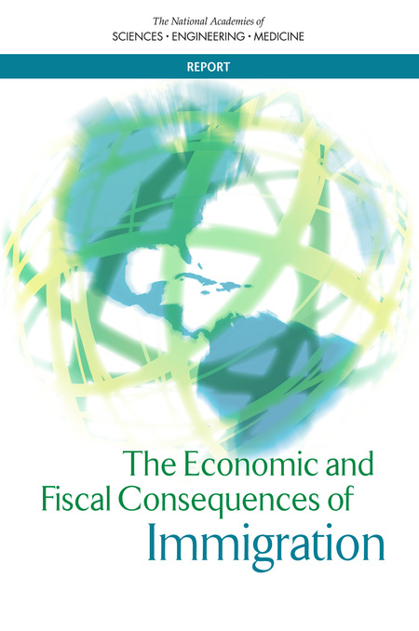
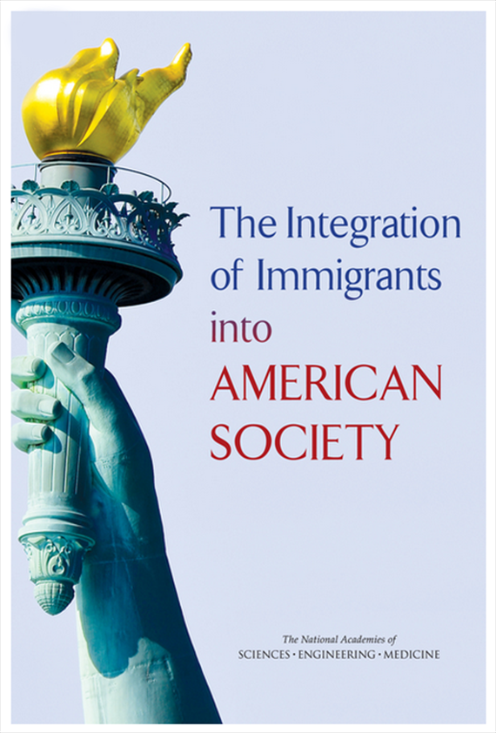
Two NAS Studies

Slide 3
The Integration of Immigrants into American Society
Committee on Population
Division of Behavioral and Social Sciences and Education

Slide 4
Panel Charge
Summarizing what is known about how immigrants and their descendants are integrating into American society;
Discussing the implications of this knowledge for informing various policy options;
Identifying any important gaps in existing knowledge and data availability.
Notes:
A sister panel on the Economic and Fiscal Effects of Immigration, sponsored by the MacArthur Foundation, is focusing specifically on the economic impacts, and will release it’s final report at the end of 2015.

Slide 5
Integration
Immigrant groups and host societies come to resemble each other.
  Two-way exchange
Measured across time and intergenerationally
Effects on well-being

Slide 6
Integration across Dimensions
Socioeconomic
  Education
  Occupation
  Income
  Poverty
Political
  Naturalization
  Civic Participation
Sociocultural
  Language
  Crime
  Religion
  Attitudes
  Intermarriage
Spatial
Familial
Health
Notes:
The report describes immigrant integration across various social dimensions, listed here.

Slide 7
Quick Summary
Immigrants and their children (the second generation) represent one of every four U.S. residents.
Immigrants and their descendants are integrating into American society across all dimensions; the pace and outcomes depend on very different starting points.
On the whole, integration increases the well-being of immigrants and their descendants, e.g., in schooling, labor-market position, and residential situation. However, this is not true in every domain. Exceptions include health, crime and family form.

Slide 8
Education
Despite large differences in starting points among the first generation, there is strong intergenerational progress in educational attainment. Second generation members of most contemporary immigrant groups meet or exceed the schooling level of typical third- and higher-generation native-born Americans.
Among Mexican American men for instance, the first generation has slightly more than 8 years of education, the second generation, 12.5 years.
Notes:
Big second-generation advance in education, in particular for the groups where immigrant education levels are low—e.g., Mexicans and Central Americans. However, for the Mexicans in particular, second-generation advance still leaves them short of the average educational level in the third generation native group. The Central Americans, like most other groups, attain the native norm in the second generation.

Slide 9
First- to second-generation educational shift (men)
Notes:
But this does mask important variations between groups. Over a quarter of immigrants have a college education or more, and they contribute a great deal to the U.S. scientific and technical workforce. Their children also do exceptionally well educationally. For instance, Indian immigrants and their children have very high educational attainment.
Other immigrants start with exceptionally low levels of education, and this is particularly true for foreign-born Mexicans and Central Americans, who have an average education of less than 10 years. Their children progress a great deal relative to their parents, with an average education of over 12 years, but do not reach parity with the general population of native-born. For instance, Mexicans, at the bottom left of this graph. This mostly reflects the low levels of schooling, English proficiency, and other forms of human capital their parents bring to the United States.

Slide 10
Employment
Immigrant men have higher employment rates than native born; immigrant women lower
Least educated immigrants much more likely to be employed than comparable native born men
Second + generation employment rates vary by race/ethnicity and gender
Notes:
Employment: Asian men are integrating with the non-Hispanic white population by this measure, and Hispanic men are making gains when their lower education is taken into account. However, second-generation Blacks appear to be integrating into the general Black native-born population, where higher education does not translate into higher employment rates.
Among women the pattern is reversed, with a substantially lower employment rate for immigrants than for the native born, but second and higher generation women’s employment rates begin to reach parity with the general native-born population, regardless of race.

Slide 11
Changes in Earnings
Positive trajectories in immigrant earnings over time
Considerably slower growth for Hispanics
Asians see growth over time but lag whites when education is controlled.
Notes:
Foreign-born workers’ earnings improve relative to the native-born the longer they reside in the United States. These overall patterns, however, are still shaped by racial and ethnic stratification. Immigrants experience a substantial earnings penalty as skin color darkens. Earnings assimilation is also considerably slower for Hispanic (predominately Mexican) immigrants than for other immigrants, probably in part because of the negative impact of unauthorized status. And although Asian immigrants and their descendants appear to do just as well as native-born whites, these comparisons become less favorable after controlling for education.

Slide 12
Earnings by Nativity and Gender, 2013
Notes:
Foreign-born workers’ earnings improve relative to the native-born the longer they reside in the United States. These overall patterns, however, are still shaped by racial and ethnic stratification. Earnings assimilation is considerably slower for Hispanic (predominately Mexican) immigrants than for other immigrants. And although Asian immigrants and their descendants appear to do just as well as native-born whites, these comparisons become less favorable after controlling for education. The schooling advantage of Asian Americans can obscure the fact that, at least among men, they tend to earn somewhat less than third+ generation non-Hispanic whites with the same level of education.
Note: US born in Figure is all native-born.

Slide 13
Occupation
Similar positive trajectories as employment and earnings
The groups concentrated in low-status occupations in the first generation improve their position greatly but don’t reach parity.
Second-gen women narrowing gap faster than men
U.S. workforce welcoming immigrants and second-gen across occupational spectrum
2nd generation Mexican men
  22% in professional or managerial positions. Move out of agricultural sector.
  Less likely to be informal sector, more likely to have benefits
Notes:
The patterns for occupation are similar to those for employment and earnings: The groups concentrated in low-status occupations in the first generation improve their occupational position substantially in the second generation, but do not reach parity with third and later generation Americans.
For instance, second-generation immigrants from Mexico and Central America make a large leap in occupational terms: 22 percent of second-generation Mexican men and 31 percent of second-generation men from Central America are in professional or managerial positions. Like their foreign-born fathers, second-generation men are overrepresented in service jobs, though they have largely left agricultural ones. In addition, second-generation Mexican men are less likely than their parents to take jobs in the informal sector, and are more likely to receive health and retirement benefits through their employment. The occupational leap for second-generation women is even greater, and the gap separating them from later-generation women narrows greatly.

Slide 14
Poverty
Poverty rates higher for foreign-born
Poverty generally declines over generations, 18%→13.6→11.5
Racial & ethnic disparities:
  First-gen Hispanics highest rates but progress between first & second-gens
  Rise in black second-gen
  Asian stalling between second and third-gens
Notes:
Immigrants are more likely to be poor than the native-born, even though their labor force participation rates are higher and they work longer hours on average.
The poverty rate for foreign-born persons was over 18 percent in 2013, compared to 13 percent for the native born. However, the poverty rate declined over generations, from over 18 percent for first generation adults (immigrants) to 13.6 percent in the second generation and 11.5 percent by the third+ generation. These overall patterns vary by race and ethnic group, with a troubling rise in poverty for the black second+ generations relative to the black first generation. The panel’s analysis also shows progress stalling among Asian Americans between the second and third generations. Overall, first-generation Hispanics have the highest poverty rates, but there is much progress from the first to the second generation.

Slide 15
Language Diversity
85% of first-generation immigrants speak another language (62% Spanish)
But half report speaking English “well” or “very well”
Less than 10% say they speak English not at all.
Not a zero sum game, you can learn English and keep your mother tongue.

Slide 16
Language
English Speaking Ability of the Foreign-born Who Speak Language Other Than English at Home, 2012
Notes:
As you can see here, the majority of the foreign-born speak English very well or well. Only 11 percent speak English “not at all.” Although the vast majority of immigrants speak a language other than English at home, and there is a great deal of language diversity among today’s immigrant groups, the evidence shows that language integration is happening at at least the same rate, if not faster, than it did among European immigrants in the 20th C.
Although this outlook is generally positive, the barriers to English proficiency among the first generation, particularly for low-skilled, poorly educated, residentially segregated, and undocumented immigrant populations, are cause for concern. Funding for English-language classes has declined even as the population of English language learners (ELL) has grown.. Since 1990, the school-age population learning English has grown at a much faster rate than the school-aged population overall. Today, 9 percent of all students in the K-12 system are ELL. Their relative concentration varies widely by state and district. Overall resources for education in English as a second language are limited for both adults and children.

Slide 17
Language Assimilation
Three generation model. First generation learns some English. Second generation is bilingual but prefers English. Third generation is monolingual in English.
Historical exceptions--Germans, French Canadians, Cajuns.
Coercion: schools, Americanization campaigns
Individual Choice: role of employment, residential integration.

Slide 18
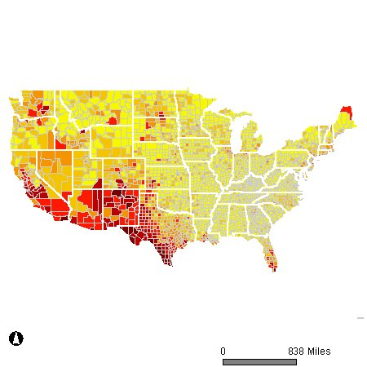

Percentage of persons speaking a language other than English, by county: 2000
MLA Language Map
All languages other than English combined
Density of foreign-language speakers highest in the Southwest, especially along Rio Grande in Texas. Note pockets of foreign-language speaking in mountain states, great plains, south Florida

Slide 19
Linguistic Isolation
Households where none of the adult members (over age 14) speak English very well.
In 2013, 4.5% of households were linguistically isolated.
22% of children living in immigrant families in 2013 lived in families that were linguistically isolated. They are more likely to be in ELL programs and to suffer educational barriers.

Slide 20
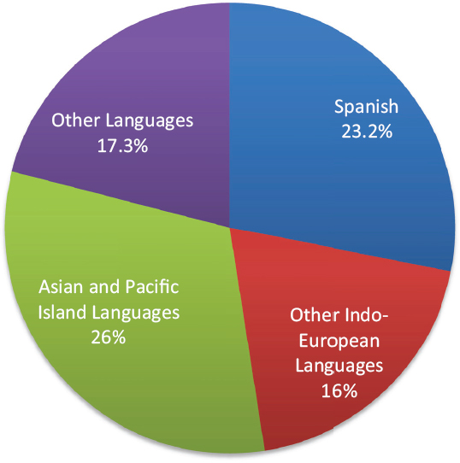
Linguistically Isolated Households by Language Spoken, 2013

Slide 21
Language Acquisition
Children of immigrants (the second generation) and later generations are acquiring English and losing their ancestors’ language at roughly the same rates as past immigrant waves; the transition to speaking solely English usually occurs within three generations.
Spanish is the one language that persists into the third generation, but the great majority of that generation is English dominant if not monolingual.
In Southern California only 4% of Mexican Americans speak Spanish at home, but 17% say they can speak it well.
Notes:
Second and third generations are generally acquiring English and losing their ancestors’ language at roughly the same rates as their historical predecessors, with English monolingualism usually occurring within three generations. Spanish speakers do appear to be acquiring English and losing Spanish at a somewhat slower rate than other immigrant groups.

Slide 22
Disjuncture Between Scholarship and Public Debate
Scholars find that bilingualism is good for cognitive development.
Scholars worry that children lose parental language too quickly.
Universal finding of rapid switch to English.
Why are Americans worried about English?

Slide 23
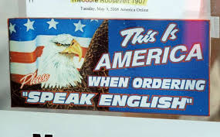

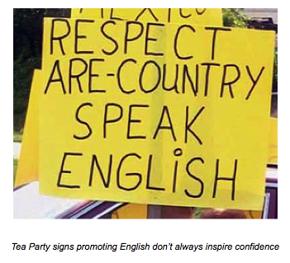
Why do Americans care so much about language assimilation?

Slide 24
Intermarriage
Native-born and immigrant marriages increasing
1 in 7 marriages today interracial/interethnic
More mixed race children
Changing racial & social boundaries

Slide 25
Declines in Well-Being: Health
Health
  Immigrants have better health outcomes, but less access to health care & insurance
  Immigrants are less likely to die from cardiovascular disease and all cancers combined.
  They have better health behaviors, less obesity, depression, alcohol and drug abuse.
  Over time these advantages decline and their health status converges with the native born. A decline also occurs between the first and second generations.
Notes:
Foreign-born have better infant, child, and adult health outcomes than the U.S.-born population in general and better outcomes than U.S.-born members of their ethnic group. In comparison with native-born Americans, the foreign born are less likely to die from cardiovascular disease and all cancers combined; experience fewer chronic health conditions; lower rates of obesity; fewer functional limitations; and fewer learning disabilities. Immigrants also have a lower prevalence of depression and of alcohol abuse.
Even though immigrants generally have better health than native-born Americans, they are disadvantaged when it comes to receiving health care to meet their preventive and medical health needs. The Affordable Care Act (ACA) should improve this situation for many poor immigrants, but the undocumented are specifically excluded from all coverage under the ACA and are not entitled to any non-emergency care in US hospitals.
Increased prevalence of immigrants is associated with lower crime rates—the opposite of what many Americans fear.
Among men age 18-39, the foreign-born are incarcerated at a rate that is one-fourth the rate for the native-born.
Cities and neighborhoods with greater concentrations of immigrants have much lower rates of crime and violence than comparable nonimmigrant neighborhoods. This phenomenon is reflected not only across space but also over time.
There is, however, evidence that crime rates for the second and third generation rise to more closely match the general population of native-born Americans. If this trend is confirmed, it may be an unwelcome aspect of integration.

Slide 26
Life Expectancy at Birth (Average Lifetime in Years) by Race/Ethnicity and Immigrant Status
Data from the US National Vital Statistics System,
1989-2001. (Singh et al., 2013)
Notes:
Immigrants live longer, too. They have a life expectancy of 80.0 years, 3.4 years higher than the native-born population, and across all the major ethnoracial categories, immigrants live longer than their native-born counterparts. Over time and generations these advantages decline and their health status converges with the native born.

Slide 27
Declines in well being: crime
ALL the evidence indicates that immigrants commit LESS crime than the native born (aside from immigration-law infractions).
  Among men aged 18-39, they are incarcerated at a fraction of rate of the native born.
Moreover, neighborhoods with more immigrants have lower crime rates.
However, in the commission of crime, the second and third generations converge with native born.
Notes:
Increased prevalence of immigrants is associated with lower crime rates—the opposite of what many Americans fear.
Among men age 18-39, the foreign-born are incarcerated at a rate that is one-fourth the rate for the native-born.
Cities and neighborhoods with greater concentrations of immigrants have much lower rates of crime and violence than comparable nonimmigrant neighborhoods. This phenomenon is reflected not only across space but also over time.
There is, however, evidence that crime rates for the second and third generation rise to more closely match the general population of native-born Americans. If this trend is confirmed, it may be an unwelcome aspect of integration.

Slide 28
Declines in well being:Families
Children of immigrants are much more likely to grow up with both parents than natives.
Immigrants have lower out of wedlock births and lower divorce rates than natives.
Over time the second generation resembles the native born and the percentage of children growing up with a single parent rises.
Notes:
Immigrants’ divorce rates and out-of-wedlock birth rates start out much lower than native-born Americans, but over time and generations these rates increase, while the likelihood of their living in extended families with multiple generations under one roof declines. Thus immigrant and second generation children are much more likely to live in families with two parents than are third and later generation children, where the proportion of single-parent families converges toward the percentage for native-born children in U.S. families generally. Since single-parent families are more likely to be impoverished, this is a disadvantage going forward.

Slide 29
Areas of Concern
Legal Status
Racial and ethnic disparities
Naturalization Rates
Notes:
The panel identified three particular areas of concern: Legal status, racial and ethnic disparities, and naturalization rates

Slide 30
Legal Status
Notes:
Although the majority of immigrants in the U.S. have green cards or are naturalized, many reside here under less than permanent, and therefore much less stable, statuses. One in 4 immigrants in the U.S., or over 11 million people, are undocumented.
4.5. million US citizen children reside with at least one undocumented parent.
And almost 2 million more immigrants have temporary or discretionary statuses the grant them limited rights and accesses to social benefits and services, and may have no direct pathway to citizenship.
Note: Data is from 2012 and are based on Pew Research Center estimates (Passel and Cohn, 2014).

Slide 31
Legal Status
Key factor in integration trajectory
Many statuses are transitional and temporary
Disproportionately impacts certain immigrant groups
Undocumented status slows but does not fully impede integration
Variation from state-to-state
Multi-generational effects. 5.2 million children have an undocumented parent, (7% of all K-12 children)
4.5 million citizen children have an undocumented immigrant parent
Notes:
The panel found evidence that legal status is a key factor in immigrant’s integration trajectory. Many statuses are designed to be transitional and temporary, but in some cases immigrants remain in these statuses for long periods of time. The effects of legal status also disproportionately impact certain groups: for instance, also undocumented immigrants come from all over the world, 52% of undocumented immigrants are Mexican, while hundreds of thousands of Central Americans are in temporary protected status, which has to be renewed in one or two year increments and has no direct pathway to citizenship. And in general immigrants from Latin America are very rarely granted refugee or asylee status, which has a direct pathway to a green card.
The panel also found that while temporary or undocumented status can slow integration, it does not fully impede it. Many undocumented immigrants have lived in the U.S. for decades and have been integrating as their length of residence increases and they raise families here. The shift in recent years to a more intense regime of enforcement has not prevented the undocumented from working, but it has coincided with a reduction in their wages. And undocumented students are less likely than other immigrants to graduate from high school and enroll in college, undermining their long-term earnings capacity.
Second, the immigration impasse has led to a plethora of laws targeting the undocumented at local, state and federal levels that often contradict each other, creating variation in integration policies across the country. Some states and localities provide in-state college tuition and drivers licenses, for undocumented immigrants and some are declaring themselves to be sanctuary cities. In other localities there are restrictive laws, such as prohibitions on renting housing to undocumented immigrants, or local enforcement of federal immigration laws.
Importantly, the current system includes restrictions on the receipt of public benefits that have created barriers to the successful integration of the citizen children of the undocumented, even though, as citizens, it is in the country’s best interest that they integrate successfully. Policies designed to block the integration of temporary or undocumented immigrants can have the unintended effect of hindering the integration of U.S. citizens and lawful permanent residents in mixed status families. Laws may be designed to apply to individuals, but take effect through households, families, and communities, with measurable long-term negative impacts on children who are citizens.

Slide 32
Racial & Ethnic Disparities
Immigrant integration shaped by race & ethnicity
Black immigrants & their children integrating more slowly with non-Hispanic whites despite higher human capital
Some evidence of discrimination impeding Latino integration
  Racial discrimination or Undocumented status?
Notes:
The panel found that patterns of immigrant integration are shaped by race.
While there is evidence of integration and improvement in socioeconomic outcomes for blacks, Latinos and Asians, their race still matters, even after controlling for all their other characteristics.
Black immigrants and their offspring are integrating with non-Hispanic whites at the slowest rate, Asians are integrated with non-Hispanic whites the fastest, and Latinos are in between.
The panel found some evidence of racial discrimination against Latinos, and some evidence that their overall trajectories of integration are shaped more by the large numbers of undocumented in their group than by a process of racialization. At this time, it is not possible with the data we have to definitively state whether Latinos are experiencing a pattern of racial exclusion, or a pattern of steady progress that could lead to a declining significance of group boundaries.
Progress in reducing racial discrimination and disparities in socioeconomic outcomes in the United States will improve the outcomes of natives and immigrants alike.

Slide 33
Economic Assimilation
Questions:
  Do immigrants take jobs from Americans?
  Do immigrants lower wages for Americans?
  What are the fiscal costs of immigrants?
Findings from the Economic Report:
  Answering these questions is complicated. Important to remember the economy is not a fixed pie.

Slide 34
Economic Impacts of Immigration
https://www.nap.edu/catalog/23550/the-economic-and-fiscal-consequences-of-immigration
The economy is not a fixed size, so that the addition of immigrants does not necessarily reduce the situation of natives.
Immigrants are not just workers, they are consumers and tax payers.
First principles of economics would assume a net gain from immigration.

Slide 35
Workforce Growth
The portion of the labor force that is foreign born has risen from about 11 percent to over 16% in the past 20 years. Immigrants and their children will account for the vast majority of current and future net workforce growth.

Slide 36
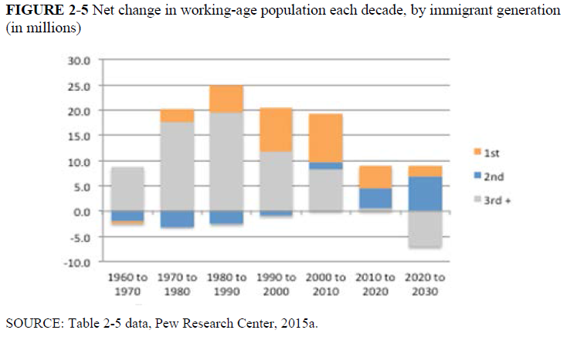

Slide 37
Impacts on Wages
The impact of immigrants on wages of native born is very small.
The negative effects are concentrated among prior immigrants who are the closest substitutes for new immigrants.
Little evidence of immigration effects on employment levels of native workers.
Some reduction of hours among teenagers, but not overall employment.

Slide 38
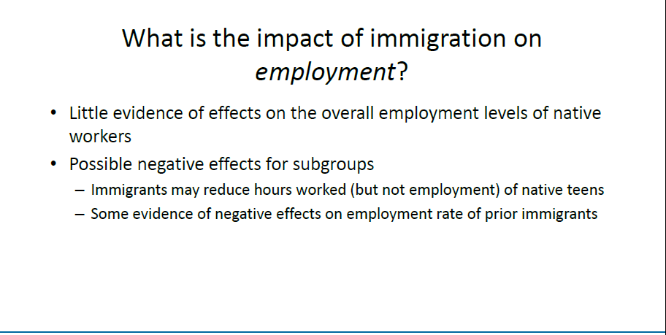

Slide 39
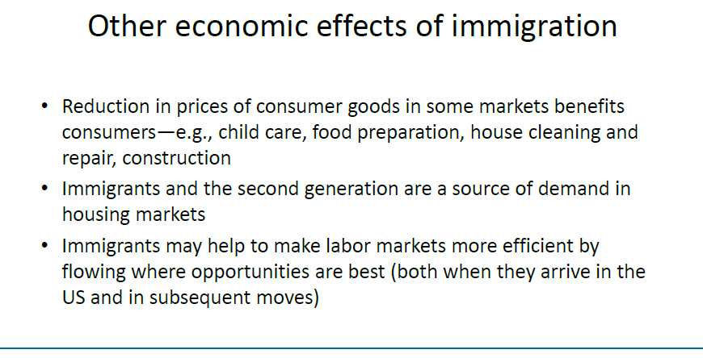

Slide 40
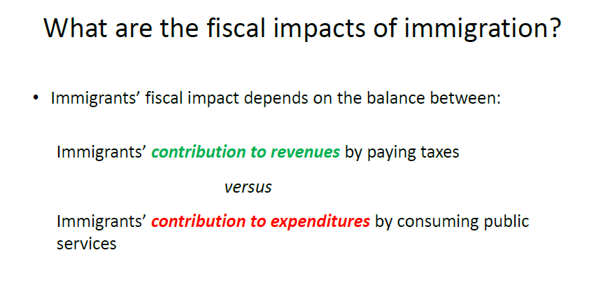

Slide 41
Different Fiscal Impacts
Age Structure of Immigrants (Education and Social Security).
Undocumented not eligible for benefits.
Refugees eligible for many benefits.
Emergency health care is a big issue.
Short run fiscal impacts are a large problem for small areas.
National vs. state and local impacts

Slide 42
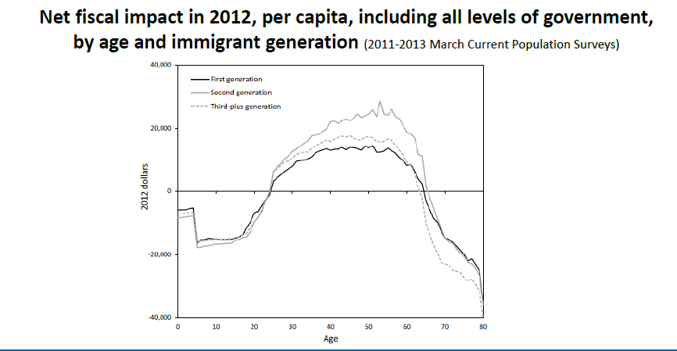

Slide 43
Fiscal Impacts
On average individuals in the first generation are more costly to governments, mainly at the state and local levels, than are the native-born generations.
The second generation are among the strongest economic an fiscal contributors in the population.

Slide 44
Fiscal Impacts
Assumptions affect estimates of fiscal impacts.
The second generation costs a lot—but they are native born. And the cost is actually an investment—most of the cost is education.
Average or marginal accounting for federal expenditures. Costs like defense and national parks do not increase with each additional person, social security costs do.

Slide 45
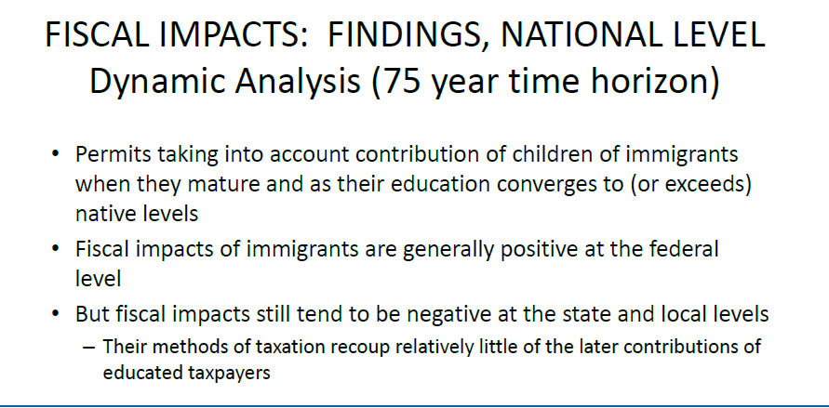

Slide 46
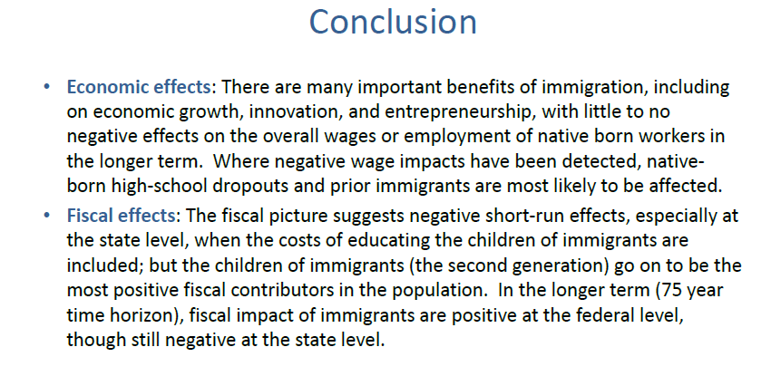

Slide 47
U.S. Citizenship Rules
5 year residence
Oral and written English ability
Knowledge of US history and government
Good moral character
Oath of allegiance
No dual citizenship (ambiguous)
  Give up foreign allegiance
New citizenship test
  https://www.uscis.gov/citizenship-resource-center/the-2020-version-of-the-civics-test/128-civics-questions-and-answers-2020-version

Slide 48
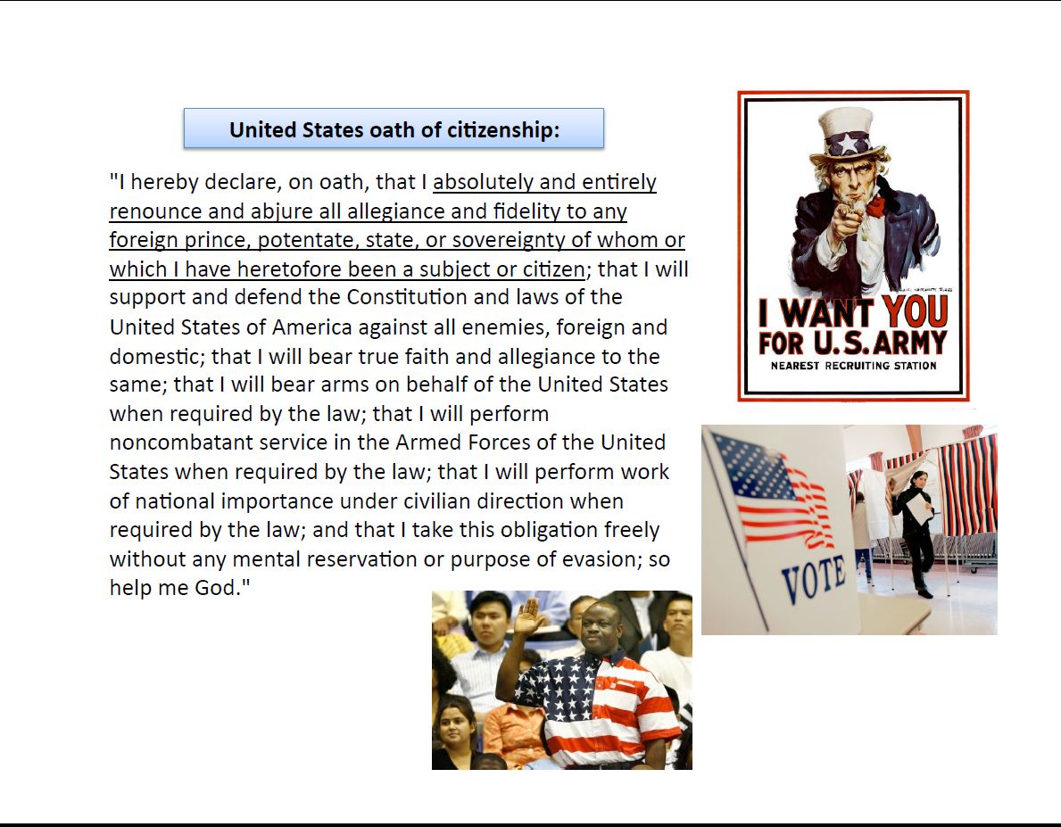

Slide 49
Ascriptive Citizenship
From 1790-1952
  Access to citizenship was racialized and unequal.
  Racial, gender hierarchies

Slide 50
States had generous laws towards immigrants
1846, Wisconsin allowed all immigrants who had the intention to naturalize and who had lived in state for one year to vote.
1850 Michigan granted vote to immigrants who had been living there 2 and a half years.

Slide 51
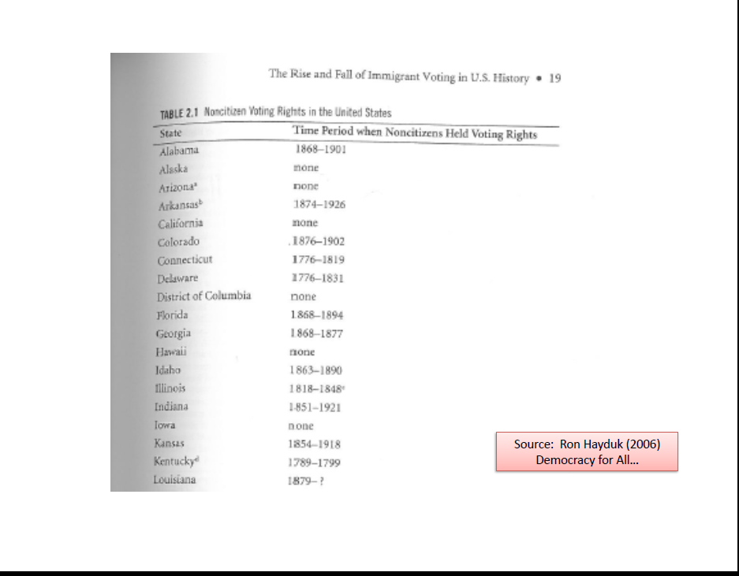

Slide 52
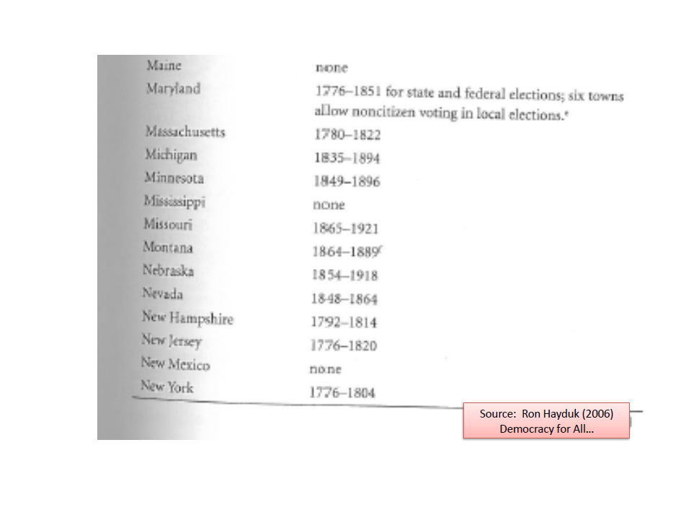

Slide 53
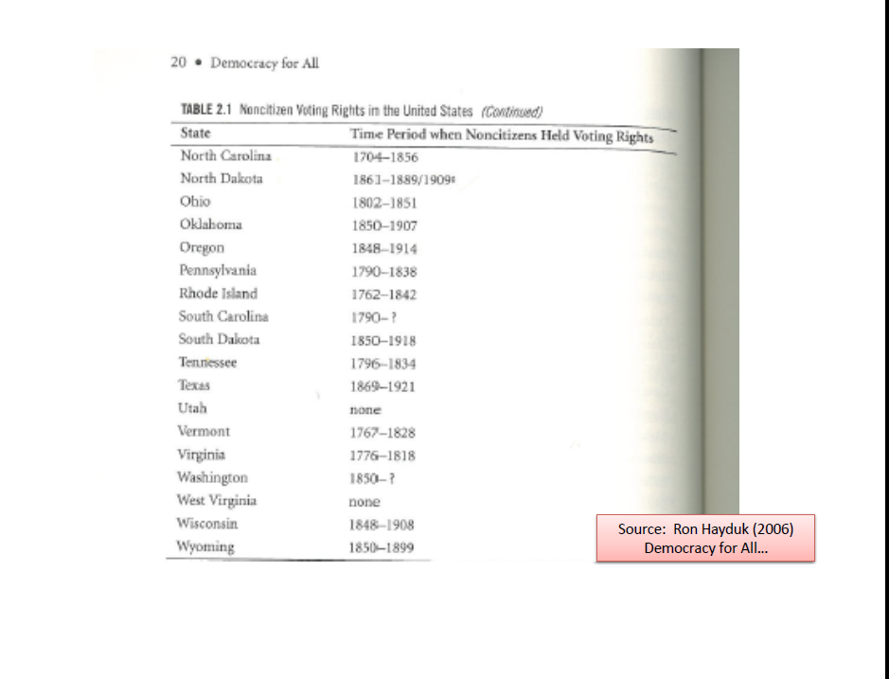

Slide 54
1857 Dred Scott Case
Dred Scott sued for his freedom on the grounds that residing in Illinois (a free state) meant that he could not be owned by someone in Missouri.
Supreme Court ruled that because he was not a citizen of Missouri he could not bring suit in federal court, and that freed blacks could never be citizens. The relevant statutes only conferred citizenship on “free whites”

Slide 55
14th Amendment 1868
“all persons born or naturalized in the US are citizens of the US and the state in which they reside” : Birthright citizenship
1870 Congress debated a law that would allow any “person” to naturalize.
But they passed a law making anyone of African descent or nativity eligible for naturalization.

Slide 56
Neither Black nor White?
1882 Chinese Exclusion Act excludes Chinese from Citizenship
1898 US vs. Wong Kim Ark
  Child born in San Francisco. US tried to deport him along with his parents. Court ruled that he was a citizen. Affirming Birth Right Citizenship

Slide 57
Race and Citizenship
1897 Mexicans. Were considered neither white or black. Court decided they could naturalize based on the promises of the Treaty of Guadalupe Hidalgo.
1910 Census counted Syrians, Armenians, Palestinians, Turks, and Persians as “Asiatics” which would mean they were ineligible for citizenship. Won a court ruling that they were “white”. Still governs census today.

Slide 58
Race and Citizenship
1911 Thai, Indians and Koreans ruled ineligible for citizenship.
1922 Japanese ineligible for citizenship

Slide 59
Native Americans
Dawes Act of 1887 gave citizenship to Indians who left the tribe for civil society.
1924: Congress gave citizenship to all Indians born within the US government.

Slide 60
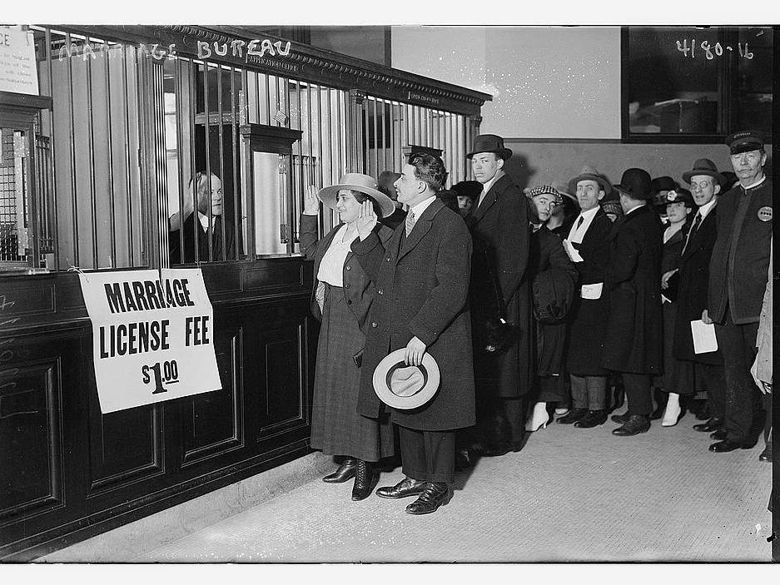
Gender and Citizenship:
1907 Expatriation Act
Women who married non citizens lost their citizenship.
When World War 1 started many women who had been born in the US had to register as enemy aliens because they were married to German men.

Slide 61
Cable Act of 1922
Allowed a woman who married an alien to keep her citizenship.
However women who had married non-citizens between 1907 and 1922 still had to apply for citizenship.
MAJOR EXCEPTION: female American citizens who married aliens ineligible for citizenship (Asians) would still be stripped of citizenship

Slide 63
Race and Citizenship
1943 ban on citizenship for Chinese lifted.
1946 ban on citizenship for Filipinos and East Indians lifted.
1952 McCarran Walter Act
  The right of a person to become a naturalized citizen of the US shall not be denied or abridged because of race or sex or because such person is married.

Slide 64
Naturalization & Citizenship
Citizenship rate in US 50% vs. 61% OECD
Adjusting for undocumented population, US still well below Canada, Australia, Sweden
Most immigrants want to naturalize
Birthright citizenship is a powerful mechanism of integration
Major barrier to political integration
Notes:
The overall level of citizenship among working-age immigrants (15-64 years old) who have been living in the United States for at least 10 years is 50 percent. After adjustments to account for the undocumented population in the United States, a group that is barred from citizenship, the naturalization rate among U.S. immigrants rises slightly but is still well below many European countries and far lower that of other traditional receiving countries such as Australia (81%) and Canada (89%).
This is surprising since the vast majority of immigrants, when surveyed, report wanting to become a U.S. citizen. So the lower levels of naturalization in the United States appear to stem not from immigrants’ lack of interest or even primarily from the bureaucratic process of applying for citizenship but somewhere in the process by which individuals translate their motivation to naturalize into action.
Further research is needed to clearly identify this barrier. Low naturalization rates have important implications for political integration because the greatest barriers to immigrants’ political participation, especially participation in elections, are gaining citizenship and voter registration.

Slide 65
Figure 4-2: Naturalization Levels among Foreign-born residents of the US, 1920-2013 (percentage naturalized)
Notes:
However, as this chart shows, the percentage of the foreign-born who naturalize has fallen considerably since 1970. The large number of undocumented who have no pathway to LPR status and naturalization are part of the story, but even after adjusting for the large number of undocumented, naturalization rates in the US are very low compared to other developed countries with large immigrant populations, like Canada and Australia.

Slide 66
Political Representation of Immigrants
Counted for apportionment (even noncitizens)
Representation through election to office
Representation through the legislative process (even noncitizens)

Slide 67
Census and Apportionment
Supreme Court hears Trump administration bid to not count undocumented people for apportionment starting this morning.
Three lower courts have ruled unanimously that the president’s action violates the constitution, the federal census statute or both.
We have always counted all people—except Indians not taxed and slaves as 3/5 of a person. Even during period of Chinese exclusion and denial of citizenship.

Slide 70
What do Americans think of when they think about immigration?

