Slide 1
Lecture 5a
Emission and Climate Scenarios:
Past, Present and Future
2021-02-15
Mitigation :
Changes in energy use to reduce climate warming
Adaptation:
Changes in society to adapt to climate change

Slide 2
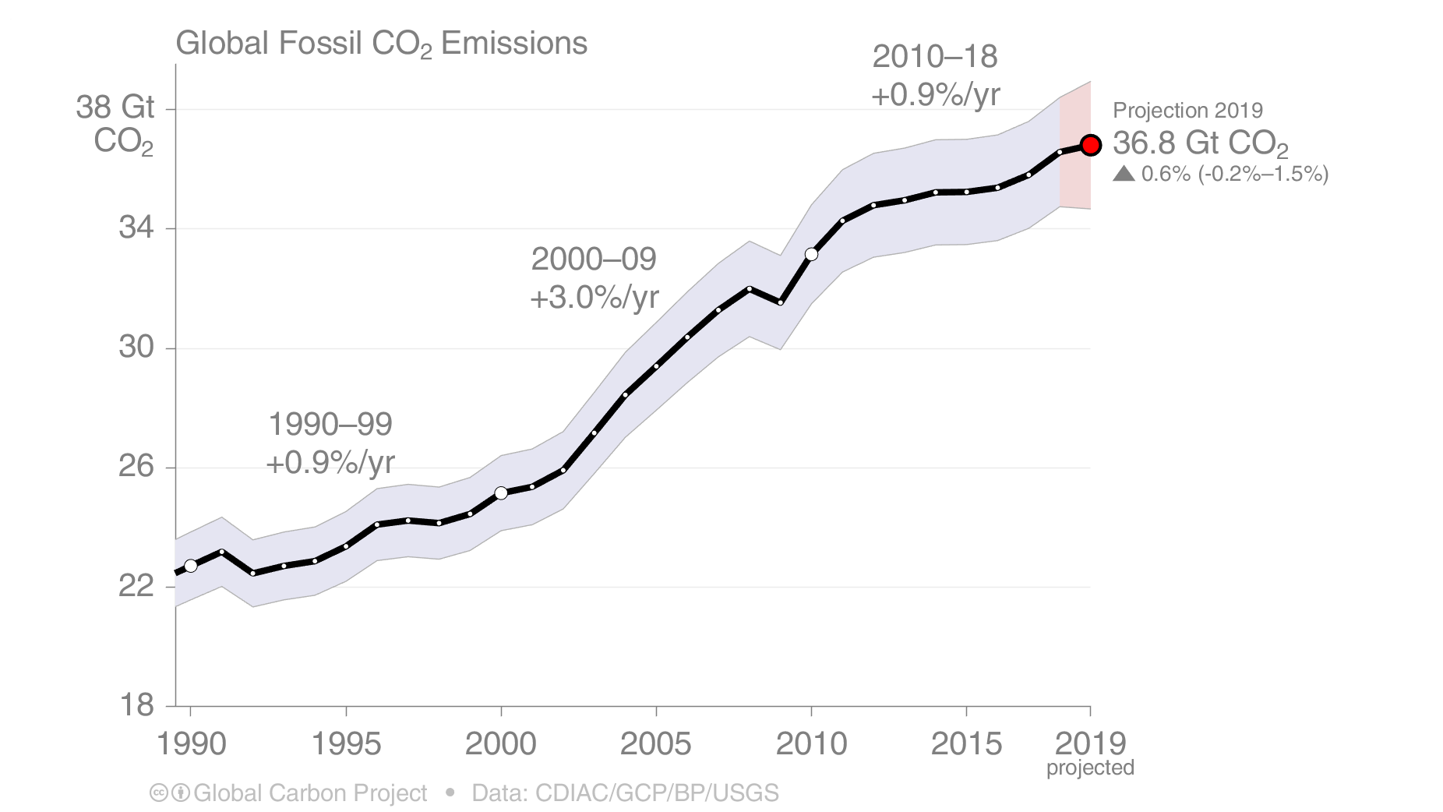
Global Fossil CO₂ Emissions
Global fossil CO₂ emissions: 36.6 ± 2 GtCO₂ in 2018, 61% over 1990
Projection for 2019: 36.8 ± 2 GtCO₂, 0.6% higher than 2018 (range -0.2% to 1.5%)
Fossil CO₂ emissions will likely be more than 4% higher in 2019 than 2015 (year of Paris Agreement)
10.0 GtC/yr
= 1992a scenario
Uncertainty is ±5% for one standard deviation (IPCC “likely” range)
The 2019 projection is based on preliminary data and modelling.
Source: CDIAC; Friedlingstein et al 2019; Global Carbon Budget 2019

Slide 3
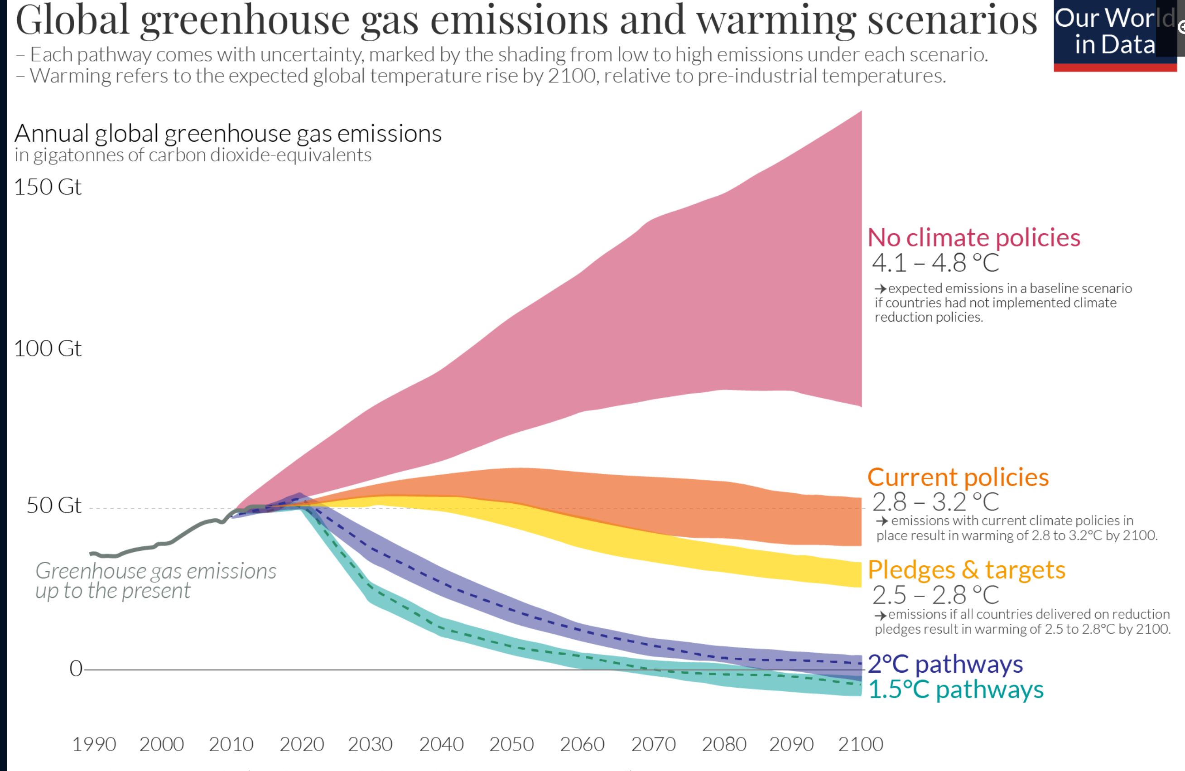
9.5 as C
8.2
6.8
5.5
4.1
2.7
1.4
(all gases)
(41 as GtC)
https://ourworldindata.org/co2-and-other-greenhouse-gas-emissions

Slide 4
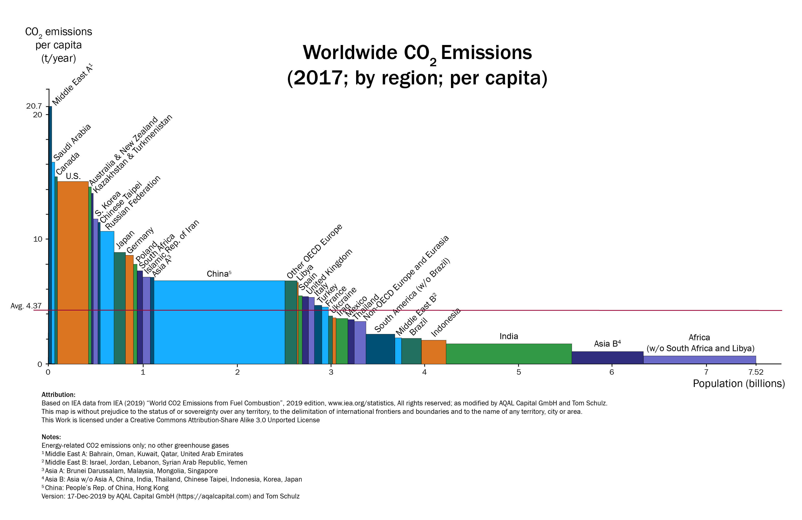
CO₂ emissions per capita t/C/yr/person
5.4
2.7
0.0
Average 1.2
0 1 2 3 4 5 6 7 7.52
Population (x 10⁹)
By Agreende - Own work, CC BY-SA 3.0, https://commons.wikimedia.org/w/index.php?curid=86182006

Slide 5
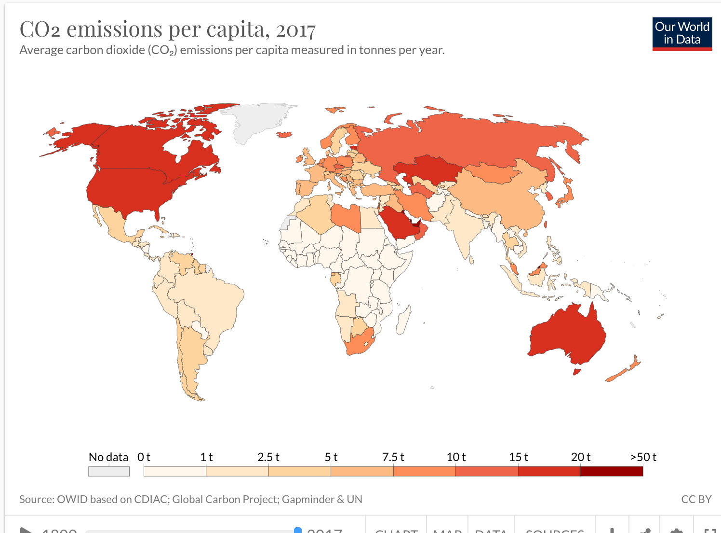
https://ourworldindata.org/co2-and-other-greenhouse-gas-emissions

Slide 6
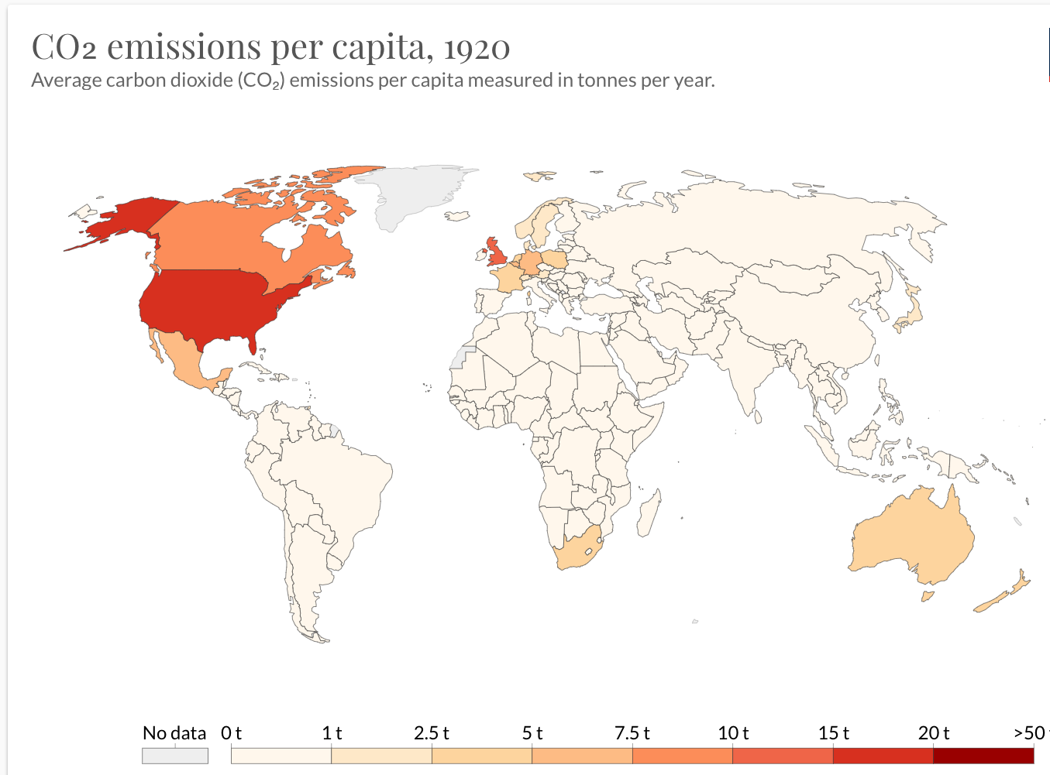
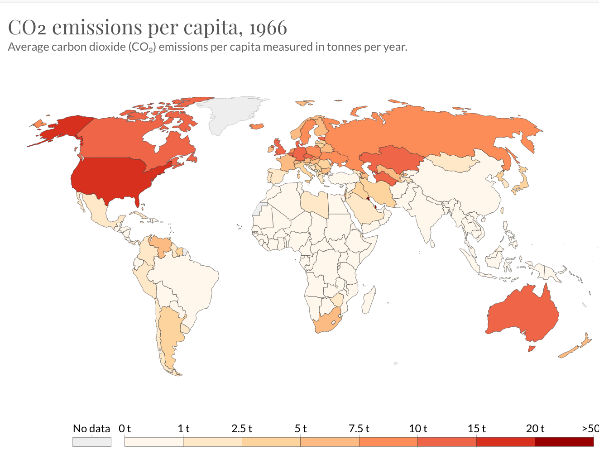

Slide 7
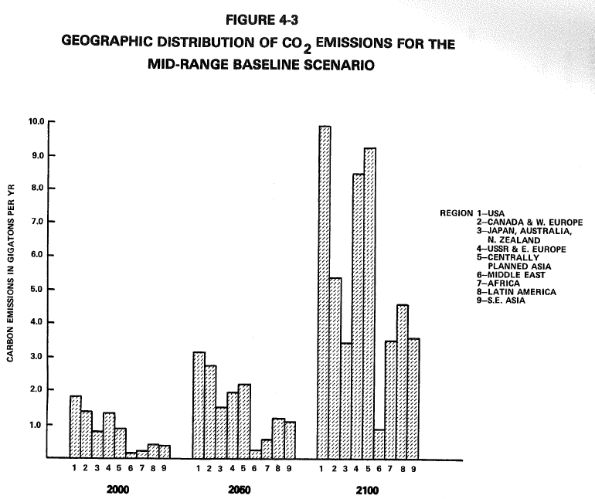

Forecasted CO₂ emissions in Hoffman (1983)
10.0 actual 2020
actual: 6.8
15 predicted
7.5 total
(predicted)
1983 estimates
EPA

Slide 8
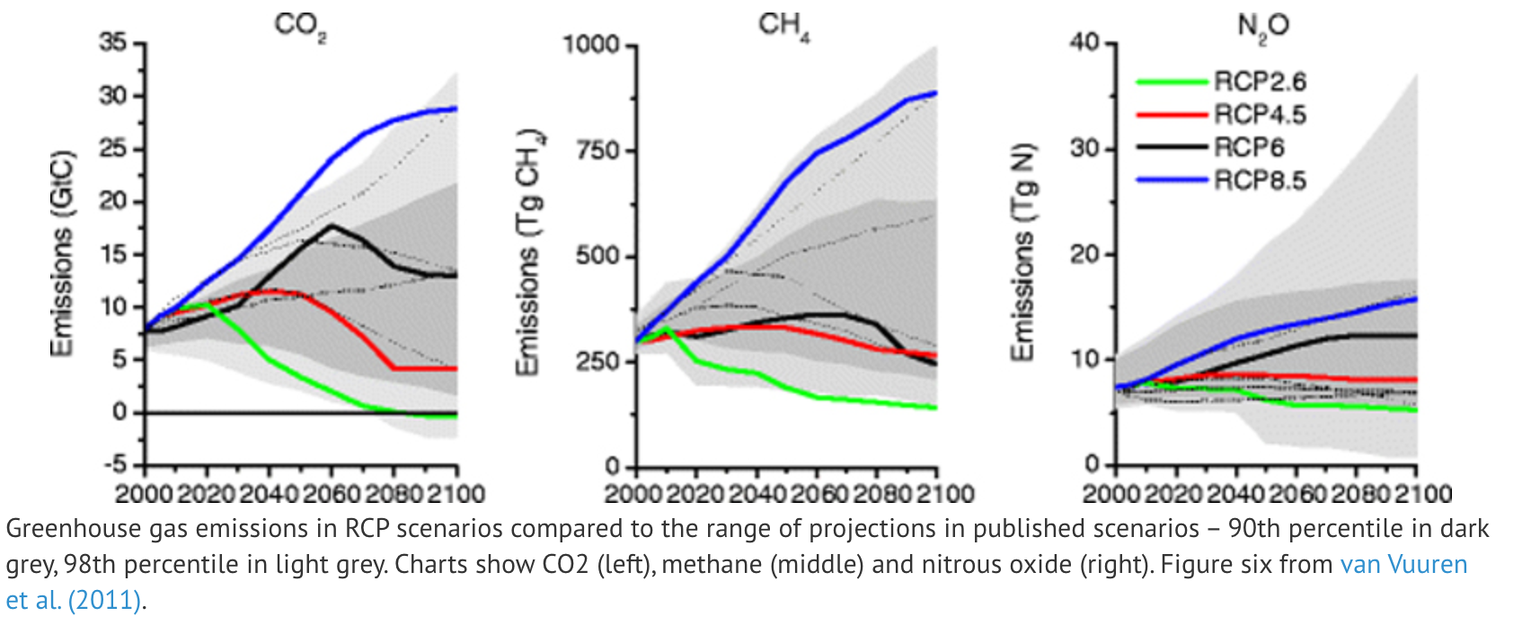
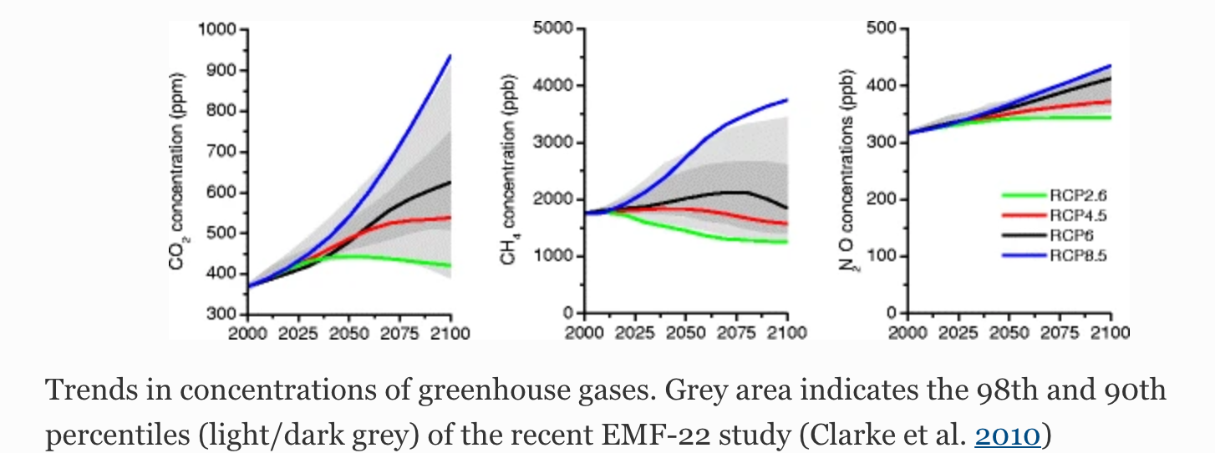
IPCC “RCP” (radiative forcing) Emissions and Concentration Scenarios
W/m²
→
→
preindustrial→

Slide 9
8.5
2.6

Slide 10
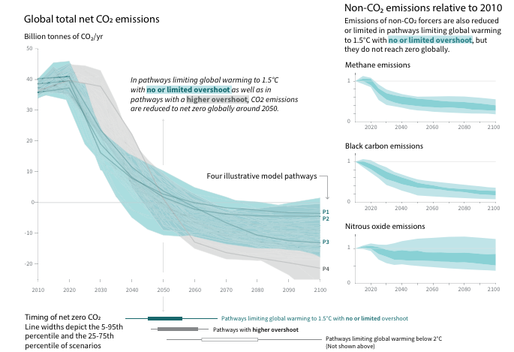
IPCC, 2018: Global Warming of 1.5°C. An IPCC Special Report
Global emissions were 2 billion tonnes of CO₂ in 1900, and over 36 billion 115 years later.
Notes:
Thrust of report: can’t do it, and if you try ou will harm the poorest people on earth. [check that!] IPCC, 2018: Global Warming of 1.5°C. An IPCC Special Report on the impacts of global warming of 1.5°C above pre-industrial levels and related global greenhouse gas emission pathways, in the context of strengthening the global response to the threat of climate change, sustainable development, and efforts to eradicate poverty

Slide 11
Past & future changes in oceans
and cryosphere RCP 2.6 and 8.5
Identify delays & feedbacks; estimate delay timescales
8.5
2.6
Notes:
"Representative Concentration Pathways (RCPs) are not new, fully integrated scenarios (i.e., they are not a complete package of socioeconomic, emissions and climate projections). They are consistent sets of projections of only the components of radiative forcing that are meant to serve as input for climate modeling, pattern scaling and atmospheric chemistry modeling," according to the RCP Database. 2.6 – peaks at 3.1 then falls to 2.6 Wm2 long term.
5 minute discussion and then class presentations (if time)

Slide 12
Projections based on Shared Socioeconomic Pathways (SSPs) were (belatedly) updated in 2019 by IIASA
SSP1 is the ‘Sustainability’ pathway, which presents relatively low challenges to climate mitigation and adaptation, and a commitment towards inclusive growth and human well-being, such that inequality both across and within countries is expected to decline. We would therefore expect this scenario to have lowest levels of Ginis from among the SSPs. Given that income inequality has increased in most countries in the last few decades, a world heading towards SSP1 would reverse historical trends in the vast majority of countries.
SSP3 …the other extreme, in which societies face high challenges for both climate mitigation and adaptation … [with] material-intensive development and high poverty, due to limited attention to broad-based human and technological development. Income inequality is expected to increase, particularly between countries, due to regionalism, conflict, and weak global institutions.…A large share of [poverty] lies in emerging economies.
SSP5, [“fossil fuel pathway”] climate adaptation challenges are low, due to high, equitable, technology- and capital-intensive growth, but powered by fossil fuels, thereby leading to high global GHG emissions. Global markets and institutions are increasingly integrated, leading to technology transfer, and economic surpluses are invested in human and social capital, and presumably the management of environmental systems to stem their degradation. This scenario would seem to achieve many dimensions of sustainability, as with SSP1. As such, one would expect [require] a number of transformative shifts towards redistributive policies compared to today, and therefore similar trends in income inequality between SSP1 and SSP5.
N. D. Rao et al., Futures vol 105, p 27-39 (2019)
[“Conflict Pathway”]

Slide 13
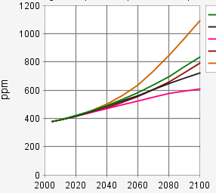
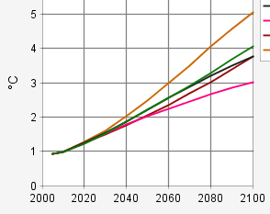
CO₂ Emission Scenarios (SSP)
SSP: Shared Socioeconomic Pathways
IIASA
Concentration of CO₂
Global Mean ΔT
ΔT ºC
Notes:
whence after 2100 ??

Slide 14
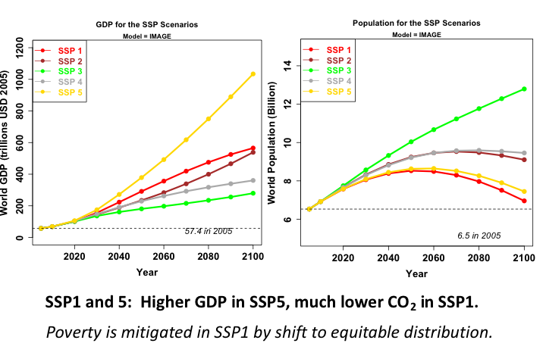

Slide 15
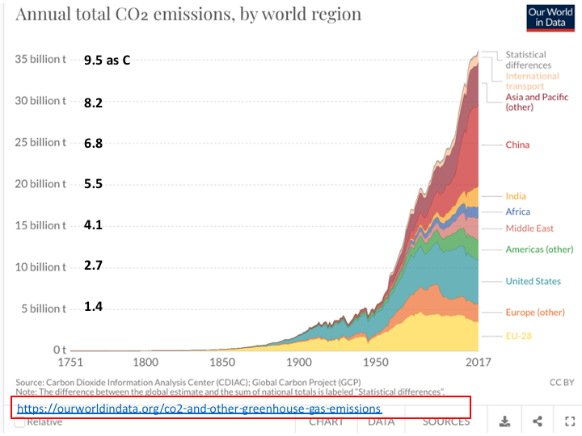
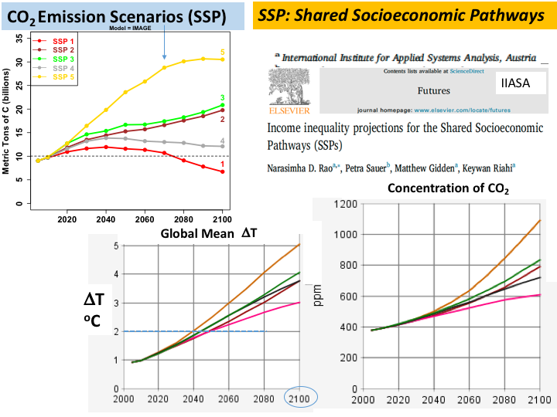
Past
Future ?
Scenarios
Roll Up

Slide 16
End of lecture 5a
2021-02-16

