Slide 1
Atmospheric Aerosols and Health Effects
ES-06: Introduction to Environmental Science and Engineering
February 18, 2021
Notes:
missing – aerosol climate effects

Slide 2
Outline
Health impacts of air pollution
Source attribution and lifetimes of aerosols in the atmosphere
Trends in control/exposures

Slide 3
What is "PM2.5"
(…PM 10, PM1, ….)
PM2.5 means particulate matter with an aerodynamic diameter less than or equal to a nominal 2.5 micrometers (μm) as measured by an EPA reference or equivalent method†.
PM2.5 particles are known to produce respiratory and cardiovascular illness, as well as systemic inflammation. They are small enough to invade even the smallest airways. These particles generally come from activities that burn fossil fuels, such as traffic, smelting, and metal processing.
Particulate air pollution can cause inflammatory responses in the body's respiratory tract and in the blood vessels, and nerve channels.
† based on 40 CFR Part 50 Appendix L and designated in accordance with 40 CFR Part 53 or by an equivalent method designated in accordance with 40 CFR Part 53.

Slide 4
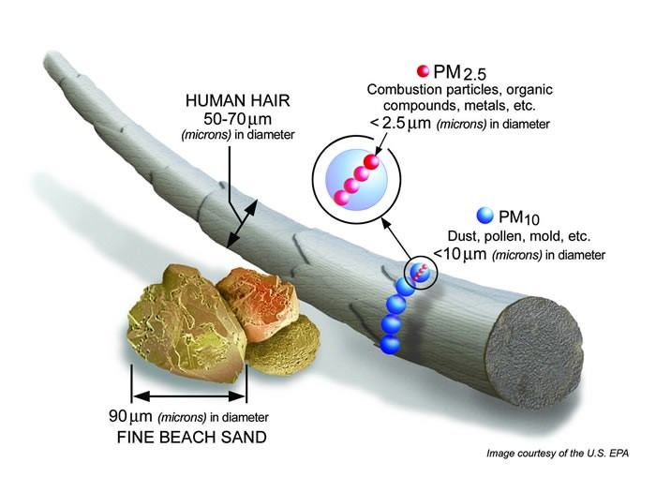
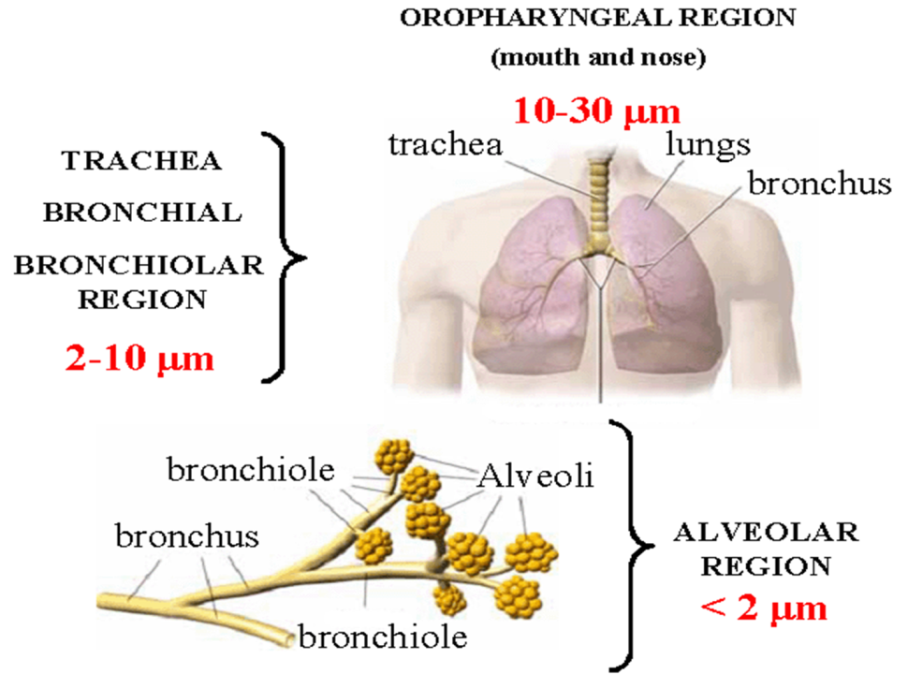
Health Impacts of Particulate Matter
Goudie and Middleton, 2006
…and moves throughout the body.
Notes:
air pollution is operationally defined – impact is really a function of chemical composition and surface properties; gets into the deepest parts of the lung … and does not stay there !!

Slide 5
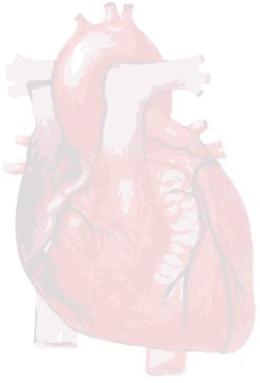
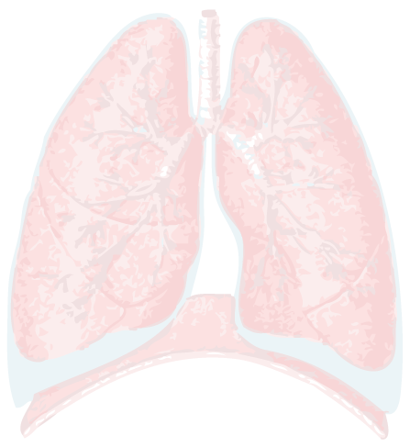
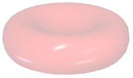
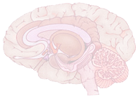
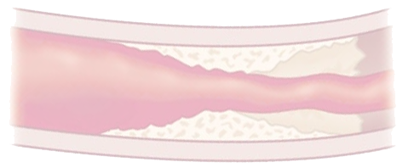
PM Inhalation
Lungs
Inflammation
Oxidative stress
Accelerated progression
and exacerbation of COPD
Increased respiratory symptoms
Effected pulmonary reflexes
Reduced lung function
Blood
Altered rheology
Increased coagulability
Translocated particles
Peripheral thrombosis
Reduced oxygen saturation
Heart
Altered cardiac
autonomic function
Increased dysrhythmic susceptibility
Altered cardiac repolarization
Increased myocardial
ischemia
Systemic Inflammation
Oxidative Stress
Increased CRP
Proinflammatory mediators
Leukocyte & platelet activation
Vasculature
Atherosclerosis,
accelerated progression of and destabilization of plaques
Endothelial dysfunction
Vasoconstriction and Hypertension
Brain
Increased cerebrovascular ischemia
There are multiple mechanistic pathways that have complex interactions and interdependencies.
Particles travel in the body!

Slide 6
Very small particles (ultrafine, nuclei) efficiently enter into cells across the cell membrane by endocytosis mechanisms
Notes:
Cellular Uptake of Nanoparticles: Journey Inside the Cell
Shahed Behzadi, Vahid Serpooshan, Wei Tao, Majd A. Hamaly, Mahmoud Y. Alkawareek, Erik C. Dreaden, Dennis Brown, Alaaldin M. Alkilany, Omid C. Farokhzad, Morteza Mahmoudi
Chem Soc Rev. Author manuscript; available in PMC 2018 Jul 17.

Slide 7
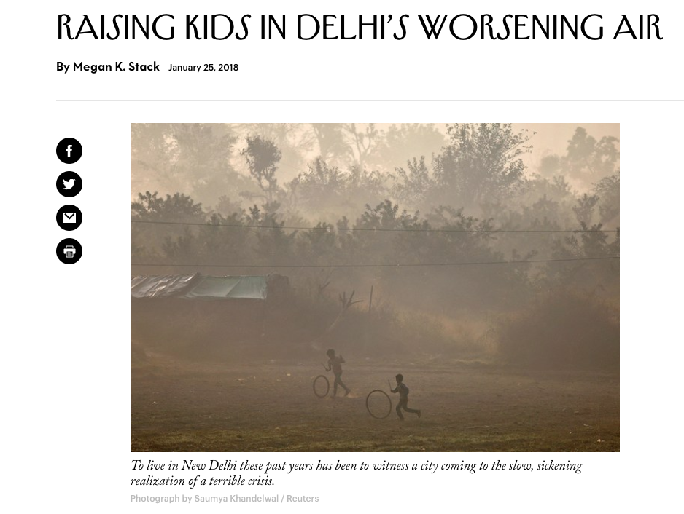
In the news…
The world’s most polluted megacity:
PM_{2.5} = >150 μg m⁻³
US Standard: 15 μg m⁻³
“Unhealthy”: 100 μg m⁻³
Health effects observed: 8 μg⁻³
https://www.newyorker.com/culture/personal-history/raising-kids-in-delhis-worsening-air
How do we know that health effects occur: people in cities… (or rats or rabbits in a chamber );
follow people for 3 decades.
Notes:
How do we know that health effects occur: people (or rats) in a chamber; follow for 3 decades

Slide 8
Wildfires may increase in the 2050s atmosphere, leading to large enhancements in smoke particles.
Many populous counties experience 40-150% increases in smoke concentrations in summer.
Much of California sees a doubling of “smoke waves” – episodes of enhanced smoke at the 98th% level.
Harvard researchers are investigating the health consequences of greater smoke.
Percent increase in smoke PM_{2.5} by midcentury relative to 2000s, by county.
connect to climate issue:
soil moisture,
T extremes,
precipitation,
snow melt
Some large cities affected by fires
Liu et al., 2016
Notes:
connect to climate unit: soil moisture, connection to climate

Slide 9
Air Pollution: Spans wide spatial and temporal scales
Global
Global Climate
Ozone Depletion
Urban Pollution
Indoor Air
Acid Rain
Local
<100 km
Regional
100-1000 km
Spatial
Notes:
Why are these scale-dependent interactions important ?? global climate effects are later

Slide 10
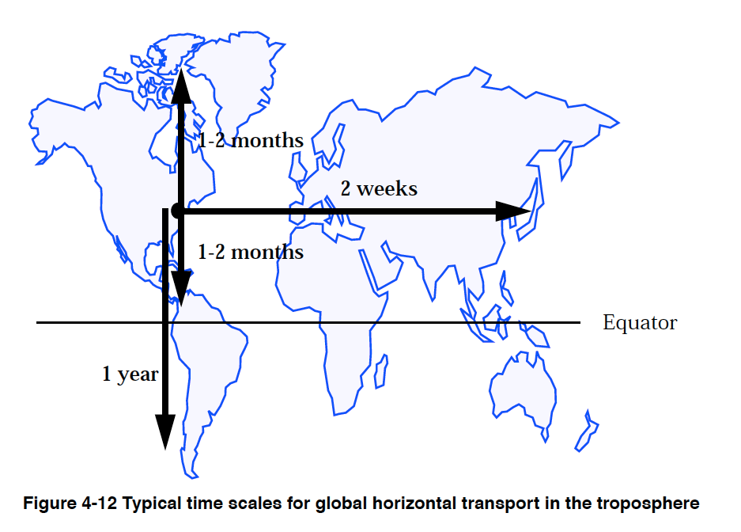
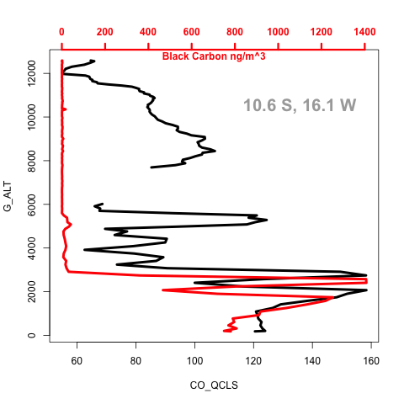
Black Carbon ng/m³
CO Concentration (ppb)
●
Notes:
Add Harvard Forest and MLO temporal

Slide 11
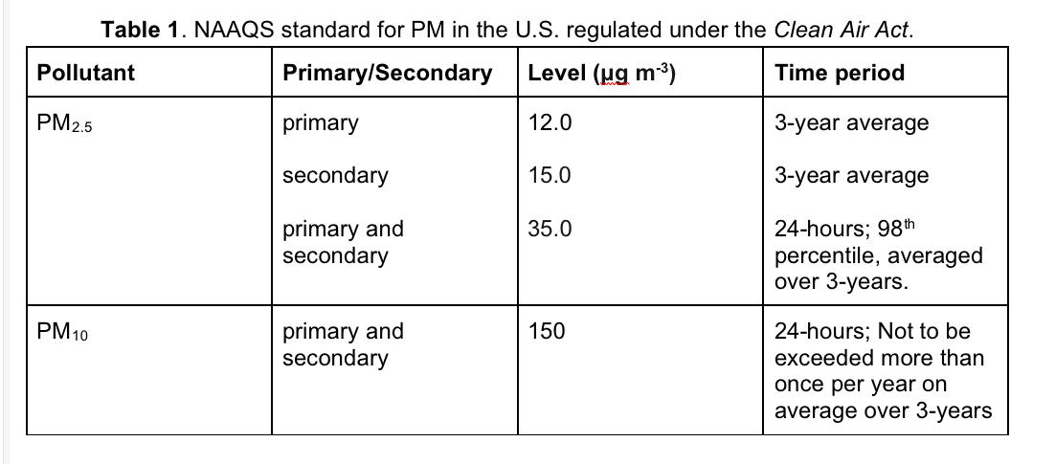
Where is PM₁ ? Why isn't PM1 a Criteria Pollutant?
Notes:
Why is PM-1 missing – students.

Slide 12
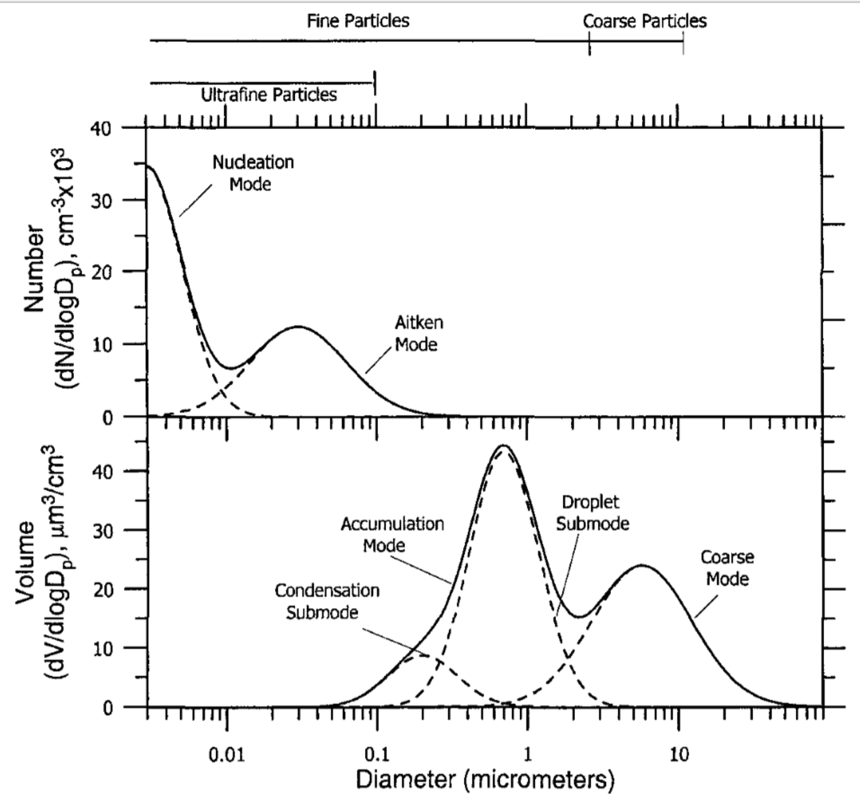
Particle Size
Distributions in the
Environment:
Different for
number, surface area
and volume (mass)
10 100 nm

Slide 13
Pyramid of Effects of Air Pollution
O₃ and PM_{2.5} make up majority of air pollution health burdens
Death
Doctor Visits,
School Absences,
Lost Work Days
Respiratory Symptoms,
Medication Use,
Asthma Attacks
ER Visits,
Hospital Admissions,
Heart Attacks
Lung Function Decrements,
Inflammation, Cardiac Effects
Thousands
Annually in US:
Tens of Thousands
Hundreds of Thousands
Severity of Effect
Estimated cost:
Hundreds of billions
Millions
Magnitude of Impacts
13
Adapted from US EPA

Slide 14
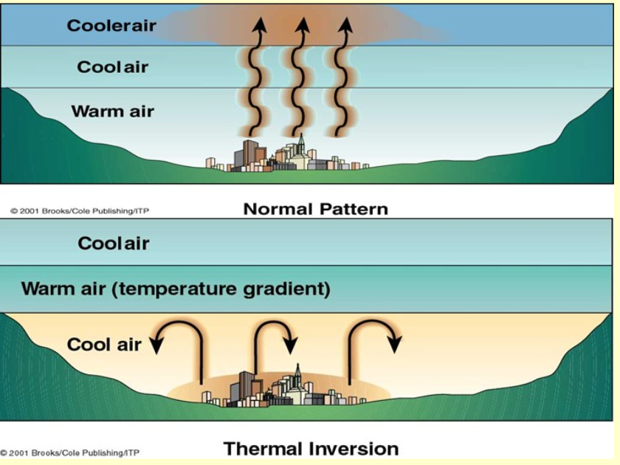
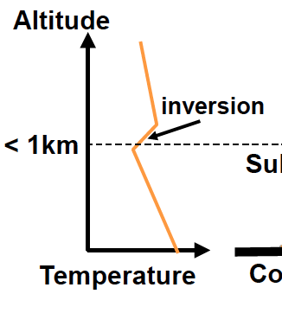
Weather conditions strongly affect pollution levels where people live.

Slide 15
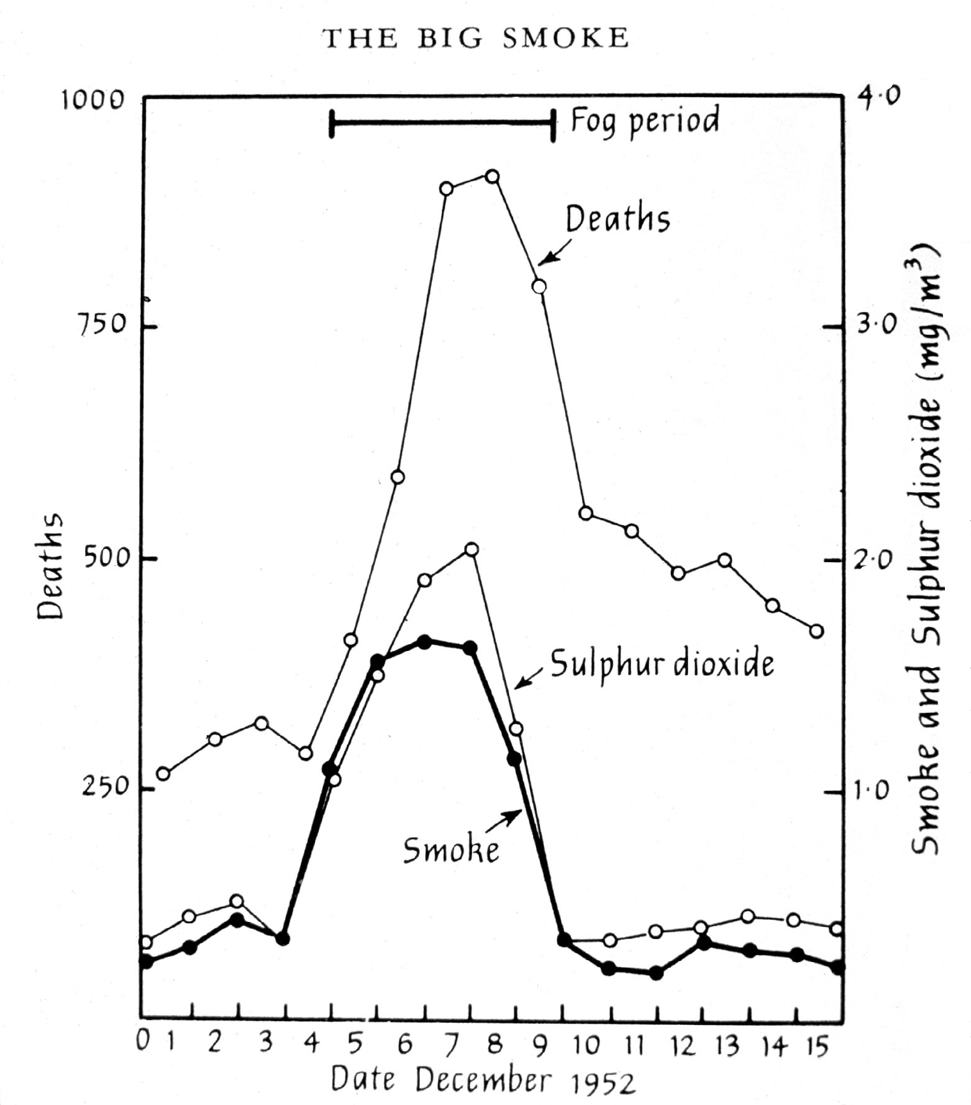
Key Features of London Fog Event (1952)
SO₂
NO_{x}
US NAAQS:
PM_{2.5} = 0.012 mg m⁻³
PM₁₀ = 0.150 mg m⁻³
An inactive person inhales about 10 m³/day
US NAAQS PM standards

Slide 16
Five minute discussion topic
2020-03-03
Estimate the number of people who died as a result of the pollution event

Slide 17
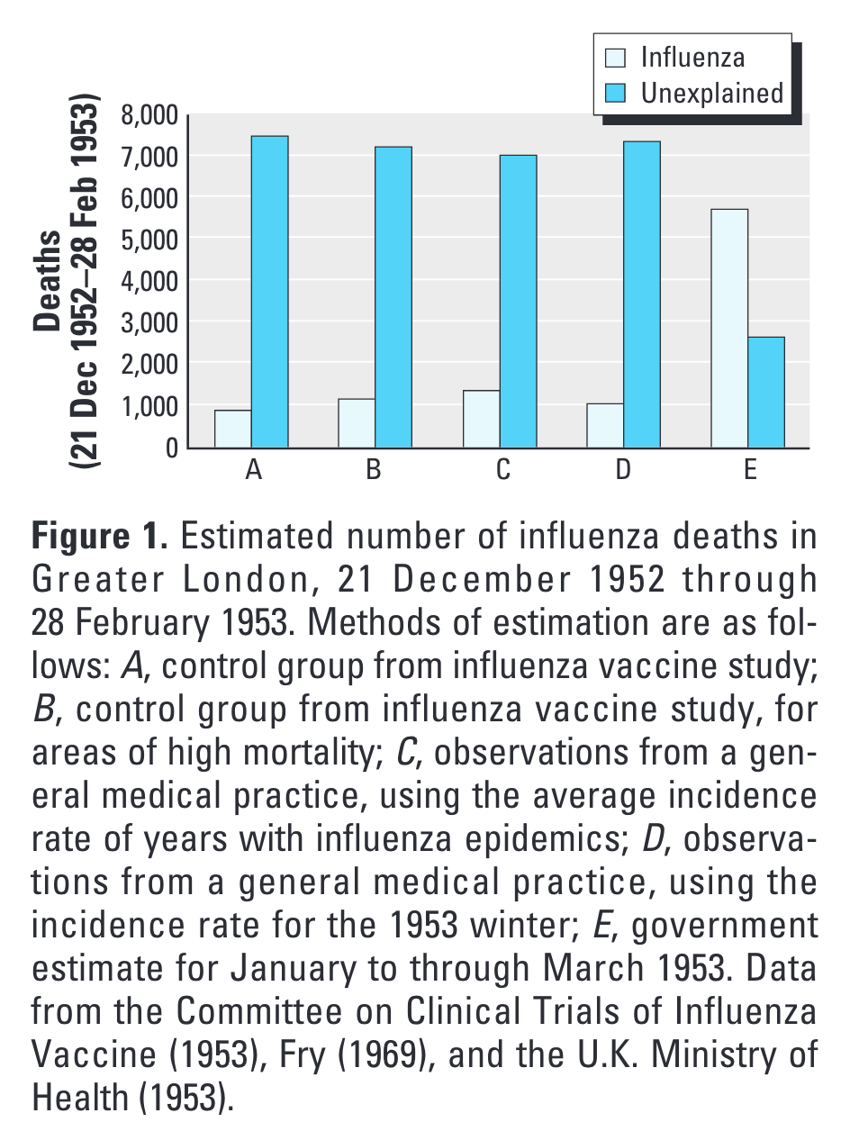

Slide 18
6 Cities Study (Dockery et al., 1993)
P = Portage, Wisconsin
T = Topeka, Kansas
W = Watertown, Massachusetts
L = St. Louis
H = Harriman, Tennessee
S = Steubenville, Ohio
n = ～ 1200 to 1600 individuals per city
Mortality
http://www.nejm.org/doi/full/10.1056/NEJM199312093292401

Slide 19
Outline
Health impacts of air pollution
Source attribution and lifetimes of aerosols in the atmosphere
Trends in control/exposures

Slide 20
AOD: Aerosol optical depth – $\int_{0}^{∞}{nπr^{2}}$ dz
(r is the effective particle radius for light scattering)

Slide 21
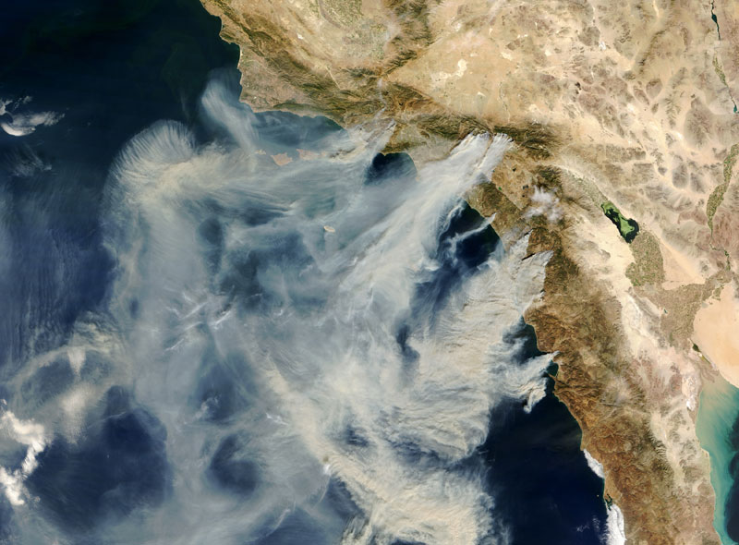
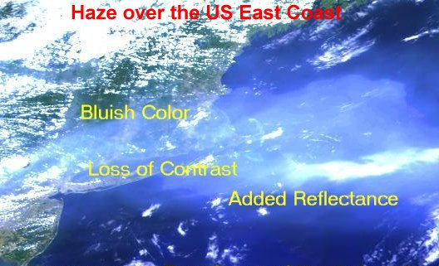
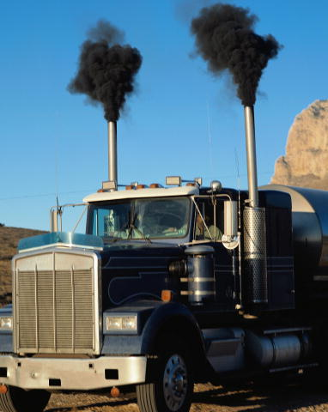
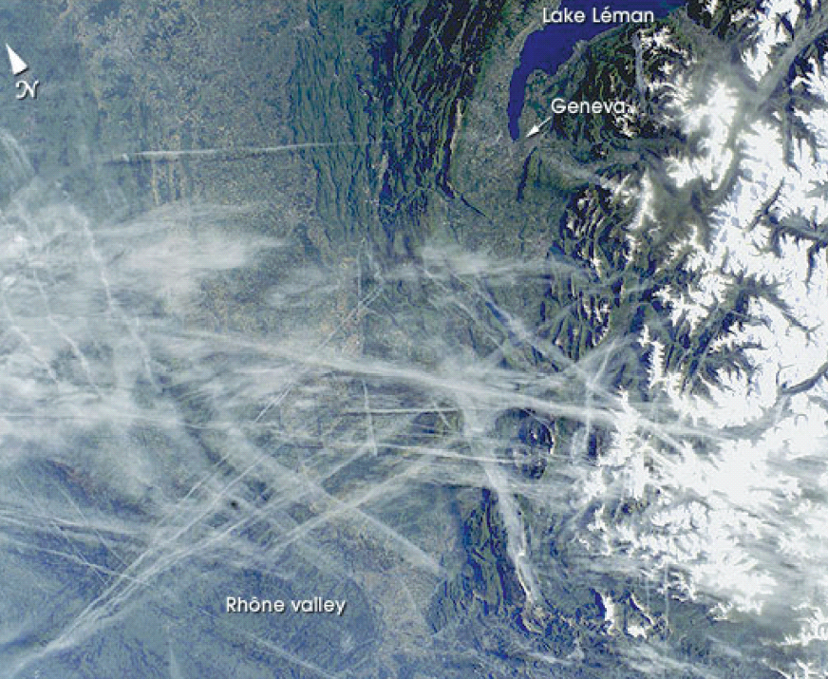
1. Examples of types of particles
California fire plumes
Pollution off U.S. east coast
Black carbon
2. Examples of how particles affect climate.
Particles contrails provide a nucleus upon which cloudwater condenses.
Light-colored particles reflect sunlight and cool the earth’s surface.
cooler

Slide 22
Life cycle of particulate matter (PM, aerosols)
Secondary Particles are formed from gases that are oxidized or create acid-base pairs
(10⁻³ – 10⁻⁴ μm)
precursor gases
ultra-fine
(<0.01 μm)
fine
(0.01-1 μm)
cloud
(1-100 μm)
sunlight
nucleation
.
.
coagulation
cycling
.
.
.
.
Soup of chemical reactions
condensation
evaporation
scavenging
Precursor gases:
SO₂, NH₃, NO_{x}, organic gases (“VOCs”)
↓↓↓ atmospheric chemical reactions, uptake by existing particles
Secondary particle components:
Sulfate, ammonium, nitrate, partially oxidized organics

Slide 23
Life cycle of particulate matter (PM, aerosols)
Life cycle of particulate matter (PM, aerosols); Primary aerosols are emitted directly
Secondary Particles, formed from gases that are oxidized or create acid-base pairs
Some particles are emitted directly, some form from gases in the air.
(10⁻³ – 10⁻⁴ μm)
precursor gases
ultra-fine
(<0.01 μm)
fine
(0.01-1 μm)
cloud
(1-100 μm)
sunlight
nucleation
.
.
coagulation
cycling
.
.
.
.
Soup of chemical reactions
condensation
evaporation
Primary particles: soot, metals, sea salt, dust, ash, smoke – usually coarse mode
coarse
(1-10 μm)
scavenging
SO₂
SO₂
NOx
VOCs
VOCs
NOx
NOx
VOCs
VOCs
VOCs
NH₃
NOx
NOx
combustion
volcanoes
agriculture
biosphere
wildfires
soil dust
sea salt
Notes:
re-create this slide; primary and secondary; SOA

Slide 24
Outline
Health impacts of air pollution
Source attribution and lifetimes of aerosols in the atmosphere
Trends in control/exposures

Slide 25
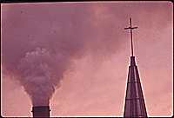
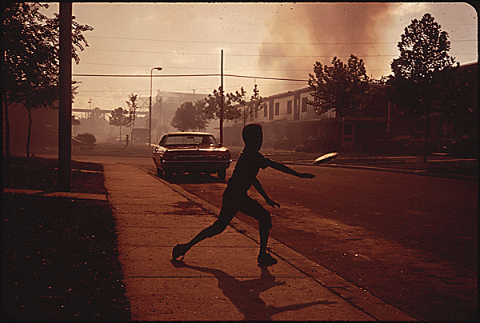
Before the U.S. Clean Air Act (1970/1990)
Typical smog in Los Angeles, California, in 1940s and 1950s
Aluminum plant (beside church) in New Orleans, Louisiana, 1973
North Birmingham, Alabama, 1972
Notes:
These are some images from around the United States from days before the Clean Air Act was in place. Our skies looked pretty different 50 years ago, particularly in some urban areas.

Slide 26
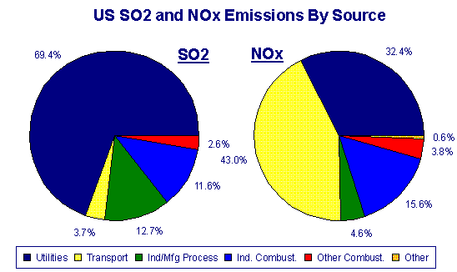
US SO₂ and NO_{x} Emissions by Source
Electric utilities are major contributors to acid rain precursors. Source: NAPAP Emissions Inventory, Nov. 1989.

Slide 27
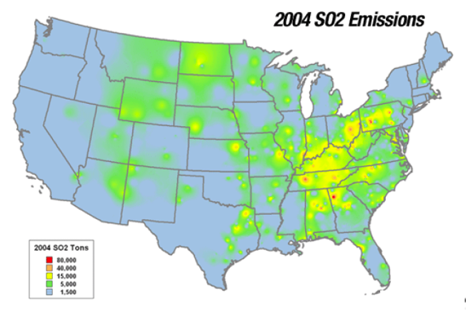
5
U.S. sulfur dioxide emissions 1970-2017
Mass of sulfur dioxide emissions in the U.S. from 1970 to 2017 (in 1,000 tons)
➗10
Coal combustion is the major source
Note: United States; 1970 to 2017
Further information regarding this statistic can be found on page 8.
Source(s): Environmental Protection Agency; ID 501303
https://www.statista.com/statistics/501303/volume-of-sulfur-dioxide-emissions-us/
(by subscription)

Slide 29
Notes:
Bhutan

Slide 30
5
U.S. nitrogen oxides emissions 1970-2017
Mass of nitrogen oxides emissions in the U.S. from 1970 to 2017 (in 1,000 tons)
➗3
NO_{x} emissions are primarily from transportation (cars, planes, and trucks) and coal combustion
https://www.statista.com/statistics/501284/volume-of-nitrogen-oxides-emissions-us/
U.S. NO₂ trends (2005-2013): EPA Air Quality System (AQS) data versus improved observations from the Ozone Monitoring Instrument (OMI), Lok N. Lok N. Lamsal, B. N. Duncan, Y. Yoshida, N. Krotkov. K. Pickering.. Streets, Z. Lu, http://dx.doi.org/10.1016/j.atmosenv.2015.03.055
Note: United States; 1970 to 2017
Further information regarding this statistic can be found on page 8.
Source(s): Environmental Protection Agency; ID 501284

Slide 31
Notes:
why the trends; discussion

Slide 32
Progress has stalled for primary PM2.5 and VOCs (source of secondary aerosols)
PM2.5 (1000 tons/yr; since 1990)
VOCs (1000 tons/yr; since 1970)
➗1.2
➗2
by subscription: https://www.statista.com/statistics/501298/volume-of-particulate-matter-2-5-emissions-us/
Note: United States; 1990 to 2017
Further information regarding this statistic can be found on page 8.
Source(s): Environmental Protection Agency; ID 501298

Slide 33
Notes:
Volkwagon ; overturned this year. Obama era bailout.

Slide 34
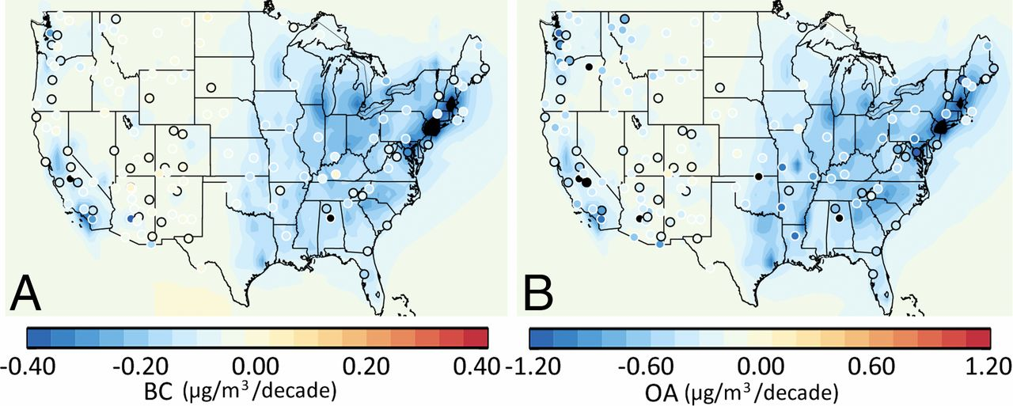
Observed and anthropogenic modeled trends in BC and OA.
Trends (μg/m³ per decade) in median annual surface BC and OA concentration
simulated in GEOS-Chem (contours) and observed at IMPROVE sites
D. A. Ridley et al. PNAS 2018;115:2:290-295
Data through 1990 - 2012.
©2018 by National Academy of Sciences
Notes:
Observed and anthropogenic modeled trends in BC and OA. (A) Trends (μg/m³ per decade) in median annual surface BC concentration simulated in GEOS-Chem (contours) and at IMPROVE sites with at least 18 y of data (black circles) and at least 10 y of data (white circles) between 1990 and 2012. Model trends are for anthropogenic BC emissions only, derived from the EPA emission inventory. (B) Same as A, but for OA. Model trends are for anthropogenic OA emissions only.

Slide 35
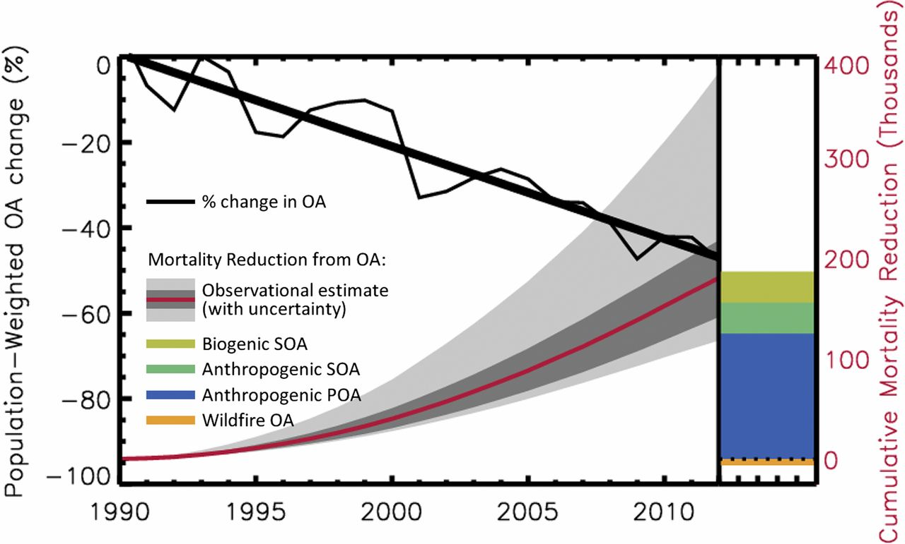
Premature mortality associated with OA.
The decline in population-weighted OA concentration averaged across the United States (thin black line)
and the trend (thick black line) based on a combination of model and IMPROVE observations.
D. A. Ridley et al. PNAS 2018;115:2:290-295
©2018 by National Academy of Sciences
Notes:
Premature mortality associated with OA. The decline in population-weighted OA concentration averaged across the United States (thin black line) and the trend (thick black line) based on a combination of model and IMPROVE observations. The cumulative reduction in premature mortality (in 1,000) resulting from the declining trend in OA (red line) is displayed with the mortality uncertainty resulting from the 1-σ uncertainty in population-weighted PM_{2.5} and OA estimates (dark gray) and the 1-σ uncertainty when combined with the relative risk uncertainty, determined by Burnett et al. (37) for diseases linked to PM exposure (light gray; SI Appendix). The premature mortality for modeled biogenic SOA (olive), anthropogenic SOA (green), primary OA (blue), and wildfire OA (orange) are shown relative to the estimate based on the combination of model and IMPROVE observations.

Slide 36
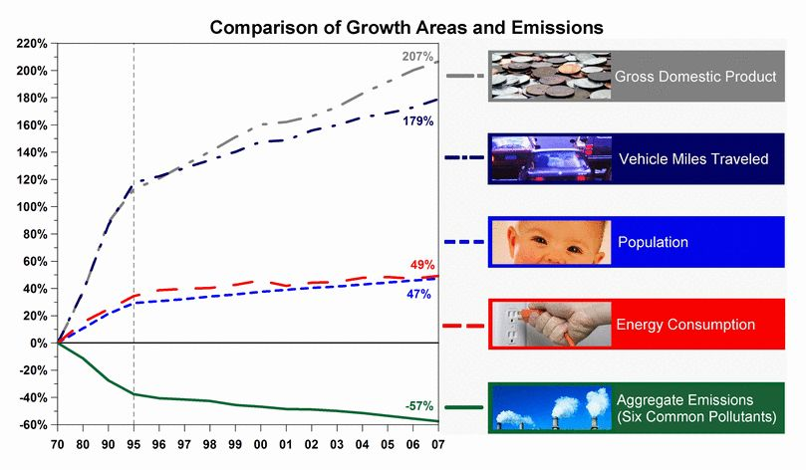
Progress in Implementation
36
Does Not Include CO2
Notes:
It is important to balance improvements in the environment with economic prosperity. Students interpret this slide.
In the U.S., we have seen large increases in a number of measures of economic growth, as well as an increase in our overall population, along with increases in energy consumption and transportation demand.
And yet, we have also been able to accomplish large reductions in emissions of air pollutants. This graph shows that from 1970 to 2007, emissions of the six principal pollutants has fallen by 57 percent, while our GDP has increased by over 200 percent.
Note that this graph does not include reductions in CO2, which will be the next big challenge for the coming decades, as we look to reduce CO2 emissions while maintaining our economic growth.
36

Slide 37
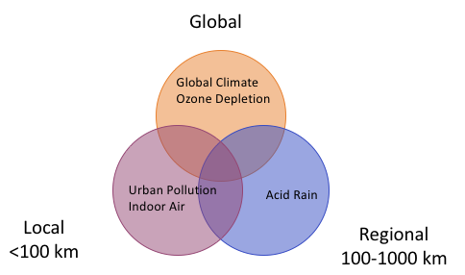
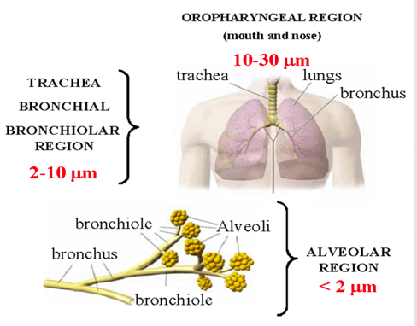
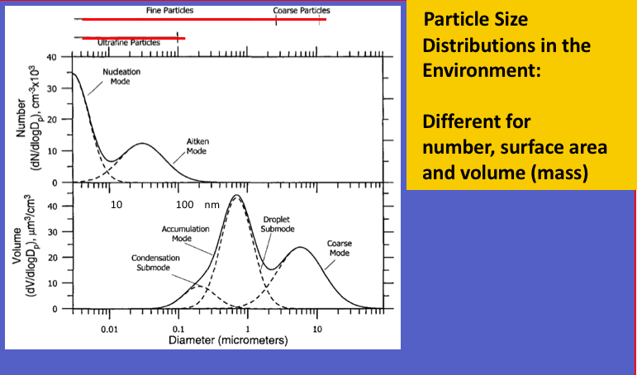
Aerosols – Roll up
Weeks/Months
Hours/Day
Days/weeks
Span of time and space scales for air pollution and atmospheric aerosols
Smaller particles are deposited deep in the lungs and travel throughout the body, even inside cells.
Size matters:
Health effects
Lifetimes
Mechanisms and
Dynamics

Slide 38
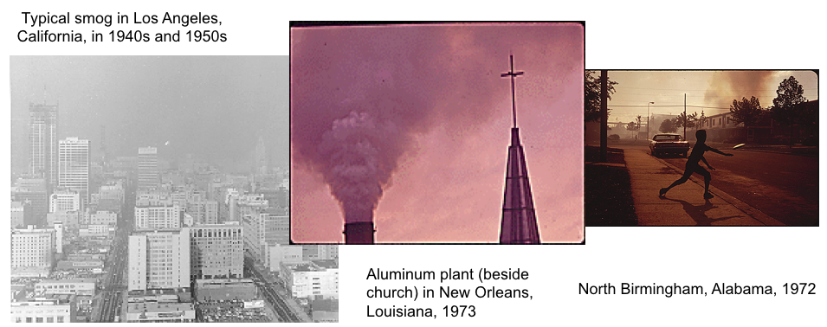
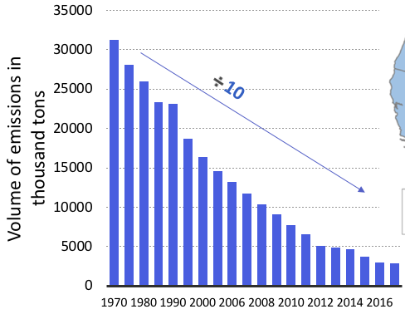
Particulate (and other) air pollution in the US was severe in the 1950s—1970s.
The Clean Air Act (1963, 1970, 1995) led to huge improvements.
Roll -up
Sulfur emissions in the US have declined 10-fold due to controls and switching from Coal to Natural Gas
for electricity.
NOx and aerosol concentrations have gone down by factors of 3 (Organic aerosol) – 10 (Sulfate aerosol).
Lives extended (since 1990) > 200,000

