Slide 1
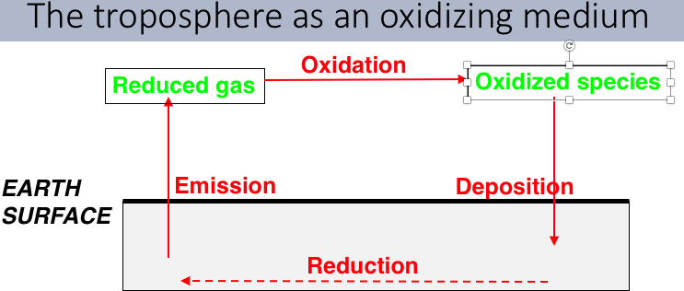
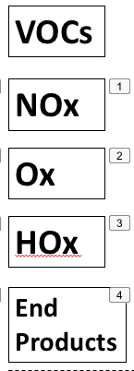
Rollup: Photochemistry and Photochemical Smog
generates radicals
Photochemistry in the atmosphere (reactions involving absorption of sunlight to create free radicals) oxidize VOCs from the biosphere, potentially creating a cascade of free radicals and other highly reactive chemical species, and SOA.
OVOCs
CO, CO₂
H₂O

Slide 2
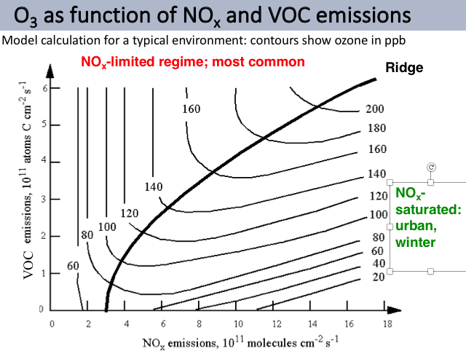
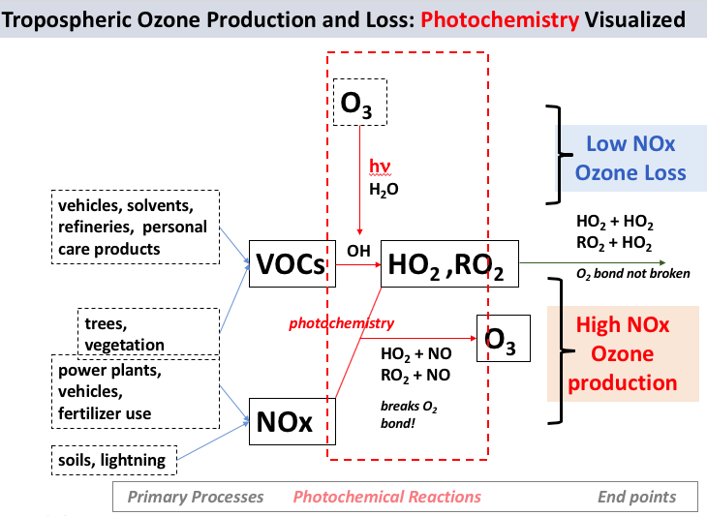
“Ridge” defined by a branching of HO₂ (RO₂) radical reactions:
→NO (produces ozone), or
→ another HO₂ (or RO₂)
(destroys ozone)
“Branching” of the reaction pathway
+ HO₂
HO₂
+ NO →NO₂

Slide 3
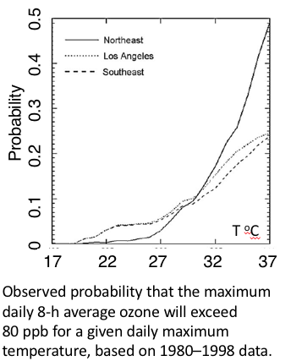
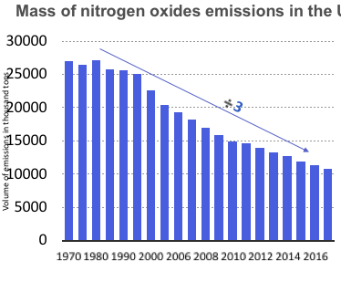
US
Emissions of most pollutants have declined and the air has gotten cleaner from 1970 (clean air act) to 2020 (50 years of steady improvement). Climate change and regulatory rollbacks may change those trends.

