Slide 1
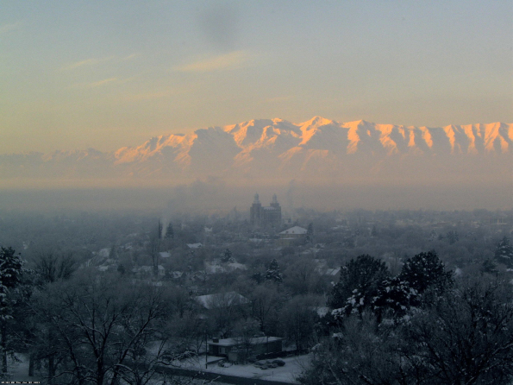
Lecture 08: Photochemical air pollution
2020302
The combination of pollutant concentrations and unfavorable weather can produce a large effect on U.S. air quality.
What U.S. city is this?
U.S. Air Quality Smog Blog, alg.umbc.edu/usaq

Slide 2
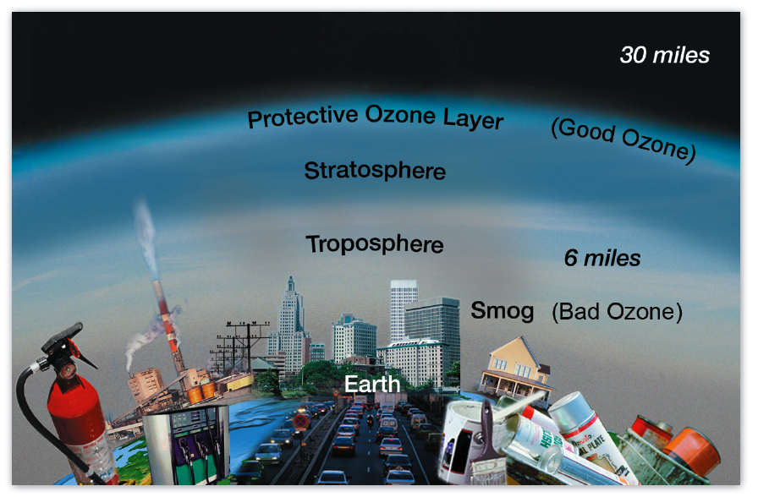
O₂
Roles of ozone (O₃) in the atmosphere.
O₃
Atmospheric ozone is mostly in the stratosphere
ozone
Tropospheric ozone is made by different processes stratospheric ozone.
“Photochemical smog” is produced when tropospheric ozone production accelerates due to addition of reactive gases.
( )
adapted from EPA

Slide 3
Several reasons to care about tropospheric ozone
In stratosphere: UV shield
Stratosphere:
90% of total
In middle/upper troposphere: greenhouse gas
Troposphere
In troposphere: source of OH
In surface air: toxic to humans and vegetation
00

Slide 4
The troposphere as an oxidizing medium
Oxidation
Reduced gas
Oxidized species
EARTH
SURFACE
Emission
Deposition
Reduction
Oxidation rids the atmosphere of environmentally harmful gases:
Greenhouse gases such as methane, halocarbons
Toxic gases such as CO, benzene
Ozone-depleting gases such as hydrochlorofluorocarbons (HCFCs)
Where the oxidation takes place affects patterns of deposition:
Acid rain
Nitrogen, mercury deposition

Slide 5
The troposphere as an oxidizing medium
Oxidation
Reduced gas
Oxidized species
EARTH
SURFACE
Emission
Deposition
Reduction
Oxidation of reduced species
is driven by ozone photochemistry
↓↑
is the driver of ozone production

Slide 6
Families of chemical species in atmospheric photochemistry
😎 New friends !
VOCs
Volatile organic carbon – from vegetation, solvents, gasoline, industry
isoprene, terpenes, methane, propane, benzene, ….
precursors
NOx
Nitrogen oxide free radicals‡ – from soils, lightning, combustion, fertilizer NO, NO₂, NO₃
Ox
“Odd oxygen” – derived photochemically from atmospheric O₂
O₃, O
oxidants
HOx
Hydrogen oxide free radicals‡ – from VOC, Ox + NOx photochemistry
OH, HO₂, (RO₂)
End Products
Stable end products of photochemistry – “sink molecules” that terminate the reactive processes
CO, CO₂, HNO₃, (Secondary organic aerosol, “SOA”)†
products
‡ Free radicals – have odd number of electrons – very reactive chemically
NO, NO₂, OH, HO₂, RO₂
† Highly oxidized organic molecules, low vapor pressure → PM, scavenged and deposited.
Notes:
New friends – so many new faces, just like Freshman week ! NOTE since VOCs (and their building blocks)are created by photosynthesis, oxygen molecules are created at the same time: CO₂ + H₂O → (H₂CO) + O₂ The cycle from O2 to Ox is closed by making CO_{2,} then by plants making VOCs.

Slide 7
Ozone is a strong oxidizer (a) Ozone strongly absorbs sunlight, greatly adding to its impact on oxidation rates in the atmosphere.
O₃ + hν → O₂ + O(¹D) photolysis
(produces O atoms in an excited electronic state, 114s lifetime)
O(¹D) + Air → O(³P) + Air quenching
(produces ground electronic state of O atoms)
O(³P) + O₂ (+ Air) → O₃ (+ Air) recombination
(regenerates O₃)
Net effect: heats the atmosphere
But some O(¹D) oxidizes water (!) (up to 3%):
O(¹D) + H₂O → 2 OH …..
Effect: OH is the principal agent of atmospheric oxidizing capacity, the cleaning agent

Slide 8
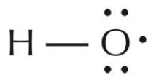
(b) Ozone photolysis generates OH free radical, the most important tropospheric oxidant
Source:
O(¹D) stores a lot of energy. It can oxidize water!
Sink:
where X is almost any non-radical reduced species
The importance of OH in the troposphere was discovered by H. Levy in 1971. It is produced when O₃ is photolyzed by UV radiation.
When OH reacts with other molecules, many products are formed, and OH can be regenerated many times. This cascade of reactions can either produce more O₃ (→ smog) or remove O₃.
OH and its progeny of other radicals can only be permanently removed when two radicals combine together, a relatively rare event.

Slide 9
(c) Photolysis of O₃ can lead to removal of ozone, if O₃ is not regenerated in subsequent reactions initiated by OH.
But each OH produced from O₃ photolysis can also produce more ozone, maybe several more, potentially creating a runaway reaction.
The process of producing more O₃ is driven by the chemistry of volatile organic carbon (VOCs) and nitrogen oxide radicals (NOx). The ratio between NOx and VOCs controls whether excess O₃ is being produced, or not.
OH + VOC → RO₂ + HO₂
HO₂ + NO → NO₂ + OH Regenerates OH, breaks O₂ bond
{ NO₂ + hν → NO + O ; O + O₂ + Air → O₃ + Air } Regenerates O₃ and NO
HO₂ + RO₂ → ROOH + O₂ A non-radical is produced, game over. No O₃ produced.
OH + NO₂ → HNO₃
Rates of O₃ production/loss are regulated by concentrations of VOCs and NOx, and their ratio.
Notes:
+ sunlight, H₂O, Temperature….

Slide 10
Ozone concentrations: dependence on NO_{x} and VOC emissions
Model calculation for a typical environment: contours show ozone in ppb
NO_{x}-limited regime; most common
Ridge
NO_{x}-
saturated
regime;
urban, winter
conditions
VOC
To reduce O₃, reduce VOC emissions…until the limit where VOCs are dominantly from vegetation. Then only NOx reductions can work. …And be careful what trees you plant!

Slide 11
Tropospheric Ozone Production and Loss: Photochemistry Visualized
O₃
Low NOx
Ozone Loss
hν
H₂O
vehicles, solvents,
refineries, personal care products
HO₂ + HO₂
RO₂ + HO₂
O₂ bond not broken
VOCs
OH
HO₂ ,RO₂
trees, vegetation
photochemistry
O₃
High NOx
Ozone production
HO₂ + NO
RO₂ + NO
breaks O₂ bond!
power plants, vehicles,
fertilizer use
NOx
soils, lightning
precursors oxidants → end
Primary Processes Photochemical Reactions End points

Slide 12
Photochemical smog has decreased significantly in most of the US, since 1980

Slide 13
Changes in climate affect air quality by modifying both meteorology and chemistry
a
b
c

Slide 14
Emissions of VOCs tend to rise as temperatures rise: biological metabolism,
OH + VOC → RO₂ + HO₂
HO₂ + NO → NO₂ + OH Regenerates OH
{ NO₂ + hν → NO + O ; O + O₂ + Air → O₃ + Air } Regenerates O₃ and NO
Rates for these reactions become faster at higher temperatures – ozone is produced more rapidly
"Double-whammy" climate – pollution positive feedback

Slide 16
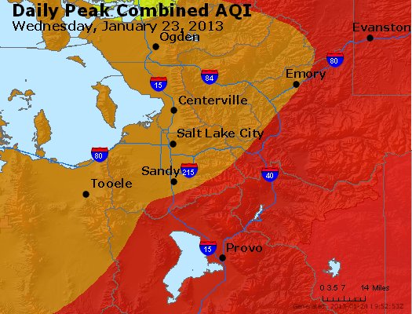
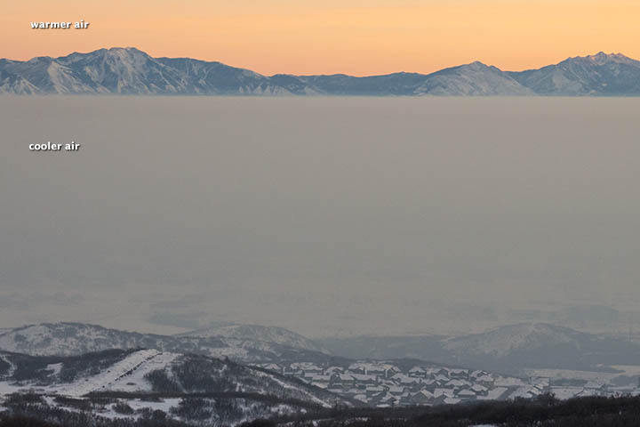
Atmospheric stability has a direct effect on air pollution:
Emissions can be trapped near the ground (L.A., S.L.C.,…)
Jan 23, 2013
warmer
cooler
Salt Lake City
Persistent temperature inversions in January 2013 over Northern Utah led to unhealthy air 11 out of 31 days.
Airnow; NASA Earth Observatory

Slide 17
Temperature role in ozone air quality from observations
Number of summer days with ozone exceedances, mean over sites in Northeast
1988, hottest on record
Probability
0 0.1 0.2 0.3 0.4 0.5
Days
T ºC
17 22 27 32 37
A very hot summer can mean more ozone exceedances, even if emissions of ozone precursors are declining.
Observed probability that the maximum daily 8-h average ozone will exceed
80 ppb for a given daily maximum temperature, based on 1980–1998 data. Values are shown for the Northeast U.S., the Los Angeles Basin, and the Southeast U.S.
Lin et al., 2001

Slide 18
Climate change affects more than temperature.
Many populous counties in the West experience 40-150% increases in smoke PM_{2.5} by 2050s. It is already happening
Percent increase in smoke PM_{2.5} by midcentury relative to 2000s, by county.
Much of California sees a doubling of “smoke waves” – episodes of enhanced smoke at the 98th% level.
Yue et al., 2013, 2014, 2015
Liu et al., 2016
Large cities affected by fires

Slide 19
Climate time scales
Vegetation (composition, emissions) ++ ++
Wildland fires + ++

Slide 20
Top level takeaways
Atmospheric photochemistry is complex, but can be understood from basic principles.
Air quality has improved in the USA since 1980.
Not all regions have benefited equally.
Climate change is expected to lead to higher levels of photochemical smog and primary PM.
Regulatory rollbacks will lead to higher levels of photochemical smog and PM.
Learning outcomes: Introduction of basic chemical concepts underlying smog – chemical species, redox reactions; how emissions of reduced species leads to production of oxidants under sunlight → free radical processes; chemical basis for worsening smog under warming.

