Slide 1
Solutions to Pollution…
Dilution only works in water
Revisit London Fog Pollution event
Watch the video link on the next slide
Come back with your thoughts on these four items:
How was the problem identified?
What was the solution?
What factors had to be considered when developing a solution?
Was the solution sufficient?

Slide 2
1950s London Fog: Watch This!
Macbeth “Fair is foul, and foul is fair: Hover through the fog and filthy air”
https://www.youtube.com/watch?v=xajjmbJrfEM

Slide 3
6 Cities Study (Lepeule et al., 2012)
London Fog: mg/m³
Since 2001 to 2009: Average PM_{2.5} = <18 μg m⁻³
Linear dose-response to 8 μg m⁻³
Each 10 μg m⁻³ of PM_{2.5}
= 14% increase in risk of all-cause mortality
= 26% increase in cardiovascular mortality
= 37% increase in risk of lung cancer mortality
Survival function (probability)
Years of follow up

Slide 4
How does the atmospheric lifetime of a pollutant affect how it is regulated?
Long-lived (persistent) chemicals can be transported long distances
For many chemical screening regulations, persistence in air is defined as a half-life of > 2 days.
UN Convention to Manage Long Range Transport of Air Pollutants (LRTAP Convention), est. 1979, 34 Member states

Slide 5
Primary vs secondary pollutants
Definition
  Primary pollutants are emitted directly to the atmosphere by the sources (SO₂)
  Secondary pollutants are formed in the atmosphere through chemical processes (O₃)
Atmosphere is an oxidizing medium (chemical reactions)
  Fate of pollutants

Slide 6
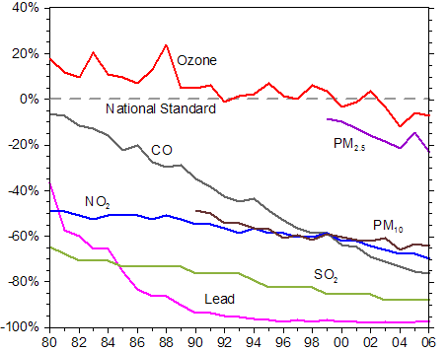
Six Criteria Air Pollutants Regulated under NAAQS (Clean Air Act)
NAAQS = National Ambient
Air Quality Standards
Ozone: O₃
Fine particulate matter: PM_{2.5}
Coarse particulate matter: PM₁₀
Carbon monoxide (CO)
Nitrous dioxide (NO₂)
Sulfur dioxide (SO₂)
Lead (Pb)
6
Notes:
In addition to reducing emissions of air pollutants, we have also seen progress in reducing pollution in the ambient air that we breathe.
For each of the six principle pollutants, we have seen steady improvements, and in much of the U.S., current air quality is at or well below the standards.
6

Slide 7
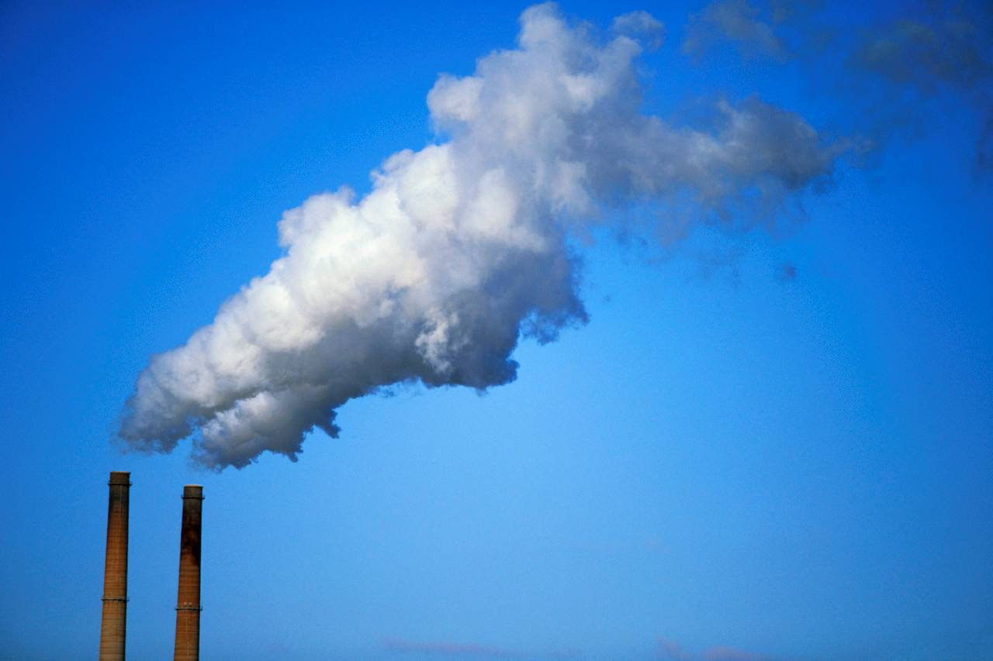
Air Toxics
A story of coal, mercury and ineffective regulations…

Slide 8
Engineering Solutions to Address
Societal Problems
Learning outcomes:
How to characterize the tradeoffs among economic, societal, and environmental outcomes when designing regulations
Critique EPA’s Regulatory Impact Assessment for HAPs regulations
Better
Interconnected
Decisions
Economy
Society
Environment
Economy
Society
Environment
Stove Pipe Decisions
Pillars of Sustainability
G. Foley, US EPA

Slide 9
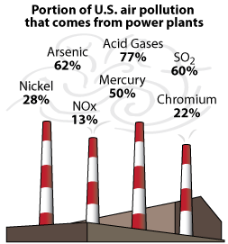
Power plants are big emitters and many lacked advanced controls (ca. 2005)
More than 200 Hazardous Air Pollutants (HAPs) are released by coal-fired utilities
About 50%
of coal-burning units were over 40 years old
Sources: Portion of pollution -- NEI Trends Data (2009) and IPM (2010) (SO₂, NO_{X}); MATS rule modeling platform, based on inventory used for 2005 NATA (Hg); Inventory used for 2005 NATA (other toxics). Percent of units: EPA Base Case v. 4.10 PTR

Slide 10
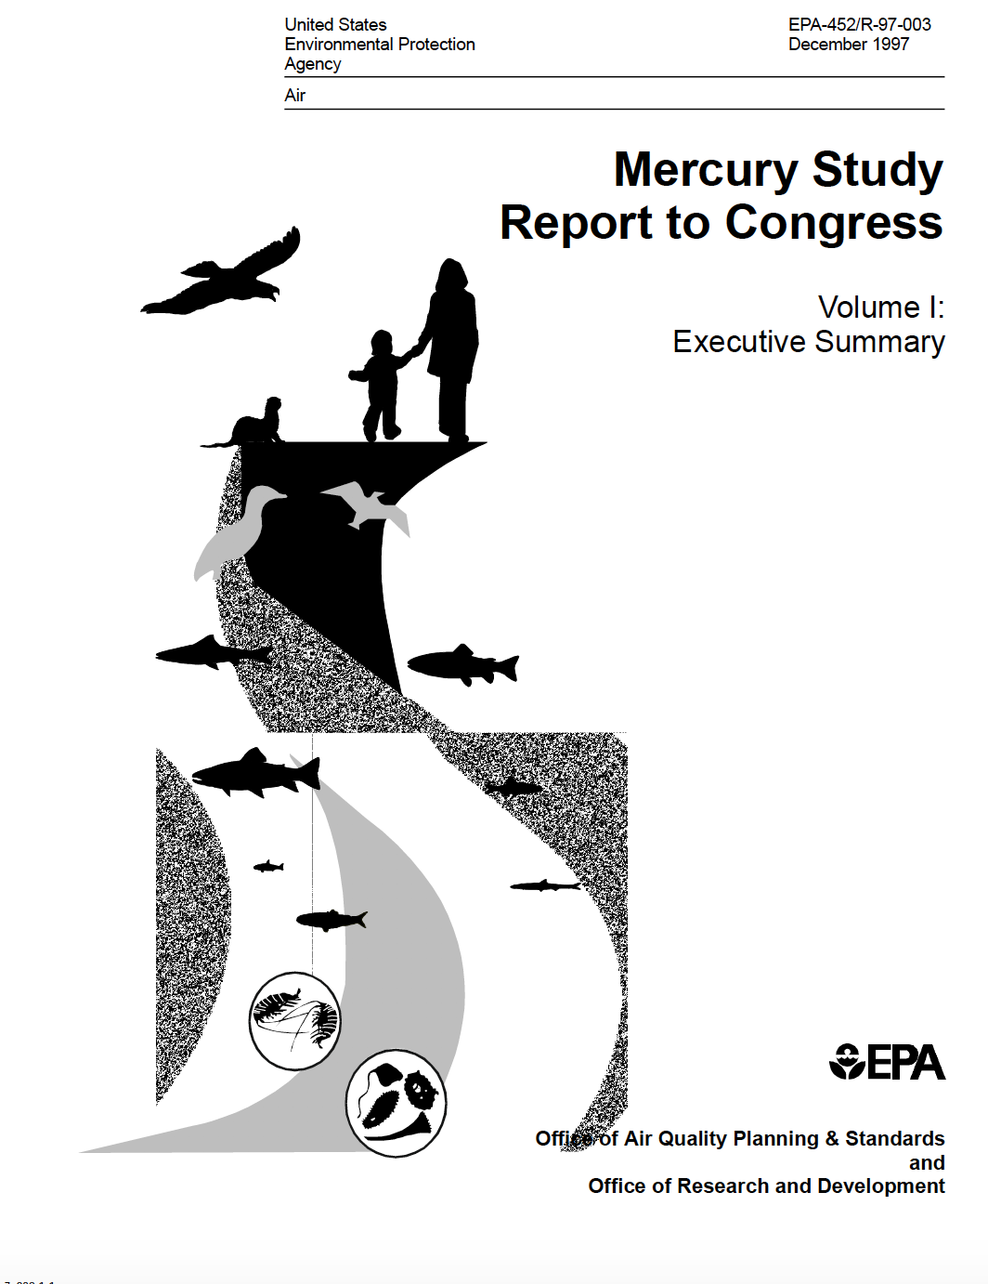
Statutory Authority:
Clean Air Act
Regulatory Agency: US EPA
Mission: “To protect human health and the environment”
1998
In 1998, EPA concluded that there was a “plausible risk to human health” associated with Hg releases from electricity generating units (EGUs) aka: coal-fired power plants.
This triggered what lawyers call the:
Appropriate and Necessary Finding
i.e., it is appropriate and necessary to regulate emissions (as opposed to arbitrary and capricious)
Notes:
Utilities/Trade Journals started discussing impending regulations for Hg
ca. 1990 after the amendments to the Clean Air Act

Slide 11

Biden administration put a hold on final decision
to overturn appropriate and necessary finding; eliminating the need to regulate Hg
The rule has been in place since 2011 and plants are already in compliance.

Slide 12
Mitigating health risks associated with mercury releases from coal-fired utilities
Are EPA’s estimated benefits = $4-6M/year and costs = $9B reasonable?
Regulatory background
U.S. electricity sector and pollution control technology costs
Modeled benefits of reducing Hg emissions
Actual changes in energy sector, Hg emissions, concentrations and exposures
Climate change and future trajectories in Hg exposure

Slide 13
Key Power Plant Rules Overdue
1990: Clean Air Act Amendments (CAA) required EPA to issue standards to reduce emissions of air toxics, also called hazardous air pollutants (HAPs), from many sources, and to study whether to do so for power plants
  Since then, EPA has issued air toxics standards for most major source categories – but not for power plants
1998: EPA released the Utility Toxics Study Report to Congress
2000: EPA listed power plants for regulation under the CAA air toxics provisions
  EPA determined it was “appropriate and necessary” to regulate emissions of air toxics from power plants, triggering CAA requirements to regulate power plants
  Mercury cited as pollutant of greatest concern but other toxics of potential concern include arsenic, chromium, cadmium, nickel, hydrochloric acid, dioxin/furan
2005: EPA reversed power plant air toxics determination
  EPA determined it was neither “appropriate nor necessary” to regulate emissions of air toxics from power plants and removed those units from the CAA section 112(c) source category list
  EPA issued the Clean Air Mercury Rule (CAMR), which regulated mercury from power plants through a cap and trade program under CAA section 111
2008: DC Circuit Court vacated both EPA's action removing power plants from the section 112(c) source category list and CAMR
2011: EPA issues final standards for MACT rule known as MATS: Mercury and Air Toxics Standards
2016: Supreme Court orders EPA to provide additional justification for the Appropriate and Necessary finding ca. 1998 given the discrepancy between costs ($9Billion) and benefits ($4-6M) listed in EPA RIA
2020: EPA reverses the Appropriate and Necessary finding, repealing MATS. All utilities are already in compliance.
2021: EPA stays the decision – basically asking for more time to decide what to do

Slide 14
Executive order 12866:
Cost-benefit analysis for regulations
In deciding whether and how to regulate
  Assess all costs and benefits of all alternatives
  Include options of not regulating
  Both quantifiable and non-quantifiable measures
Maximize net benefits including:
  Economic, Environmental, Public health and safety, Distributive impacts, Equity
Propose regulation
  “Upon a reasoned determination that the benefits of the intended regulation justify its costs”
  One piece of information to inform the decision-making process
This becomes part of the “Regulatory Impact Assessment” (RIA) that supports each proposed regulation

Slide 15
Benefits from regulating U.S.
Coal-fired Utilities
US EPA (2011)** | Maximum Available Control Technology (MACT) Standards (MATS) | Benefits: $4-6 million per year.
US EPA (2005) | Hg cap under CAIR and CAMR for power plant emissions | Benefits: Less than $168 million per year.
Trasande et al. (2005) | Costs of current Hg emissions from all sources | $9.5 billion per birth cohort $1.4 billion due to power plants
Rice & Hammitt (2005) | Cap of 26 tons and 15 tons on power plant emissions (U.S.) | Benefit: $3.8 - $5.7 billion
**Long list of unquantified benefits = $$ zero for policy-makers

Slide 16
What information is needed to assess the costs and benefits of utility regulations?

Slide 17
Mitigating health risks associated with mercury releases from coal-fired utilities
Are EPA’s estimated benefits = $4-6M/year and costs = $9B reasonable?
Regulatory background
U.S. electricity sector and pollution control technology costs
Modeled benefits of reducing Hg emissions
Actual changes in energy sector, Hg emissions, concentrations and exposures
Climate change and future trajectories in Hg exposure

Slide 18
Electric Power Industry Revenues in Hundreds of Billions/year
$219 billion in annual electricity sales in 2002
Utilities (65% of generation¹)
  Investor-owned
  Municipal
  Rural co-ops
  State-owned
  Federal (Tennessee Valley Authority, Bonneville Power Authority, Power Marketing Administrations)
Non-utilities (35% of generation)
  Independent power producers
  Combined heat and power facilities (commercial and industrial)
  Share has grown dramatically - $90 Billion of merchant plant investment in past 5 years
[1] Data from EIA for July 2004

Slide 19
Most U.S. Electricity Generation From Coal ca. 2002
Electric Generation in 2002
Historical & Projected Electric Generation
Forecast
Source: 2002 and historical generation is from EIA’s Annual Energy Review. Projected generation is from EPA’s Integrated Planning Model.

Slide 20
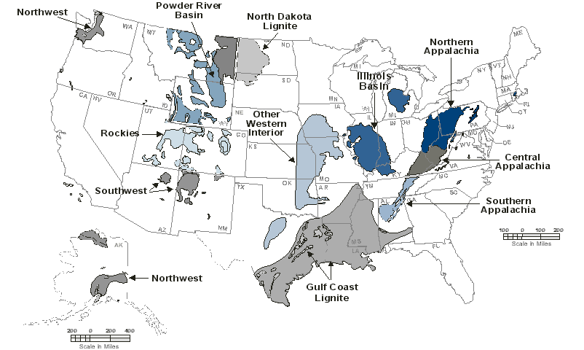
Coal Supply Regions
Regulations try to avoid adversely affecting the economic interests of different regions
Appalachia (Bituminous)
  Northern
  Central
  Southern
Interior (Lignite and Bituminous)
  North Dakota Lignite
  Gulf Coast Lignite
  Illinois Basin
  Other Western Interior
West (Bituminous and Subbituminous)
  Powder River Basin (PRB)
  Rockies
  Southwest
  Northwest

Slide 21
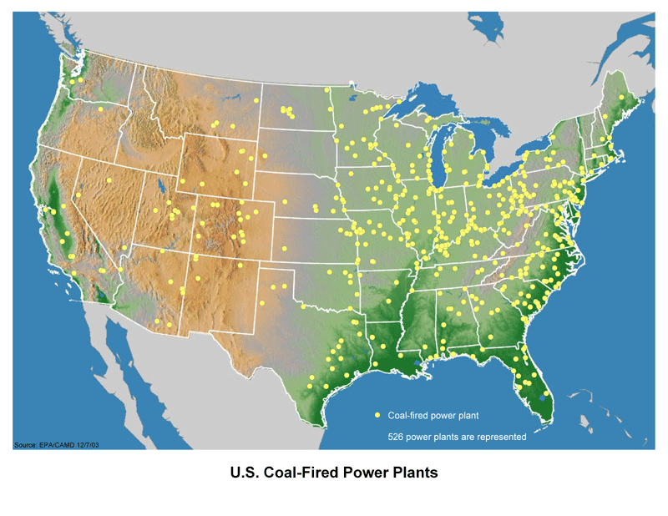
Coal Fired Power Plants in the U.S. ca. 2002
About 1,300 coal-fired generation units (~ 500 coal-fired power plants), representing about 305 GW of generation capacity
Existing Controls:
  Almost all units have particulate matter (PM) control devices
  About one-third of capacity has SO2 scrubbers
  Most have initial NOx controls (low-NOx burners)
  About one-third of the capacity (primarily in the east) will have advanced NOx control (SCR) when NOx SIP call is fully implemented

Slide 22
We have the technology to virtually eliminate emissions of ALL pollutants from coal-fired utilities– implementation is a matter of cost
NO_{x}: Selective Catalytic Reduction (SCR), Selective Non Catalytic Reduction (SNCR)
PM: ESP=Electrostatic Precipitator, FF=Fabric Filter, Cyclone, Scrubber
Covert NOx into N₂ and H₂O
SO_{x}: Flue Gas Desulfurization (FGD)
Hg: Activated Carbon Injection (ACI)

Slide 23
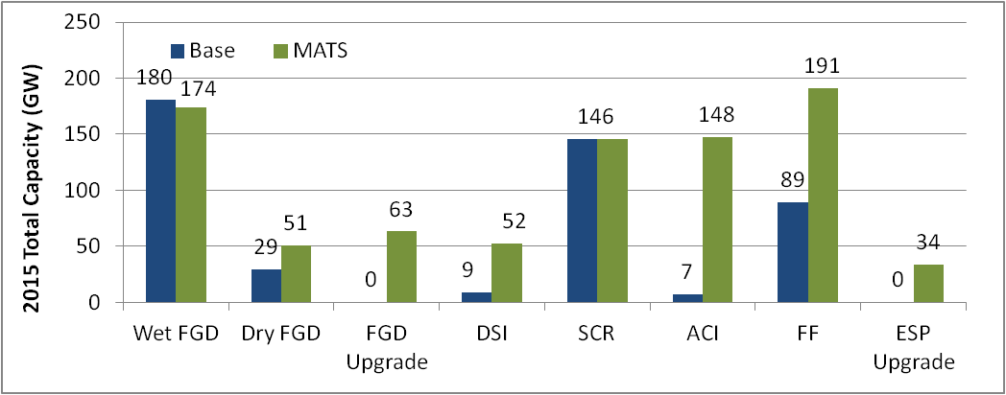
Control Technology Needed to Achieve MATS Standards
Retrofit pollution control installations on coal-fired capacity (by technology) with the base case and with the final MATS, 2015 (measured in GW capacity).
SCR: selective catalytic reduction
ACI: activated carbon injection
FF: fabric filter
FGD: flu gas desulfurization (scrubber)
DSI: dry sorbent injection
Source: Integrated Planning Model run by EPA, 2011

Slide 24
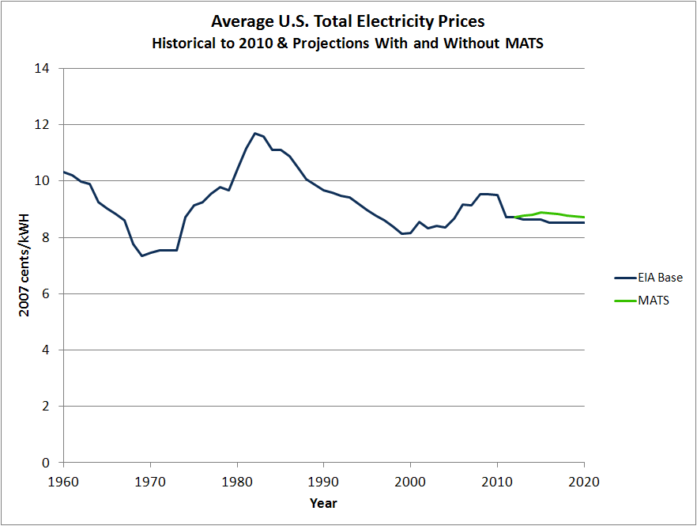
Modeled effects of MATS on future electricity costs small and within normal historical fluctuations
Total costs of regulations estimated at $9B
This is a small fraction of industry revenue (hundreds of billions)
Costs are passed on to consumers
Effects of MATS are small and projected costs were within the normal historical fluctuation of electricity prices.
Actual costs have been less than $1B/year and were overestimated
This is common in environmental regulations
Average monthly electric bill would increase by a maximum of $2.71 (0.3 cents per kW hour)
Sources: EIA Historical (Annual Energy Review – October 2011); EIA Projected (Annual Energy Outlook 2011 ); EPA modeling of projected price increases using the Integrated Planning Model.

Slide 25
Mitigating health risks associated with mercury releases from coal-fired utilities
Regulatory background
U.S. electricity sector and pollution control technology costs
Modeled benefits of reducing Hg emissions
Actual changes in energy sector, Hg emissions, concentrations and exposures
Climate change and future trajectories in Hg exposure
Are EPA’s estimated benefits = $4-6M/year and costs = $9B reasonable?

Slide 26
Mercury is a local and global pollutant
Long range
transport
Hg⁰
Hg^{II}
c
far-field
deposition
Near-field
deposition
Hg “HOT SPOT”
foreign countries
remote environments

Slide 27
Power Plants were the Largest Remaining Source of Mercury Emissions in the U.S.
48% of total Hg emissions in 2015
Industrial Category | 1990 Emissions tons per year (tpy) | 2005 Emissions (tpy) | % Reduction
Power Plants | 59 | 53 | 10%
Municipal Waste Combustors | 57 | 2 | 96%
Medical Waste Incinerators | 51 | <1 | >98%
Source: EPA’s 2005 NATA Inventory Modified for the Toxics Rule 2005 Base Year (2010)

Slide 28
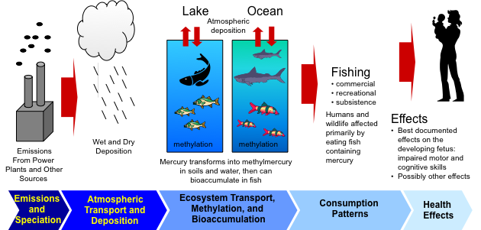
Components of Regulatory Impact Assessment (RIA) for Hg Releases from Coal-Fired Utilities
Hg⁰ (gas)
Hg^{II}
CH₃Hg (MeHg)

Slide 29








Methylmercury is a bioaccumulative neurotoxicant
Concentrations are x10⁶-10⁷ water
Neurotoxicant
Impaired cardiovascular health
Endocrine disruptor
Immunotoxin
top predators
big fish
10⁴ - 10⁵
small fish
water
CH₃Hg(I)
plankton
methylmercury concentration
Societal Costs of methymercury exposure in US & Europe > $15 B
(Bellanger et al., 2013; Grandjean et al., 2012)

Slide 30
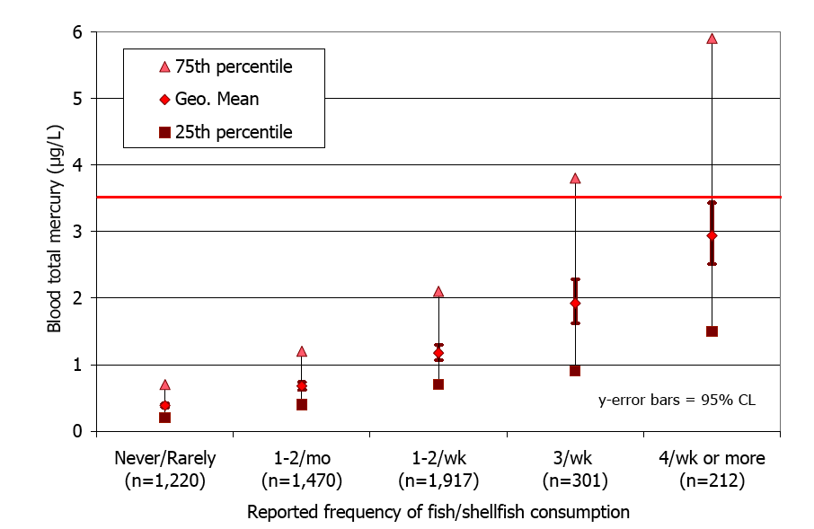
Exposure to methyl-Hg is from seafood consumption
Rice exposures in contaminated mining regions in China are a localized problem
Mahaffey et al., 2009

Slide 31

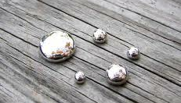

The form of Hg determines its health impact
Inorganic Hg includes:
Quicksilver
  0.01% absorption
Hg⁰ (inhalation)
~70% absorption
Hg^{II}
  Avg of 7% absorption (range 1-17%)
Methyl-Hg (CH₃Hg or MeHg)
>90% absorption efficiency
Primarily a central nervous system toxin
Half-life of 50-70 days
Chelation not effective

Slide 32
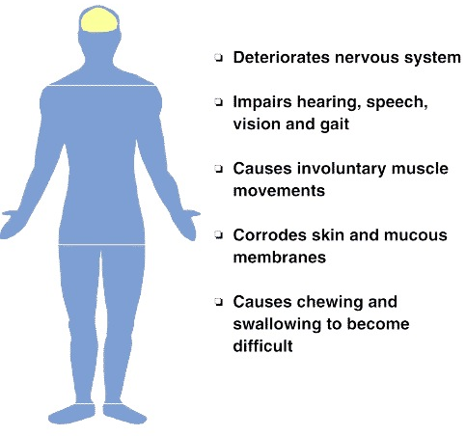
Health Effects Associated with MeHg Exposures
Frothing at the mouth
“Excessive” shyness
Source: USGS Fact Sheet

Slide 33



Cases of acute toxicity in adults (mercury poisoning)
Mainly among sushi lovers and/or when canned tuna is consumed in extremely large quantities
“After a personal experience with mercury poisoning, Richard Gelfond ’82 (IMAX CEO) established a new fund in the amount of $1 million to improve understanding of environmental cycling and public health effects of mercury.”
http://www.stonybrook.edu/research/news/RN/resnew100512.shtml

Slide 34
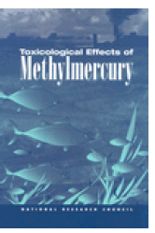
EPA chose to only include impacts of methylmercury exposure on IQ in children in their RIA
EPA’s RfD (2000)
5.8 μg/L blood ~ 1 ppm hair (100,000 – 600,000 US children/year)
Children IQ Deficits
Adult Cardiovascular Effects
Fetal exposures
>> RfD
Any fetal exposures
Male consumers of non-fatty freshwater fish with high MeHg
Male fish consumers
All fish consumers
Decreasing Credibility
Rice and Hammitt, 2005
http://books.nap.edu/execsumm_pdf/9899.pdf

Slide 35
There is no evidence of a threshold effect associated with methylmercury exposure
EPA’s RfD = 0.1 ug/kg/d (Other countries RfD: 0.1 - 0.47 µg/kg/d )
Based on an uncertainty factor of 10 to protect sensitive groups.
EPA’s RfD (reference dose) is widely believed to be too high – is currently being revisted
At maternal blood concentrations of 58 μg/L blood mercury one would expect a doubling of the number of poor performers on neurodevelopmental tests (from 5% to 10% of the population).
5.8 μg/L
Uncertainty factor of 10 to
protect sensitive groups

Slide 36
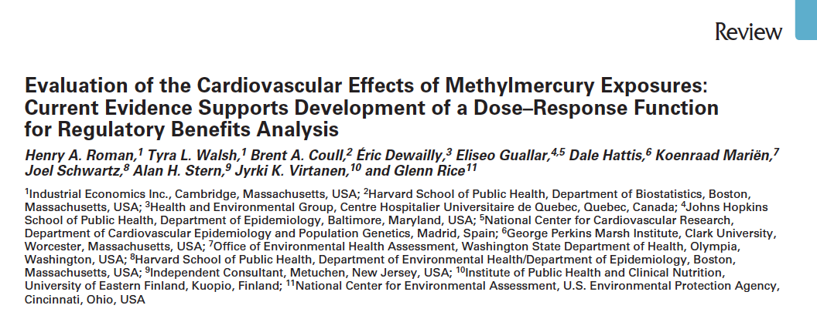
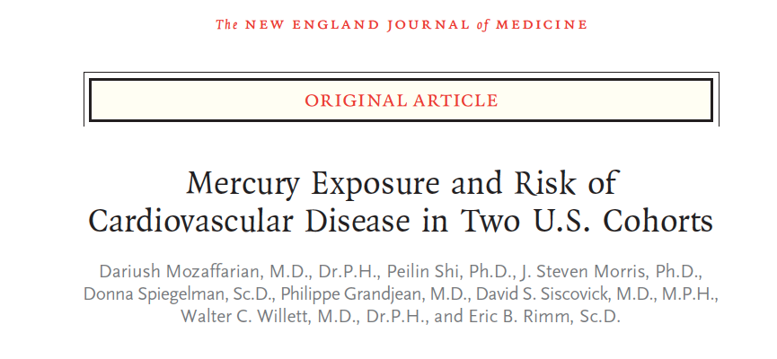

Robust evidence for cardiovascular impacts of MeHg Exposure
Environmental Health Perspectives
Vol. 119, No. 5, May 2011
New England J of Medicine, 2011
Low to moderate fish consumers

Slide 37

Monetary benefits attributable to cardiovascular health are much large than IQ benefits
CVD Leading Cause of Death for US Adults (>900,000/year)
Cardiovascular
Benefits (~80%)²
Declines in mortality
IQ Benefits
$18,000/IQ point
US: 4.2 million births 240 million adults
Cost: VSL = $7.6M
Cost: 15.8 Billion USD/year^{3,4}
¹AHA, 2004; ²Rice et al., 2010; ³Bellanger et al., 2013; ⁴Grandjean et al., 2012
VSL = Value of Statistical Life established by the Office of Management and Budget
https://www.epa.gov/environmental-economics/mortality-risk-valuation#whatvalue

Slide 38
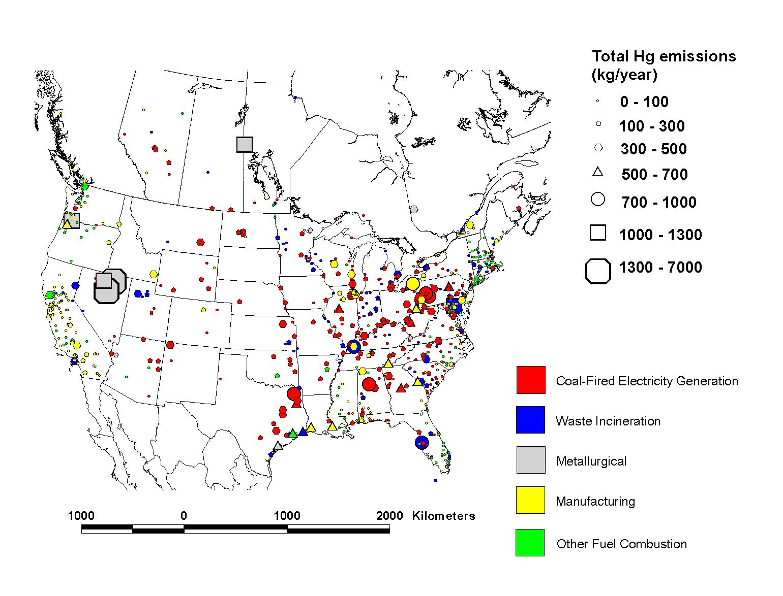
Geographic Distribution of Largest Anthropogenic Mercury Emissions Sources in the U.S. (1999) and Canada (2000)
15

Slide 39

Atmospheric redox chemistry plays key role
in Hg deposition to the surface
Long-range transport
oxidation
Hg(0)
Hg(II)
reduction
Hg(II)
Near-field deposition
far-field deposition
atmosphere
Local “hot spot”
foreign countries
remote environments
surface
39

Slide 40
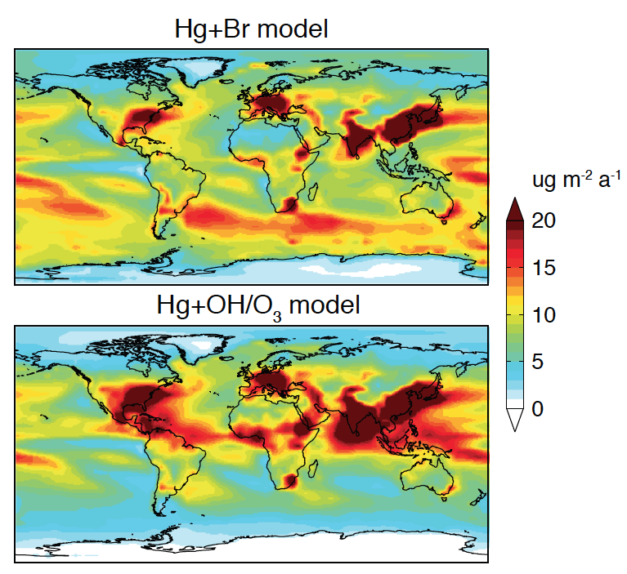
Oxidation and reduction reactions shift global deposition patterns
Selin et al. (2007)
Holmes et al. (2010)
Low concentrations of marine organics
NO₂ and HO₂, and higher Br
49%
Horowitz et al. (2017)
Higher deposition to tropical oceans supported by observed high oceanic Hg⁰ concentrations in the ITCZ, but no observations of wet deposition to constrain directly
40

Slide 41
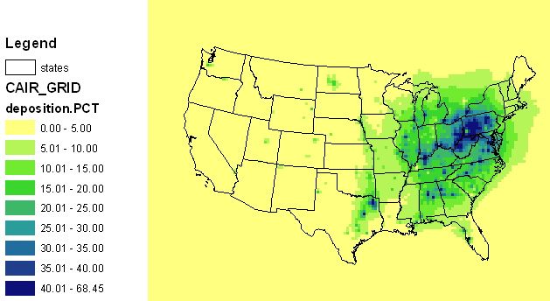
EPA models suggested the majority of Hg emissions from utilities would be transported globally
Mercury Deposition Attributable to Utility Emissions
Percent Change in Deposition (associated with a 100% decrease in utility emissions)
U.S. EPA Simulations using CMAQ Model 2005

Slide 42
Conversion of Hg(II) to CH₃Hg drives bioaccumulation
Hg(II)
Hg(0)
AIR
Hg(II)
CH₃Hg
SEDIMENT/
WATER
microbes
Sulfate/Iron Reducing Bacteria

Slide 43
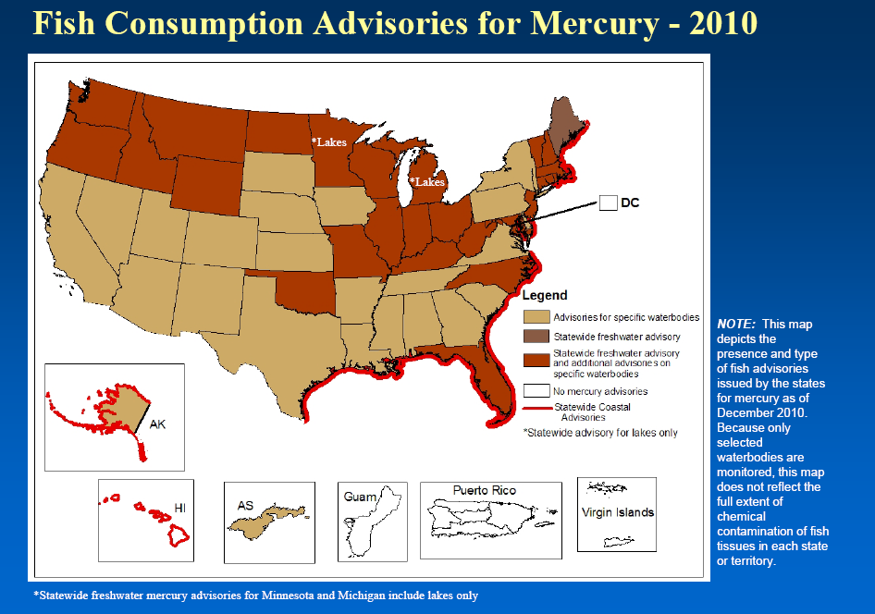
Fish Consumption Advisories for Mercury are Everywhere!
Advisories in 2010
Advisories for specific water bodies
Statewide freshwater advisory
Statewide freshwater advisory and additional advisories on specific waterbodies.
No mercury advisories
Statewide Coastal Advisories
* Statewide advisory for lakes only
NOTE: This map depicts the presence and type of fish advisories issued by the states for mercury as of December 2010. Because only selected waterbodies are monitored, this map does not reflect the full extent of chemical contamination of fish tissues in each state.
Source: 2010 National Listing of Fish Advisories
http://water.epa.gov/scitech/swguidance/fishshellfish/fishadvisories/upload/nlfa_slides_2011.pdf

Slide 44
EPA chose to only consider methylmercury exposures for the children of freshwater recreational fishers
Most seafood consumed in the US is from the commercial market and marine ecosystems
Source: EPA RIA, 2005

Slide 45
Number of Freshwater Recreational Freshwater Anglers very Small Compared to Total Seafood Consumers (>300 million)
>90% of the U.S. population reports consuming seafood
Region | Days Fishing (million days) | Percent of Total | Estimated Number of Consumers (millions of people)
Northeast | 37 | 9 | 2.0-4.9
Mid-Atlantic | 3 | 1 | 0.2-0.4
Southeast | 110 | 26 | 5.9-15
Midwest | 151 | 36 | 8.1-20
West | 123 | 29 | 6.6-17
Source: Fish and Wildlife Service, 2002

Slide 46
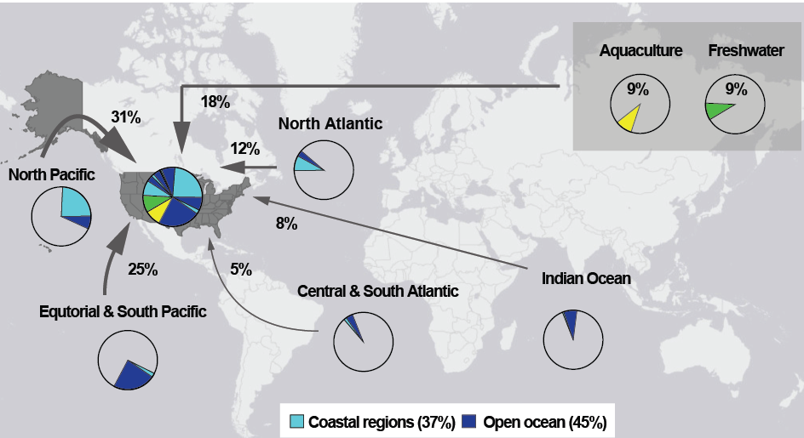
82% of Population-Wide MeHg Exposure
from Marine Ecosystems
Commercial marine fish consumption is the predominant source of MeHg exposure the United States
Sunderland et al., 2018

Slide 47
Mitigating health risks associated with mercury releases from coal-fired utilities
Regulatory background
U.S. electricity sector and pollution control technology costs
Modeled benefits of reducing Hg emissions
Actual changes in energy sector, Hg emissions, concentrations and exposures
Climate change and future trajectories in Hg exposure
Are EPA’s estimated benefits = $4-6M/year and costs = $9B reasonable?

Slide 48
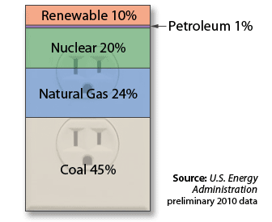
Sources of U.S. Electricity Generation
2016
2010

Slide 49
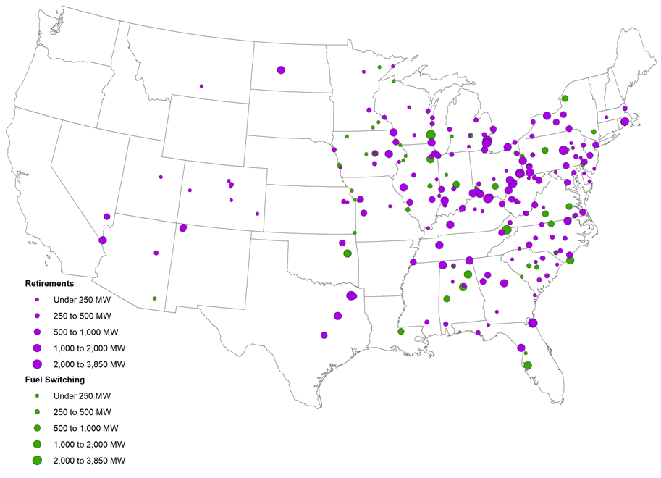
Hg emissions declines reflect retirements, fuel switching and emissions controls for coal-fired utilities
Source: US EPA, 2019

Slide 50
Source: US EPA, 2019

Slide 51
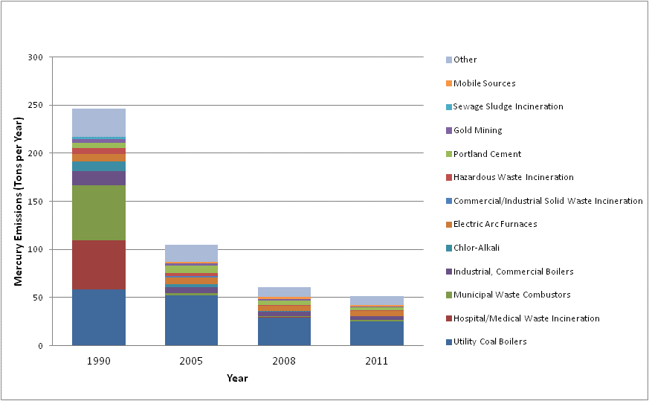
U.S. mercury emissions, major sources 1990, 2005, 2008, 2011
79% Decrease between 1990-2011
246
Mercury emissions from coal-fired EGUs declined 86% between 2010 and 2018
105
61
52
NEI 2011 version 1 2014

Slide 52
Marked decreases in Hg⁰ and Hg^{II} emissions due to SOx and NOx controls
U.S. mercury emissions from the power sector have decreased
65% from 2015-2017 and 81.7% from 2011-2017. TRI 2018
Decline in this component was underestimated by EPA
Zhang et al., 2016

Slide 53
We saw a >30% decline in atmospheric Hg concentrations between 1990 and 2010
Observed Trends Atmospheric Hg⁰ (1990-2010)
Hg⁰ (ng m⁻³)
Zhang et al., 2016

Slide 54
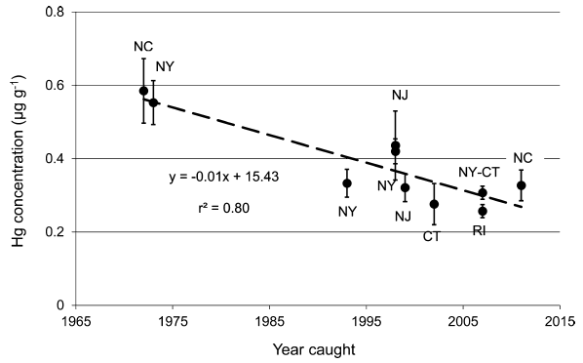
Decreasing Hg in mid-Atlantic blue fish
Cross et al. 2015

Slide 55
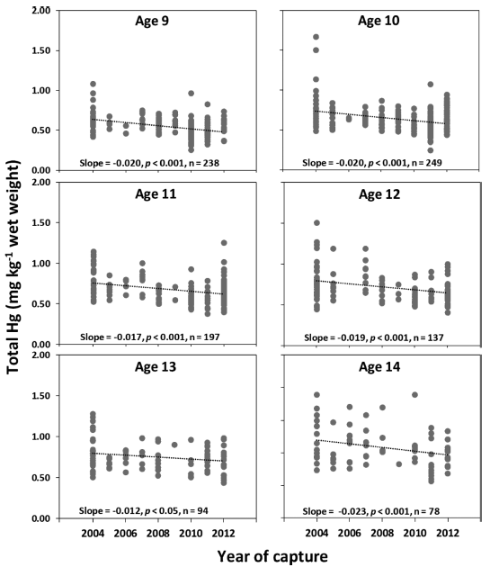
Decreases in mercury in Atlantic bluefin tuna
Decreases
in mercury 2004-2012
Across age classes in
Atlantic bluefin tuna
Lee et al, 2016

Slide 56
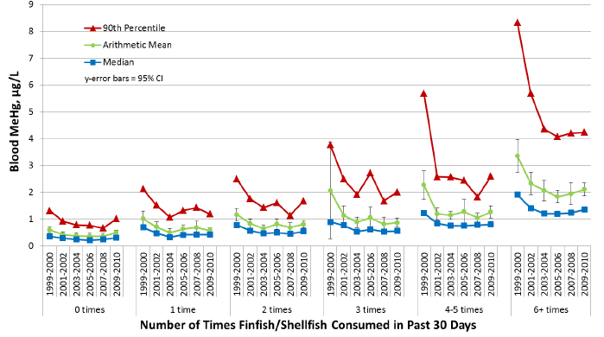
Declines in human exposure in National Health and Nutrition Examination Survey (NHANES)
Blood methylmercury in
U.S. women (16-49) have
declined likely due to
decreases in fish
mercury coupled with
improved consumption
advisories. NHANES 2013
U.S. children born with prenatal exposure exceeding the EPA reference dose have decreases from 200,000-400,000 to 100,000-200,000. EPA 2013

Slide 57
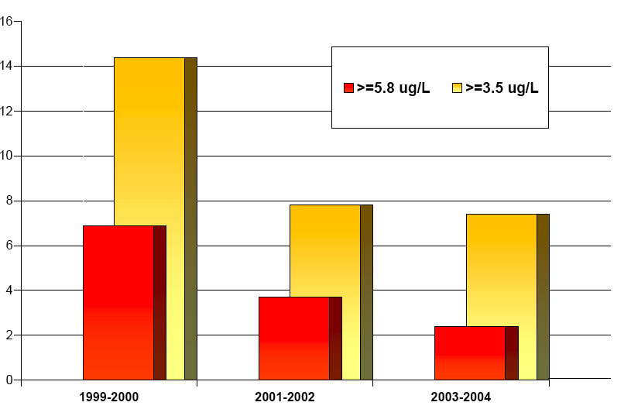

Blood Hg levels in women of childbearing age
U.S. Women Age 16-49 between 1999-2004
Percent of women exceeding U.S. EPA RfD
NHANES Survey Year
Source: Mahaffey et al., 2009

Slide 58
Mitigating health risks associated with mercury releases from coal-fired utilities
Regulatory background
U.S. electricity sector and pollution control technology costs
Modeled benefits of reducing Hg emissions
Actual changes in energy sector, Hg emissions, concentrations and exposures
Climate change and future trajectories in Hg exposure
Are EPA’s estimated benefits = $4-6M/year and costs = $9B reasonable?

Slide 59
What does the future hold?
Appropriate and Necessary finding for MATS reversed (“some pollutants are not worth regulating!”)
Once in, always in rule also being repealed:
Established in 1995, the “once in, always in” policy determined that any facility subject to major source standards would always remain subject to those standards—even if production processes changed or controls were implemented that eliminated or permanently reduced that facility's potential to emit hazardous air pollutants…
Climate change is altering chemical cycling independently of emissions (see tuna example)

Slide 60
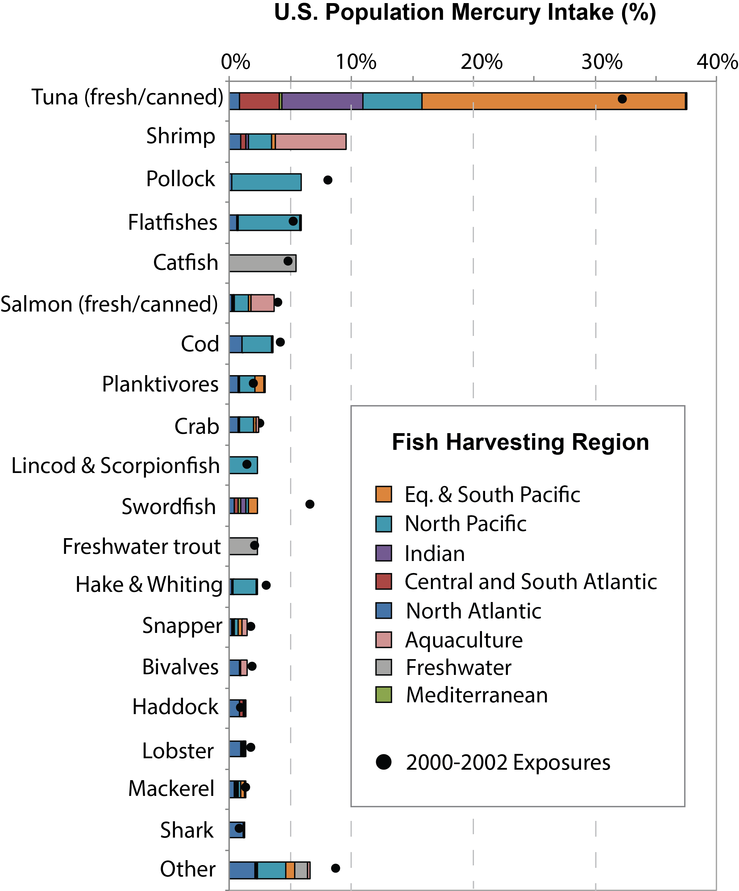

Tuna accounts for almost 40% of
US population-wide methylmercury exposure
Decadal differences
2000 – 2010
Based on NMFS
and FAO data
Sunderland et al., 2018

Slide 61
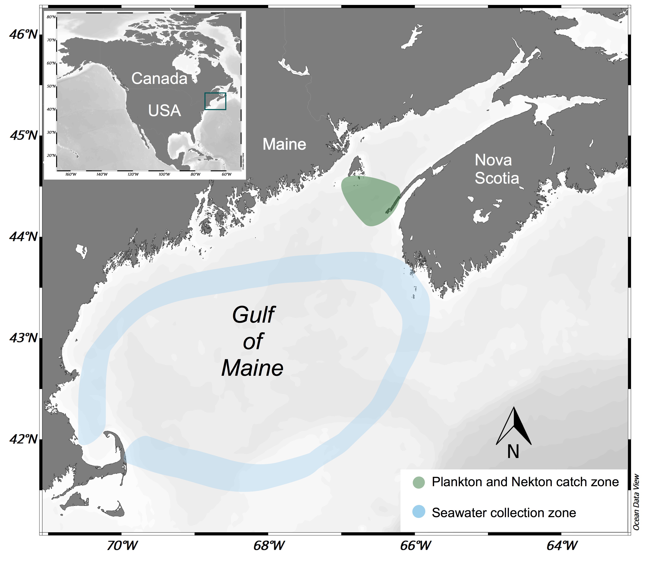
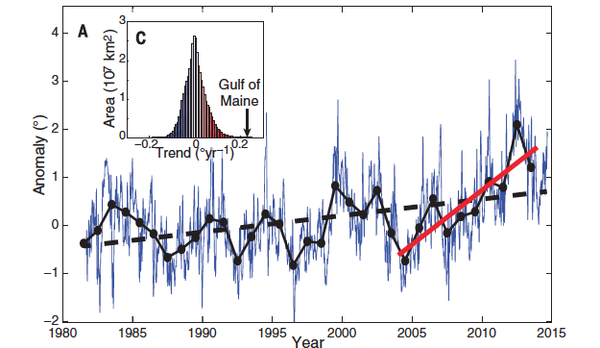
Seawater warming affects fish metabolism and growth, MeHg elimination, prey availability, and species habitat
Notes:
Mean seawater temperatures increased between 0.5 to 0.7°C between 1900 and 2000, followed by a period of rapid warming of 0.03°C per year beginning in 2004

Slide 62

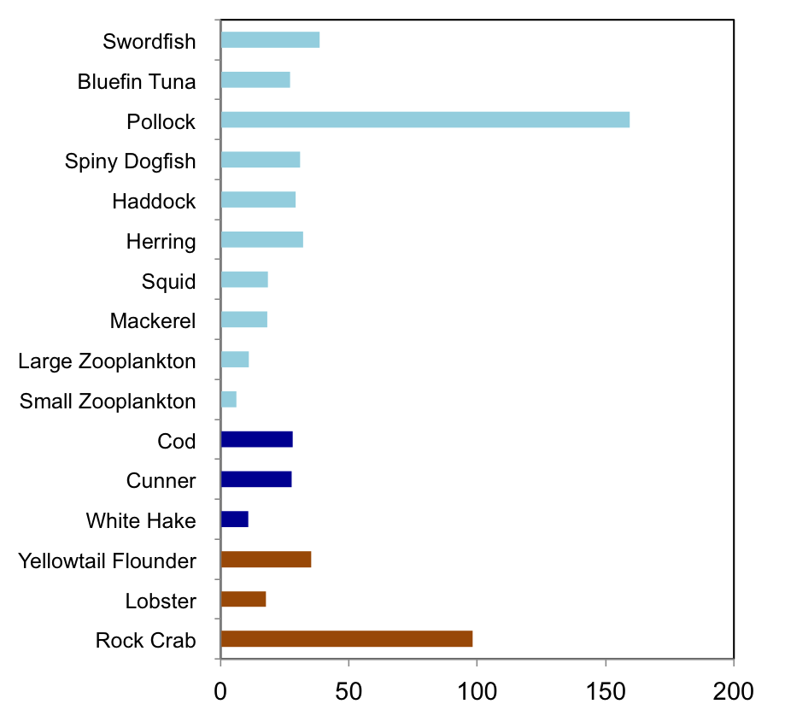

Species respond differently to temperature increase
Relative change in MeHg (%) in response to 1°C increase
Average
30%
Max
160%

Slide 63
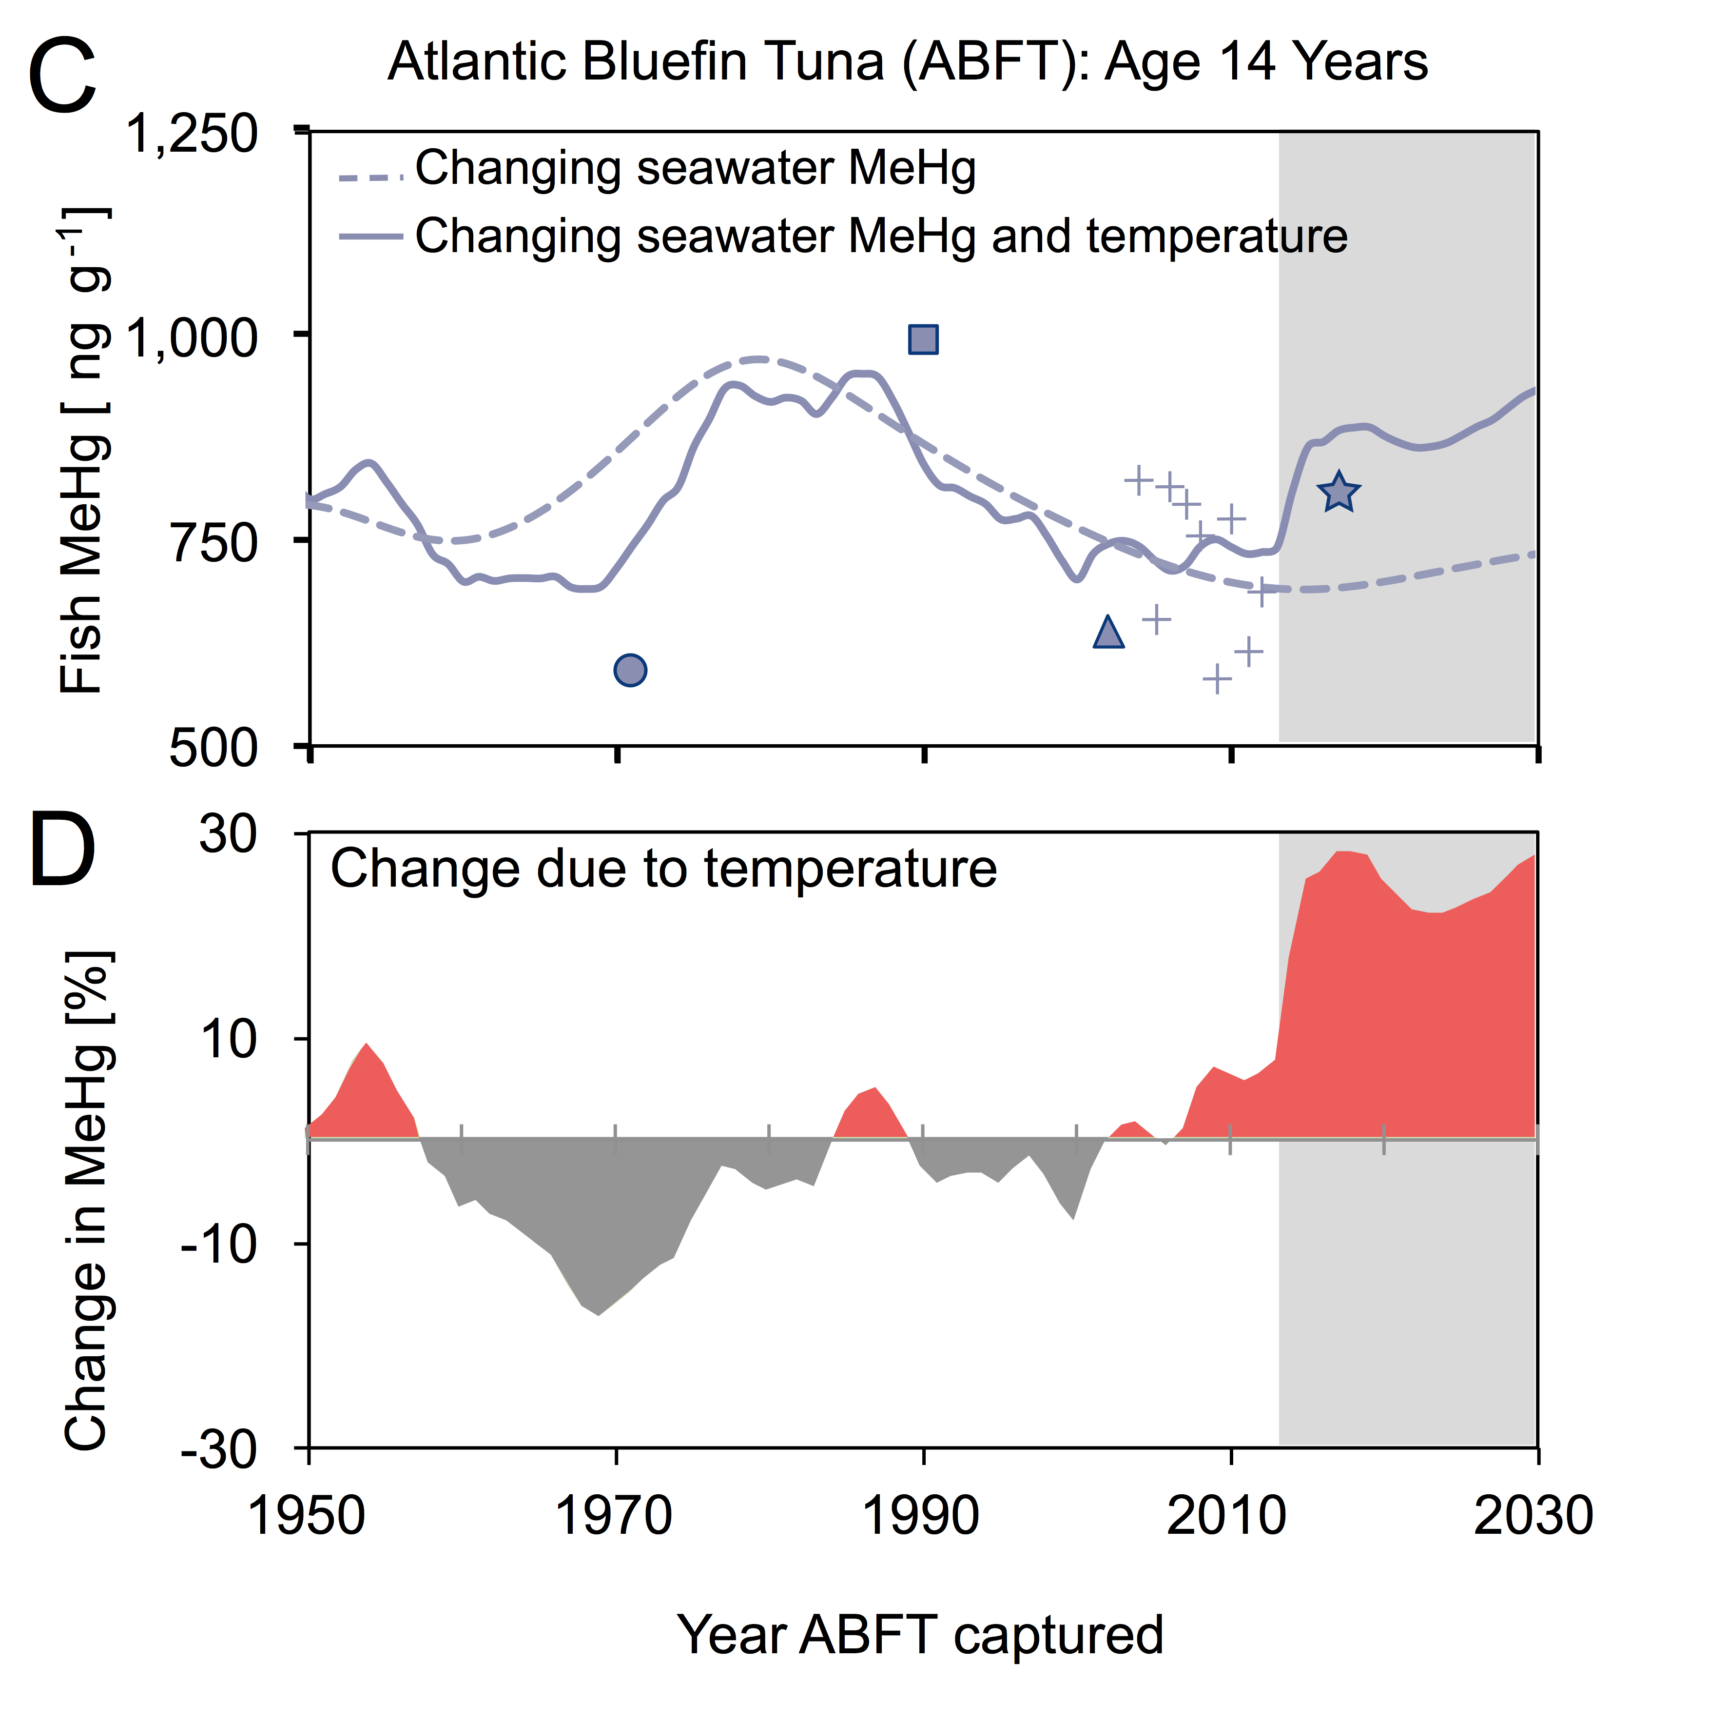
>20% decrease
between
1990-2010
~50% Increase
between
1970-2015
Schartup et al., 2019, Nature

Slide 64
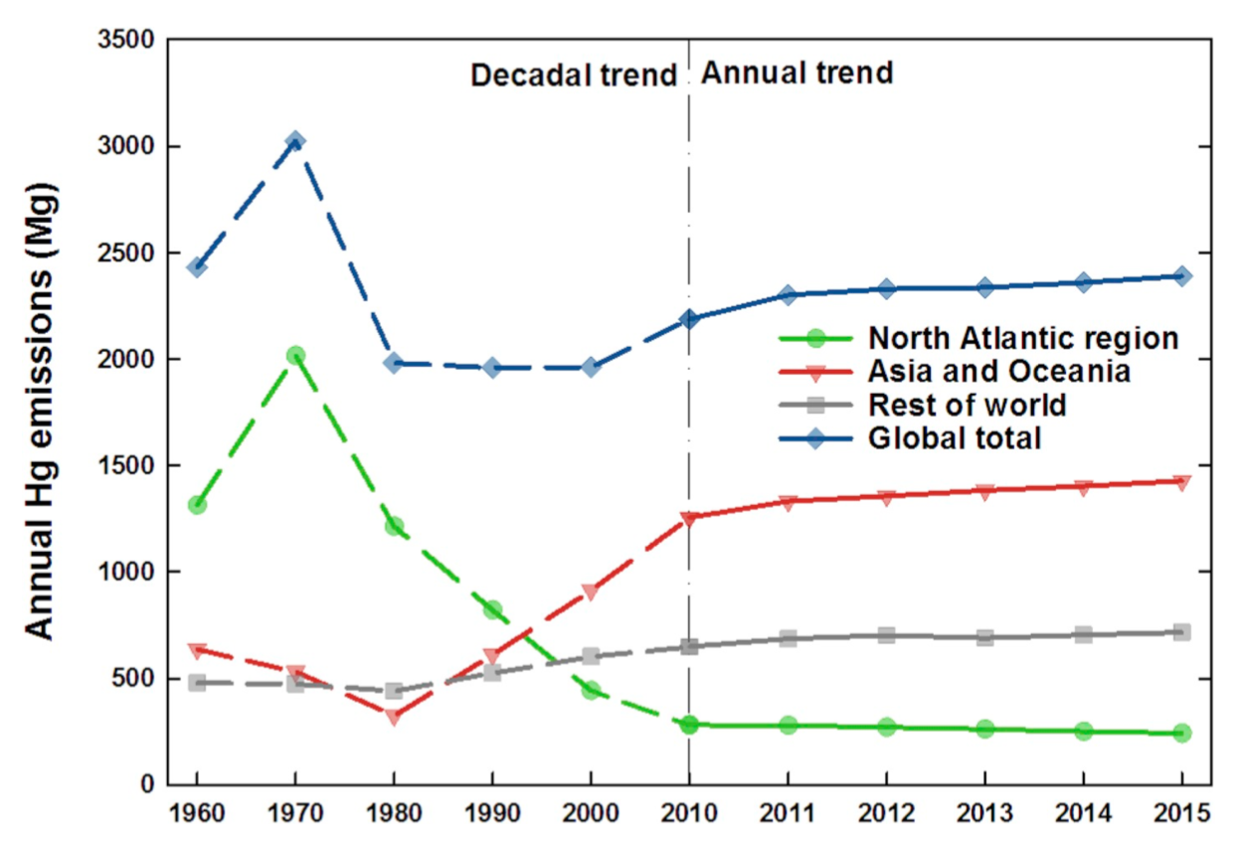
Current plateau in global Hg emissions means seawater warming will be important factor for methylmercury in marine fish
Need to reduce both CO₂ and Hg emissions!
Streets et al., 2019, Atm Environ

Slide 65
How to Download the Data
Air Markets Program Data https://ampd.epa.gov/ampd/
FTP site ftp://newftp.epa.gov/DMDnLoad/emissions/mats/
Field Audit Checklist Tool (FACT) https://www.epa.gov/airmarkets/field-audit-checklist-tool-fact
FACT API https://www.epa.gov/airmarkets/field-audit-checklist-tool-fact-api

Slide 66
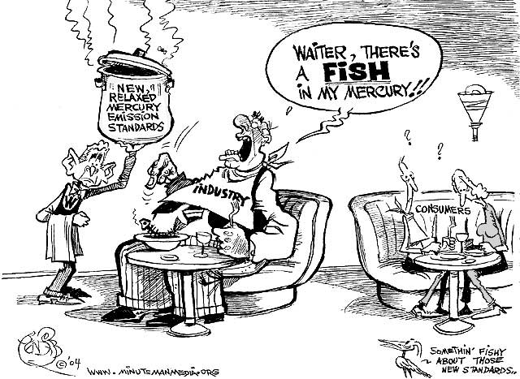
We need stronger not weaker regulations!

Slide 67
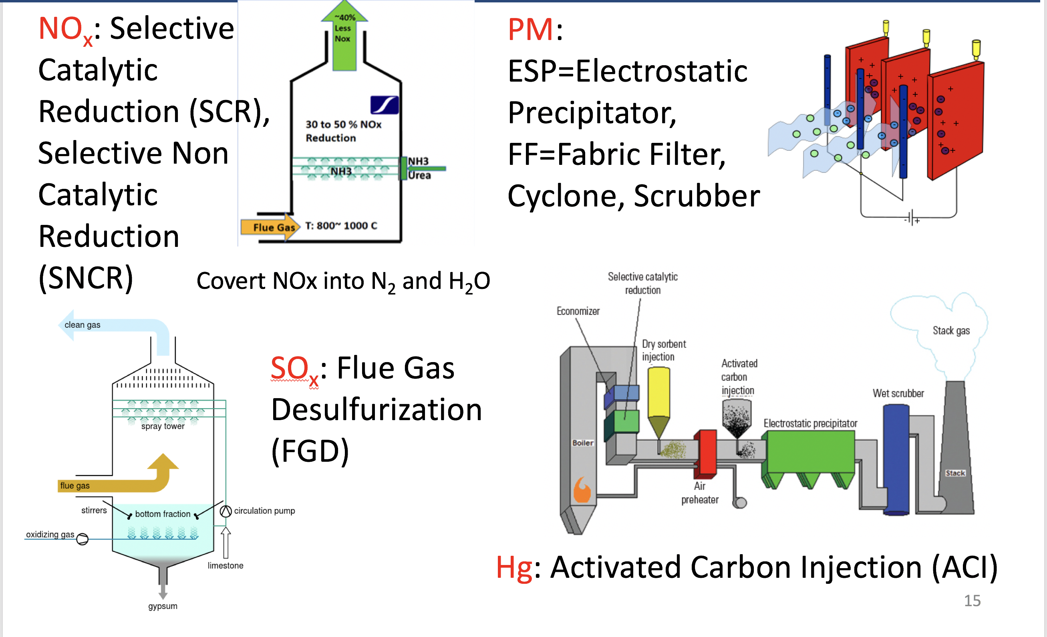
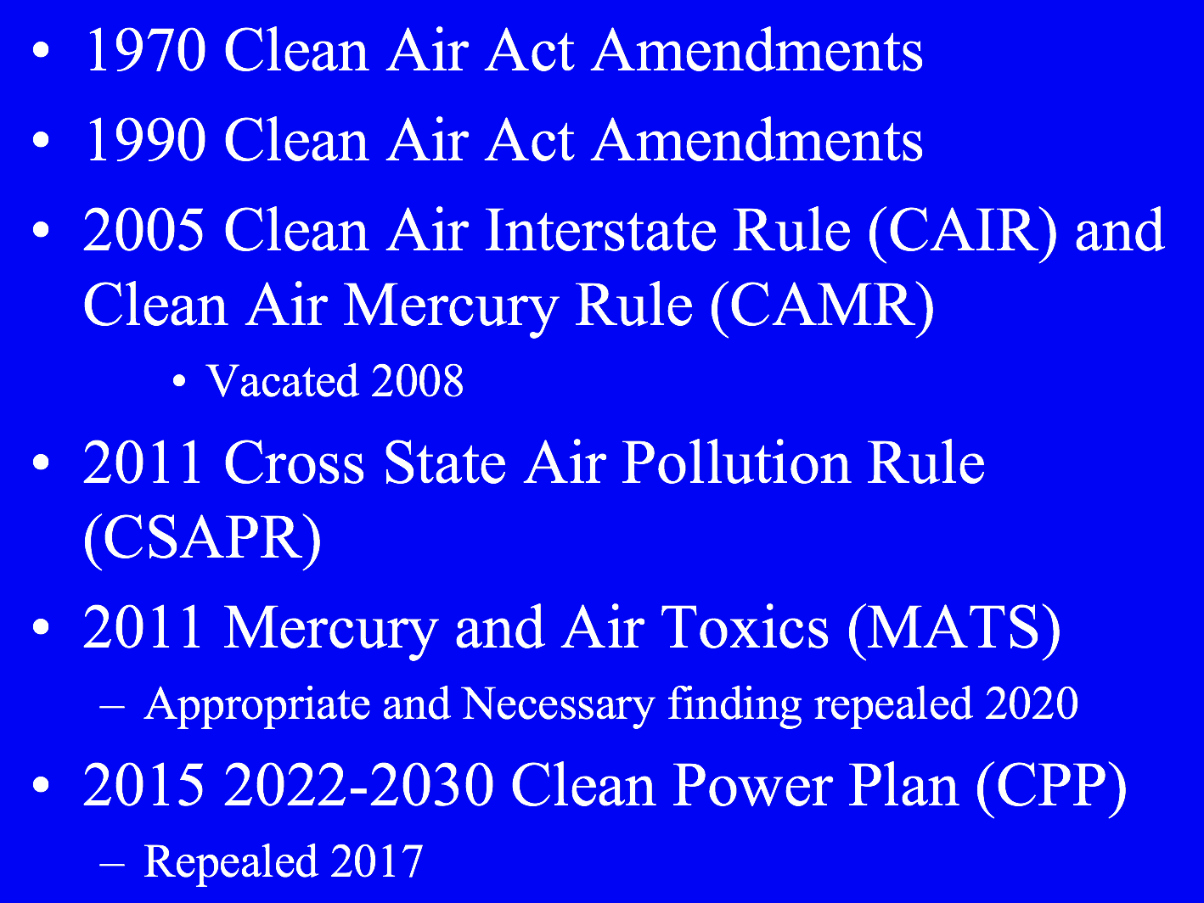
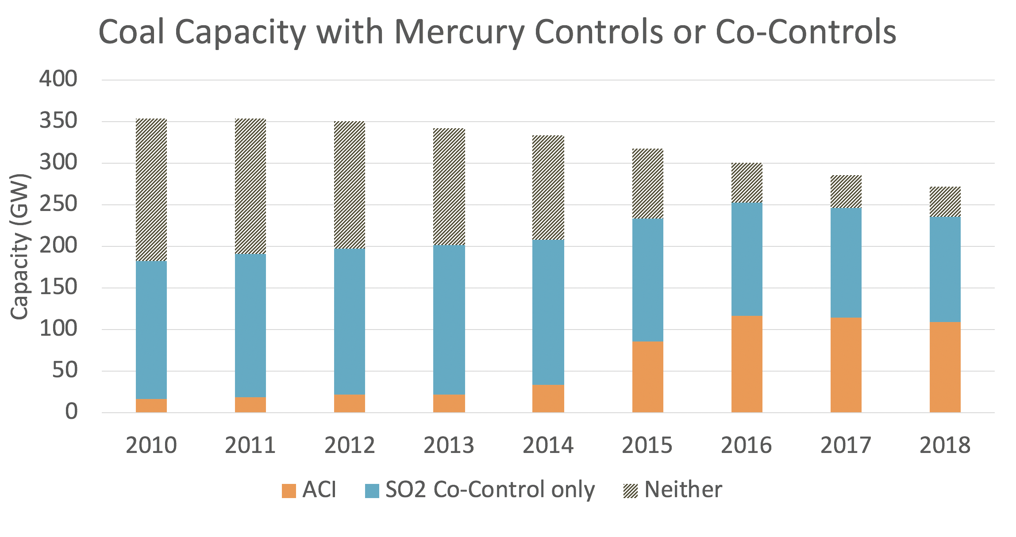
Air Toxics Roll Up: Coal-Fired Utilities
Coal was the most important component of US electricity generation in 2002.
We have the technology to virtually eliminate emissions of all pollutants from coal-fired utilities; implementation is a matter of cost and incentives.
>200 Hazardous Air Pollutants(HAPs) Released from Coal-Fired Utilities
By 2016, natural gas had replaced coal as the most important fuel used for electricity generation.
Electricity generation from coal has declined because many older, dirty plants have been retired. Remaining utilities have a suite of emissions control devices and came into compliance with MATS between 2015-2017.
Many air quality regulations have targeted pollution from coal-fired utilities: HAPs, criteria air pollutants (NAAQS), CO₂

Slide 68
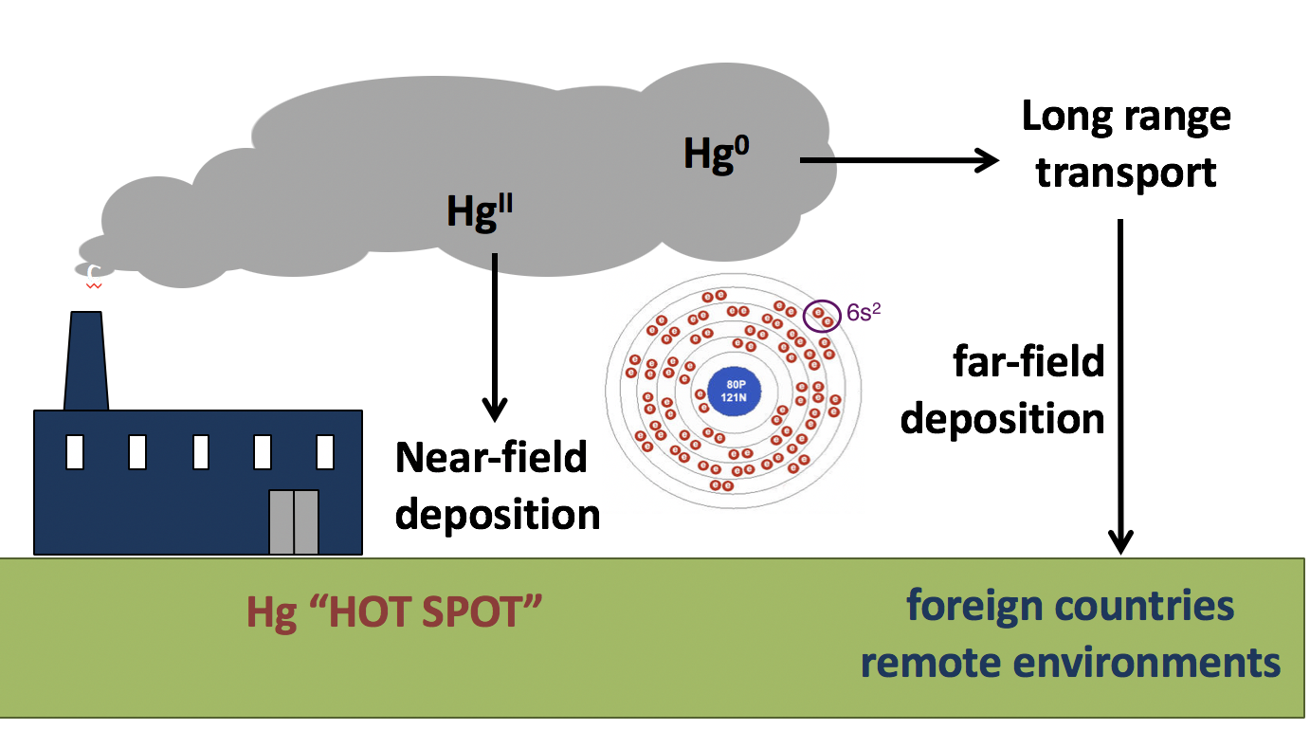
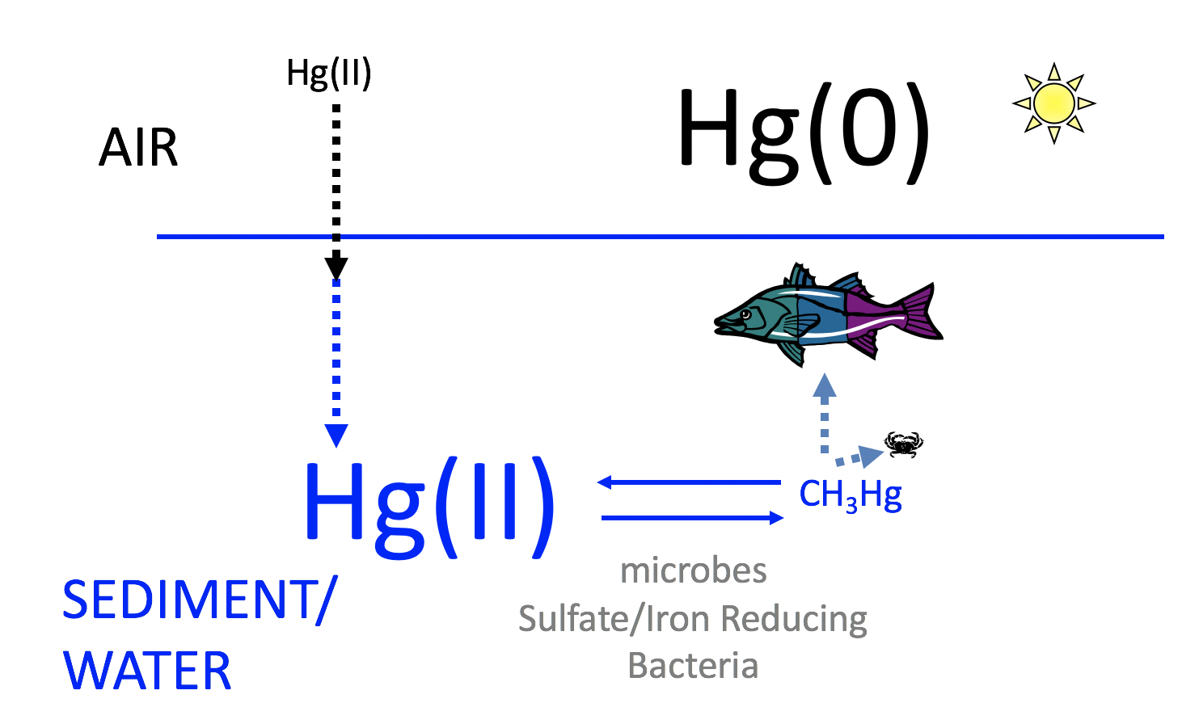
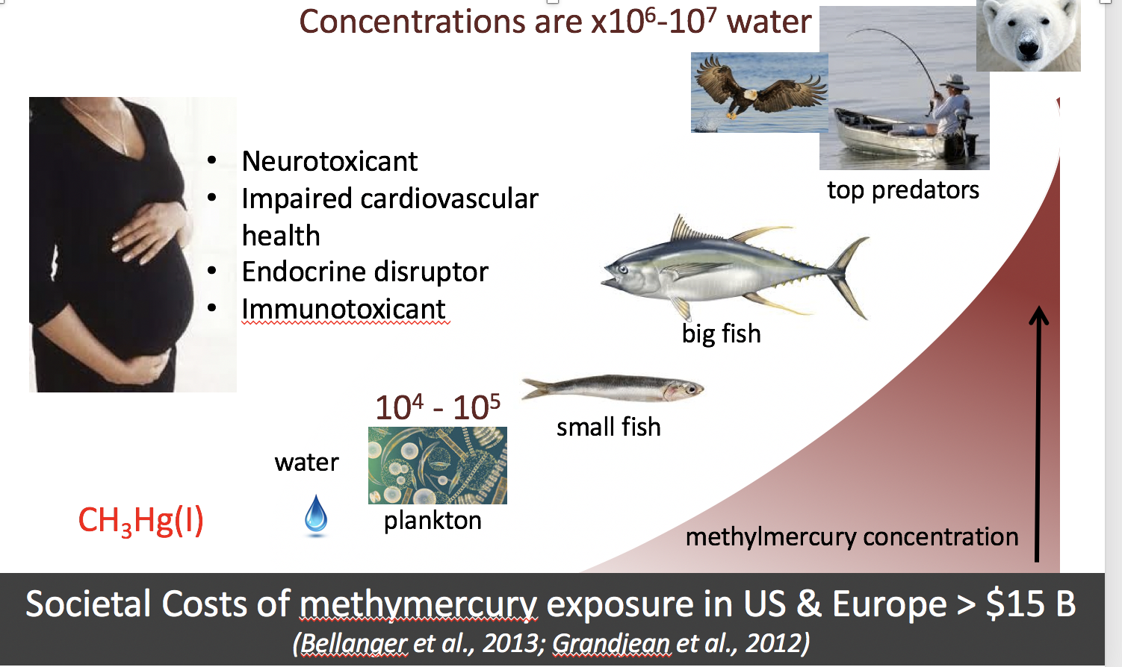
Air Toxics Roll Up: Case Study of Mercury in the Environment
Redox chemistry of Hg (gain of electrons or reduction to Hg⁰ and loss of electrons to form Hg^{II} dictates behavior (deposition or transport) in the atmosphere
Most Hg in ecosystems is Hg^{II}. A small fraction is converted by microbes under low oxygen conditions to CH₃Hg, the only form of Hg that biomagnifies in food webs.
Pregnant women (developing fetus) and children are most vulnerable to neurodevelopmental effects of CH₃Hg exposure; Main effect in adults is negative impacts on cardiovascular health.
CH₃Hg exposure is a function of how much fish you eat (magnitude) x the [Hg] in fish. This varies ~100x across species and is highest in older, predatory fish like swordfish and tuna
Shrimp are low in mercury but consumed a lot

Slide 69
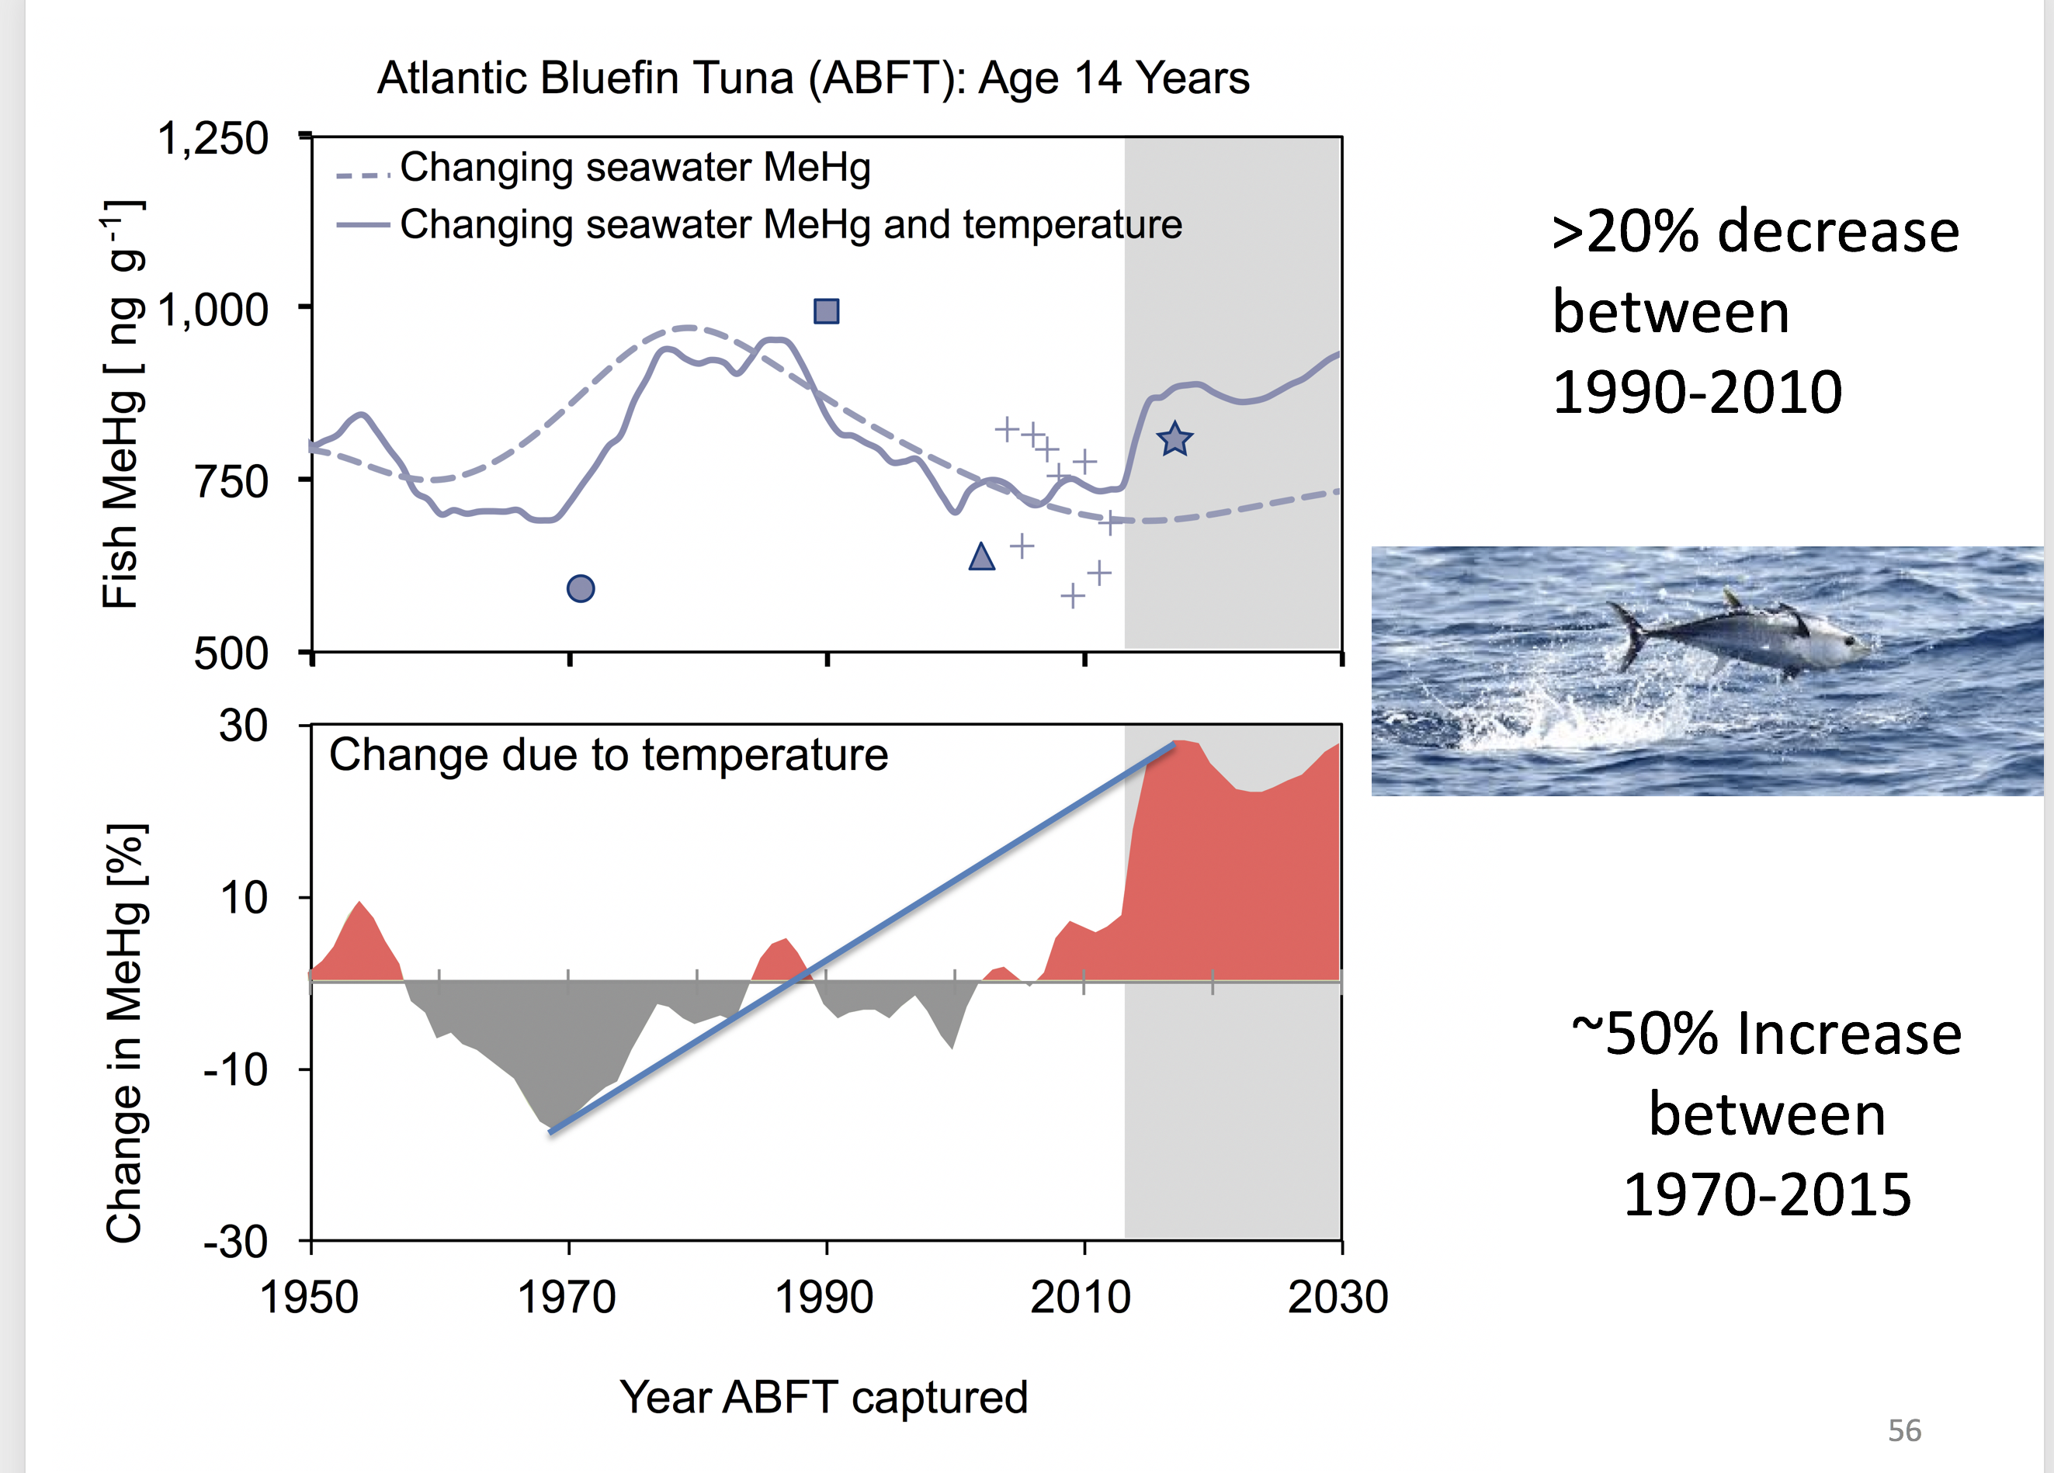
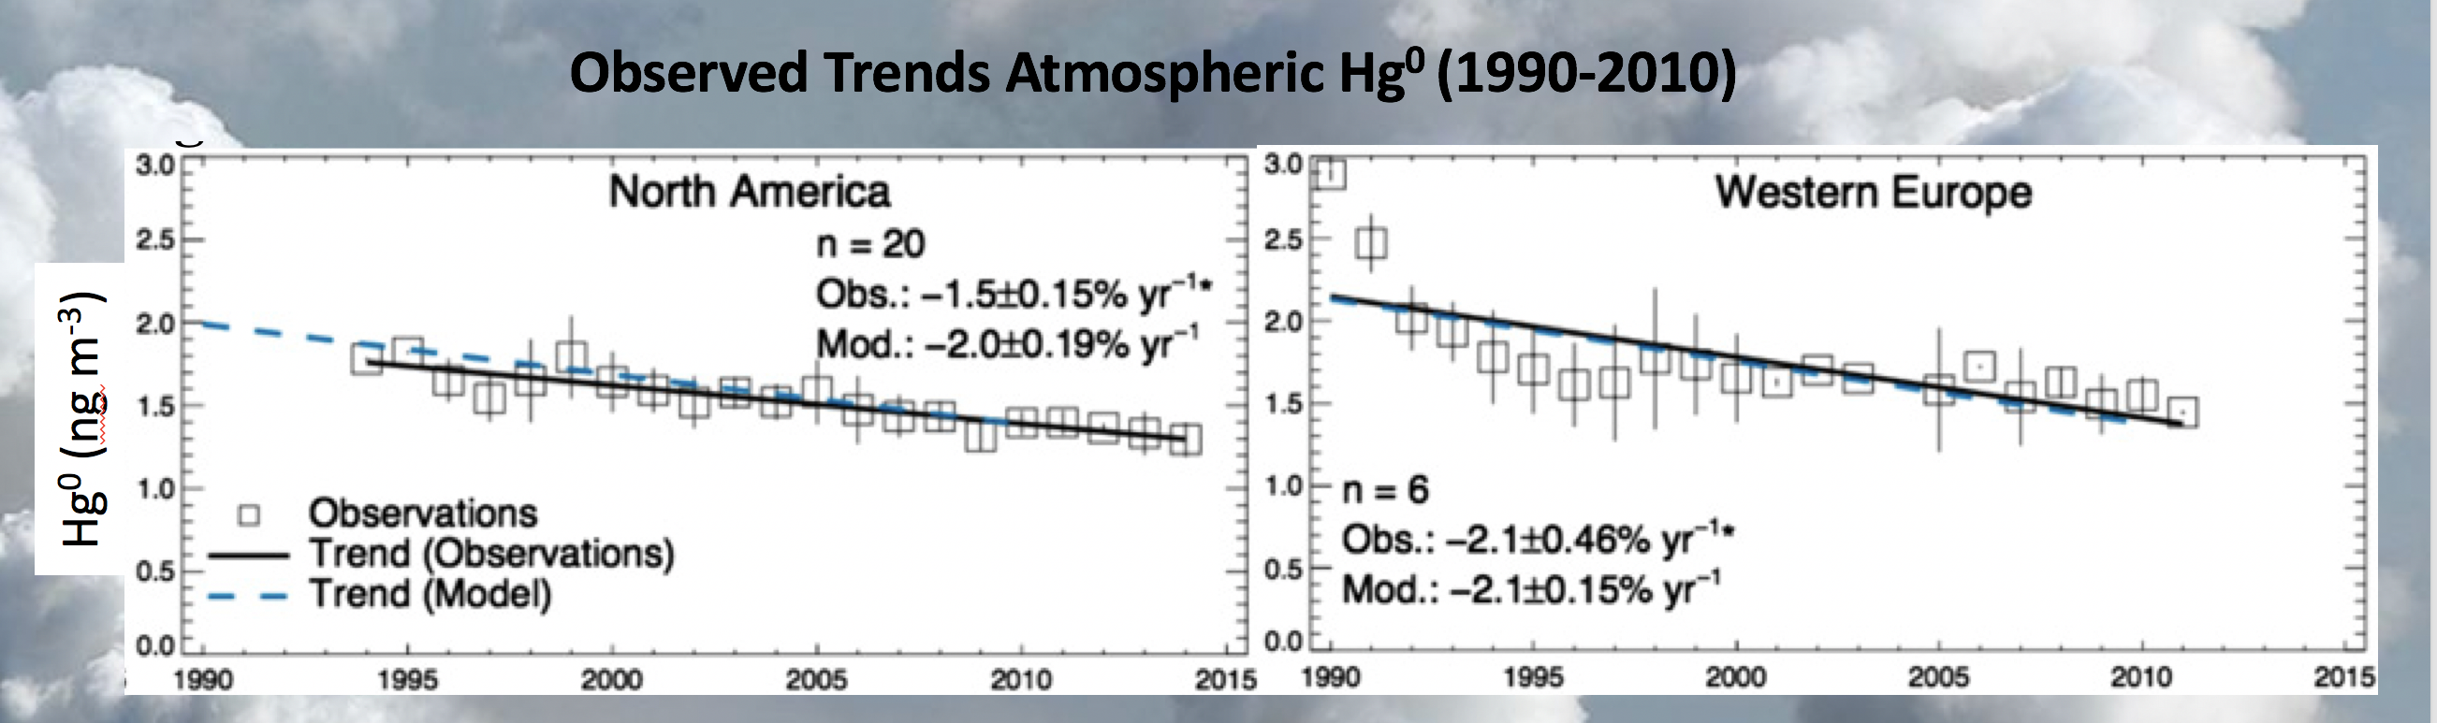
Air Toxics Roll Up: Trends in Mercury in the Environment
Coal-fired utilities accounted for 48% of US mercury emissions in 2015; largest remaining primary anthropogenic source
Large decline in Hg emissions from US coal-fired utilities mainly reflects co-benefits of controls on traditional air pollutants (FGD/SCR)
79% Decrease in US Hg emissions 1990-2011
Declining Hg concentrations were observed in tuna in the western North Atlantic between 2004-2012 but these levels now appear to be rising due to warming seawater temperatures! Controls on both Hg and CO₂ needed!
Declines in Hg emissions explain a 30% decline in atmospheric Hg concentrations observed between 1990-2010. This is much larger than expected when the MATS rule was developed.

