Slide 1
International Corporate Finance
Review Session 10
Nicole Hruban

Slide 2
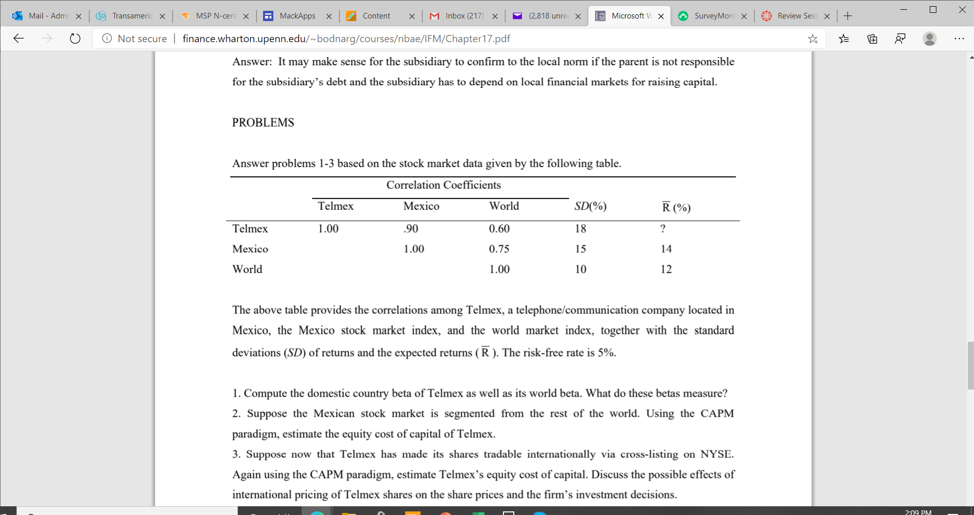

International Cost of Capital

Slide 3
International Cost of Capital

Slide 4
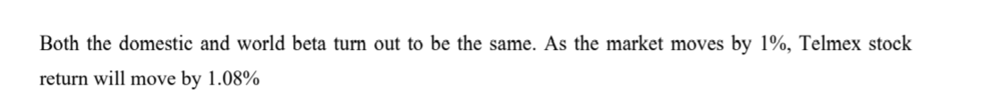
International Cost of Capital
$$Country Beta of Telmex: β= ρ_{i,,M}∗\frac{σ_{i}}{σ_{M}}=0.9∗\frac{0.18}{0.15}=1.08$$
$$World Beta of Telmex: β= ρ_{i,,W}∗\frac{σ_{i}}{σ_{W}}=0.6∗\frac{0.18}{0. 10}=1.08$$

Slide 5
International Cost of Capital

Slide 6
International Cost of Capital
= 5% + 1.08 *(14%-5%) = 14.72%

Slide 7
International Cost of Capital

Slide 8
International Cost of Capital
= 5% + 1.08*(12%-5%) = 12.56%
Since the Cost of Capital decreased, the company’s share price will likely increase. Company will also be able to undertake more projects profitability

Slide 9
International CAPITAL BUDGETING
Slinger Wayne, a U.S.-based private equity firm, is trying to determine what it should pay for a tool manufacturing firm in Honduras named Carambola. Slinger Wayne estimates that Carambola will generate a free cash flow of 13 million Honduran lempiras (Lp) next year (2012), and that this free cash flow will continue to grow at a constant rate of 8.0% per annum indefinitely. A private equity firm like Slinger Wayne, however, is not interested in owning a company for long, and plans to sell Carambola at the end of three years for approximately 10 times Carambola’s free cash flow in that year. The current spot exchange rate is Lp14.80/$, but the Honduran inflation rate is expected to remain at a relatively high rate of 16.0% per annum compared to the U.S. dollar inflation rate of only 2.0% per annum. Slinger Wayne expects to earn at least a 20% annual rate of return on international investments like Carambola.
What is Carambola worth if the Honduran lempira were to remain fixed over the three year investment period?
What is Carambola worth if the Honduran lempira were to change in value over time according to purchasing power parity?

Slide 10
Assumptions:
What is Carambola worth if the Honduran lempira were to remain fixed over the three year investment period?

Slide 11
Notes:
FCF = EBIT(1-T) + DEP – del NWCI – CAPEX
Del NWCI = (dA/R + dINV + dPrep ) – (delA/P + del Accruals)
CAPEX = EOP NFA – BOP NFA + DEP

Slide 12
8% growth per year
e.g. 13MM * 1.08 = 14.04MM
10th multiple of 2015 cash flow
Assumption: Lp remains fixed over project period
Divide the Lp cash flows by the Lp/$ exchange rate, e.g.
Lp13MM / (Lp14.8/$) = 878,378
PV factor = 1/(1+i)^{t},
e.g. for year 1
1/(1+20%)¹ = 0.833

Slide 13
Assumptions:
What is Carambola worth if the Honduran lempira were to change in value over time according to purchasing power parity?

Slide 14
Assumptions:
Step) Calculate the PPP implied exchange rate for the Honduran Lempira vs. USD

Slide 15
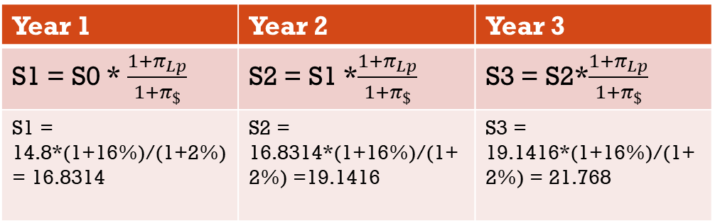
Assumptions:
Step) Calculate the PPP implied exchange rate for the Honduran Lempira vs. USD
Year 1 | Year 2 | Year 3
S1 = S0 * $\frac{1+π_{Lp}}{1+π_{\$}}$ | S2 = S1 *$\frac{1+π_{Lp}}{1+π_{\$}}$ | S3 = S2*$\frac{1+π_{Lp}}{1+π_{\$}}$
S1 = 14.8*(1+16%)/(1+2%) = 16.8314 | S2 = 16.8314*(1+16%)/(1+2%) =19.1416 | S3 = 19.1416*(1+16%)/(1+2%) = 21.768

Slide 17
8% growth per year
e.g. 13MM * 1.08 = 14.04MM
10th multiple of 2015 cash flow
Calculated rate
Divide the Lp cash flows by the Lp/$ exchange rate, e.g.
Lp13MM / (Lp16.8314/$) = 772,367
PV factor = 1/(1+i)^{t},
e.g. for year 1
1/(1+20%)¹ = 0.833

Slide 18
International Capital Budgeting
Natural Mosaic Company (U.S.) is considering investing Rs50,000,000 in India to create a wholly owned tile manufacturing plant to export to the European market. After five years the subsidiary would be sold to Indian investors for Rs100,000,000. A pro forma income statement for the Indian operation predicts the generation of Rs7,000,000 of annual cash flow, is listed below.
The initial investment will be made on December 31, 2011, and cash flows will occur on December 31st of each succeeding year. Annual cash dividends to Philadelphia Composite from India will equal 75% of accounting income.
The U.S. corporate tax rate is 40% and the Indian corporate tax rate is 50%. Because the Indian tax rate is greater than the U.S. tax rate, annual dividends paid to Natural Mosaic will not be subject to additional taxes in the United States. There are no capital gains taxes on the final sale. Natural Mosaic uses a weighted average cost of capital of 14% on domestic investments, but will add 6 percentage points for the Indian investment because of perceived greater risk. Natural Mosaic forecasts the rupee/dollar exchange rate for December 31st on the next six years are listed below.
What is the net present value and internal rate of return on this investment?

Slide 19
Assumptions:

Slide 20
Project View

Slide 21
Project View
PV factor = 1/(1+i)^{t},
e.g. for year 1
1/(1+20%)¹ = 0.833
For year 2
1/(1+20%)² = 0.6944

Slide 22
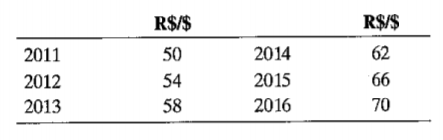
Parent View

Slide 23
Note: IRR is calculated with non-discounted Cash Flows
PV factor = 1/(1+i)^{t},
e.g. for year 1
1/(1+20%)¹ = 0.833
For year 2
1/(1+20%)² = 0.6944

