Slide 1
International Corporate Finance
Review Session 11
Nicole Hruban

Slide 2
International CAPITAL BUDGETING
Slinger Wayne, a U.S.-based private equity firm, is trying to determine what it should pay for a tool manufacturing firm in Honduras named Carambola. Slinger Wayne estimates that Carambola will generate a free cash flow of 13 million Honduran lempiras (Lp) next year (2012), and that this free cash flow will continue to grow at a constant rate of 8.0% per annum indefinitely. A private equity firm like Slinger Wayne, however, is not interested in owning a company for long, and plans to sell Carambola at the end of three years for approximately 10 times Carambola’s free cash flow in that year. The current spot exchange rate is Lp14.80/$, but the Honduran inflation rate is expected to remain at a relatively high rate of 16.0% per annum compared to the U.S. dollar inflation rate of only 2.0% per annum. Slinger Wayne expects to earn at least a 20% annual rate of return on international investments like Carambola.
What is Carambola worth if the Honduran lempira were to remain fixed over the three year investment period?
What is Carambola worth if the Honduran lempira were to change in value over time according to purchasing power parity?

Slide 3
Assumptions:
What is Carambola worth if the Honduran lempira were to remain fixed over the three year investment period?

Slide 4
Notes:
FCF = EBIT(1-T) + DEP – del NWCI – CAPEX
Del NWCI = (dA/R + dINV + dPrep ) – (delA/P + del Accruals)
CAPEX = EOP NFA – BOP NFA + DEP

Slide 5
8% growth per year
e.g. 13MM * 1.08 = 14.04MM
10th multiple of 2015 cash flow
Assumption: Lp remains fixed over project period
Divide the Lp cash flows by the Lp/$ exchange rate, e.g.
Lp13MM / (Lp14.8/$) = 878,378
PV factor = 1/(1+i)^{t},
e.g. for year 1
1/(1+20%)¹ = 0.833

Slide 6
Assumptions:
What is Carambola worth if the Honduran lempira were to change in value over time according to purchasing power parity?

Slide 7
Assumptions:
Step) Calculate the PPP implied exchange rate for the Honduran Lempira vs. USD

Slide 8
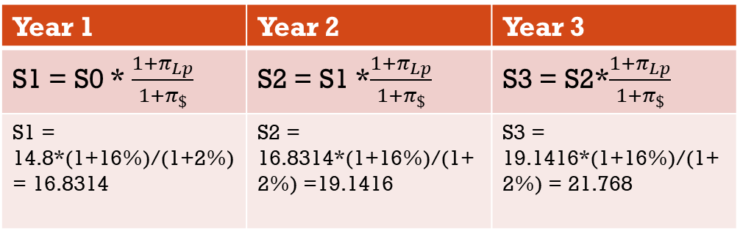
Assumptions:
Step) Calculate the PPP implied exchange rate for the Honduran Lempira vs. USD
Year 1 | Year 2 | Year 3
S1 = S0 * $\frac{1+π_{Lp}}{1+π_{\$}}$ | S2 = S1 *$\frac{1+π_{Lp}}{1+π_{\$}}$ | S3 = S2*$\frac{1+π_{Lp}}{1+π_{\$}}$
S1 = 14.8*(1+16%)/(1+2%) = 16.8314 | S2 = 16.8314*(1+16%)/(1+2%) =19.1416 | S3 = 19.1416*(1+16%)/(1+2%) = 21.768

Slide 10
8% growth per year
e.g. 13MM * 1.08 = 14.04MM
10th multiple of 2015 cash flow
Calculated rate
Divide the Lp cash flows by the Lp/$ exchange rate, e.g.
Lp13MM / (Lp16.8314/$) = 772,367
PV factor = 1/(1+i)^{t},
e.g. for year 1
1/(1+20%)¹ = 0.833

Slide 11
International Capital Budgeting
Natural Mosaic Company (U.S.) is considering investing Rs50,000,000 in India to create a wholly owned tile manufacturing plant to export to the European market. After five years the subsidiary would be sold to Indian investors for Rs100,000,000. A pro forma income statement for the Indian operation predicts the generation of Rs7,000,000 of annual cash flow, is listed below.
The initial investment will be made on December 31, 2011, and cash flows will occur on December 31st of each succeeding year. Annual cash dividends to Philadelphia Composite from India will equal 75% of accounting income.
The U.S. corporate tax rate is 40% and the Indian corporate tax rate is 50%. Because the Indian tax rate is greater than the U.S. tax rate, annual dividends paid to Natural Mosaic will not be subject to additional taxes in the United States. There are no capital gains taxes on the final sale. Natural Mosaic uses a weighted average cost of capital of 14% on domestic investments, but will add 6 percentage points for the Indian investment because of perceived greater risk. Natural Mosaic forecasts the rupee/dollar exchange rate for December 31st on the next six years are listed below.
What is the net present value and internal rate of return on this investment?

Slide 12
Assumptions:

Slide 13
Project View

Slide 14
Project View
PV factor = 1/(1+i)^{t},
e.g. for year 1
1/(1+20%)¹ = 0.833
For year 2
1/(1+20%)² = 0.6944

Slide 15
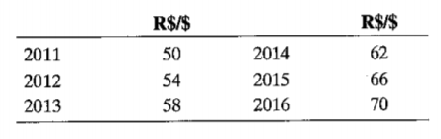
Parent View

Slide 16
Note: IRR is calculated with non-discounted Cash Flows
PV factor = 1/(1+i)^{t},
e.g. for year 1
1/(1+20%)¹ = 0.833
For year 2
1/(1+20%)² = 0.6944

Slide 17
Kraftstoff is a German-based company that manufactures electronic fuel-injection carburetor assemblies for several large automobile companies in Germany, including Mercedes, BMW, and Opel. The firm, like many firms in Germany today, is revising its financial policies in line with the increasing degree of disclosure required by firms if they wish to list their shares publicly in or out of Germany. The company’s earnings before tax (EBT) is €483,500,000.
Kraftstoff’s primary problem is that the German corporate income tax code applies a different income tax rate to income depending on whether it is retained (45%) or distributed to stockholders (30%).
If Kraftstoff planned to distribute 50% of its net income, what would be its total net income and total corporate tax bills?
b. If Kraftstoff was attempting to choose between a 40% and 60% payout rate to stockholders, what arguments and values would management use in order to convince stockholders which of the two pay-outs is in everyone’s best interest?

Slide 19
Retained is taxed 15% above distributed:
15%*E169,225,000=
$25,383,750
E169,225,000+E143,841,250=E313,066,250
E145,050,000 + E25,383,750 = E170,433,750

Slide 20
TAXATION
Pacific Jewel Airlines is a U.S.-based air freight firm with a wholly owned subsidiary in Hong Kong. The subsidiary, Jewel Hong Kong, has just completed a long-term planning report for the parent company in San Francisco, in which it has estimated the following expected earnings and payout rates for the years 2011–2014.
The current Hong Kong corporate tax rate on this category of income is 16.5%. Hong Kong imposes no withholding taxes on dividends remitted to U.S. investors (per the Hong Kong-United States bilateral tax treaty). The U.S. corporate income tax rate is 35%. The parent company wants to repatriate 75% of net income as dividends annually.
a. Calculate the net income available for distribution by the Hong Kong subsidiary for the years 2011–2014.
b. What is the amount of the dividend expected to be remitted to the U.S. parent each year?
c. After estimating the theoretical U.S. tax liability on the expected dividend (what is often termed gross-up in the U.S.), what is the total dividend after tax, including all Hong Kong and U.S. taxes, expected each year?
d. What is the effective tax rate on this foreign-sourced income per year?

Slide 21
Taxation
a. Calculate the net income available for distribution by the Hong Kong subsidiary for the years 2011–2014.

Slide 22
Taxation
a. Calculate the net income available for distribution by the Hong Kong subsidiary for the years 2011–2014.
$8,000 - $800 - $1,188 = $6,012
$10,000 - $1,000 - $1,1485 = $7,515

Slide 23
Taxation
What is the amount of the dividend expected to be remitted to the U.S. parent each year?
Dividends remitted
Retained Earnings

Slide 24
Taxation
What is the amount of the dividend expected to be remitted to the U.S. parent each year?
NOTE: No withholding tax on dividends
75%*$6,012 = $4,509
75%*$7,515 = $5,636

Slide 25
After estimating the theoretical U.S. tax liability on the expected dividend (what is often termed gross-up in the U.S.), what is the total dividend after tax, including all Hong Kong and U.S. taxes, expected each year?

Slide 26
Difference between Theoretical Liability and Foreign tax credits:
$1890 - $891 = $999
75% of Hong Kong Corporate Income Tax:
0.75*$1,180=891
(we only paid out 75%)
35%*$5,400=
$1,890
We can a credit for the (proportional) HK income tax paid $891

Slide 27
Difference between Theoretical Liability and Foreign tax credits:
$1890 - $891 = $999
75% of Hong Kong Corporate Income Tax:
0.75*$1,180=891
(we only paid out 75%)
35%*$5,400=
$1,890
We can a credit for the (proportional) HK income tax paid $891
Net dividends – Additional US taxes =
$4,509 - $999 = $3,510

Slide 28
d. What is the effective tax rate on this foreign-sourced income per year?

Slide 29
$1,800 / $5,400 = 35%
$2,363 / $6,750 = 35%

