Slide 1
International Corporate Finance
Review Session 1
Nicole Hruban

Slide 2
RecaLL: Balance of Payments
Balance of Payments statement is a summary of transactions between the residents of a country and the rest of the world.
BOP Statement is a flow statement and summarizes flows within a certain period, not the stock!
The BOP is more like a cash flow statement for a country!
By recording all international transactions over a period of time such as a year, it tracks the continuing flows of purchases and payments between a country and all other countries.
Current transactions having cash flows completed within one year, such as for the import or export of goods and services.
Capital and financial transactions, in which investors acquire ownership of a foreign asset, such as a company, or a portfolio investment, such as bonds or shares of common stock.
Main type of economic activities measured

Slide 3
Recall: The Accounts of the BOP
The BOP is composed of five accounts:
  Current Account (transactions in real sectors)
  Financial Account (transactions in financial sectors)
  Capital Account (Includes the value of financial assets transferred across country borders by people who move to a different country; it also includes patents and trademarks)
  Official Reserves account tracks government currency transactions
  Net Errors and Omissions account is produced to preserve the balance of the BOP. Although it is not indicated as a separate account in IMF format it is useful to consider this account separately.

Slide 4
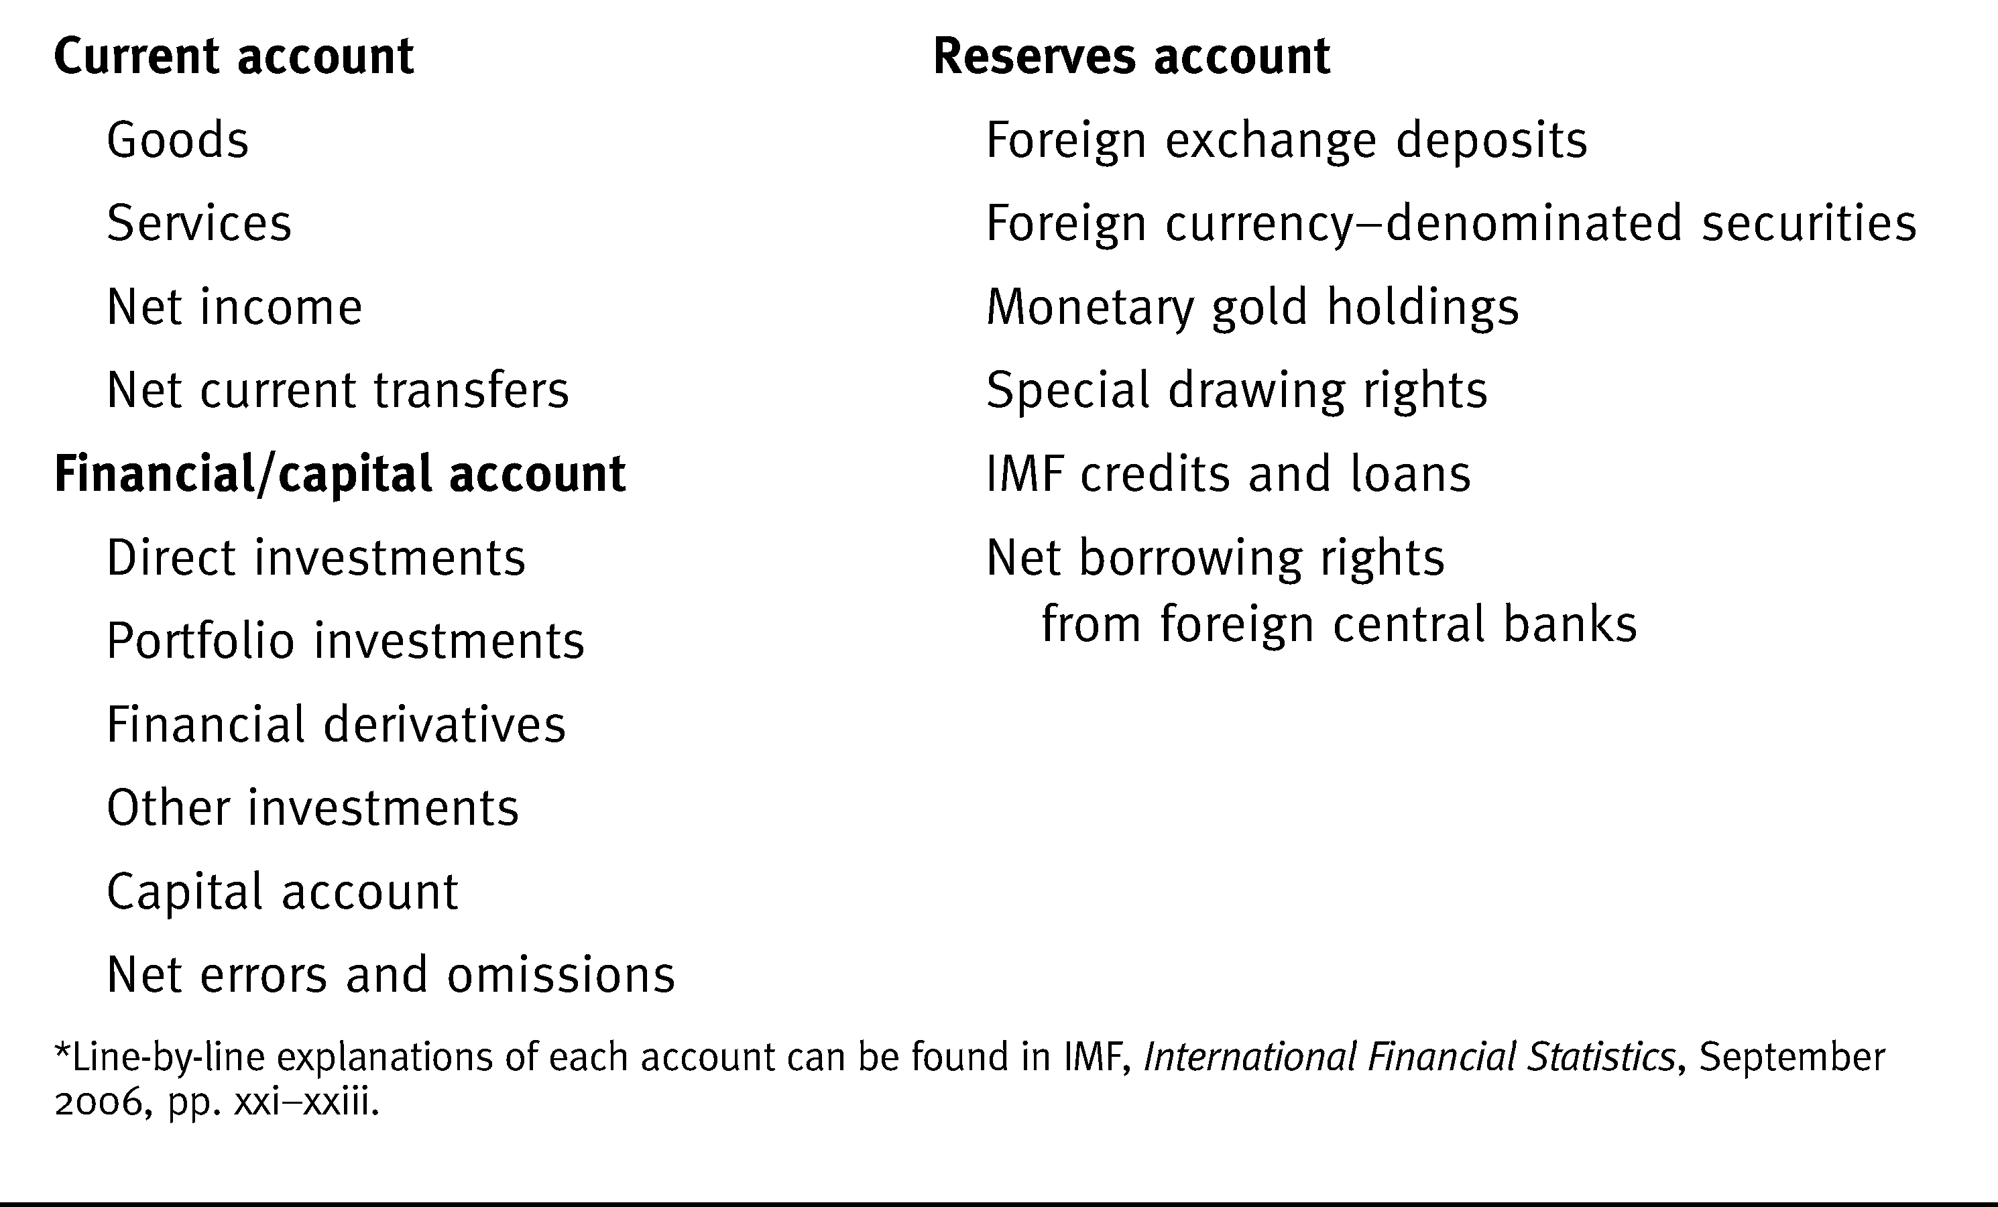
BOP Accounts-IMF Format

Slide 5
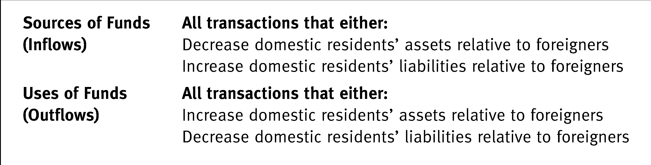
Sources of funds ~ sources of foreign exchange => CREDIT
CA: Export goods & services, income receipts (interest, dividends, compensation from foreigners) and unilateral transfers from abroad
FA: Foreign purchase of domestic financial assets (lending from abroad)
Uses of funds ~ uses of foreign exchange => DEBIT
CA: imports goods & services, unilateral transfer to foreigners, income payments to foreigners)
FA: Domestic purchases of foreign assets (lending to foreigners)

Slide 6
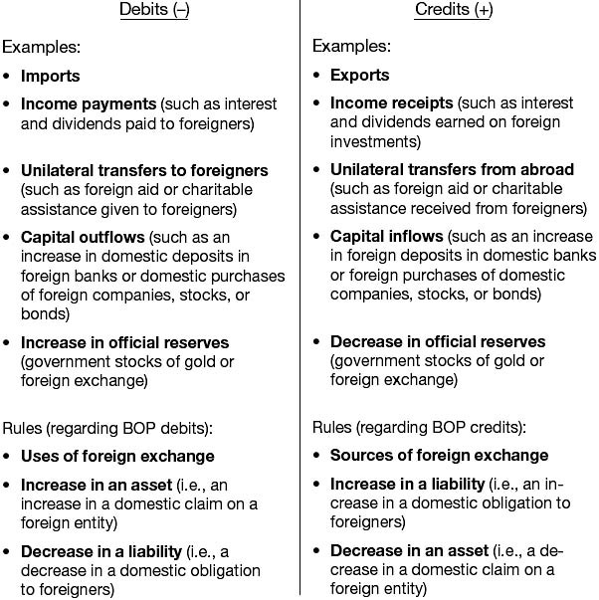
Examples of Debit and Credit Entries in BOP

Slide 7
Current Account - Main Components
Trade in goods (tangible – raw materials to manufactured items)
Trade in services (intangible – shipping, investment banking, consulting)
Income payments and receipts (financial return on cross border investments & compensation)
(Unilateral) current transactions / transfers (nonreciprocal transaction, e.g. foreign aid, also remittances)
.
Balance of Trade
Balance on Goods
Balance on Services
Balance on Income
Balance on current transfers

Slide 8
Current Account - Main Components
CREDIT
DEBIT
Trade in goods:
Debit: U.S. firm purchases German machine tools.
Credit: Singapore Air Lines buys a Boeing jet.
Trade in services:
Debit: An American takes a cruise on a Dutch cruise line.
Credit: The Brazilian tourist agency places an ad in The New York Times.

Slide 9
Current Account - Main Components
Income payments and receipts:
Debit: The U.S. subsidiary of a Taiwan computer manufacturer pays dividends to its parent.
Credit: A British company pays the salary of its executive stationed in New York.
Unilateral current transactions:
Debit: The U.S.-based International Rescue Committee pays for an American working on the Afghan border.
Credit: A Spanish company pays tuition for an employee to study for an MBA in the United States.

Slide 10
Financial Account
The Financial Account of the balance of payments measures all international economic transactions of financial assets.
Foreign Direct Investment, in which the investor exerts some explicit degree of control over the assets
Portfolio Flows, in which the investor has no control over the assets
  Government Bonds and Treasuries
  Corporate Bonds
  Equities
Other Investment – (Also currency swaps or forwards)
  consists of various short-term and long-term trade credits,
  cross-border loans,

Slide 11
Financial Account – Main Components
Direct investment.
Debit: Ford Motor Company builds a factory in Australia.
Credit: Ford Motor Company sells its factory in Britain to British investors.
Portfolio investment.
Debit: An American buys shares of stock of a European food chain on the Frankfurt Stock Exchange.
Credit: The government of Korea buys United States treasury bills to hold as part of its foreign exchange reserves.

Slide 12
Financial Account – Main Components
Net financial derivatives.
Debit: A U.S. firm purchases a financial derivative like a currency swap in London
Credit: A U.S. firm sells a financial derivatives like a forward contract on the dollar versus the pound to a London buyer
Other investment.
Debit: A U.S. firm deposits $1 million in a bank balance in London.
Credit: A U.S. firm generates an account receivable for exports to Canada.

Slide 13
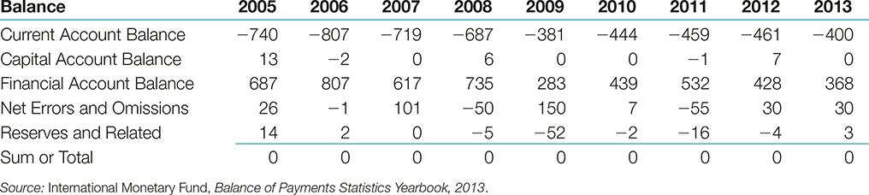
BOP Arithmetic's
CAB+KAB+FAB+NE+ Change in Reserves=0 or
CAB+KAB+FAB+NE= Change in Reserves
Note that a positive figure reported in Reserves line implies a decline in reserves, and a negative figure implies an increase in reserves
2005:
-740+13+687+26+14=0 → Reserves declined by 14bn
2012:
-461+7+428+30-4=0 → Reserves increased by 4bn

Slide 14
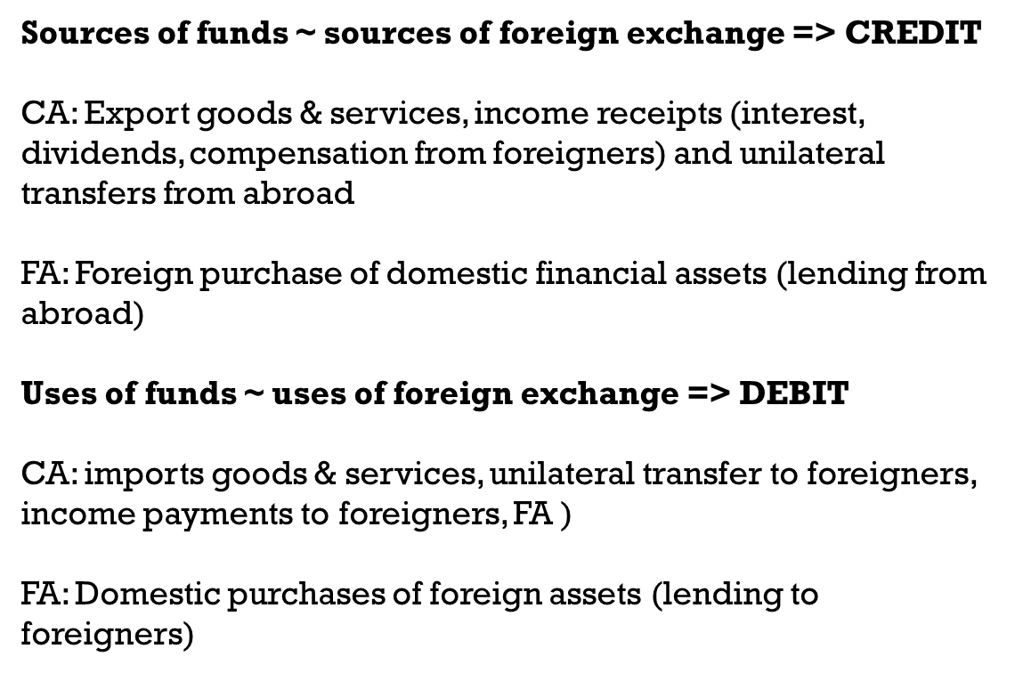
WARM-UP
(3.12) Classify the following as a transaction reported in a sub-component of the current account or the capital and financial accounts of the two countries involved:
A U.S. resident purchases a euro-denominated bond from a German company.
A U.S. university gives a tuition grant to a foreign student from Singapore.

Slide 15
WARM-UP
(3.12) Classify the following as a transaction reported in a sub-component of the current account or the capital and financial accounts of the two countries involved:
A U.S. resident purchases a euro-denominated bond from a German company.
Debit to U.S. portfolio part of financial account; credit to German portfolio of financial account.
A U.S. university gives a tuition grant to a foreign student from Singapore.
If the student is already in the United States, no entry will appear in the balance of payments because payment is between U.S. residents. (A student already in the U.S. becomes a resident for balance of payments purposes.)

Slide 16
(3.12) Classify the following as a transaction reported in a sub-component of the current account or the capital and financial accounts of the two countries involved:
A London-based insurance company buys U.S. corporate bonds for its investment portfolio.
An American multinational enterprise buys insurance from a London insurance broker.

Slide 17
(3.12) Classify the following as a transaction reported in a sub-component of the current account or the capital and financial accounts of the two countries involved:
A London-based insurance company buys U.S. corporate bonds for its investment portfolio.
A debit to the portfolio investment section of the British financial accounts; a credit to the portfolio investment section of the U.S. balance of payments.
An American multinational enterprise buys insurance from a London insurance broker.
A debit to the services part of the U.S. current account; a credit to the services part of the British current account.

Slide 18
(3.12) Classify the following as a transaction reported in a sub-component of the current account or the capital and financial accounts of the two countries involved:
A U.S. professor goes abroad for a year and lives on a Fulbright grant.
A French tourist from the provinces pays for a hotel in Paris with his American Express card.

Slide 19
(3.12) Classify the following as a transaction reported in a sub-component of the current account or the capital and financial accounts of the two countries involved:
A U.S. professor goes abroad for a year and lives on a Fulbright grant.
The current transfers section of the U.S. current account would be debited for the salary paid to a foreign resident. (Even though an American, the professor is a foreign resident during the time he lives abroad.) The current transfers section of the host country’s current account would be credited..
A French tourist from the provinces pays for a hotel in Paris with his American Express card.
A French resident most likely has a French-issued credit card, issued by the French subsidiary of American Express. In this instance, no entry would appear in either country’s balance of payments. If, later, the French subsidiary of American Express paid a dividend back to the U.S., that would be recorded in the income part of the current accounts. (Credit US – Debit France)

Slide 20
Use the above data from the IMF to answer the following questions
3.1 What is Australia's balance on goods?
3.2 What is Australia's balance on services?
3.3 What is Australia's balance on goods and services?
3.4 What is Australia's current account balance?
Let’s calculate for years 2005, 2010, 2015 (calculation similar to other years)

Slide 21
Balance on Goods
Let’s calculate for years 2005, 2010, 2015 (calculation similar to other years)

Slide 22
Balance on goods:
Goods exports – Goods Imports

Slide 23
Current transfers
Balance on services:

Slide 24
Balance on services:
Service Exports – Service Imports

Slide 25
Balance on goods & services:
Balance on goods + Balance on services

Slide 26
Balance on goods & services:
Balance on goods + Balance on services
Balance on goods & services

Slide 27
What is the current account balance?

Slide 28
What is the current account balance?

Slide 29
Assume the United States has the following import/export volumes and prices. It undertakes a major "devaluation" of the dollar, say 18% on average against all major trading partner' currencies. What is the pre-devaluation and post-devaluation trade balance?

Slide 30
The pre-devaluation trade balance?
Step 1)
Determine the revenue from exports in $
QTY Exports * Price of exports ($) = 100 (units) * 20.0 ($) = $2,000
Receive $ for exports
Step 2)
Determine expenditures on imports in foreign currency (fc)
QTY Imports * Price of import (fc) = 120 (units) * 12.00 (fc) = 1,440 (fc)

Slide 31
The pre-devaluation trade balance?
Step 3)
Determine expenditures on imports in $
Expenditures on imports in fc * Initial Spot rate ($/fc) = 1,440 (fc) * 2($/ fc)=
= $ 2,880
Step 4) Determine pre-devaluation trade balance:
Exports ($) – Imports ($) = $2,000 - $2,880) = ($880)

Slide 32
The post-devaluation trade balance?

Slide 33
The post-devaluation trade balance?
Step 1)
Determine the revenue from exports in $
QTY Exports * Price of exports ($) = 100 (units) * 20.0 ($) = $2,000
Receive $ for exports
Step 2)
Determine expenditures on imports in foreign currency (fc)
QTY Imports * Price of import (fc) = 120 (units) * 12.00 (fc) = 1,440 (fc)

Slide 34
The post-devaluation trade balance?

Slide 35
The post-devaluation trade balance?
Step 3)
Determine the new spot rate:
18% devaluation : 2 ($/fc) * (1+.18) = 2.36 ($/fc)
Step 4)
Determine expenditures on imports in $
Expenditures on imports in fc * New Spot rate ($/fc) = 1,440 (fc) * 2.36($/ fc)=
= $ 3,398.4

Slide 36
The post-devaluation trade balance?
Step 4) Determine post-devaluation trade balance:
Exports ($) – Imports ($) = $2,000 - $ 3,398.4 = ($1,398.4)
So what is happening here?

Slide 37
EXCHANGE RATES

Slide 38
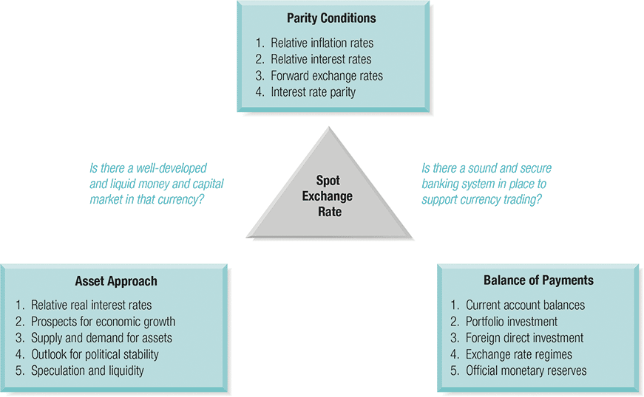
The Determinants of Foreign Exchange Rates
0
Might have to bring PPP recall in after
Eiteman / Moffett

Slide 39

RECALL: Exchange Rate & Change in Value Definitions
$$S_{\frac{DC}{FC}} or S_{\frac{H}{F}} or S_{\frac{LC}{FC}}$$
We will use the following definition:
  Exchange Rate=S=# of domestic currency units per unit of foreign currency
In this definition, exchange rate will always express one unit of foreign currency in terms of domestic currency

Slide 40
Basics: Change in the value of Currency
You probably heard the terms appreciation and revaluation and depreciation and devaluation. In FX markets they mean the following:
  Revaluation is an increase in the value of a government controlled currency → Driven by the monetary authority
  Appreciation is an increase in the value of a freely floating currency → Driven by the market
  Devaluation is a decline in the value of a government controlled currency → Driven by the monetary authority
  Depreciation is a decline in the value of a freely floating currency → Driven by the market

Slide 41
International Parity Conditions
1) APPP & RPPP
You are planning a ski vacation to Mt. Blanc in Chamonix, France, one year from now. You are negotiating over the rental of a chateau. The chateau's owner wishes to preserve his real income against both inflation and exchange rate changes, and so the present weekly rent of €9,800 (Christmas season) will be adjusted upwards or downwards for any change in the French cost of living between now and then. You are basing your budgeting on purchasing power parity (PPP). French inflation is expected to average 3.5% for the coming year, while U.S. dollar inflation is expected to be 2.5%. The current spot rate is $1.3620/€. What should you budget as the U.S. dollar cost of the one week rental?

Slide 42
Absolute Version of PPP
  In its absolute form APPP simply says, “bilateral exchange rates between two currencies should be equal to the ratio of price levels of comparable consumption baskets”.
  S_{LC/FC}= PI^{LC} /PI^{FC}
Simple Example:
Remember Assumptions
Good in US $200 – good in GB 100GBP
S implied $s per GBP = 2/1
if S rate is 1/1 ($s per GBP) then arbitrage
take $100 exchange to 100 GBP => buy good in GB => ship back to US sell for $200 => instant $100 profit
  In practice, spot rates often deviate from their PPP implied levels.
  When exchange rate deviates from its PPP implied level, it is referred to be either over or under valued.
    If the actual spot rate is above PPP implied rate the exchange rate (of the LC) is undervalued.
    If the actual spot rate is below PPP implied rate the exchange rate (of the LC) is overvalued.

Slide 43
Fair Value, Under/Overvaluation
To find out the extent of under or overvaluation of terms (foreign) or local currency we use:
To find out the extent of under or overvaluation of terms or base (foreign) currency we use:
SPOT > PPP Rate => Undervaluation of LC
SPOT < PPP Rate => Overvaluation of LC
SPOT > PPP Rate => Overvaluation of FC
SPOT < PPP Rate => Undervaluation of FC

Slide 44
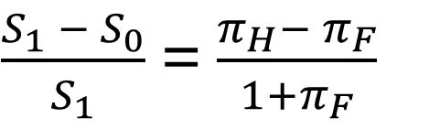


  RPPP→ Forecasting Future Exchange rate by using relative inflation rates
Recall: RPPP
$$S_{\frac{DC}{FC}} or S_{\frac{H}{F}} or S_{\frac{LC}{FC}}$$
RPPP tells us that given an equilibrium spot rate, next period exchange rate can be inferred from relative, expected inflation rates at home and abroad.
This result can be expanded to a multi-period model (multiplication). The idea here is that the exchange rates are a function of expected inflation rates.
$\frac{S_{1} − S_{0}}{S_{1}}$ = $\frac{π_{H}− π_{F}}{1+π_{F}}$
or

Slide 45
International Parity Conditions
1) APPP & RPPP
You are planning a ski vacation to Mt. Blanc in Chamonix, France, one year from now. You are negotiating over the rental of a chateau. The chateau's owner wishes to preserve his real income against both inflation and exchange rate changes, and so the present weekly rent of €9,800 (Christmas season) will be adjusted upwards or downwards for any change in the French cost of living between now and then. You are basing your budgeting on purchasing power parity (PPP). French inflation is expected to average 3.5% for the coming year, while U.S. dollar inflation is expected to be 2.5%. The current spot rate is $1.3620/€. What should you budget as the U.S. dollar cost of the one week rental?

Slide 46
What should you budget as the U.S. dollar cost of the one week rental?

Slide 47
Step 1)
Determine nominal weekly rent in Euro 1 Year from now
Rent Now + (1 Inflation rate France) = €9,800 * (1+0.035) = $10,143

Slide 48
Step 2)
Determine Purchasing Power Exchange Rate forecast

Slide 49
Step 2)
Determine Purchasing Power Exchange Rate forecast
= S_{t+1} = 1.3620 ($/€) * (1+0.025)/(1+0.035) =
= 1.3488 ($/ €)

Slide 50
Step 3)
Determine Cost of rent in USD one year from now:

Slide 51
Step 3)
Determine Cost of rent in USD one year from now:
Rent 1 yr from now * PPP forecasted Spot Rate = 10,143€ * 1.3488 ($/ €) =
= $ 13,681.39

Slide 52
AVTO – Part I

Slide 53
AVTO – Part I

Slide 54
AVTO – Part I
260,000*1.14
331,968*1.11
296,400*1.12

Slide 55


AVTO – Part I
$$S_{\frac{DC}{FC}}$$
$$S_{\frac{rubles}{\$}}$$

Slide 56
AVTO – Part I
$$S_{\frac{DC}{FC}}$$
$$S_{\frac{rubles}{\$}}$$
$S_{02}= S_{01}∗\frac{(1+π_{rubles})}{(1+π_{\$})}$ = 30 * $\frac{(1+14\%)}{(1+2.5\%)}$ = 33.37 (rubles/$)

Slide 57
AVTO – Part I

Slide 58
AVTO – Part I
260,000(rubles)/30(rubles/$)
296,400(rubles)/33.37(rubles/$)

Slide 59
AVTO – Part II

Slide 60
AVTO – Part II

Slide 61
AVTO – Part II
260,000(rubles)/30(rubles/$)
296,400(rubles)/30(rubles/$)

