Slide 1
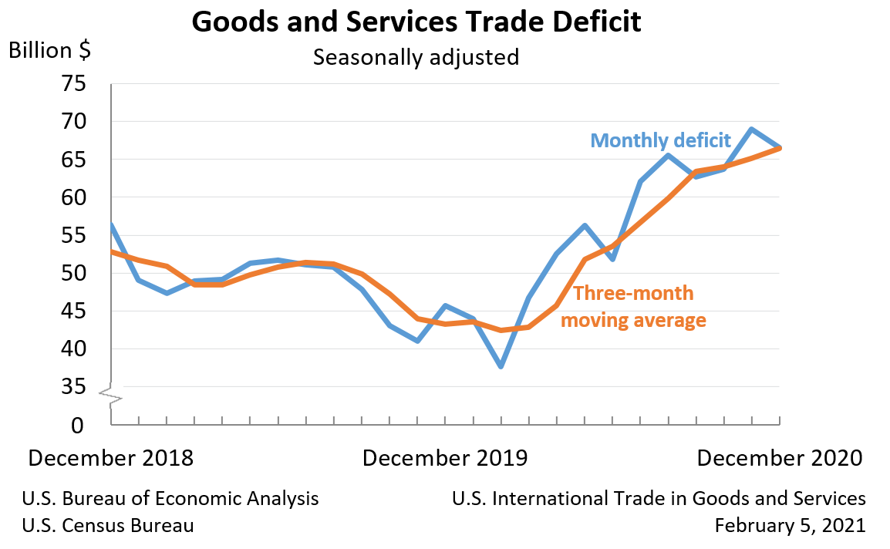
Notes:
THIS IS MONTHLY

Slide 2
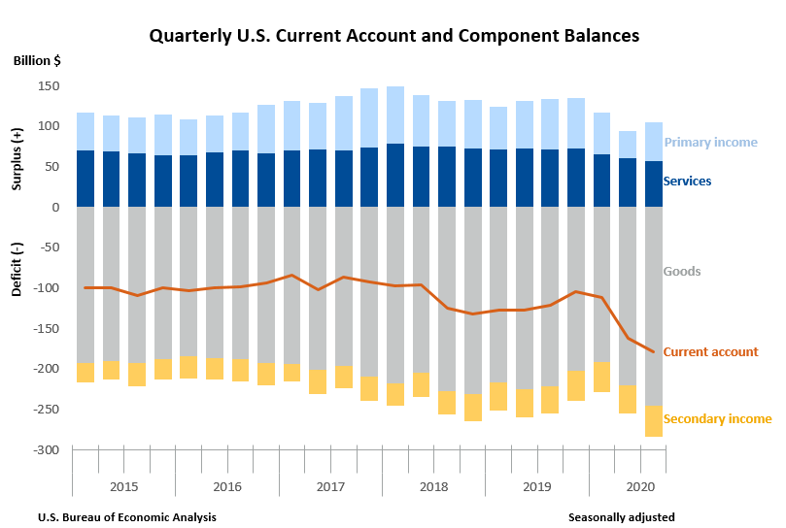
Notes:
This is quarterly Bea – Buro of Economic analysis

