Slide 1
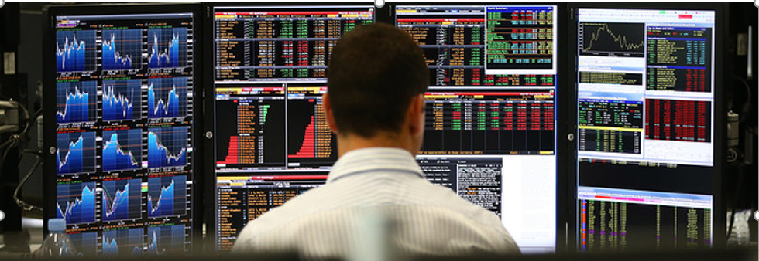
FX Markets & Instruments An Overview

Slide 2
Market Fact Sheet
An integrated virtual market place
Electronically connected financial institutions make up the market worldwide
Over $6.6 trillion daily trading volume!
By far the largest financial market; closest rival bond market volume (about $900bn per day) trails the FX volume with a huge gap
Large portion of trading takes place in proprietary electronic trading systems (Reuters & EBS)
Approximately 60% of transactions are cross-border
85%-90% of all inter-bank spot market transaction for the currency majors
Large players dominate the market

Slide 3
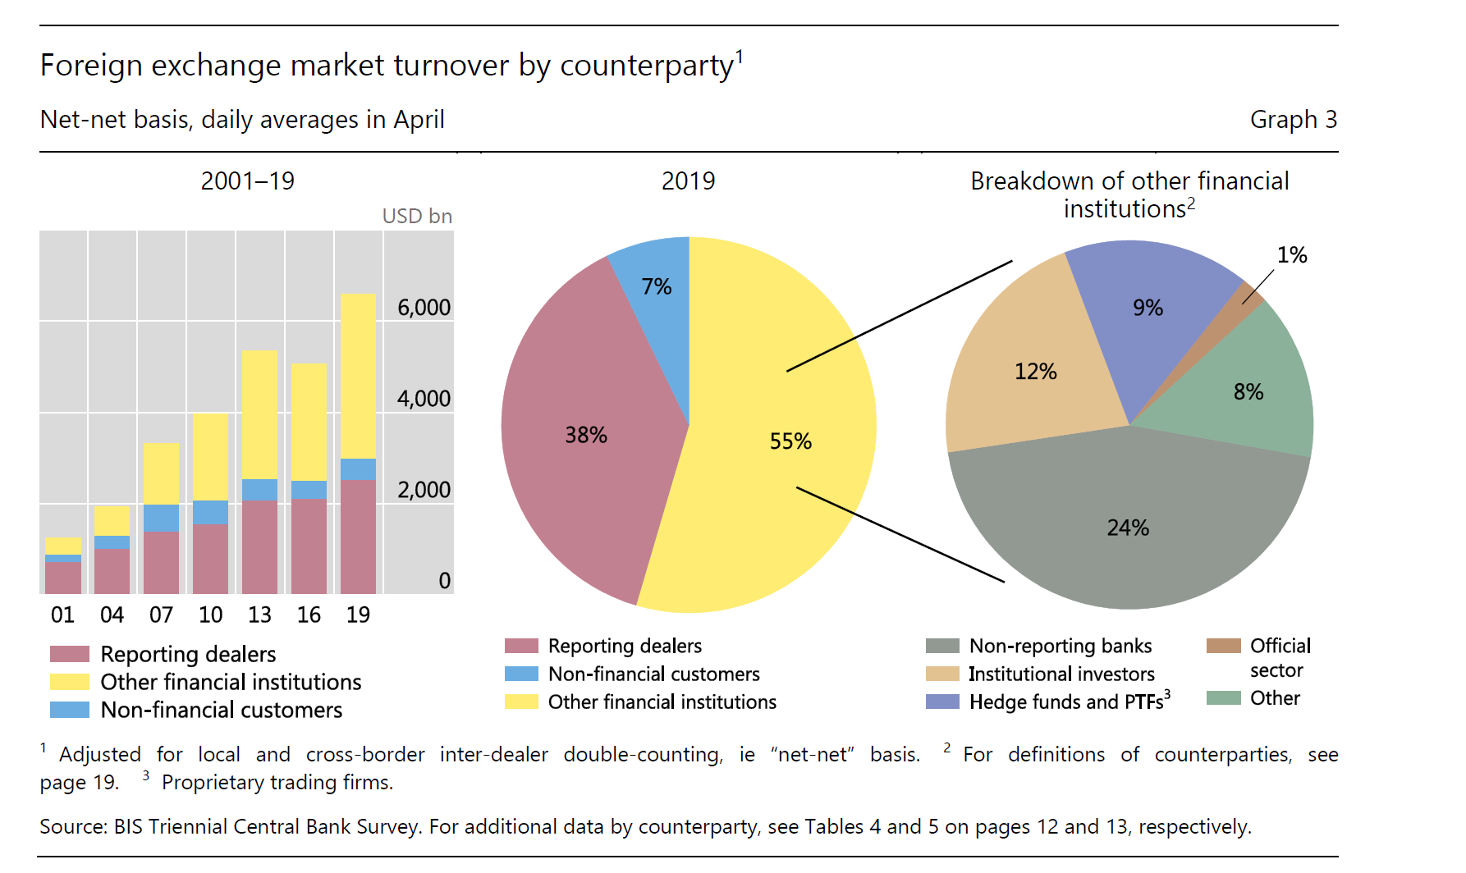
Turnover by Counterparty

Slide 4
FX Market Participants
Reporting Dealers [38% of the Volume]
Multinational Banks such as JP Morgan, Citi, DB, Barclays, HSBC etc.
Other Financial Institutions [55% of the Volume]
Non-reporting banks (24%)
Smaller regional banks
Institutional Investors (12%)
Mutual Funds, Pension Funds
Hedge Funds & PTF (9%)
Official Sector (1%)
Central Banks
Non-financial Customers [7% of the Volume]
MNEs, exporters, importers

Slide 5
Leading FX Traders

Slide 6
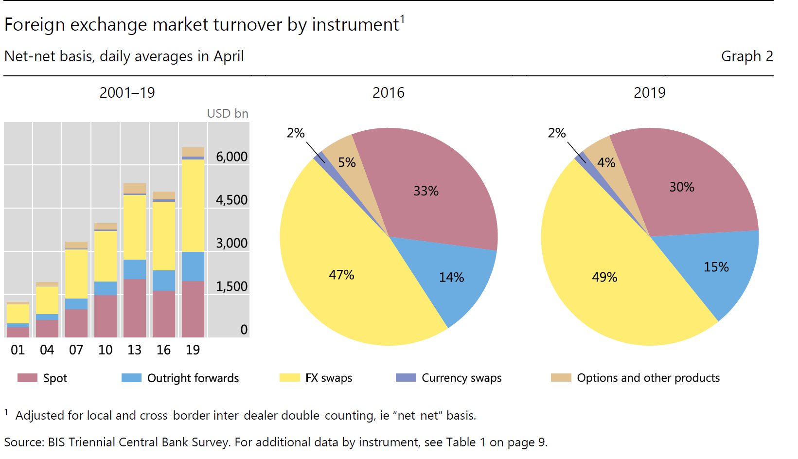
Turnover by Instrument

Slide 7
FX Instruments
Spot
Settlement: T+2
Forwards
Settlement: T+3 and beyond; rare beyond 2 years
FX Swaps
Bundle of Spot and Forward transactions in opposite directions; e.g. but spot + sell forward; sell spot buy forward
FX Options
Plain Vanilla Call/Put, Combinations
FX Futures
Similar to forwards in end result, but distinct product and institutional characteristics
Currency Swaps/Cross Currency Swaps
Bundles of forward contracts stretching to 10-15 years

Slide 8
Spot Transactions
Dealer Quotes
Dealers quote Bid and Ask rates, They buy the base currency at the bid rate and sell it at the ask rate
Once the transaction is confirmed, settlement takes place in two business days, hence T+2
In interbank market transactions are multiples of millions; “I take 5 at 13” means I am buying EUR5 million at 1.2313; dealers usually spell that the last two digits
Base Currency
(Foreign Currency)
Terms or Price Currency
(Local Currency)
Currency | Bid Rate | Ask Rate
EUR/USD | 1.2310 | 1.2313
GBP/USD | 1.7945 | 1.7949
USD/JPY | 110.73 | 110.83
USD/CHF | 1.2810 | 1.2815
USD/CAD | 1.1514 | 1.1517
USD/BRL | 2.1780 | 2.2345
EUR/USD 1.2310-1.2313
Dealer Buys EUR at this rate
Dealer sells EUR at this rate
The difference between bid and ask rates is the spread, in this case 3 pips or $0.0003; each point in the fourth decimal is 1 pip

Slide 9
Example
A US importer buys JPY 100,000,000 worth of memory chips from Toshiba.
Toshiba expects payment upon confirmation of the terms of the sale.
Which segment of the FX Market should the importer use to pay Toshiba?

Slide 10
Currency Forwards: Definition
An agreement to exchange a given amount of currency at a predetermined fixed rate at a specified future date.
Forward contracts are customized in terms of amounts and maturities

Slide 11
Characteristics
It is an OTC product
Its maturity typically ranges from 3 days to 1 year, but longer maturities may be available
Forward contracts are zero cost contracts (i.e. value of the contract at inception is zero)
In a forward contract there is only one cash flow and it takes place at the maturity!!

Slide 12
Day Count Conventions and Maturities
Country | Domestic | Euromarket
Eurozone | ACT/360 | ACT/360
Canada | ACT/365 | ACT/360
Australia | ACT/365 | ACT/360
Japan | ACT/365 | ACT/360
HK | ACT/365 | ACT/365
Singapore | ACT/365 | ACT/365
UK | ACT/365 | ACT/365
US | ACT/360 | ACT/360
ON Overnight
TN Tomorrow Next
SW Spot Week (One Week)
1M One Month
2M Two Months
3M Three Months
6M Six Months
9M Nine Months
1Y One Year
2Y Two Years (Some Currencies Only)
5Y Five Years (Some Currencies Only)

Slide 13
Forward Transactions
Dealer Spot-Forward Outright Quotes
Maturity | ISO | Bid | Ask
Spot | EUR/USD | 1.1025 | 1.1028
ON | EUR/USD | 1.1022 | 1.1025
SW | EUR/USD | 1.1030 | 1.1033
2W | EUR/USD | 1.1034 | 1.1038
1M | EUR/USD | 1.1046 | 1.1049
2M | EUR/USD | 1.1064 | 1.1069
3M | EUR/USD | 1.1082 | 1.1087
6M | EUR/USD | 1.1131 | 1.1136
9M | EUR/USD | 1.1175 | 1.1181
1Y | EUR/USD | 1.1224 | 1.1232
“d” is days in forward, 30/360 is the money market day count convention; it is actual/365 for GBP, actual/360 for LIBOR, EUR and USD.
The forward rate is a function of home and foreign interest rates. If the home rate is higher than the foreign rate, forward rate will be higher than the spot rate; this implies that the foreign/base currency is at a forward premium.
The table on the left, indicates higher interest rates in the US which implies a forward premium for the EUR.
Dealers quote rates for variety of settlement dates from spot to 1 Year forward.
For instance the dealer sells EUR 1-Month Forward at $1.1049; the buyer pays more USD than the spot rate of $1.0128; in this case the base currency EUR is selling at a forward premium

Slide 14
Dealer Spot Forward Point Quotes (or Swap Point Quotes)
Maturity | Points Bid | Points Ask
Spot | 1.1025 | 1.1028
ON | -2.98 | -2.61
SW | 4.76 | 4.97
2W | 9.45 | 9.84
1M | 21.04 | 21.2
2M | 39.42 | 41.02
3M | 56.68 | 58.68
6M | 105.65 | 107.65
9M | 149.98 | 152.98
1Y | 199.42 | 203.88
Forward points are quoted in reference to the spot rates. We can calculate the outright rates from forward points:
ON: Overnight
SW: Spot Week
Outright Forward rates are calculated as:
Forward =Spot +Forward Points
Alternatively, forward points are the difference between the forward and spot rates:
Forward Points=Forward -Spot

Slide 15
Forward Points and Outright Rates
Since forward points are a function of interest rate differentials, traders find them more intuitive and use primarily forward points in trading environment.
From the corporate treasury perspective forward points give an indication of the cost or benefit of entering forward contracts.
For instance forward points for 1-year contract is 203.88; this implies that we pay $0.020388 more per EUR than the spot ask rate of 1.1028; 1-Year forward ask rate is 1.1028+0.0204=$1.1232!

Slide 16
Few Words about Forward Contracts
They are “over the counter” privately negotiated contracts
They are customized for the specific needs; amounts and maturities are flexible
The cost is embedded in bid-ask spread; there is no commission
Both parties in the contract take credit risk, but since it is a swap of currencies against each other, the credit risk is small;
The forward contract has zero value at the inception, at T=0; but the contract has non-zero value at any time T=t, between 0 and maturity T.
It has only one cash flow that occurs at the maturity
It is not transferable; contracts are not traded
Daily trading volume of outright contracts are $920bn

Slide 17
Advantages and Disadvantags as a Risk Management Tool
Advantages
Disadvantages
Simple
One cash flow
Widely available
Easily customized for specific needs
Zero cost
Lack of liquidity
Credit risk
No flexibility; does not allow to take advantage of favorable movements

Slide 18
Example
You have EUR5,000,000 receivable due in one year.
Spot EUR/USD is 1.3176-1.3177
1 year outright forward quote is given as:
Forward EUR/USD 1.3366-1.3374
Note that as seller of EUR, you receive forward points!
Assume that you locked into 1-year forward rate!

Slide 19
Forward Contract
You will trade at bid rate of $1.3366.
The transaction requires you to deliver €5,000,000 euros in exchange for $6,683,000
The transaction settles 1 year after spot value date (spot value date: T+2)
Notes:
T+2 implies 2 business days following the trade. This is the conventional settlement period of cross border transactions.

Slide 20
The USD Value of the Receivable
Alternative | $1.2000 | $1.3000 | $1.4000
Spot/Unhedged | $6,000,000 | $6,500,000 | $7,000,000
Forward/Hedged | $6,683,000 | $6,683,000 | $6,683,000
Hedging Gain (Loss) | $ 683,000 | $ 183,000 | $ (317,000)
Both the table above and the chart on the left tell the same story
Forward contract locks the EUR receivables at a fixed dollar amount.
This could be a blessing when the spot rate is below the forward rate 1.3366, but a missed opportunity when the spot is above this rate!
Loss
Gain

Slide 21
FX Swaps
The largest segment of the FX market
It involves simultaneous spot and forward transactions:
Buy spot – sell forward
Sell spot – buy forward
Both spot and forward rates are known at the time of the initiation of the trade
It facilitates a cost effective and safe switching from one currency to another
Banks use swaps extensively; servicing clients, making bets, investing in foreign securities are primary motivations
It is equivalent to “Repo” market in domestic setting; instead of providing a T-Bill as a collateral, you provide a currency as collateral!

Slide 22
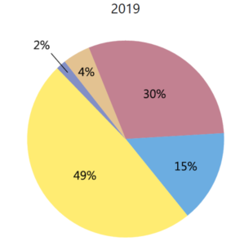
FX Swaps
The largest segment of the FX market
It involves simultaneous spot and forward transactions:
Buy spot – sell forward
Sell spot – buy forward
Both spot and forward rates are known at the time of the initiation of the trade
FX Swaps facilitate cost effective and safe switching from one currency segment to another
FX Spot
FX Swaps
Forward
Banks use swaps extensively; servicing clients, making bets, investing in foreign securities are primary motivations
It is equivalent to “Repo” market in domestic setting; instead of providing a T-Bill as a collateral, you provide a currency as collateral!

Slide 23
FX Swap Example
It is composed of a spot and forward transaction.
Suppose spot rate and 3-month forward rate are $1.5110 and $1.5190 per EUR
Commerzbank swaps EUR 1,000,000 with City London
Commerzbank delivers EUR 1,000,000 and receives $1,511,000 from City [think of EUR 1m is delivered to City as collateral]
In three months, Commerzbank receives its EUR 1,000,000 back and pays out $1,519,000 [City returns collateral back]
Commerzbank (the dollar borrower) pays interest on the borrowed amount; ~2.1% pa; the interest paid is equivalent to forward premium of EUR, as the collateral earns interest for the lender.
You can see that Commerzbank buys USD spot and sells USD forward, both at prices that are determined today

Slide 24
Why would Commerzbank do that?
FX swap is the largest segment of the FX market, it nearly accounts for the half of the transactions
FX swaps are mainly used by banks. In the example we used, a European bank, Commerzbank, is in need of dollars to lend to a customer for 90 days;
It receives $1,511,000 and lends it to a client for 90 days say at 10% annual interest
In 90 days, it receives $1,548,775 from its client and pays $1,519,000 of that to get back its EUR 1,000,000. In the process it makes $29,775 profit;
The EUR equivalent of this $29,775/1.5190=€19,601; assuming 1.5% opportunity cost for EUR collateral, the net gain is 19,601-3,750=€15,851.71

Slide 25
The main benefit is that Commerzbank does not take any currency risk and satisfies the client need!
On the other side of the deal, City may lend the EURs it received for 90 days or invests in an instrument to take advantage of the funds it will hold for 90 days.
FX Swaps are an important element of the plumbing of the global financial markets.

Slide 26
What is an FX Option
A foreign currency option is a contract giving the purchaser of the option the right to buy or sell a given amount of currency at a fixed price per unit for a specified time period
Currency Options are traded in two different settings:
Options Exchanges (CME, PHLX)
Over The Counter Market (Major global banks)

Slide 27
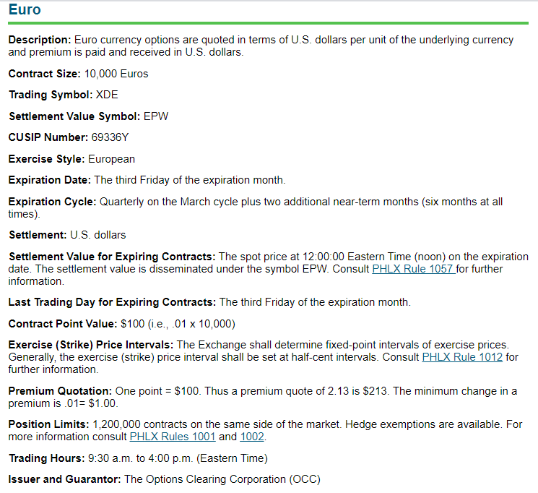
EUR Contract in NASDQ-PHLX

Slide 28
Options: Characteristics
The most important part of clause is the “right, but not the obligation” to take an action
Two basic types of options, calls and puts
Call – buyer has right to purchase currency
Put – buyer has right to sell currency
The buyer of the option is the holder and the seller of the option is termed the writer

Slide 29
Basic Terminology
Every option has three main elements
Strike Price
Premium
Expiration Date
There are two types of options
American options may be exercised at any time during the life of the option (all exchange traded options)
European options may not be exercised until the specified maturity date (all over the counter options)

Slide 30
Plain Vanilla Options as Hedging Tools
Call Option:
Used to limit (cap) the local currency cost of a FC payable (liability)
Cap is set @ Call Strike+Premium
Put Option
Used to protect (set a floor) the local currency value of FC receivable (asset)
Floor is set @ Put Strike-Premium

Slide 31
Simple Example
ABC has Euro 10m payment due in 128 days.
Buys Call options to limit (cap) its cost of Euro payable!
Strike Price: $1.31 per Euro
Premium: $0.016 per Euro

Slide 32
Spot=EUR/USD 1.3500
If spot rate is $1.3500 should the call option be exercised!
Yes, because Spot >1.3100 and the option allows purchase at a lower price
Cost=Strike x Underlying Amt + Premium
Premium=$0.016 x 10,000,000=$160,000
Cost= 1.31 x (10,000,000)+160,000 =$13,260,000
Or unit cost $1.31+$0.016=$1.3260

Slide 33
Spot<1.31
If 1.2900 < 1.3100, should the call be exercised.
No, because we can buy Euro at a lower price in the spot market
Remember that premium is a sunk cost and has no bearing on the exercise decision
Cost=Spot x Underlying Amt.+Premium
Premium=$0.016 x 10,000,000=$160,000
Cost=1.2900 x 10,000,000+160,000=13,060,000
=or per unit =1.2900+0.016=1.3060 <1.3260

Slide 34
Cost of 10m Euro payment: Range:$1.28-$1.35
=$13,260,000
Per Unit:
1.31+0.016 =$1.3260

Slide 35
Buying Option with no underlying exposure
Suppose we expect Euro to appreciate and we would like to make a bet on Euro appreciation. We buy 160 Euro call options in CME with a strike price of 1.31 at a cost of $0.016 per EURO. Each Euro contract is on EUR 62,500.
What would be your profit/loss if EUR/USD rate is $1.3500 at expiration?
What would be your profit/loss if EUR/USD rate is $1.2900 at expiration?
What would be your profit/loss if EUR/USD rate is 1.3200 at expiration?

Slide 36
$1.35 per EUR
Since Spot >Exercise price, we would exercise the call
1.3500>1.3100
We will pay $1.31 per EURO and get:
Pay 1.3100 x 62,500 x 16=$13,100,000 → get €10,000,000
Sell €10.000,000 at spot rate of $1.3500 and collect
10,000,000 x 1.3500=13,500,000
Since we paid the upfront premium of $0.016 our premium cost:
0.016 x 62,500x160=$160,000
Net gain=13,500,000-13.100,000-160,000=240,000
ROI=240,000/160,000=150%

Slide 37
$1.29 per EUR
Since Spot <Exercise price, we would NOT exercise the call
1.2900<1.3100
Since we paid the upfront premium of $0.016 our premium cost: $160,000
Net gain/loss=-160,000
ROI=-160,000/160,000=-100%

Slide 38
$1.3200 per EUR
Since Spot >Exercise price, we would exercise the call
1.3200>1.3100
We will pay $1.31 per EURO and get:
Pay 1.3100 x 62,500 x 160=$13,100,000 → get €10,000,000
Sell €10,000,000 at spot rate of $1.3200 and collect
10,000,000 x 1.3200=13,200,000
Since we paid the upfront premium of $0.016 our premium cost: $160,000
Net gain=13,200,000-13,100,000-160,000=-60,000
ROI=-60,000/160,000=-37.5%

Slide 39
Note that speculator will breakeven at 1.3260; at any spot rate below this, speculator will incur a loss and at any price above it, she will enjoy profit.

Slide 40
Option Payoff
Break-even point:1.3260

Slide 41
Right Scale

Slide 42
Example: Japanese Importer and EUR Call Option
A Japanese importer, who incurs costs in Euro's and invoices its customers in JPY, is concerned about the depreciation of JPY against Euro due to EURO payables of 1,000,000 in three months.
To hedge (protect himself/herself) the position, importer decides to use option markets.
Currently at the money call options with JPY 130 strike are traded at JPY10 (i.e. currently spot rate is EUR/JPY 130).
Suppose the importer buys at the money call options on EUR 1,000,000. At the option expiration date three months later, spot price of EUR is EUR/JPY 139.
What should be the unit cost of EURO for the Japanese importer in terms of JPY?

Slide 43
Solution
Payable | 1,000,000
Spot at T=0 | 130
Strike | 130
Premium | 10
Spot @ Expiration (T=T) | 139
Decision | Exercise the call
Cost in JPY | 140,000,000
Since Spot > Strike Price → Exercise the call option
At time T=T → Exercise the call → Pay JPY130 x 1,000,000=JPY130,000,000
Option Premium Paid at T=0, JPY10 x 1,000,000=JPY10,000,000
Total Cost=JPY130,000,000 +JPY10,000,000=JPY 140,000,000
(Note that we ignored the time value of the premium here for simplicity)
Cap= Strike + Premium on a per unit basis
Cap on position = 130 x 1,000,000 + 10 x 1,000,000 =140,000,000

Slide 44
Hedging EUR Liability with a EUR Call Option
The call option protects the importer when the spot rate appreciates beyond JPY 130, but allows the importer to take advantage of the EUR depreciation to below JPY 130
The importers cost will never exceed JPY140 million, but it may be lower

Slide 45
Example: US Exporter and Euro Receivables: Put Option Hedge
A U.S. company wants to use European currency put options to hedge 25 million Euro in accounts receivable due in one year.
The premium of the currency put option with a strike price of $1.3675 is $0.045.
In one year, at the expiration date of the option, spot rate of Euro turns out to be EUR/USD 1.2210.
What is the USD value of the hedged receivable in one year.

Slide 46
Solution
A/R | 25,000,000
Put Strike | 1.3675
Put Premium | 0.045
Spot at Expiration | 1.221
Decision | ?

Slide 47
Solution
A/R | 25,000,000
Put Strike | 1.3675
Put Premium | 0.045
Spot at Expiration | 1.221
Since the spot value of Euro is well below the put strike of 1.3675, we would exercise the put option sell 25m Euros at $1.3675 and receive $34,187,500.
After deducting the premium of [25,000,000 x $0.045=$1,125,000], the net amount of USD received is $33,062,500.
USD received per Euro=Strike –Premium =1.3675-0.045=1.3225
1.3225 x 25,000,000 =33,062,5000
Alternatively:
25,000,000 x 1.3675 –(25,000,000*0.045) =33,062,500

Slide 48
Range Forward Contacts
Range forward requires buying a put option and selling a call option.
The idea is to maintain the protection at a lower cost! The premium received from the call option should bring the cost down!
The trade-off to cost reduction is the limit imposed on the upside with the call strike; when the exchange rate moves in favor, at some point call will be exercised.
Other names used for Range-Forward contracts are:
Collar,
Flexible Forward,
Cylinder Option,
Fence,
Zero-Cost Tunnel,
Mini-Max

Slide 49
How to Set it up?
In the case of a foreign currency denominated receivable, we first set the protection level (downside) which establishes the floor for the receivable.
Then depending on the upside potential that we are willing to give up, we set the cap/limit on the upside with the call strike.
The more we give up, the more premium we collect!
In zero-cost combinations, the call strike is selected such that the call premium fully covers the put premium we pay.
Note that the call strike, the lower the call premium; therefore, if we desire to cover the put premium, we will have to settle with a relatively low limit.

Slide 50
Range Forward Example
Suppose we have GBP 1m receivable; we are unsure about the direction of the pound.
The forward contract on pound trades at $1.4700 per pound; if we sell pound forward at 1.47 we are protected as the pound depreciates, but we miss the opportunity to benefit from its appreciation.
A put option offers the upside potential that we do not get with the forward contract.
We can buy a put option at a strike close to the forward rate; this would affords us the protection that forward contract provides and will allow us to benefit from the appreciation of pound.
The only problem with this solution is its cost; a put option at $1.47 will cost a substantial amount!

Slide 51
Range Forward Example
“Range Forward” or “Zero Cost Collar” could be a possible compromise.
We buy a put option with strike 1.4500; this sets the floor at $1.4500 per pound; the cost of this put option is $0.0226.
To mitigate the put premium, we sell a call option that would cover the cost of buying put. A call option on pound with strike price $1.4900 costs $0.0226 which would cover the cost of the put option.
With a long put with strike 1.4500 and short call with strike 1.4900 the net premium is zero.
Long put at $1.4500 sets the floor for the pound receivable
Short call at $1.4900 sets the cap for the pound receivable
If the spot is below 1.45, we exercise the put; if the spot is above 1.49, call holder exercise the call. Between 1.45 and 1.49, neither option is exercised; we sell pound spot.

Slide 52
Range Forward

Slide 53
Analysis
If spot is below 1.45, we exercise the put option and clear $1,450,000!
If spot is above 1.49, the call option is exercised and we clear 1,490,000!
If the spot is between 1.45 and 1.49, neither option is exercised, and we sell pound in the spot market!

Slide 54
Example: F. Mayer Zero Cost Collar
F. Mayer, an Australian importer of gourmet food from Europe has EUR 70 m payable in four months and is willing to hedge its EUR exposure.
Plain Vanilla put options offered by F.Mayer’s at strike price EUR0.6910, has a premium of approximately €1.49m or AUD 2.13.
In order to reduce this hefty put premium to limit the COGS below AUD103m, F. Mayer could sell call options on AUD at an acceptable strike price.
With this, it can practically offset the premium paid for the put option by giving up cost reduction opportunities beyond the call strike!
F. Mayer’s banker suggested F. Mayer buys a put with €0.6860 and sells a call option with €0.6942 with the same expiration dates. At these strike prices, premiums paid and received offset each other; in other words combination has zero net cost.

Slide 55
The parameters of the Collar-1
If the EUR appreciates beyond EUR0.6860; F.Mayer exercises the AUD put/EUR call and limits its EUR 70 million cost at
EUR70,000,000/[AUD/EUR0.6860]=A$102,040,816
If the EUR depreciates beyond €0.6942, the call holder exercises the call option and the cost of EUR 70m payable turns out to be:
EUR70,000,000/[AUD/EUR0.6942]=A$100,835,494
If the spot is between 0.6860 and 0.6942, neither option is exercised and F. Mayer purchases EUR 70m at the spot rate.
With this arrangement, F. Mayer is locked into a range between €0.6860 and €0.6942; with this, cost of EUR 70 m will never exceed A$102m, but it will also never be below A$100.8m
The chart in the next slide illustrates this visually!

Slide 56
Hedging with Collars:Long Put with Strike €0.6860 and Short Call with Strike €0.6942
Spot<0.6860
Put is Exercised
Spot<0.6942
Call is Exercised
0.6869<Spot<0.6942
Neither of the Options are Exercised
By combining a long put option (or put option bought) and short call option (or call option sold) F. Mayer can eliminate option premiums. This incredible gain comes at a cost: we give up the opportunity to benefit from favorable exchange rate movements above 0.6942. This strategy locks F.Mayer’s COGS between AUD102,040,816 and AUD100,835,494.

Slide 57
Option Pricing and Valuation
0
The premium of an option is composed of two parts: intrinsic value and time value.
Intrinsic value is the financial gain if the option is exercised immediately.
S=Spot Rate, K=Exercise Price
For a call option, intrinsic value is Max{(S-K),0}
IV is zero when the spot price is below the strike price (IV=0 if S<K), otherwise it is (S-K)
For a Put Option, Intrinsic Value (IV) is Max{(K-S),0}.
IV is zero if the exercise price is below spot price (IV=0 if K<S)
At the expiration, an option will have a value equal to its intrinsic value (zero time remaining to expiration means zero time value)
Option Premium
Intrinsic Value
Call-IV:Max{(S-K),0}
Put IV:Max{(K-S),0}.
Time Value
Call/Put TV: f (T,i_{d}-i_{f},σ)
+

Slide 58
The time value of the option reflects the prospect of a favorable movement of the spot rate such that the option expires with a more favorable intrinsic value than the current intrinsic value.
It exists because the spot rate, can potentially move further and further into the money between the present time and the option’s expiration date.

Slide 59
Option Pricing and Valuation
0
The pricing of any currency option combines six elements:
Spot rate
Strike Price
Time to maturity
Domestic interest rate
Foreign currency interest rate
Volatility (standard deviation of daily spot price movements)

Slide 60
Option Prices/Value
Factors | Call Premium | Put Premium
Spot Price | + | -
Strike Price | - | +
Time to Expiration | + | +
Volatility | + | +
Domestic Interest Rate | + | -
Foreign Interest Rate | - | +

Slide 61
Modified Black and Sholes Option Pricing Model
d₁, maps the expected spot rate at the expiration to a standard normal variable with mean zero and volatility 1 with the condition imposed that S>K
d₂, maps the expected spot rate at the expiration to a standard normal variable with mean zero and volatility 1 with no condition imposed
Option Price=f (Spot, Strike, Time To Expiration, Volatility, Interest Rate Diff)

Slide 62
Pricing a Call Option
Suppose we want to price one year call option on Euros at a strike rate of EUR/USD1.2500 when the spot rate is 1.2675.
Also assume that the domestic and foreign interest rates are 1.45 and 2.19%, respectively. The volatility of EUR/USD exchange rate is 10.5%.
What is the B-S-M-K value of the call option? Or simply what is the option premium for this call option?

Slide 63
B-S-M-K Model/Call Option Premium
To solve the problem we need to use B-S-M-Garman-Kolhagen currency option model which is given as:
The inputs in the model are spot rate, domestic and foreign interest rates and two probabilities N(d₁) and N(d₂). “d₁” and d₂ are given as follows:

Slide 64
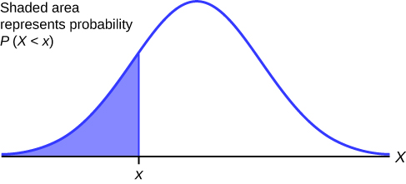
Two Probabilities in the Model
=d₁
N(d₁)=Normsdist(d₁)→ is the area below d₁. This is the probability of observing random variables smaller than d₁ or Pr(Z≤d₁).
In BSMK model we calculate probabilities Pr(Z≤d₁) and Pr(Z≤d₂)

Slide 65
B-S-M-K Model/Put Option Premium
To solve the problem we need to use B-S-M-Garman-Kolhagen currency option model which is given as:
The inputs in the model are spot rate, domestic and foreign interest rates and two probabilities N(d₁) and N(d₂). “d₁” and d₂ are given as follows:

Slide 66
Calculating the BSMK Call Premium
Inputs for the model:
S₀ | 1.2675
K | 1.2500
T | 1
r_{d} | 1.45%
r_{f} | 2.19%
s | 10.50%

Slide 67
N(d₁)=Pr(Z≤d₁)
d₁=0.1144
Pr(Z≤0.1144)=N(0.1144)=Normsdist(0.1144)=0.5455
Similarly Pr(Z≤d₂)=Pr(Z≤0.0094)=N(0.0094)=Normsdist(0.0094)=0.5038

Slide 68
Calculating the BSMK Call Premium
Inputs for the model:
S₀ | 1.2675
K | 1.2500
T | 1
r_{d} | 1.45%
r_{f} | 2.19%
s | 10.50%
Pr(Z≤0.1144)=N(d1)=N(0.1144)=Normsdist(0.1144)=0.5455
Pr(Z≤0.0094)=N(d2)=N(0.0094)=Normsdist(0.0094)=0.5038

Slide 69
Call Option with Strike 1.2500, Spot:1.2675, Vol=10.5%
Pricing Currency Options on the Euro
 | A U.S.-based firm wishing to buy |  |  |  |  |  | A European firm wishing to buy
 | or sell euros (the foreign currency) |  |  |  |  |  | or sell dollars (the foreign currency)
 |  | Variable |  | Value |  |  |  | Variable |  | Value
Spot rate (domestic/foreign) |  | S₀ |  | $1.2675 |  |  |  | S₀ |  | € 0.7890
Strike rate (domestic/foreign) |  | X |  | $1.2500 |  |  |  | X |  | € 0.8000
Domestic interest rate (% p.a.) |  | r_{d} |  | 1.450% |  |  |  | r_{d} |  | 2.190%
Foreign interest rate (% p.a.) |  | r_{f} |  | 2.190% |  |  |  | r_{f} |  | 1.450%
Time (years, 365 days) |  | T |  | 1.000 |  |  |  | T |  | 1.000
Days equivalent |  |  |  | 365.00 |  |  |  |  |  | 365.00
Volatility (% p.a.) |  | s |  | 10.500% |  |  |  | s |  | 10.500%
Call option premium (per unit fc) |  | c |  | $0.0559 |  |  |  | c |  | € 0.0302
Put option premium (per unit fc) |  | p |  | $0.0478 |  |  |  | p |  | € 0.0353
(European pricing)
Call option premium (%) |  | c |  | 4.41% |  |  |  | c |  | 3.83%
Put option premium (%) |  | p |  | 3.77% |  |  |  | p |  | 4.47%
Copyright © 2004, Barbara S. Petitt and Michael H. Moffett, Thunderbird, The Garvin School of International Management.

Slide 70
BSMK Option Premium
Call on EURO with Strike 1.2500
Daily Volatility | 0.66%
Annual Volatility | 10.50%
# Trading Days | 255
S₀ | 1.2675
K | 1.2500
T | 1
r_{d} | 1.45%
r_{f} | 2.19%
s | 10.50%
s^2 | 1.10%
d1 | 0.114432
d2 | 0.009432
N(d1) | 0.545552
N(d2) | 0.503763
Call Premium | 0.0559
Call Premium | 4.41%

Slide 71
BSMK Option Premium
Call on EURO with Strike 1.2500
Daily Volatility | 0.66%
Annual Volatility | 10.50%
# Trading Days | 255
S₀ | 1.2675
K | 1.2500
T | 1
r_{d} | 1.45%
r_{f} | 2.19%
s | 10.50%
s^2 | 1.10%
d1 | 0.114432
d2 | 0.009432
N(d1) | 0.545552
N(d2) | 0.503763
Call Premium | 0.0559
Call Premium | 4.41%

Slide 72
New Spot Rate & Volatility
What would be the value of the same call option if the volatility was 12% and the spot rate was EUR/USD US1.2480

Slide 73
Spot 1.2480 and Volatility=12%
Call premium with spot price of 1.2480 and the volatility of 12% can be calculated as follow:

Slide 74
BSMK Option Pricing
Call on EURO with Strike 1.2500
Daily Volatility | 0.66% | 0.75%
Annual Volatility | 10.50% | 12.00%
# Trading Days | 255 | 255
S₀ | 1.2675 | 1.2480
K | 1.2500 | 1.2500
T | 1 | 1
r_{d} | 1.45% | 1.45%
r_{f} | 2.19% | 2.19%
s | 10.50% | 12.00%
s^2 | 1.10% | 1.44%
d1 | 0.114432 | -0.01501
d2 | 0.009432 | -0.13501
N(d1) | 0.545552 | 0.494012
N(d2) | 0.503763 | 0.446302
Call Premium | 0.0559 | 0.053325
Call Premium | 4.41% | 4.27%

Slide 75
The B-S-M-K Formula and Replication
Position on the Underlying
Currency
Position on the
domestic Bond
The second term is the discounted expected cost of owning the option, with expectations taken under the risk neutral probability measure! N(d2) is the risk neutral probability that the option finishes in the money, K is your cost if it does, and the e^{-rdT} is the discount factor at the risk free rate!
delta
borrowing
First Term
Second Term
The first term is the discounted partial expectation of the exchange rate conditional on spot exceeding the strike price at time T:

Slide 76
Trillion Dollar Bet
I recommend the following documentary; it is one of the most accessible accounts of the model:
http://watchdocumentaries.com/trillion-dollar-bet/

Slide 77
Interpretation of N(d₂)
In this model interpretation of N(d₂) is straightforward as it is the unconditional risk neutral probability of future spot price exceeding the strike price. We can calculate this probability as follows:
µ=expected change in the exchange rate which is the interest rate differential r_{d}-r_{f}

Slide 78
Interpretation of N(d₁)
On the other hand, interpretation of N(d₁) is not straightforward. None of seminal BSM papers clarifies the interpretation of N(d₁).
Note that d₁=d₂+σ√T; since volatility cannot be negative N(d₁)>N(d₂)
A commonly agreed interpretation of N(d₁) is the probability that is adjusted for the extent of S_{T} exceeding risk neutral expected value of S at T

Slide 79
Calculating probabilities corresponding to d1 and d2 we get the following:
N(d1)=Normsdist(d₁)=Normsdist(-0.014511) =0.4942
N(d2)=Normsdist(d₂)=Normsdist (-0.13451)=0.4465

Slide 80
Value of a Forward Contract time T=t
Suppose we enter into a contract to receive EUR 1 at T=0. The forward rate is F_{0,T} at T=0; as per the contract we will deliver F_{0,T} dollars and receive EUR1 at T=T.
Suppose at time T=t, the forward rate for EUR 1 is F_{t,T} for maturity T. In other words, the buyer of EUR pays F_{t,T} and receives EUR1.
If the original EUR forward contract holder sold EUR he/she is expected to receive in T=T, would receive F_{t,T} at the maturity T=T and deliver EUR1.
The net proceeds of the original contract holder at time T=T would be
The present value of this proceed at time T=t is:

Slide 81
Forward Contract Value at time t:
T=0
T=t
T=T
F_{0,T}
F_{t,T}
-F_{0,T}
+€1
PV of the cash flow at T=T
+ F_{t,T}
-€1
[F_{t,T}-F_{0,T}]

Slide 82
Example
We enter a forward contract to purchase £100m in on December 31, 2020 at forward ask rate of $1.3110.
On June 30th, pound forward contract with December 31 delivery trades as $1.3520 (we can deliver 1 pound and receive $1.3520).
If the USD interest rate is 3% pa what is the value of your original contract?

Slide 83
Answer:
If we enter a 6 month forward contract to deliver £ and receive $, we can do this at 1.3520.
Our original forward contract requires us to pay $1.3110 and receive one £.
The net proceed at T=T is (1.3520-1.3110) per pound. The present value of this amount on June 30th is given as:

