Slide 1
International Corporate Finance
Review Session 2
Nicole Hruban

Slide 2
EXCHANGE RATES

Slide 3
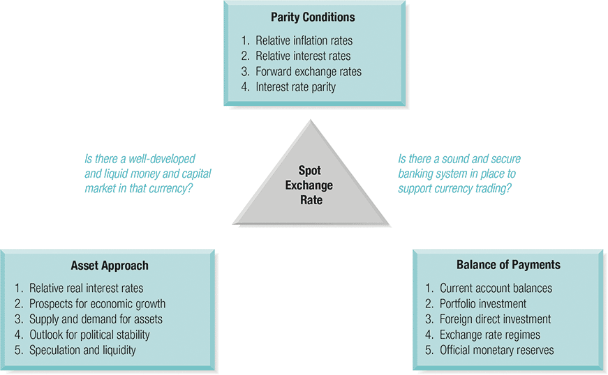
The Determinants of Foreign Exchange Rates
0
Eiteman / Moffett

Slide 4
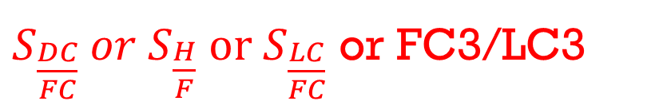
RECALL: Exchange Rate & Change in Value Definitions
$S_{\frac{DC}{FC}} or S_{\frac{H}{F}} or S_{\frac{LC}{FC}}$ or FC3/LC3
We will use the following definition:
  Exchange Rate=S=# of domestic currency units per unit of foreign currency
In this definition, exchange rate will always express one unit of foreign currency in terms of domestic currency

Slide 5
Basics: Change in the value of Currency
You probably heard the terms appreciation and revaluation and depreciation and devaluation. In FX markets they mean the following:
  Revaluation is an increase in the value of a government controlled currency → Driven by the monetary authority
  Appreciation is an increase in the value of a freely floating currency → Driven by the market
  Devaluation is a decline in the value of a government controlled currency → Driven by the monetary authority
  Depreciation is a decline in the value of a freely floating currency → Driven by the market

Slide 6
International Parity Conditions
1) APPP & RPPP
You are planning a ski vacation to Mt. Blanc in Chamonix, France, one year from now. You are negotiating over the rental of a chateau. The chateau's owner wishes to preserve his real income against both inflation and exchange rate changes, and so the present weekly rent of €9,800 (Christmas season) will be adjusted upwards or downwards for any change in the French cost of living between now and then. You are basing your budgeting on purchasing power parity (PPP). French inflation is expected to average 3.5% for the coming year, while U.S. dollar inflation is expected to be 2.5%. The current spot rate is $1.3620/€. What should you budget as the U.S. dollar cost of the one week rental?

Slide 7
Absolute Version of PPP
  In its absolute form APPP simply says, “bilateral exchange rates between two currencies should be equal to the ratio of price levels of comparable consumption baskets”.
  S_{LC/FC}= PI^{LC} /PI^{FC}
Simple Example:
Remember Assumptions
Good in US $200 – good in GB 100GBP
S implied $s per GBP = 2/1
if S rate is 1/1 ($s per GBP) then arbitrage
take $100 exchange to 100 GBP => buy good in GB => ship back to US sell for $200 => instant $100 profit
  In practice, spot rates often deviate from their PPP implied levels.
  When exchange rate deviates from its PPP implied level, it is referred to be either over or under valued.
    If the actual spot rate is above PPP implied rate the exchange rate (of the LC) is undervalued.
    If the actual spot rate is below PPP implied rate the exchange rate (of the LC) is overvalued.
Notes:
In the absence of trade frictions (such as transport costs and tariffs), and under conditions of free competition and price flexibility (where no individual sellers or buyers have power to manipulate prices and prices can freely adjust), identical goods sold in different locations must sell for the same price when prices are expressed in a common currency

Slide 8
Fair Value, Under/Overvaluation
To find out the extent of under or overvaluation of terms (foreign) or local currency we use:
To find out the extent of under or overvaluation of terms or base (foreign) currency we use:
SPOT > PPP Rate => Undervaluation of LC
SPOT < PPP Rate => Overvaluation of LC
SPOT > PPP Rate => Overvaluation of FC
SPOT < PPP Rate => Undervaluation of FC

Slide 9
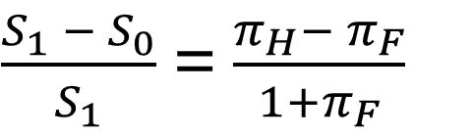


  RPPP→ Forecasting Future Exchange rate by using relative inflation rates
Recall: RPPP
$$S_{\frac{DC}{FC}} or S_{\frac{H}{F}} or S_{\frac{LC}{FC}}$$
RPPP tells us that given an equilibrium spot rate, next period exchange rate can be inferred from relative, expected inflation rates at home and abroad.
This result can be expanded to a multi-period model (multiplication). The idea here is that the exchange rates are a function of expected inflation rates.
$\frac{S_{1} − S_{0}}{S_{1}}$ = $\frac{π_{H}− π_{F}}{1+π_{F}}$
or

Slide 10
International Parity Conditions
1) APPP & RPPP
You are planning a ski vacation to Mt. Blanc in Chamonix, France, one year from now. You are negotiating over the rental of a chateau. The chateau's owner wishes to preserve his real income against both inflation and exchange rate changes, and so the present weekly rent of €9,800 (Christmas season) will be adjusted upwards or downwards for any change in the French cost of living between now and then. You are basing your budgeting on purchasing power parity (PPP). French inflation is expected to average 3.5% for the coming year, while U.S. dollar inflation is expected to be 2.5%. The current spot rate is $1.3620/€. What should you budget as the U.S. dollar cost of the one week rental?

Slide 11
What should you budget as the U.S. dollar cost of the one week rental?

Slide 12
Step 1)
Determine nominal weekly rent in Euro 1 Year from now
Rent Now + (1 Inflation rate France) = €9,800 * (1+0.035) = € 10,143

Slide 13
Step 2)
Determine Purchasing Power Exchange Rate forecast

Slide 14
Step 2)
Determine Purchasing Power Exchange Rate forecast
= S_{t+1} = 1.3620 ($/€) * (1+0.025)/(1+0.035) =
= 1.3488 ($/ €)

Slide 15
Step 3)
Determine Cost of rent in USD one year from now:

Slide 16
Step 3)
Determine Cost of rent in USD one year from now:
Rent 1 yr from now * PPP forecasted Spot Rate = 10,143€ * 1.3488 ($/ €) =
= $ 13,681.39

Slide 17
AVTO – Part I

Slide 18
AVTO – Part I

Slide 19
AVTO – Part I
260,000*1.14
331,968*1.11
296,400*1.12

Slide 20


AVTO – Part I
$$S_{\frac{DC}{FC}}$$
$$S_{\frac{rubles}{\$}}$$

Slide 21
AVTO – Part I
$$S_{\frac{DC}{FC}}$$
$$S_{\frac{rubles}{\$}}$$
$S_{02}= S_{01}∗\frac{(1+π_{rubles})}{(1+π_{\$})}$ = 30 * $\frac{(1+14\%)}{(1+2.5\%)}$ = 33.37 (rubles/$)
Notes:
For 2003 33.73*(1+12%)/(1+3%)

Slide 22
AVTO – Part I

Slide 23
AVTO – Part I
260,000(rubles)/30(rubles/$)
296,400(rubles)/33.37(rubles/$)

Slide 24
AVTO – Part II

Slide 25
AVTO – Part II

Slide 26
AVTO – Part II
260,000(rubles)/30(rubles/$)
296,400(rubles)/30(rubles/$)

Slide 27
Covered Interest Arbitrage

Slide 28
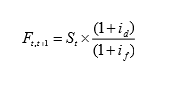
Recall: Interest Rate Parity
Forward Rate: exchange rate quoted for settlement at some future date. A forward contract states the exchange rate at which a foreign currency will be bought or sold forward at a specific date in the future
Interest Rate Parity model establishes a strong linkage among spot rates, forward rates, and relative interest rates
Domestic nominal interest rate from t to t+1
Forward rate at time t with a maturity t+1
Foreign nominal interest rate from t to t+1
Spot rate at time t
Notes:
CIA is based on IRP

Slide 29
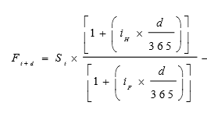
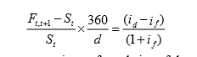
NOTE: id and if are quoted annually, if we want to estimate a non-annual forward (e.g. 90 day forward) we need to slightly modify the formula
day period
i _{d}
_{t, t+d}
i _{f}
We can Find Covered Interest Arbitrage Opportunities by checking if IRP holds (need to variate the model to):
Notes:
Note the differences in day count
Money market basis (actual/360)
This basis is commonly used for all Eurocurrency LIBOR rates, except sterling. The day count fraction is defined as the actual number of days in the period over 360.
Actual/365 fixed
This basis is commonly used for all sterling interest rates, including LIBOR.
The day count fraction is defined as the actual number of days in the period over 365.
It is also used for money markets in Australia, Canada and New Zealand.
This basis is sometimes confused with actual/365, which is defined next.
Actual/365 or actual/actual
This basis is commonly used for all sterling bonds, Euro denominated bonds, US Treasury bonds and for some USD interest rate swaps.
In this case, the day-count fraction is the number of days in the period in a normal year over 365 or the number of days in the period in a leap year over 366.
30/360 - calculates the daily interest using a 360-day year and then multiplies that by 30 (standardized month).
30/365 - calculates the daily interest using a 365-day year and then multiplies that by 30 (standardized month).
actual/360 - calculates the daily interest using a 360-day year and then multiplies that by the actual number of days in each time period.
actual/365 - calculates the daily interest using a 365-day year and then multiplies that by the actual number of days in each time period.
actual/actual - calculates the daily interest using the actual number of days in the year and then multiplies that by the actual number of days in each time period.

Slide 30
RECALL: How DO we Check for CIA?
There are many ways to identify the covered interest arbitrage opportunities, we will use one method to keep it simple:
• Since covered interest arbitrage involves home and foreign interest rates, spot and forward rates, we can use these to conduct a simple test. We have only two options:
– Borrow in home currency and invest in foreign currency
– Borrow in foreign currency and invest in home currency
• Our simple test will require us to compare return on investment and cost of borrowing

Slide 31
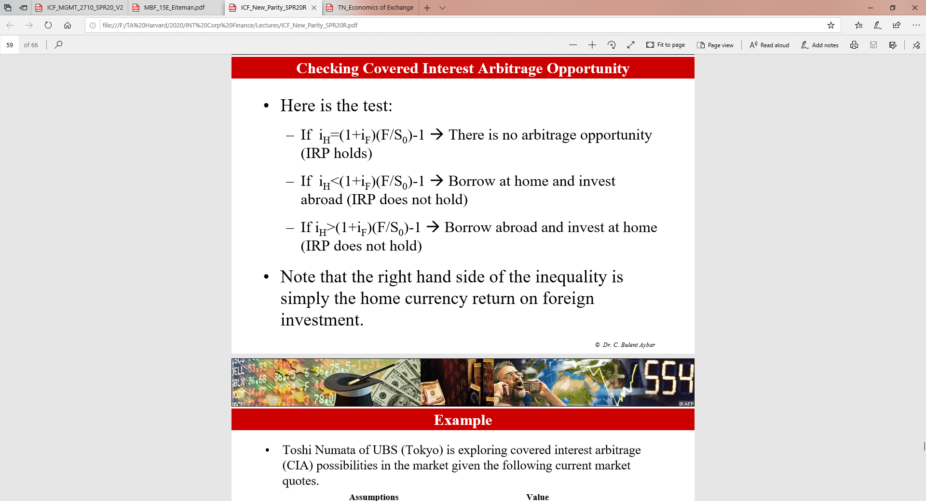
RECALL: How DO we Check for CIA?

Slide 32
Covered Interest Arbitrage
i_{H} =
i_{H} p. forward period =
i_{F} =
i_{F p. forward period} =
F =
S₀ =

Slide 33


Covered Interest Arbitrage
home
$$S_{\frac{H}{F}}$$
$$S_{\frac{SFr}{\$}}$$
NOTE: INTEREST RATES ARE ANNUAL - NEED TO ADJUST INTEREST RATE FOR TERMS TO APPLY TEST
foreign
i_{H} = 3.2%
i_{H} p. forward period = 3.2%/4 = 0.8%
i_{F} = 4.8%
i_{F p. forward period} = 4.8%/4 =1.2%
F = 1.274
S₀ =1.281
0.8% vs. (1+1.2%)*(1.274/1.281)-1 => 0.8% > 0.65%

Slide 34
What is home and abroad?

Slide 35


What is home and abroad?
$$S_{\frac{H}{F}}$$
$$S_{\frac{SFr}{\$}}$$
So borrow in USD and invest in SFr!!!

Slide 36
Covered Interest Arbitrage:
STEP 1) Borrow in USD:
STEP 2.1) Exchange USD into SFr @ Spot
STEP 3) Invest SFr @ 3.2% per year (0.8% for 3mths)
STEP 4) Sell SFr forward for USD @ 1.274
STEP 5) Pay Back Loan and collect Profit

Slide 37
Covered Interest Arbitrage:
STEP 1) Borrow in USD:
$1,000,000 @ 4.8% per year (or 1.2% for 3mths)
STEP 2.1) Exchange USD into SFr @ Spot
  $1,000,000 * Spot (SFr/$) = $1,000,000 * 1.281 = SFr1,281,000
STEP 3) Invest SFr @ 3.2% per year (0.8% for 3mths)
  SFr1,281,000*(1+0.008) = SFr1,291,248
STEP 4) Sell SFr forward for USD @ 1.274
  SFr 1,291,248 / 1.274 (SFr/$) = $1,013,538.4
STEP 5) Pay Back Loan and collect Profit
Loan: $1,000,000*(1+0.012) = $1,012,000 => Profit: $1,013,538.4 - $1,012,000 = $1,538.46

Slide 38
FISHER EFFECT & INT. FISHER EFFECT

Slide 39
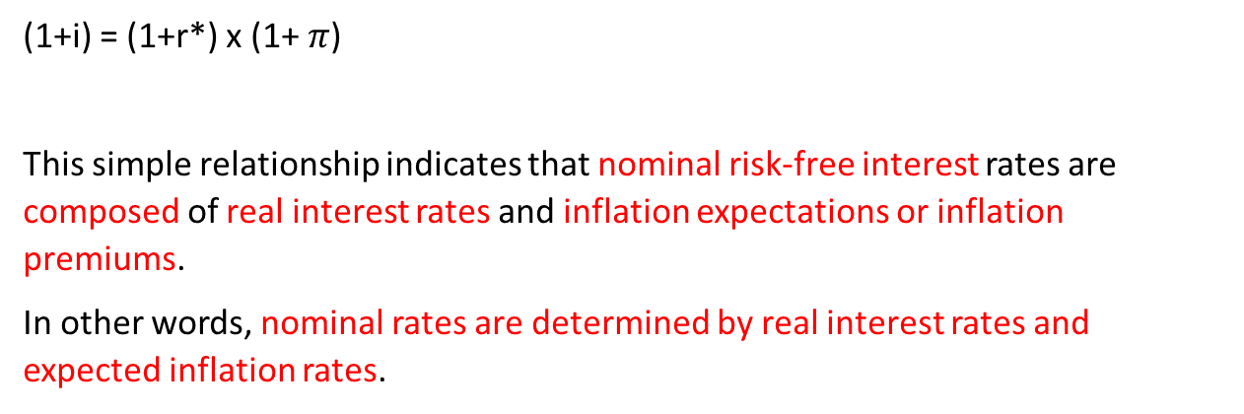
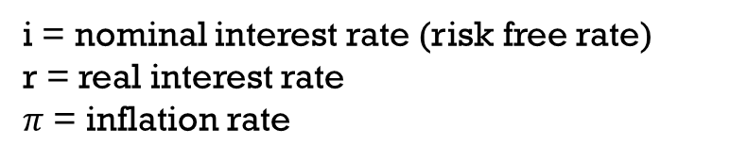
RECALL: FISHER EFFECT & INT. FISHER EFFECT
Fisher Effect
i = nominal interest rate (risk free rate)
r = real interest rate
$π$ = inflation rate
(1+i) = (1+r*) x (1+ $π$)
This simple relationship indicates that nominal risk-free interest rates are composed of real interest rates and inflation expectations or inflation premiums.
In other words, nominal rates are determined by real interest rates and expected inflation rates.
Notes:
IFE = UIP
Next slide: not visible shows how IFE or UIP is derived from RPPP and Fisher

Slide 40
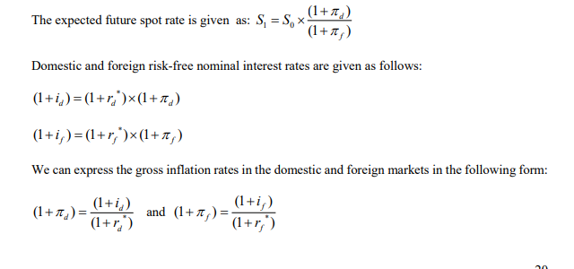
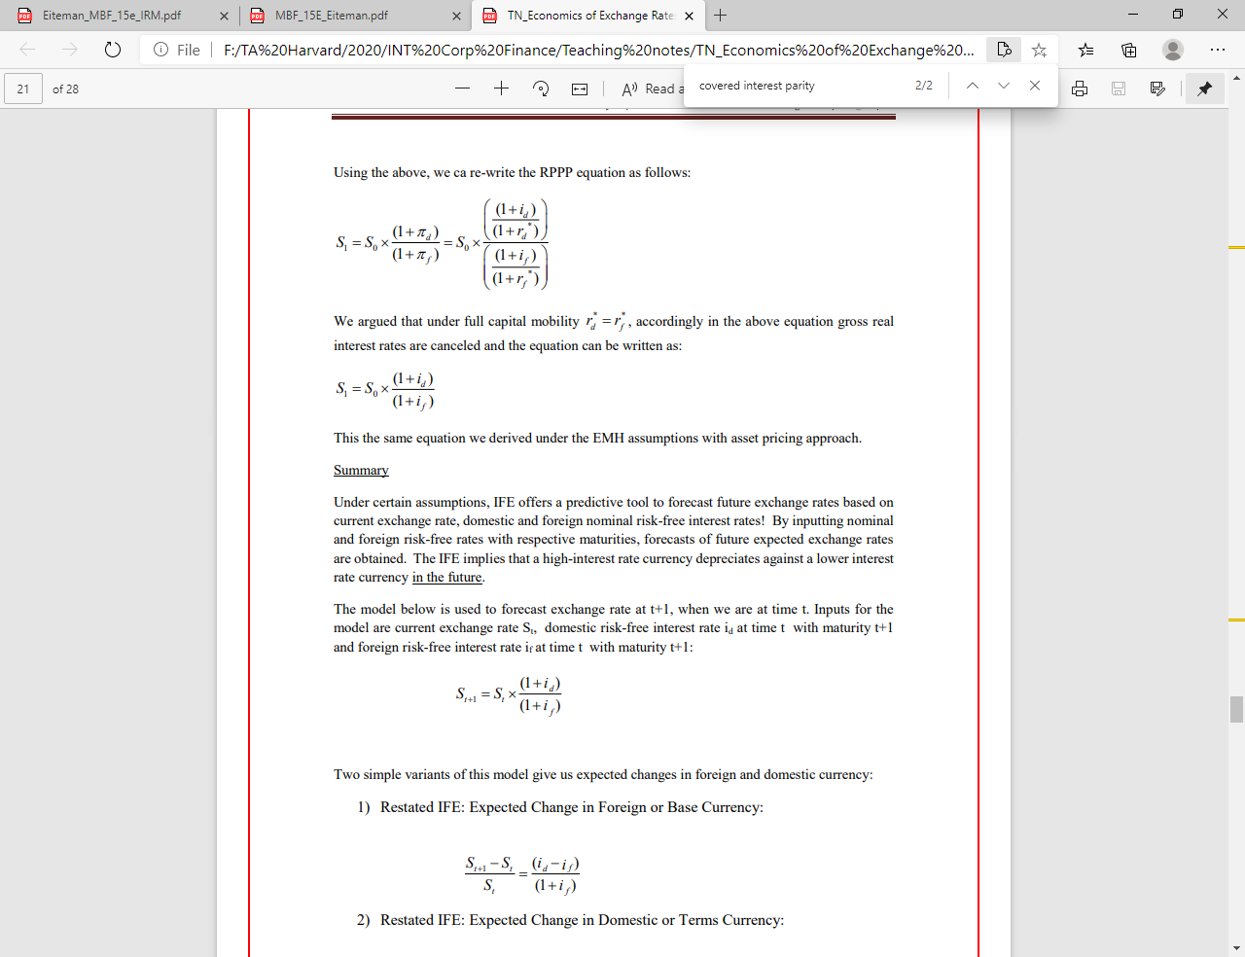
RECALL: FISHER EFFECT & INT. FISHER EFFECT
We can derive the IFE or UIP from RPPP and Fisher Effect as:

Slide 41
RECALL: International Fisher Effect
The relationship is given as follows:
This equation tells us that if we know the domestic (home) and foreign interest rates from time t to t+1, we can forecast the spot exchange rate at time t+1.
Expected:
This is in a way the capital market equivalent of “law of one price”
It looks similar to the RPPP model; in IFE interest rates replaces inflation expectations!!
• It is important to understand that this is a normative perspective; in light of efficient market hypothesis, we expect the future spot rate to take a particular value.
• It also rests on an important assumption that real interest rates across markets are equal and there are no impediments to capital mobility!

Slide 42

Expected change in the exchange rate based on IFE
$$S_{\frac{H}{F}}= S_{\frac{LC}{FC}}$$
Expected Change in the value of FC
Expected Change in the value of LC
These two formulas suggest that we can estimate the expected change in the local or foreign currency by using inflation rate differentials.

Slide 43
How can we solve?

Slide 44
Assumptions: Fisher & IFE
REAL INTEREST RATES ARE EQUAL
Step 1) Use Fisher to find real interest rate for US
Step 2) Use real interest rate (and Fisher) to find inflation for Europe

Slide 45
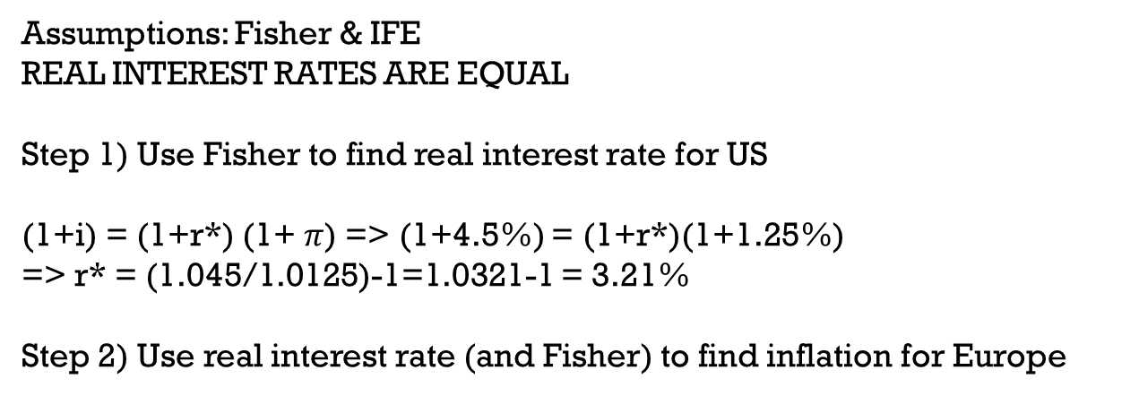
Assumptions: Fisher & IFE
REAL INTEREST RATES ARE EQUAL
Step 1) Use Fisher to find real interest rate for US
(1+i) = (1+r*) (1+ $π$) => (1+4.5%) = (1+r*)(1+1.25%)
=> r* = (1.045/1.0125)-1=1.0321-1 = 3.21%
Step 2) Use real interest rate (and Fisher) to find inflation for Europe

Slide 46
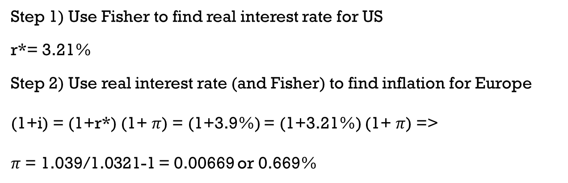
Step 1) Use Fisher to find real interest rate for US
r*= 3.21%
Step 2) Use real interest rate (and Fisher) to find inflation for Europe
(1+i) = (1+r*) (1+ $π$) = (1+3.9%) = (1+3.21%) (1+ $π$) =>
$π$ = 1.039/1.0321-1 = 0.00669 or 0.669%

Slide 48


$$S_{1}=1.3264 ∗ \frac{1+4.5\%}{1+3.9\%}$$
$S_{1 }$= 1.334059 ~ 1.3341 ($/€)
What is the expected exchange rate change in $ and € respectively?

Slide 49

What is the expected exchange rate change in $ and € respectively?
$S_{\frac{H}{F}}= S_{\frac{\$}{€}}$ = $S_{\frac{LC}{FC}}$
S₀ = 1.3264 S₁ = 1.3341
Expected Change in the value of FC
Expected Change in the value of LC
Change in Euro:
(1.3341 – 1.3264) / 1.3264 =
= 0.581%
Change in USD:
(1.3264 – 1.3341) / 1.3341
= -0.577%

