Slide 1
International Corporate Finance
Review Session 3
Nicole Hruban

Slide 2
Another IfE Example
Assume that three month T-bills in the UK yield 2% p.a. and 0.9% in the U.S.
  What should be the IFE implied exchange rate change in British Pound?
  What should be the IFE implied exchange rate change in USD?
Expected Change in the value of FC
Expected Change in the value of LC

Slide 3
Example
Assume that three month T-bills in the UK yield 2% p.a. and 0.9% in the U.S.
  What should be the IFE implied exchange rate change in British Pound?
  What should be the IFE implied exchange rate change in USD?
We need to decide about the local and foreign exchange rates. The choice is arbitrary. Let’s select pound as domestic currency and USD as foreign currency:
  What should be the IFE implied exchange rate change in British Pound?
  What should be the IFE implied exchange rate change in USD?
Expected Change in the value of LC (DC)
Expected Change in the value of FC

Slide 4

Using IFE to determine return on foreign investment
Assume that you invest in a German Corporate Bond and you expect to earn 4% return in Euro terms. Current spot rate is $1.1990 per Euro and spot rate expected in one year is $1.2500. What would be your dollar return on your Euro investment?

Slide 5
Using IFE to determine return on foreign investment
Cross border investment is ubiquitous; US investors often invest in foreign markets in other currencies and borrow from foreign lenders in foreign currencies.
When we invest or borrow in foreign currencies, it is important that we understand the impact of exchange rates on our returns or borrowing costs.
An American investor, would like to know his expected return in USD terms as an American borrower would like to know its cost of borrowing in USD.
IFE helps us to convert foreign investment returns into USD or foreign cost of borrowing into USD.

Slide 6
Using IFE to determine return on foreign investment
Cross border investment is ubiquitous; US investors often invest in foreign markets in other currencies and borrow from foreign lenders in foreign currencies.
When we invest or borrow in foreign currencies, it is important that we understand the impact of exchange rates on our returns or borrowing costs.
An American investor, would like to know his expected return in USD terms as an American borrower would like to know its cost of borrowing in USD.
IFE helps us to convert foreign investment returns into USD or foreign cost of borrowing into USD.

Slide 7

Using IFE to determine return on foreign investment
We will estimate USD return on an investment in another country and in another currency. To avoid confusion let’s call the other country as investment country and the other currency as investment currency. Then USD return is defined as:
If the exchange rate is expressed as # USD per Investment Currency then the formula will be:
where S= USD per investment currency and
S₁/S₀=(1+%change in investment currency)
From above relationship we can estimate our USD return on our IC investment.
$$R_{\$}^{IC}=(1+R_{IC})×(1+Δ\% \text{in} \text{IC})\text{−1}$$
F1:
Notes:
The last bullet point is simply saying that in order R$(€)= [(1+R€)(S₁/S₀)]-1=R$ to hold, S₁ should take a specific value. That value is indeed can be seen at time 0, because all the variables in the above equation, but S₁ is known. And only for one specific value of S1 can satisfy this relationship.

Slide 8
Using IFE to determine return on foreign investment
Investment
In contrast if the exchange rate is expressed investment country’s currency per USD then the change in the value of the formula change:
where S= # investment currency per 1 USD and
S₀/S₁=(1+%change in investment currency)
From above relationship we can estimate our USD return on our IC investment.
F2:
Notes:
The last bullet point is simply saying that in order R$(€)= [(1+R€)(S₁/S₀)]-1=R$ to hold, S₁ should take a specific value. That value is indeed can be seen at time 0, because all the variables in the above equation, but S₁ is known. And only for one specific value of S1 can satisfy this relationship.

Slide 9
Using IFE to determine return on foreign investment
Investment
Assume that you invest in a German Corporate Bond and you expect to earn 4% return in Euro terms. Current spot rate is $1.1990 per Euro and spot rate expected in one year is $1.2500. What would be your dollar return on your Euro investment?
STEP 1) Determine the investment country and currency
STEP 2) Look at how the exchange rate is expressed to determine applicable formula
# USD per Investment Currency
F1:
# investment country’s currency per USD
F2:

Slide 10
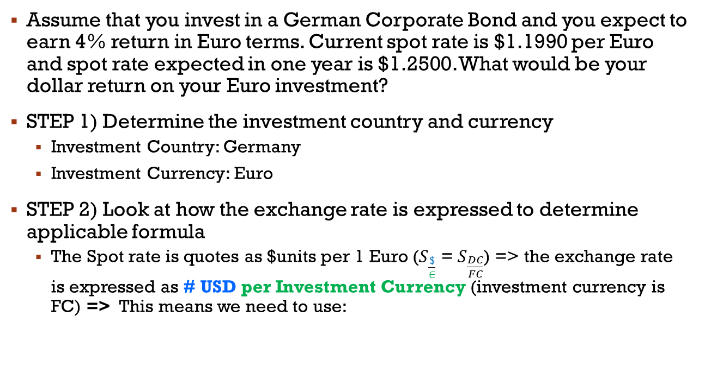
Using IFE to determine return on foreign investment
Investment
Assume that you invest in a German Corporate Bond and you expect to earn 4% return in Euro terms. Current spot rate is $1.1990 per Euro and spot rate expected in one year is $1.2500. What would be your dollar return on your Euro investment?
STEP 1) Determine the investment country and currency
  Investment Country: Germany
  Investment Currency: Euro
STEP 2) Look at how the exchange rate is expressed to determine applicable formula
  The Spot rate is quotes as $units per 1 Euro ($S_{\frac{\$}{∈}}$ = $S_{\frac{DC}{FC}}$) => the exchange rate is expressed as # USD per Investment Currency (investment currency is FC) => This means we need to use:
F1:

Slide 11
Using IFE to determine return on foreign investment
Investment
Practice for you
Assume that you invest in a Japanese Corporate Bond and you expect to earn 1% return in JPY terms. Current spot rate is JPY125 per USD and spot rate expected in one year is JPY115. What would be your dollar return on your JPY investment?
STEP 1) Determine the investment country and currency
STEP 2) Look at how the exchange rate is expressed to determine applicable formula
# USD per Investment Currency
F1:
# investment country’s currency per USD
F2:

Slide 12
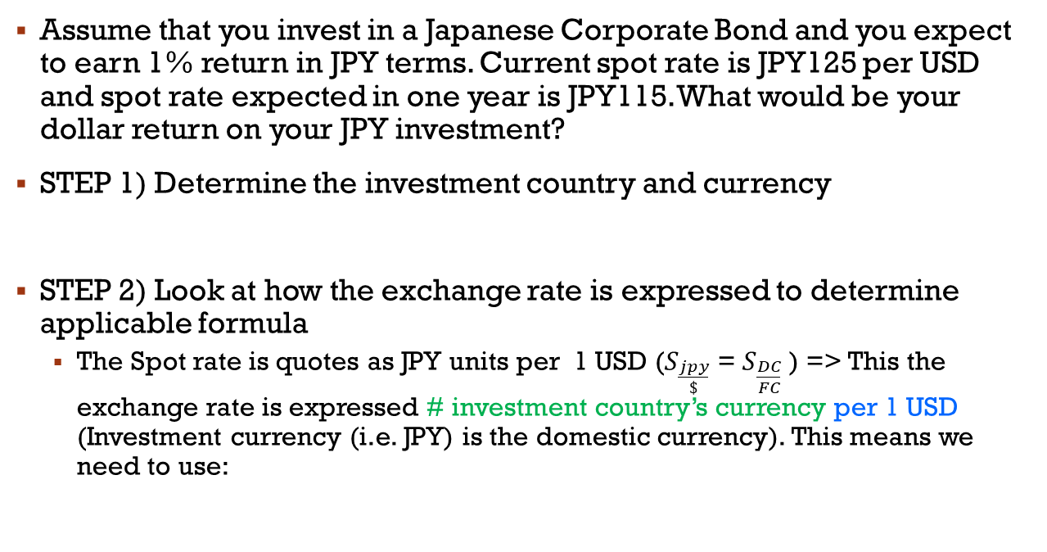
Using IFE to determine return on foreign investment
Investment
Assume that you invest in a Japanese Corporate Bond and you expect to earn 1% return in JPY terms. Current spot rate is JPY125 per USD and spot rate expected in one year is JPY115. What would be your dollar return on your JPY investment?
STEP 1) Determine the investment country and currency
STEP 2) Look at how the exchange rate is expressed to determine applicable formula
  The Spot rate is quotes as JPY units per 1 USD ($S_{\frac{jpy}{\$}}$ = $S_{\frac{DC}{FC}}$ ) => This the exchange rate is expressed # investment country’s currency per 1 USD (Investment currency (i.e. JPY) is the domestic currency). This means we need to use:
  Investment Country: Japan
  Investment Currency: JPY
F2:

Slide 13
Using IFE to determine return on foreign investment
Investment
Assume that you invest in a Japanese Corporate Bond and you expect to earn 1% return in JPY terms. Current spot rate is JPY125 per USD and spot rate expected in one year is JPY115. What would be your dollar return on your JPY investment?
Sort out the variables:
  Investment Country: Japan
  Investment Currency: JPY
  Investment Currency expressed as JPY per unit of USD; this suggest that we treat investment currency as domestic currency and calculate change in its value accordingly:

Slide 14
Example-3:
borrowing
Assume that an American company borrows from a French bank. French bank charges 9% interest in Euro terms. Current spot rate is $1.1990 per Euro and spot rate expected in one year is $1.2500. What should be the dollar cost of American company’s Euro loan?
In this question, we should first sort out the variables:
STEP 1) Determine the borrowing country and currency
  STEP 2) Look at how the exchange rate is expressed to determine applicable formula

Slide 15
Example-3:
borrowing
Assume that an American company borrows from a French bank. French bank charges 9% interest in Euro terms. Current spot rate is $1.1990 per Euro and spot rate expected in one year is $1.2500. What should be the dollar cost of American company’s Euro loan?
In this question, we should first sort out the variables:
STEP 1) Determine the borrowing country and currency
  Borrowing Country: France
  Borrowing Currency: Euro
  STEP 2) Look at how the exchange rate is expressed to determine applicable formula
  Borrowing Currency expressed as USD per unit of borrowing currency; this suggest that we treat borrowing currency as foreign currency and calculate change in its value accordingly:

Slide 16
Example-3:
borrowing
Assume that an American company borrows from a French bank. French bank charges 9% interest in Euro terms. Current spot rate is $1.1990 per Euro and spot rate expected in one year is $1.2500. What should be the dollar cost of American company’s Euro loan?
In this question, we should first sort out the variables:
  Borrowing Country: France
  Borrowing Currency: Euro
  Borrowing Currency expressed as USD per unit of borrowing currency; this suggest that we treat borrowing currency as foreign currency and calculate change in its value accordingly:
# USD per Borrowing Currency
F1:
We replace IC with BC

Slide 17
Example-4:
borrowing
PRACTICE
Assume that GE borrows from a Japanese Bank at earn 2% annual interest in JPY terms. Current spot rate is JPY117 per USD and spot rate expected in one year is JPY115. What would be GE’s USD cost of JPY loan?
Sort out the variables:
  Borrowing Country: Japan
  Borrowing Currency: JPY
  Borrowing Currency expressed as JPY per unit of USD; this suggest that we treat borrowing currency as domestic currency and calculate change in its value accordingly:

Slide 18
FX Trading – Warm Up
Currency | Bid Rate | Offer Rate
EUR/USD | 1.2310 | 1.2313
GBP/USD | 1.7945 | 1.7949
USD/JPY | 110.73 | 110.83
USD/CHF | 1.2810 | 1.2815
USD/CAD | 1.1514 | 1.1517
USD/BRL | 2.1780 | 2.2345
Based on the above quotes determine the following:
a) You have 100,000 USD and you want to buy BRL. How many BRL do you receive?
b) You have 100,000 CHF and you want to buy USD. How many USD do you receive?
c) You have 100,000 CAD and you want to buy JPY. How many JPY do you receive?

Slide 19
RECALL: FX Trading BASICS
The key to correct trading decisions is to read the quotations correctly.
When you see a quotation, immediately determine the domestic (terms) and foreign currency (base).
  When you buy base currency you pay the offer (ask) rate
  When you sell the base currency you are paid the bid rate
Note that buying the base (foreign) currency is equivalent to selling the terms (domestic) currency
Similarly, selling the base currency is equivalent to buying the terms (domestic) currency

Slide 20

RECALL: Spot Transactions
$$Note the relation to: S_{\frac{LC}{FC}}$$
Terms or Price Currency
(Local Currency)
Dealer Quotes
Dealers quote Bid and Ask rates, They buy the base currency (foreign currency) at the bid rate and sell it at the ask rate
Once the transaction is confirmed, settlement takes place in two business days, hence T+2
In interbank market transactions are multiples of millions; “I take 5 at 13” means I am buying EUR5 million at 1.2313; dealers usually spell that the last two digits
Base Currency
(Foreign Currency)
EUR/USD 1.2310-1.2313
Currency | Bid Rate | Ask Rate
EUR/USD | 1.2310 | 1.2313
GBP/USD | 1.7945 | 1.7949
USD/JPY | 110.73 | 110.83
USD/CHF | 1.2810 | 1.2815
USD/CAD | 1.1514 | 1.1517
USD/BRL | 2.1780 | 2.2345
Dealer Buys EUR (for USD) at this rate
Dealer sells EUR (for USD) at this rate
The difference between bid and ask rates is the spread, in this case 3 pips or $0.0003; each point in the fourth decimal is 1 pip

Slide 21
FX Trading – Warm Up
Dealer Buys Base (for term) at this rate
Dealer sells Base (for term) at this rate
Currency | Bid Rate | Offer Rate
EUR/USD | 1.2310 | 1.2313
GBP/USD | 1.7945 | 1.7949
USD/JPY | 110.73 | 110.83
USD/CHF | 1.2810 | 1.2815
USD/CAD | 1.1514 | 1.1517
USD/BRL | 2.1780 | 2.2345
Quotation:
BASE (or FC) / TERM (or LC)
You have 100,000 USD and you want to buy BRL. How many BRL do you receive?
STEP 1) Determine Base in applicable quote
STEP 2) Determine applicable rate
STEP 3) Calculate the amount

Slide 22
FX Trading – Warm Up
Dealer Buys Base (for term) at this rate
Dealer sells Base (for term) at this rate
Currency | Bid Rate | Offer Rate
EUR/USD | 1.2310 | 1.2313
GBP/USD | 1.7945 | 1.7949
USD/JPY | 110.73 | 110.83
USD/CHF | 1.2810 | 1.2815
USD/CAD | 1.1514 | 1.1517
USD/BRL | 2.1780 | 2.2345
Quotation:
BASE (or FC) / TERM (or LC)
You have 100,000 USD and you want to buy BRL. How many BRL do you receive?
STEP 1) Determine Base: USD
STEP 2) Determine applicable rate: You have USD and the dealer buys USD (Base) at 2.178 (BRL per 1$)
STEP 3) Calculate the amount: $100,000 * 2.178 (BRL/$) = 217,800 BRL

Slide 23
FX Trading – Warm Up
Dealer Buys Base (for term) at this rate
Dealer sells Base (for term) at this rate
Currency | Bid Rate | Offer Rate
EUR/USD | 1.2310 | 1.2313
GBP/USD | 1.7945 | 1.7949
USD/JPY | 110.73 | 110.83
USD/CHF | 1.2810 | 1.2815
USD/CAD | 1.1514 | 1.1517
USD/BRL | 2.1780 | 2.2345
Quotation:
BASE (or FC) / TERM (or LC)
Based on the above quotes determine the following:
b) You have 100,000 CHF and you want to buy USD. How many USD do you receive?
STEP 1) Determine Base in applicable quote
STEP 2) Determine applicable rate
STEP 3) Calculate the amount

Slide 24
FX Trading – Warm Up
Dealer Buys Base (for term) at this rate
Dealer sells Base (for term) at this rate
Currency | Bid Rate | Offer Rate
EUR/USD | 1.2310 | 1.2313
GBP/USD | 1.7945 | 1.7949
USD/JPY | 110.73 | 110.83
USD/CHF | 1.2810 | 1.2815
USD/CAD | 1.1514 | 1.1517
USD/BRL | 2.1780 | 2.2345
Quotation:
BASE (or FC) / TERM (or LC)
Based on the above quotes determine the following:
b) You have 100,000 CHF and you want to buy USD. How many USD do you receive?
STEP 1) Determine Base in applicable quote: USD
STEP 2) Determine applicable rate: You have CHF and want USD, the dealer sells USD (BASE) for 1.2825 (chf per $)
STEP 3) Calculate the amount: 100,000CHF / 1.2815 (CHF/$) = $78,033.55

Slide 25
FX Trading – Warm Up
Dealer Buys Base (for term) at this rate
Dealer sells Base (for term) at this rate
Currency | Bid Rate | Offer Rate
EUR/USD | 1.2310 | 1.2313
GBP/USD | 1.7945 | 1.7949
USD/JPY | 110.73 | 110.83
USD/CHF | 1.2810 | 1.2815
USD/CAD | 1.1514 | 1.1517
USD/BRL | 2.1780 | 2.2345
Quotation:
BASE (or FC) / TERM (or LC)
c) You have 100,000 CAD and you want to buy JPY. How many JPY do you receive?
Note: There are no direct quote for CAD/JPY, so we must first exchange CAD for USD and then exchange USD for JPY (essentially running Step 1 through 3 two times)

Slide 26
FX Trading – Warm Up
Dealer Buys Base (for term) at this rate
Dealer sells Base (for term) at this rate
Currency | Bid Rate | Offer Rate
EUR/USD | 1.2310 | 1.2313
GBP/USD | 1.7945 | 1.7949
USD/JPY | 110.73 | 110.83
USD/CHF | 1.2810 | 1.2815
USD/CAD | 1.1514 | 1.1517
USD/BRL | 2.1780 | 2.2345
Quotation:
BASE (or FC) / TERM (or LC)
c) You have 100,000 CAD and you want to buy JPY. How many JPY do you receive?
CAD - USD exchange:
STEP 1) Determine Base in applicable quote
STEP 2) Determine applicable rate
STEP 3) Calculate the amount

Slide 27
FX Trading – Warm Up
Dealer Buys Base (for term) at this rate
Dealer sells Base (for term) at this rate
Currency | Bid Rate | Offer Rate
EUR/USD | 1.2310 | 1.2313
GBP/USD | 1.7945 | 1.7949
USD/JPY | 110.73 | 110.83
USD/CHF | 1.2810 | 1.2815
USD/CAD | 1.1514 | 1.1517
USD/BRL | 2.1780 | 2.2345
Quotation:
BASE (or FC) / TERM (or LC)
c) You have 100,000 CAD and you want to buy JPY. How many JPY do you receive?
CAD - USD exchange:
STEP 1) Determine Base in applicable quote: USD
STEP 2) Determine applicable rate: You have CAD and want to buy USD, the dealer sells (offer) USD (Base) for 1.1517 (CAD per 1$)
STEP 3) Calculate the amount: 100,000CAD / 1.1517 (CAD/$) = $86,828.17

Slide 28
FX Trading – Warm Up
Dealer Buys Base (for term) at this rate
Dealer sells Base (for term) at this rate
Currency | Bid Rate | Offer Rate
EUR/USD | 1.2310 | 1.2313
GBP/USD | 1.7945 | 1.7949
USD/JPY | 110.73 | 110.83
USD/CHF | 1.2810 | 1.2815
USD/CAD | 1.1514 | 1.1517
USD/BRL | 2.1780 | 2.2345
Quotation:
BASE (or FC) / TERM (or LC)
c) You have 100,000 CAD and you want to buy JPY. How many JPY do you receive?
USD – JPY exchange:
STEP 1) Determine Base in applicable quote
STEP 2) Determine applicable rate
STEP 3) Calculate the amount

Slide 29
FX Trading – Warm Up
Dealer Buys Base (for term) at this rate
Dealer sells Base (for term) at this rate
Currency | Bid Rate | Offer Rate
EUR/USD | 1.2310 | 1.2313
GBP/USD | 1.7945 | 1.7949
USD/JPY | 110.73 | 110.83
USD/CHF | 1.2810 | 1.2815
USD/CAD | 1.1514 | 1.1517
USD/BRL | 2.1780 | 2.2345
Quotation:
BASE (or FC) / TERM (or LC)
c) You have 100,000 CAD and you want to buy JPY. How many JPY do you receive?
USD – JPY exchange:
STEP 1) Determine Base in applicable quote: USD
STEP 2) Determine applicable rate: You have USD and want to buy JPY, the dealer buys (bid) USD (Base) for 110.73 (¥ per 1$)
STEP 3) Calculate the amount: $86,828.17 * 110.73 (¥ per 1$) = 9,614,483.26¥

Slide 30
Transatlantic Arbitrage
A corporate treasury working out of Vienna with operations in New York simultaneously calls Citibank in New York City and Barclays in London. The two banks give the following quotes at the same time on the euro:
Using $1 million or its euro equivalent, show how the corporate treasury could make geographic arbitrage profit with the two different exchange rate quotes.
Citibank NYC Barclays London
EUR/USD0.7551-0.7561 EUR/USD0.7571-0.7575

Slide 31
Transatlantic Arbitrage
A corporate treasury working out of Vienna with operations in New York simultaneously calls Citibank in New York City and Barclays in London. The two banks give the following quotes at the same time on the euro:
Using $1 million or its euro equivalent, show how the corporate treasury could make geographic arbitrage profit with the two different exchange rate quotes.
Citibank NYC Barclays London
EUR/USD0.7551-0.7561 EUR/USD0.7571-0.7575

Slide 32
Transatlantic Arbitrage
The quotation above suggests that New York dealer sells Euros at $0.7561; and the London dealer buys EUR at $0.7571. This suggests that we can benefit from the discrepancy:
Buy EURO at $0.7561 in NYC → $1,000,000/($0.7561/€)= €1,322,576
Sell EURO in London at $0.7571/ € → €1,322,576 x 0.7571=$1,001,322.57
Net Arbitrage Profit: $1,322.57
Citibank NYC Barclays London
EUR/USD0.7551-0.7561 EUR/USD0.7571-0.7575
Dealer Buys Base (for term) at this rate
Dealer sells Base (for term) at this rate
Dealer Buys Base (for term) at this rate
Dealer sells Base (for term) at this rate

Slide 33
Forward Transactions
Company ABC is a large U.S. importer that frequently does business with Germany. ABC has EUR 5,000,000 payable due in one year. They would like to hedge the exchange risk associated with this transaction and therefore turn to their trusted banker / dealer.
They receive the following quotes:
  Spot EUR/USD is 1.3176/77
  The one year Forward (outright) is 1.3366/74
What is the amount of USD that you will have to pay one year from now if you were to enter in the forward contract?
Let’s assume ABC’s did not hedge the transfer, what would have been is USD amount if the applicable Spot rate in one year was EUR/USD 1.25? What if it was EUR/USD 1.35?.

Slide 34
RECALL: Forward Transactions
Dealer Spot-Forward Outright Quotes
Maturity | ISO | Bid | Ask
Spot | EUR/USD | 1.1025 | 1.0128
ON | EUR/USD | 1.1022 | 1.1025
SW | EUR/USD | 1.1030 | 1.1033
2W | EUR/USD | 1.1034 | 1.1038
1M | EUR/USD | 1.1046 | 1.1049
2M | EUR/USD | 1.1064 | 1.1069
3M | EUR/USD | 1.1082 | 1.1087
6M | EUR/USD | 1.1131 | 1.1136
9M | EUR/USD | 1.1175 | 1.1181
1Y | EUR/USD | 1.1224 | 1.1232
“d” is days in forward, 30/360 is the money market day count convention; it is actual/365 for GBP, actual/360 for LIBOR, EUR and USD.
The forward rate is a function of home and foreign interest rates. If the home rate is higher than the foreign rate, forward rate will be higher than the spot rate, this implies that the foreign currency is at a forward premium.
The table on the left, indicates higher interest rates in the US which implies a forward premium for the EUR.
Dealers quote rates for variety of settlement dates from spot to 1 Year forward.
For instance the dealer sells EUR 1-Month Forward at $1.1049; the buyer pays more USD than the spot rate of $1.0128; in this case EUR is selling at a forward premium

Slide 35
RECALL Day Count Conventions
Country | Domestic | Euromarket
Eurozone | ACT/360 | ACT/360
Canada | ACT/365 | ACT/360
Australia | ACT/365 | ACT/360
Japan | ACT/365 | ACT/360
HK | ACT/365 | ACT/365
Singapore | ACT/365 | ACT/365
UK | ACT/365 | ACT/365
US | ACT/360 | ACT/360

Slide 36
Forward Transactions
EUR 5,000,000 payable due in one year.
They receive the following quotes:
  Spot EUR/USD is 1.3176/77
  The one year Forward (outright) is 1.3366/74
What is the amount of USD that you will have to pay one year from now if you were to enter the forward contract?

Slide 37
Forward Transactions
EUR 5,000,000 payable due in one year.
They receive the following quotes:
  Spot EUR/USD is 1.3176/77
  The one year Forward (outright) is 1.3366/74
What is the amount of USD that you will have to pay one year from now if you were to enter the forward contract?
  The one year Forward (outright) is 1.3366/74
We have dollars and need euros
ABC will need $1.3374 ($ p. Euro) * 5,000,000 Euro = $6,687,000 in one year and two days (note: transactions settle 1 year after the Spot value date which is T+1)

Slide 38
Forward Transactions
ABC has EUR 5,000,000 payable due in one year.
Let’s assume ABC’s did not hedge the transfer, what would have been is USD amount if the applicable Spot rate in one year was EUR/USD 1.2455/1.2500? What if it was EUR/USD 1.3456/1.3500?.

Slide 39
Forward Transactions
ABC has EUR 5,000,000 payable due in one year.
Let’s assume ABC’s did not hedge the transfer, what would have been is USD amount if the applicable Spot rate in one year was EUR/USD 1.2455/1.2500? What if it was EUR/USD 1.3456/1.3500?.
We have dollars and need euros
Alt1: 1.25 ($ per euro) * 5,000,000 Euro = $6,250,000
Alt2:1.35 ($ per euro) *5,000,000 Euro= $6,750,000
$6,687,000

Slide 40
ForwardS
Christoph Hoffeman trades currency for Kapinsky Capital of Geneva. Christoph has $10 million to begin with, and he must state all profits at the end of any speculation in U.S. dollars. The spot rate on the euro is EUR/USD1.3358, while the 30-day forward rate is EUR/USD 1.3350.
a. If Christoph believes the euro will continue to rise in value against the U.S. dollar, so that he expects the spot rate to be $1.3600/€ at the end of 30 days, what should he do?
b. If Christoph believes the euro will depreciate in value against the U.S. dollar, so that he expects the spot rate to be $1.2800/€ at the end of 30 days, what should he do?

Slide 41
ForwardS
Christoph Hoffeman trades currency for Kapinsky Capital of Geneva. Christoph has $10 million to begin with, and he must state all profits at the end of any speculation in U.S. dollars. The spot rate on the euro is EUR/USD1.3358, while the 30-day forward rate is EUR/USD 1.3350.
a. If Christoph believes the euro will continue to rise in value against the U.S. dollar, so that he expects the spot rate to be $1.3600/€ at the end of 30 days, what should he do?

Slide 42
ForwardS
Christoph anticipates increase in Euro Values (rel to USD)
In this case, Christoph believes the dollar will be trading at $1.36/€ in the open market at the end of 30 days, but he has the ability to buy or sell dollars at a forward rate of $1.3350/€.
He should therefore buy euros forward 30 days (requires no actual cash flow up-front), and at the end of 30 days take delivery of those euros and sell in the spot market at the higher dollar rate for profit.

Slide 43
ForwardS

Slide 44
ForwardS
Christoph Hoffeman trades currency for Kapinsky Capital of Geneva. Christoph has $10 million to begin with, and he must state all profits at the end of any speculation in U.S. dollars. The spot rate on the euro is EUR/USD1.3358, while the 30-day forward rate is EUR/USD 1.3350.
b. If Christoph believes the euro will depreciate in value against the U.S. dollar, so that he expects the spot rate to be $1.2800/€ at the end of 30 days, what should he do?

Slide 45
ForwardS
b. If Christoph believes the euro will depreciate in value against the U.S. dollar, so that he expects the spot rate to be $1.2800/€ at the end of 30 days, what should he do?
Christoph believes that the dollar will strengthen to $1.28 in 30 days
He should sell euros forward now at the higher dollar rate, wait 30 days and buy the euros needed on the open market at $1.28, and immediately then use those euros to fulfill his forward contract to sell euros for dollars at $1.3350. For a profit.

Slide 46
ForwardS

