Slide 1
International Corporate Finance
Review Session 4
Nicole Hruban

Slide 2
Cross Rates
Anne Dietz lives in Singapore, but is making her first business trip to Sydney, Australia. Standing in Singapore's new terminal #3 at Changi Airport, she looks at the foreign exchange quotes posted over the FX trader's booth. She wishes to exchange 1,000 Singapore dollars (S$ or SGD) for Australian dollars (A$ or AUD).
What is the Singapore dollar to Australian dollar cross rate?
How many Australian dollars will Anne get for her Singapore dollars?

Slide 3
Recall: Cross Rates
Many currency pairs are only inactively traded, so their exchange rate is determined by their relationship to a third, widely traded currency
When we are working with cross rates, we need to again pay attention on how the exchange rate is denoted, i.e. which currency is the base (foreign) and which one is the term (local, domestic) currency.
Base Currency
(Foreign Currency)
Terms or Price Currency
(Local Currency)
EUR/USD

Slide 4
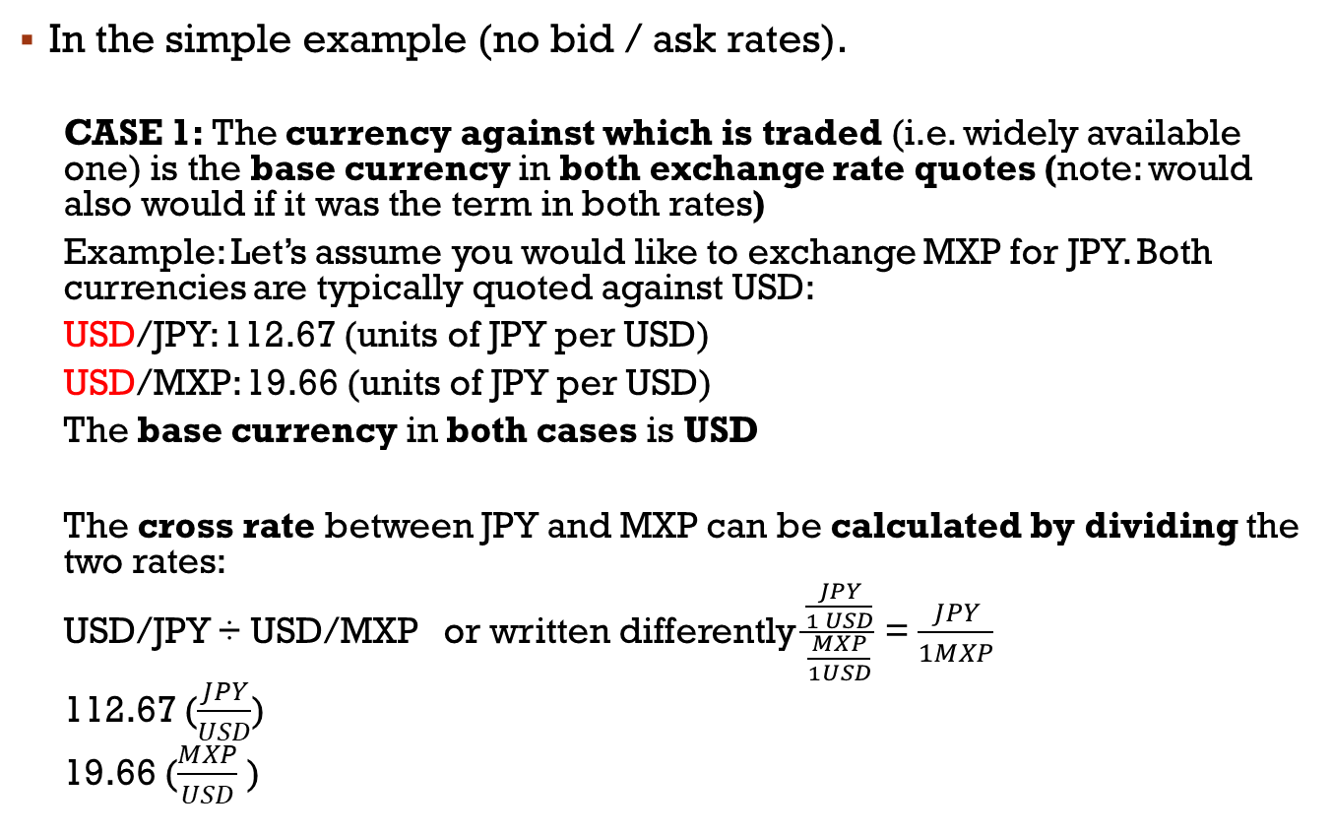

Recall: Cross Rates
Base Currency
(Foreign Currency)
Terms or Price Currency
(Local Currency)
EUR/USD
In the simple example (no bid / ask rates).
  CASE 1: The currency against which is traded (i.e. widely available one) is the base currency in both exchange rate quotes (note: would also would if it was the term in both rates)
  Example: Let’s assume you would like to exchange MXP for JPY. Both currencies are typically quoted against USD:
  USD/JPY: 112.67 (units of JPY per USD)
  USD/MXP: 19.66 (units of JPY per USD)
  The base currency in both cases is USD
  The cross rate between JPY and MXP can be calculated by dividing the two rates:
  USD/JPY ÷ USD/MXP or written differently $\frac{\frac{JPY}{1 USD}}{\frac{MXP}{1USD}}$ = $\frac{JPY}{1MXP}$
  112.67 ($\frac{JPY}{USD}$)
  19.66 ($\frac{MXP}{USD}$ )
= 5.731 ($\frac{JPY}{MXP}$)

Slide 5
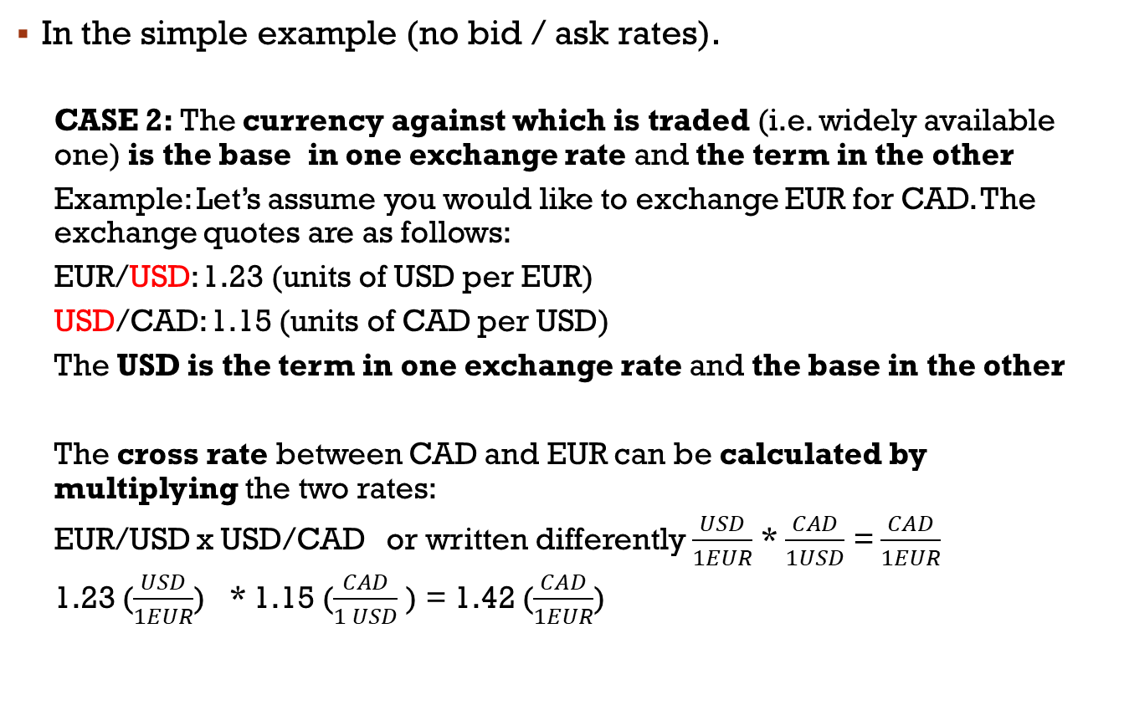
Recall: Cross Rates
Base Currency
(Foreign Currency)
Terms or Price Currency
(Local Currency)
EUR/USD
In the simple example (no bid / ask rates).
  CASE 2: The currency against which is traded (i.e. widely available one) is the base in one exchange rate and the term in the other
  Example: Let’s assume you would like to exchange EUR for CAD. The exchange quotes are as follows:
  EUR/USD: 1.23 (units of USD per EUR)
  USD/CAD: 1.15 (units of CAD per USD)
  The USD is the term in one exchange rate and the base in the other
  The cross rate between CAD and EUR can be calculated by multiplying the two rates:
  EUR/USD x USD/CAD or written differently $\frac{USD}{1EUR}$ * $\frac{CAD}{1USD}$ = $\frac{CAD}{1EUR}$
  1.23 ($\frac{USD}{1EUR}$) * 1.15 ($\frac{CAD}{1 USD}$ ) = 1.42 ($\frac{CAD}{1EUR}$)

Slide 6
Cross Rates
Anne Dietz lives in Singapore, but is making her first business trip to Sydney, Australia. Standing in Singapore's new terminal #3 at Changi Airport, she looks at the foreign exchange quotes posted over the FX trader's booth. She wishes to exchange 1,000 Singapore dollars (S$ or SGD) for Australian dollars (A$ or AUD).
What is the Singapore dollar to Australian dollar cross rate?
How many Australian dollars will Anne get for her Singapore dollars?

Slide 7
Cross Rates
Step 1) Determine how the exchange rates are quoted i.e. is it Case 1 or Case 2?
Step 2) Calculate the cross rate
  CASE 1: The currency against which is traded (i.e. widely available one) is the base currency in both exchange rate quotes (note: would also would if it was the term in both rates)
  CASE 2: The currency against which is traded (i.e. widely available one) is the base in one exchange rate and the term in the other

Slide 8
Cross Rates
Step 1) Determine how the exchange rates are quoted i.e. is it Case 1 or Case 2?
Step 2) Calculate the cross rate
  CASE 1: The currency against which is traded (i.e. widely available one) is the base currency in both exchange rate quotes (note: would also would if it was the term in both rates)
  CASE 2: The currency against which is traded (i.e. widely available one) is the base in one exchange rate and the term in the other
Multiply the exchange rates

Slide 9

Cross Rates
Step 1) Determine whether it is Case 1 or Case 2
Step 2) Calculate the cross rate
  1.34 ($\frac{SGD}{1USD}$) * 0.764 ($\frac{USD}{1 AUD}$ ) = 1.024 ($\frac{SGD}{AUD}$)
How many Australian dollars will Anne get for her Singapore dollars?

Slide 10

Cross Rates
Step 1) Determine whether it is Case 1 or Case 2
Step 2) Calculate the cross rate
  1.34 ($\frac{SGD}{1USD}$) * 0.764 ($\frac{USD}{1 AUD}$ ) = 1.024 ($\frac{SGD}{AUD}$)
How many Australian dollars will Anne get for her Singapore dollars?
1,000 (SGD) ÷ 1.024 ($\frac{SGD}{AUD}$) = 977 AUD

Slide 11
CROSS RATES - Algorithm
Realistically exchanges rates are quotes as bids and offer rates, we can calculate the cross rates for bid / ask as follows:
Case 1: Can you get the cross rate by dividing one currency pair into the other one? (i.e. third currency is the base (or term) in both exchange rates) If “no” proceed to the next bullet point. If yes, then:
  Cross Bid Rate=Bid of the nominator pair/Offer of the denominator pair
  Cross Offer Rate= Offer of the nominator pair/Bid of the denominator pair
CASE 2: Can you get the cross rate by multiplying one currency pair with the other? (i.e. i.e. third currency is the base in one and the term in other exchange rates) If yes then
  Cross Bid Rate=Bid of the First Pair x Bid of the Second Pair
  Cross Offer Rate=Offer of the first pair x Offer of the second pair

Slide 12
Example: CAD/JPY Cross Rate
Use the following USD based quotes to calculate CAD/JPY Cross Rate:
  USD/JPY 105.50-106.10
  USD/CAD 1.2840-1.2850
STEP 1) Identify whether it is case 1 or case 2
STEP 2) Calculate the rates
Case 1: Can you get the cross rate by dividing one currency pair into the other one? (i.e. third currency is the base (or term) in both exchange rates)
CASE 2: Can you get the cross rate by multiplying one currency pair with the other? (i.e. i.e. third currency is the base in one and the term in other exchange rates)

Slide 13
Example: CAD/JPY Cross Rate
Use the following USD based quotes to calculate CAD/JPY Cross Rate:
  USD/JPY 105.50-106.10
  USD/CAD 1.2840-1.2850
STEP 1) Identify whether it is case 1 or case 2
STEP 2) Calculate the rate
Case 1: Can you get the cross rate by dividing one currency pair into the other one? (i.e. third currency is the base (or term) in both exchange rates)
  Cross Bid Rate=Bid of the nominator pair/Offer of the denominator pair
  Cross Offer Rate= Offer of the nominator pair/Bid of the denominator pair
CASE 2: Can you get the cross rate by multiplying one currency pair with the other? (i.e. i.e. third currency is the base and the term in other exchange rates)

Slide 14
Example: CAD/JPY Cross Rate
Use the following USD based quotes to calculate CAD/JPY Cross Rate:
  USD/JPY 105.50-106.10
  USD/CAD 1.2840-1.2850
STEP 1) Identify whether it is case 1 or case 2
STEP 2) Calculate the rate
BID ASK
Note, we want CAD to be quoted as base in our exchange rate, so we have to divide by USD/CAD (i.e. it is the denominator pair)
Case 1: Can you get the cross rate by dividing one currency pair into the other one? (i.e. third currency is the base (or term) in both exchange rates)
  Cross Bid Rate=Bid of the nominator pair/Offer of the denominator pair
  Cross Offer Rate= Offer of the nominator pair/Bid of the denominator pair

Slide 15
Example: CAD/JPY Cross Rate
Use the following USD based quotes to calculate CAD/JPY Cross Rate:
  USD/JPY 105.50-106.10
  USD/CAD 1.2840-1.2850
Solution: To get CAD/JPY rate we need to divide USD/JPY rate to USD/CAD rate. In other words CAD/JPY= (USD/JPY)/(USD/CAD)
If we check the algorithm the answer to first statement in the algorithm is “YES”. Then follow the rule.
  Bid Rate of CAD/JPY is= Bid of the nominator (USD/JPY) / Offer of the denominator (USD/CAD)= 105.50/1.2850=82.10
  Offer Rate= Offer of the nominator (USD/JPY) / Bid of the denominator (USD/CAD)=106.10/1.2840=82.63
Cross Rate: CAD/JPY 82.10-82.63

Slide 16
Example-2
Given the following rates, calculate EUR/CAD Cross rate:
  EUR/USD 1.2310-1.2315
  USD/CAD 1.2840-1.2850
Calculate EUR/CAD Cross Rate:
STEP 1) Identify whether it is case 1 or case 2
STEP 2) Calculate the rate
CASE 1: Can you get the cross rate by dividing one currency pair into the other one? (i.e. third currency is the base (or term) in both exchange rates)
CASE 2: Can you get the cross rate by multiplying one currency pair with the other? (i.e. i.e. third currency is the base and the term in other exchange rates)

Slide 17
Example-2
Given the following rates, calculate EUR/CAD Cross rate:
  EUR/USD 1.2310-1.2315
  USD/CAD 1.2840-1.2850
Calculate EUR/CAD Cross Rate:
BID ASK
CASE 2: Can you get the cross rate by multiplying one currency pair with the other? (i.e. i.e. third currency is the base and the term in other exchange rates)
  Cross Bid Rate=Bid of the First Pair x Bid of the Second Pair
  Cross Offer Rate=Offer of the first pair x Offer of the second pair

Slide 18
Example-2
Given the following rates, calculate EUR/CAD Cross rate:
  EUR/USD 1.2310-1.2315
  USD/CAD 1.2840-1.2850
Calculate EUR/CAD Cross Rate:
(EUR/USD) x (USD/CAD)=EUR/CAD or our answer to first statement is “NO”. Our answer to second statement is “YES”. Follow the rule stated in 2:
  Cross-Bid Rate= Bid x Bid= 1.2310 x 1.2840=1.5806
  Cross-Offer Rate= Offer x Offer=1.2315 x 1.2850=1.5825
Hence EUR/CAD 1.806-1.5825

Slide 19
A more realistic Triangular Arbitrage Example:
Assume that following rates appear in your screen:
  EUR/USD 1.3520 -1.3525
  USD/TRY 1.5890-1.5940
  EUR/TRY 2.1390-2.1433
Can you see an arbitrage opportunity here?

Slide 20
A more realistic Triangular Arbitrage Example:
Assume that following rates appear in your screen:
  EUR/USD 1.3520 -1.3525
  USD/TRY 1.5890-1.5940
  EUR/TRY 2.1390-2.1433
Can you see an arbitrage opportunity here?
STEP 1) Calculate the CROSS bid and offer rates
STEP 2) Compare the quoted cross rate. If different arbitrage opportunity

Slide 21
A more realistic Triangular Arbitrage Example:
Assume that following rates appear in your screen:
  EUR/USD 1.3520 -1.3525
  USD/TRY 1.5890-1.5940
  EUR/TRY 2.1390-2.1433
Can you see an arbitrage opportunity here?
STEP 1) Calculate the CROSS bid and offer rates
CASE 2: Can you get the cross rate by multiplying one currency pair with the other? (i.e. third currency is the base and the term in other exchange rates) If yes then
  Cross Bid Rate=Bid of the First Pair x Bid of the Second Pair
  Cross Offer Rate=Offer of the first pair x Offer of the second pair

Slide 22
Cross Rate and Arbitrage Check
Assume that following rates appear in your screen:
  EUR/USD 1.3520 -1.3525
  USD/TRY 1.5890-1.5940
  EUR/TRY 2.1390-2.1433
The cross rate: EUR/TRY
  We can calculate the cross rate EUR/TRY from USD based quoted:
  (EUR/USD )x( USD/TRY)=EUR/TRY
  In this case since the cross rate is obtained through multiplication we should multiply bid of the first rate with bid of the second rate (and offer to offer to calculate the offer rate of the cross:
  Bid Rate=1.3520 x 1.5890=2.1483
  Offer Rate=1.3535 x 1.5940=2.1559
Arbitrage?

Slide 23
EUR/TRY cross rate calculated
  Bid Rate=1.3520 x 1.5890=2.1483
  Offer Rate=1.3535 x 1.5940=2.1559
As these rate diverge from the direct quote of
  EUR/TRY 2.1390 -2.1433
One can purchase the EUR directly at 2.1433, and sell indirectly at 2.1483.
The steps in the arbitrage will be shown in the next slide:
Bid Ask
Cross rate calculated EUR/TRY 2.1483 – 2.1559
Indirect price dealer will buy at
Dealer sells Euro
Notes:
The discrepancy between the Cross rates of EUR/TRY 2.1483-2.1559 and direct quotation of EUR/TRY 2.1390-2.1433 suggest that there is an arbitrage opportunity despite the transaction costs.
We can purchase EURO by paying TRY 2.1433
We can use EUR to purchase USD
Then we can sell USD against TRY
If the resulting TRY is larger than the initial TRY we used to purchase the EUR, then we generate an arbitrage profit.

Slide 24
Bid Ask
  EUR/TRY 2.1390-2.1433
Use TRY100m to purchase EUR spot:
TRY100,000,000 /2.1433= EUR46,657,024
Buy USD at 1.3520
EUR46,657,024 x 1.3520=$63,080,297
Sell USD at 1.5890 against TRY
=$63,080,297x1.5890=TRY100,234,591
Arbitrage Profit: TRY 234,591
The dollar equivalent is $147,634
  EUR/USD 1.3520 -1.3525
  USD/TRY 1.5890-1.5940
Notes:
The dollar equivalent is 147,634 is calculated by using the bid rate of 1.5890 because the arbitrage desk could only sell 100,000,000 worth of USD against TRY to recover its initial resources. This would require:
100,000,000/1.5890=$62,932,662 delivery. The balance
$63,080,297-62,932,662=147,634.95 is retained in dollars if the profits are required to be generated in USDs.

Slide 25
FX SWAPS
Mercury Bank of NY (USA) has been approached by one of its clients. The client needs a short term (90 days) loan in the amount of 10,000,000 JPY.
After a couple of phone calls Mercury gets the following quotes:
Spot: 1.367 (JPY per USD)
Forward (90days): 1.371 (JPY per EURO)
Mercury’s client is not willing to pay more than 5% (p.a.) interest for this transaction, as he has a competitor’s quote for a similar rate, but would prefer dealing with Mercury because of the existing relationship.
Should Mercury extend the loan?

Slide 26
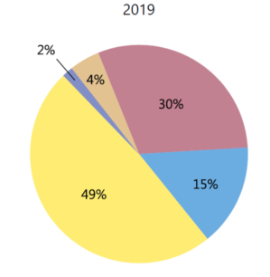
RECALL: FX Swaps
The largest segment of the FX market
It involves simultaneous spot and forward transactions:
  Buy spot – sell forward
  Sell spot – buy forward
Both spot and forward rates are known at the time of the initiation of the trade
FX Swaps facilitate cost effective and safe switching from one currency segment to another
FX Spot
FX Swaps
Forward
Banks use swaps extensively; servicing clients, making bets, investing in foreign securities are primary motivations
It is equivalent to “Repo” market in domestic setting; instead of providing a T-Bill as a collateral, you provide a currency as collateral!

Slide 27
FX SWAPS
Mercury Bank of NY (USA) has been approached by one of its clients. The client needs a short term (90 days) loan in the amount of 10,000,000 JPY.
After a couple of phone calls Mercury gets the following quotes:
Spot: 1.367 (JPY per USD)
Forward (90days): 1.371 (JPY per EURO)
Mercury’s client is not willing to pay more than 5% (p.a.) interest for this transaction, as he has a competitor’s quote for a similar rate, but would prefer dealing with Mercury because of the existing relationship.
Should Mercury extend the loan?
Assumptions:
Funds needed by Mercury: 10,000,000JPY
Spot: 1.367 (JPY per USD)
FWD: 1.371 (JPY per USD)
Interest Rate: 5% p.a.

Slide 28
FX Swaps
Assumptions:
Funds needed by Mercury: 10,000,000JPY
Spot: 1.367 (JPY per USD)
FWD: 1.371 (JPY per USD)
Interest Rate: 5% p.a.
STEP 1: Calculate USD cost for 10MM JPY at Spot
STEP 2: Calculate the amount of USD Mercury will receive by selling 10MM JPY forward for 90 days
STEP 3: Calculate “interest” Mercury will pay for in the swap for the 10MM JPY for 90days
STEP 4: Calculate the interest Mercury will receive (in JPY)
STEP 5: Calculate the interest Mercury will receive in USD and see it can make a profit

Slide 29
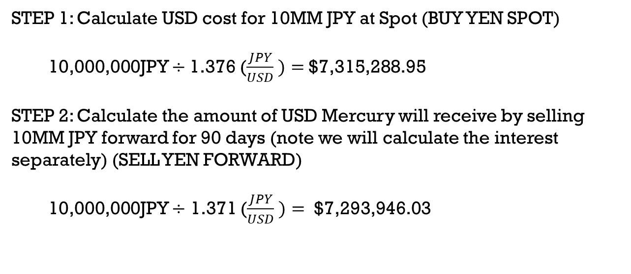
FX Swaps
Assumptions:
Funds needed by Mercury: 10,000,000JPY
Spot: 1.367 (JPY per USD)
FWD: 1.371 (JPY per USD)
Interest Rate: 5% p.a.
STEP 1: Calculate USD cost for 10MM JPY at Spot (BUY YEN SPOT)
10,000,000JPY $÷$1.376 ($\frac{JPY}{USD} )=$$7,315,288.95
STEP 2: Calculate the amount of USD Mercury will receive by selling 10MM JPY forward for 90 days (note we will calculate the interest separately) (SELL YEN FORWARD)
10,000,000JPY $÷$ 1.371 ($\frac{JPY}{USD} )=$ $7,293,946.03

Slide 30
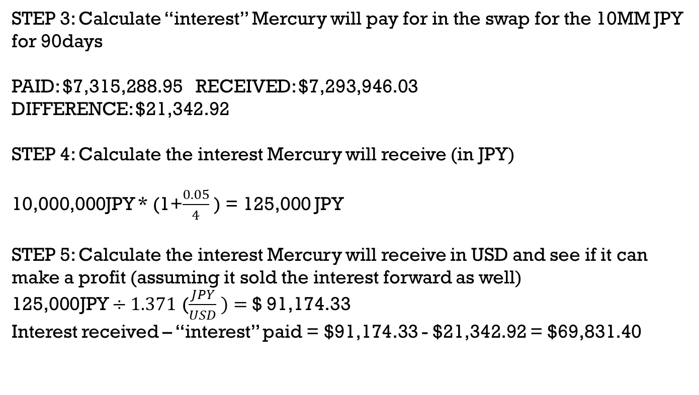
FX Swaps
Assumptions:
Funds needed by Mercury: 10,000,000JPY
Spot: 1.367 (JPY per USD)
FWD: 1.371 (JPY per USD)
Interest Rate: 5% p.a.
STEP 3: Calculate “interest” Mercury will pay for in the swap for the 10MM JPY for 90days
PAID: $7,315,288.95 RECEIVED: $7,293,946.03
DIFFERENCE: $21,342.92
STEP 4: Calculate the interest Mercury will receive (in JPY)
10,000,000JPY * (1+$\frac{0.05}{4}$ ) = 125,000 JPY
STEP 5: Calculate the interest Mercury will receive in USD and see if it can make a profit (assuming it sold the interest forward as well)
125,000JPY $÷1.371$ ($\frac{JPY}{USD} )=$$ 91,174.33
Interest received – “interest” paid = $91,174.33 - $21,342.92 = $69,831.40

