Slide 1
Interest Rate and Currency Swaps An Overview
Dr. Bulent Aybar
Professor of International Finance

Slide 2
What is a Swap?
A Swap is essentially exchange of two streams of cash flows
Interest rate swaps involve exchanging a stream of floating cash flows indexed to a benchmark like LIBOR against a fixed stream of cash flows
In currency swaps a stream of cash flows denominated in one currency exchanged against a stream of cash flows denominated in another currency.
One can view currency swaps as a bundle of forward contracts.

Slide 3
Utility of Swaps
Swaps facilitate cost effective switching across interest rate and currency segments
Swaps help various players in the market to hedge their interest rate and currency exposures
Swaps eliminate inefficiencies in fixed income and currency markets through arbitraging across the interest rate and currency segments.

Slide 4
Comparative Advantage Argument
The efficiency argument rests on mispricing of credit risk and resulting comparative advantage for the borrowers.
For instance a company may be perceived to be less risky in a floating rate interest segment as compared to a fixed interest rate segment.
Alternatively risk perception my differ in different currency segments.
While fixed income and currency markets are increasingly efficient, they are not immune to mispricing.

Slide 5
Global Interest Rate Swap Market: $456 trn as of H1 2020

Slide 6
Global Currency Swap Market: $26 trn as of H1 2020

Slide 7
Example: Floating to Fixed Rate Swap
Suppose that Microsoft has borrowed $100 million at LIBOR+10 bp, but would like to convert its floating rate liability into a fixed rate liability.
Microsoft enters into a Swap with a Swap Dealer Bank where it receives 6-month LIBOR and pays semiannual fixed interest of 5.015%.
After the swap agreement, Microsoft
Pays LIBOR + 0.001 to its lender
Receives LIBOR from its Swap Dealer
Pays 5.015% to its Swap Dealer

Slide 8
These three sets of cash flows net out to an interest rate payment of 5.115%.
- (LIBOR+0.001)+LIBOR – 0.05015=-0.05115 or 5.115%
By using Swap, Microsoft, transforms a floating rate liability based on LIBOR into annualized fixed rate liability of 5.115%

Slide 9
Microsoft Floating to Fixed Swap
Fixed 5.015%
Microsoft
Swap Dealer
LIBOR
LIBOR + 10bp
Floating Rate Lender Receives
LIBOR + 10bp
Net Cost to Microsoft=-(LIBOR+0.001)+LIBOR – 0.05015
=-0.05015-0.001 = 5.115%

Slide 10
Swap Cash Flows
Reset Date | 6-Month LIBOR | MSFT Receives LIBOR | MSFT Pays Floating | MSFT Pays Fixed | MSFT Net Fixed Cost
5-Mar-14 | 4.20%
5-Sep-14 | 4.80% | 2,100,000 | -2,150,000 | -2,507,500 | -2,557,500
5-Mar-15 | 5.30% | 2,400,000 | -2,450,000 | -2,507,500 | -2,557,500
5-Sep-15 | 5.50% | 2,650,000 | -2,700,000 | -2,507,500 | -2,557,500
5-Mar-16 | 5.60% | 2,750,000 | -2,800,000 | -2,507,500 | -2,557,500
5-Sep-16 | 5.90% | 2,800,000 | -2,850,000 | -2,507,500 | -2,557,500
5-Mar-17 |  | 2,950,000 | -3,000,000 | -2,507,500 | -2,557,500

Slide 11
Floating to Fixed Rate Swap
Suppose, on the other side of the deal, Intel swaps its fixed rate loan into a floating rate loan.
Intel has borrowed $100 million at a fixed rate of 5.2% and would like to convert its fixed rate liability into a LIBOR indexed floating rate liability.
Like Microsoft, Intel enters into a Swap with a Swap Dealer Bank where it pays LIBOR and receives a fixed rate of 4.985%.
After the swap agreement, Intel
Pays 5.2% to its lender
Receives 4.985% fixed rate from its Swap Dealer
Pays LIBOR to its Swap Dealer

Slide 12
These three sets of cash flows net out to an interest rate payment of :
-(5.2%)+4.985% -LIBOR= -(LIBOR+0.00215)
By using Swap, Intel transforms a fixed rate liability into a floating rate liability based on LIBOR

Slide 13
Intel Fixed to Floating Swap
LIBOR
Intel
Swap Dealer
4.985%
5.2%
Lender Receives
Fixed 5.2%
Net Cost to Intel=-(5.2%)+4.985% -LIBOR
= -(LIBOR+0.00215)

Slide 14
Reset Date | 6-Month LIBOR | Intel Pays LIBOR | Intel Receives Fixed 4.895% | Intel Pays Fixed 5.2% | Net Cost
5-Mar-14 | 4.20%
5-Sep-14 | 4.80% | -2,100,000 | 2,492,500 | -2,600,000 | -2,207,500
5-Mar-15 | 5.30% | -2,400,000 | 2,492,500 | -2,600,000 | -2,507,500
5-Sep-15 | 5.50% | -2,650,000 | 2,492,500 | -2,600,000 | -2,757,500
5-Mar-16 | 5.60% | -2,750,000 | 2,492,500 | -2,600,000 | -2,857,500
5-Sep-16 | 5.90% | -2,800,000 | 2,492,500 | -2,600,000 | -2,907,500
5-Mar-17 |  | -2,950,000 | 2,492,500 | -2,600,000 | -3,057,500

Slide 15
Swap Dealer’s Profit
LIBOR
LIBOR
Intel
Swap Dealer
Microsoft
4.985%
5.015%
5.2%
LIBOR + 10bp
Swap Dealer’s Gain
5.015%-4.985%=0.3%
Lender Receives
Fixed 5.2%
Lender Receives
LIBOR+0.001
Net Cost to Intel= -(LIBOR+0.00215)
Net Cost to Microsoft =5.115%

Slide 16
Swap Dealer Cash Flows
Reset Date | 6-M LIBOR | (+) LIBOR | (-) LIBOR | (+) Fixed 5.015% | (-) Fixed 4.895% | Net CF to SB
5-Mar-14 | 4.20%
5-Sep-14 | 4.80% | 2,100,000 | -2,100,000 | 2,507,500 | -2,492,500 | 15,000
5-Mar-15 | 5.30% | 2,400,000 | -2,400,000 | 2,507,500 | -2,492,500 | 15,000
5-Sep-15 | 5.50% | 2,650,000 | -2,650,000 | 2,507,500 | -2,492,500 | 15,000
5-Mar-16 | 5.60% | 2,750,000 | -2,750,000 | 2,507,500 | -2,492,500 | 15,000
5-Sep-16 | 5.90% | 2,800,000 | -2,800,000 | 2,507,500 | -2,492,500 | 15,000
5-Mar-17 |  | 2,950,000 | -2,950,000 | 2,507,500 | -2,492,500 | 15,000

Slide 17
Cost of Borrowing in GBP and USD Segments
Suppose the current spot rate of GBP/USD is 1.4995-1.5000
Company B can borrow five year fixed rate pound at 12%, but it is interested in borrowing USD. Its direct cost of borrowing five year fixed USD is 10%.
Company A, on the other hand is interested in borrowing pounds, but its five year fixed pound cost is 11.60%. It can borrow in the USD segment at 8%, almost 3.6% lower interest.
 | USD | GBP
Company-A | 8.00% | 11.60%
Company-B | 10.00% | 12.00%
Credit Risk Diff | 2.00% | 0.40%

Slide 18
If we inspect the respective costs, we can make following observations:
Company A seems to have a higher credit rating; its cost of borrowing lower as compared to company B
Company A has a comparative advantage in USD segment, as its cost of borrowing is 200bp lower
It can borrow pound also at a lower cost, but its cost advantage as compared to company B is only 40 bp.
This points to a mispricing of credit risk in two segments of the market.
 | USD | GBP
Company-A | 8.00% | 11.60%
Company-B | 10.00% | 12.00%
Credit Risk Diff | 2.00% | 0.40%

Slide 19
Such credit mispricing creates an opportunity for firms A and B to reduce their respective cost of borrowing by engaging in a swap deal.

Slide 20
The swap dealer offers the following deal to company A:
"I can pay you USD 8% on a principal of $15,000,000 in exchange for GBP 11% on a principal of GBP 10,000,000". In other words, I pay you USD 1,200,000 and receive GBP 1,100,000 per year over five years.
When company B approaches to the swap dealer, the dealer offers the following deal to company B:
"I can pay you GBP 12% on a principal of GBP 10,000,000 in exchange for USD 9.4% on a principal of USD 15,000,000". In other words, I pay you GBP 1,200,000 and receive USD 9,400,000 per year over five years.

Slide 21
In this case, company A can go ahead and borrow $15,000,000 at 8% annual interest; sign the contract with the swap dealer to pay 11% on 10 m Pound and receive 8% on $15m.

Slide 22
When the company A borrows USD 15m, it delivers the loan proceeds to the dealer and receives GBP 10 m in exchange.
At the maturity, company A pays the dealer GBP 10 m and receives USD 15m and covers his principal payment in the loan. With this deal, cash flows and the GBP borrowing cost of company A is as follows:
The net cost of borrowing of company A is 11% in GBP terms. This is 60 bp lower than the cost company would incur if it borrowed directly in the GBP fixed interest rate segment.
Year | USD Loan CF | Swap CF (GBP) | Swap Cash Flows (USD) | Net Cash Flows
0 | 15,000,000 | 10,000,000 | -15,000,000 | 10,000,000
1 | -1,200,000 | -1,100,000 | 1,200,000 | -1,100,000
2 | -1,200,000 | -1,000,000 | 1,200,000 | -1,000,000
3 | -1,200,000 | -1,000,000 | 1,200,000 | -1,000,000
4 | -1,200,000 | -1,000,000 | 1,200,000 | -1,000,000
5 | -16,200,000 | -11,100,000 | 16,200,000 | -11,100,000

Slide 23
The cash flows for company B and its USD cost of borrowing would be as follows:
The company B's dollar cost of borrowing with the swap deal is 9.4%; this is 60 bp lower than the direct cost of borrowing at 10%.
Year | GBP Loan CF | Swap CF (GBP) | Swap Cash Flows (USD) | Net Cash Flows
0 | 10,000,000 | -10,000,000 | 15,000,000 | 15,000,000
1 | -1,200,000 | 1,200,000 | -1,410,000 | -1,410,000
2 | -1,200,000 | 1,200,000 | -1,410,000 | -1,410,000
3 | -1,200,000 | 1,200,000 | -1,410,000 | -1,410,000
4 | -1,200,000 | 1,200,000 | -1,410,000 | -1,410,000
5 | -11,200,000 | 11,200,000 | -16,410,000 | -16,410,000

Slide 24
In this deal swap dealer will have the following cash flows:
As the cash flows indicate, the dealer assumes currency risk in this deal. If the net dollar receipts exceed net pound payments, the dealer makes money. Although small, there is a risk that dealer can lose money in this deal if it does not hedge the net exposure.
 | USD |  | GBP
Year | Receives | Pays | Receives | Pays | USD Net | GBP Net
0 | 15,000,000 | -15,000,000 | 10,000,000 | -10,000,000 | 0 | 0
1 | 1,410,000 | -1,200,000 | 1,100,000 | -1,200,000 | 210,000 | -100,000
2 | 1,410,000 | -1,200,000 | 1,000,000 | -1,200,000 | 210,000 | -100,000
3 | 1,410,000 | -1,200,000 | 1,000,000 | -1,200,000 | 210,000 | -100,000
4 | 1,410,000 | -1,200,000 | 1,000,000 | -1,200,000 | 210,000 | -100,000
5 | 16,410,000 | -16,200,000 | 11,100,000 | -11,200,000 | 210,000 | -100,000

Slide 25
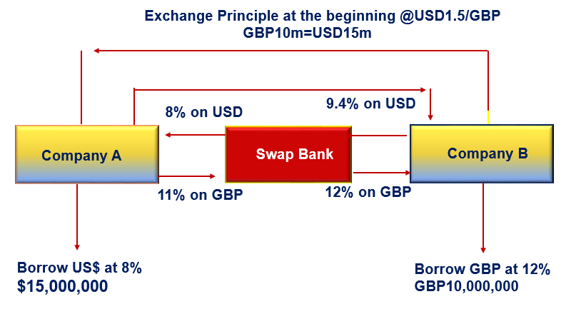
Fixed to Fixed Currency Swap

Slide 26
Case Background
In 1985 Walt Disney undertook a sophisticated global financing transaction involving parties in NY, Paris and Tokyo!
Disney raised dollar funds, partially hedged a JPY royalty stream and became the first US corporation to issue a sinking fund ECU bond in the Euromarket!
Through this transaction, single A rated Disney attained a cost approaching to AAA rates!

Slide 27
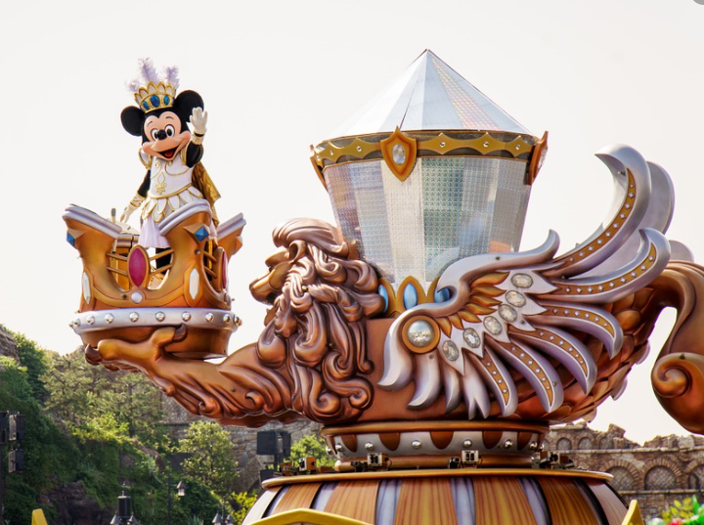
Walt Disney’s Japanese Yen Financing

Slide 28
Facts: Disney (at the time of the deal)
1.7bn consolidated revenue in 1984
1.1 bn revenue from entertainment and recreation
Net Income of $97.8m
$2.7bn total assets
43% Debt/TA ratio
2/3rds of the debt in short term loans

Slide 29
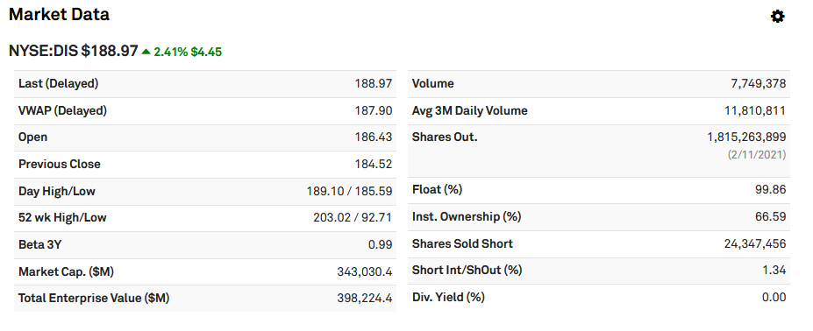
Disney April 2, 2021

Slide 30
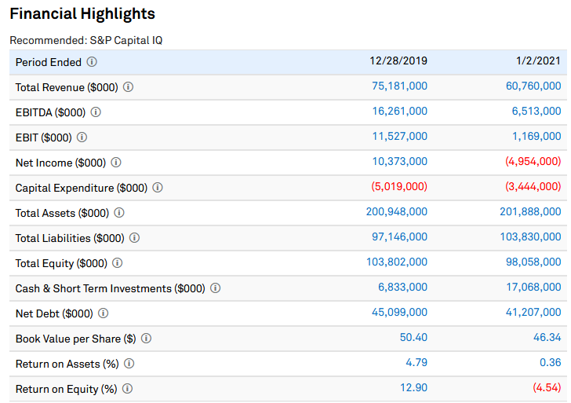

Slide 31
Case Facts
Disney has a significant Yen exposure due to its royalty receipts (JPY8bn) from Disney Tokyo!
8% depreciation of Yen from 229.7 to 248 created a renewed concern!
Disney looks at alternative hedging techniques to stabilize the dollar value of its JPY cash flows!

Slide 32
Hedging Alternatives
FX Options
Futures
Forwards

Slide 33
Other Alternatives: Yen Term Loan
Disney could borrow in JPY now, convert the proceeds into USD and pay off Yen debt as it receives royalties !!
Current Yen loan conditions:
Coupon: 7.5% semiannual
Feasible Notional: JPY15bn (Disney can borrow up to this amount)
Maturity: 10 years
Front-end Fee: 0.75% (of the principal)
Principle paid at maturity (bullet loan; not amortized)

Slide 34
All in Cost of JPY Financing
Assuming that the bond is sold at par value, we calculate the net proceeds after factoring the transaction costs of 0.75%.
Solve r for all in cost financing in JPY! Note that r is the semiannual cost → r=3.804%
Bond equivalent annual all in cost is
(3.804% x 2=7.61%)
This annualized cost of 7.61% is comparable only to loans and bonds with semiannual payments

Slide 35
BEY: The Standard Yield Measure in Bond Markets
Most bonds in domestic bond markets pay semi-annual interest;
The yield quoted or communicated among bond market professionals is the “Bond Equivalent Yield”
In the previous slide annualized All in Cost “7.61% “is the cost comparable to BEY and can be directly compared to semiannual bonds.

Slide 36
Adjustment in the BEY Comparable All in Cost
To compare 7.61% All in Cost with an annual coupon paying bond All in Cost, we need to set m=1 and calculate r:
7.75% is a comparable rate with an annual interest paying Eurobonds All in Cost.

Slide 37
Eurobond Comparable Rates
Eurobonds pay annual coupons
Annual coupon comparable of a semiannual bond/loan yield can be found as follows:
Alternatively we can convert a Eurobond Yield into BEY as

Slide 38
Plain Vanilla Yen Swap
A possible solution was to swap USD denominated interest payments into JPY through a generic swap.
In such a deal, Disney would accept USD payments from a counterparty in exchange for JPY payments.
But the problem is that 61% of the $850m debt consists of short term credit and commercial papers and mature within 4 years!
Short dated Yen swaps at the time were not very attractive!! In other words, in short dated maturities Disney would have to make large JPY payments in exchange for USDs it receives. This would increase effective cost.
¥
¥
Unknown Counterparty
Disney
Swap Bank
(facilitator)
$
$

Slide 39
Creative Investment Bankers Step in: Goldman Sachs Proposal
Goldman Sachs suggests an alternative route to Yen financing. They propose the following:
Issue 10 year ECU80m bond (feasible amount for low cost)
(In this segment of the market Disney would get favorable borrowing terms as investors in this segment do not have US Company exposures; it helps to diversify their bond portfolios in this currency segment)
Swap ECU proceeds into Yen
Pay 3.34% Japanese Yen semi annual interest on JPY 15bn and receive 9.125% annual ECU interest payments on ECU 80m.
Pay ECU bond interest with the interest received from the swap dealer

Slide 40
The terms of the ECU bond
Total ECU raised: ECU 80 million
At the current spot rate of USD/ECU0.7420 ~$60 million
Price: 100.250%
Coupon: 9.125% p.a.
Fees: 2%
Expenses: $75,000
Sinking Fund: 5-year straight line beginning in Year 6
ECU=$0.7420

Slide 41
Cost of the issue and net proceeds
Since the bond is sold at 100.25% of the par value, the total amount raised is ECU 80m x 1.0025=ECU 80.2m
Fees are charged based on the nominal value of the bonds sold which ECU 80m →
ECU80 m x 0.02=ECU 1,600,000
Expenses in USD 75,000; Converted into ECU at the exchange rate of USD/EUC 0.7420:
75,000/0.7420=ECU101,078
Total Transaction Costs
=ECU1,600,000 +ECU 101,078=1,701,079
Net Cleared by Disney:
ECU 80,200,000-ECU1,701,079=78,498,921.83

Slide 42
ECU Bond Cash Flows
No sinking fund payments; only coupon payments
Coupon and Sinking Fund payments of ECU 16m per period
Year | Cash Flows
0 | € 78,499.00
1 | -€ 7,300.00
2 | -€ 7,300.00
3 | -€ 7,300.00
4 | -€ 7,300.00
5 | -€ 7,300.00
Year | Cash Flows
6 | - € 23,300
7 | - € 21,840
8 | - € 20,380
9 | - € 18,920
10 | - € 17,460

Slide 43
All in Cost of ECU Bond
Use @IRR function in Excel
Solve for r! → r=9.473% annual payments
Bond Equivalent Yield=

Slide 44
Swap Terms
Swap is structured for Disney to receive ECU and pay JPY
The notional principles in ECU and JPY on which interest payments are made:
ECU78,499,044
JPY14,445,153,000
¥
Swap Bank
(facilitator)
¥
Unknown Counterparty
Disney
ECU
ECU

Slide 45
Swap Terms
In the Swap deal, these notional principles may or may not be exchanged at the inception. These are equivalent when measured in ECU or JPY at the spot rate, therefore they wash each other
Disney pays ~3.34% semiannual interest on the JPY principle: JPY483,226,000
In exchange Disney receives ECU7,300,000 for the first five years and ECU23.3m, 21.84m, 20.38m, 18.92m and 17.46m in the following six years!
¥
Swap Bank
(facilitator)
¥
Unknown Counterparty
Disney
ECU
ECU

Slide 46
Swap Bank IBJ
The Swap is facilitated by IBJ. In this case IBJ is the party who receives JPY and pays out ECU.
IBJ finds a counterparty to the Disney swap and agrees to receive ECU and to pay out JPY.
The counterparty is a AAA rated French utility interested in covering its JPY debt.
French utility would like to service its JPY debt with ECU!

Slide 47
Swap Terms
¥ 483,226 | ¥ 1,764,650
¥ 483,226 | ¥ 1,721,160
¥ 483,226 | ¥ 1,677,670
¥ 483,226 | ¥ 1,634,179
¥ 483,226 | ¥ 1,590,689
¥ 483,226 | ¥ 1,547,199
¥ 483,226 | ¥ 1,503,708
¥ 483,226 | ¥ 1,460,218
¥ 483,226 | ¥ 1,416,728
¥ 1,808,141 | ¥ 1,520,450
Disney
Swap Bank
JPY 3.34% on the ¥14.45bn
ECU 9.125% on ECU 80m
9.125%
€ 7,300
€ 7,300
€ 7,300
€ 7,300
€ 7,300
€ 23,300
€ 21,840
€ 20,380
€ 18,920
ECU Bond Investors

Slide 48
Swap Terms-Counterparty
JPY 3.34% on 14,445m
French Utility
Swap Bank
IBJ
ECU 9.1875% on ECU80m
Japanese Yen Bond Investors
Swap Bank passes all the JPY payments it receives from Disney, but retains
(9.1875-9.1250)=0.0625% or
6.25bp of the interest received from the Utility

Slide 49
Disney Swap Cash Flows
Year | ECU | JPY
0 | -€ 78,499.00 | +JPY 14,445,153
0.5 |  | -JPY 483,226
1 | +€ 7,300.00 | -JPY 483,226
1.5 |  | -JPY 483,226
2 | +€ 7,300.00 | -JPY 483,226
2.5 |  | -JPY 483,226
3 | +€ 7,300.00 | -JPY 483,226
3.5 |  | -JPY 483,226
4 | +€ 7,300.00 | -JPY 483,226
4.5 |  | -JPY 483,226
5 | +€ 7,300.00 | -JPY 1,808,141

Slide 50
Swap Cash Flows
5.5 |  | -JPY 1,764,650
6 | +€ 23,300.00 | -JPY 1,721,160
6.5 |  | -JPY 1,677,670
7 | +€ 21,840.00 | -JPY 1,634,179
7.5 |  | -JPY 1,590,689
8 | +€ 20,380.00 | -JPY 1,547,199
8.5 |  | -JPY 1,503,708
9 | +€ 18,920.00 | -JPY 1,460,218
9.5 |  | -JPY 1,416,728
10 | +€ 17,460.00 | -JPY 1,520,450

Slide 51
What is the basis of Swap?
Why French Utility and Disney can benefit from this swap? Analyzing their comparative costs in JPY and ECU segments answers this question!
As a AAA credit risk entity, in relative terms French utility can borrow at a lower cost than Disney both in ECU and JPY bond segments. In other words, it has absolute advantage both in ECU and JPY.
However, when we look at ECU segment, its cost advantage is only 10bp vs its advantage in the JPY segment which is 96bp
 |  | ECU | JPY
French Utility (AAA) |  | 9.37% | 6.79%
Disney (A-) |  | 9.47% | 7.75%
Credit Spread |  | 10bp | 96bp

Slide 52
What is the basis of Swap?
The interest rate differentials between ECU and JPY are due to varying inflation expectations in Japan and EC, but these differentials should be consistent across borrowers.
Different Credit Spreads observed in ECU and JPY segments suggests mispricing of risk.
Either JPY segment is overstating Disney risk or ECU segment is understating it. Regardless the source of mispricing, it creates an opportunity for borrowers.
 |  | ECU | JPY
French Utility (AAA) |  | 9.37% | 6.79%
Disney (A-) |  | 9.47% | 7.75%
Credit Spread |  | 10bp | 96bp

Slide 53
Analysis
Disney’s relative credit spread in ECU is just 10 basis points, whereas it is 96 basis points in Yen. Buyers of the Euro-ECU bond issue appear to be overpricing the issue (or underestimating the Disney risk).
The difference between the two relative credit spreads is 86 basis points and represents the “pie” that can be sliced up among Disney, the French utility, and a swap dealer!

Slide 54
When we compute the IRRs using the cash flows in the cash flow columns, we find that Disney’s all-in funding cost in Yen (from issuing the ECU bond and swapping to Yen) is just 7.01% ( 1+0.0345)^2=7.01%)
This is 74 bp lower than the 10-Year JPY term loan at 7.75%.
The all in cost for the French utility is 9.187%. This is about 18bp below its direct ECU cost!!
IBJ took 6.25bps on Euro.
Disney is the major beneficiary of the Swap! It attained a AAA rate as a result!!

Slide 55
Combined Swap Cash Flows
Disney Swap Flows: Fr. Utility Swap Flows:
(Paid to)/received from IBJ Received from/(paid to) IBJ
Year Yen (A) ECU (B) Yen (C) ECU (D)
0 14,445.153 (78.499) (14,445.153) 80.000
0.5 (483.226) 483.226
1 (483.226) 7.300 483.226 (7.350)
1.5 (483.266) 483.266
2 (483.266) 7.300 483.266 (7.350)
2.5 (483.266) 483.266
3 (483.266) 7.300 483.266 (7.350)

Slide 56
Combined Swap Cash Flows
Disney Swap Flows: Fr. Utility Swap Flows:
Paid to/(received from) IBJ Received from/(paid to) IBJ
Year Yen (A) ECU (B) Yen (C) ECU (D)
3.5 (483.266) 483.266
4 (483.266) 7.300 483.266 (7.350)
4.5 (483.266) 483.266
5 (1,808.141) 7.300 1,808.141 (7.350)
5.5 (1,764.650) 1,764.650
6 (1,721.160) 23.300 1,721.160 (23.350)
6.5 (1,677.670) 1,677.670
7 (1,634.179) 21.840 1,634.179 (21.880)
7.5 (1,590.689) 1,590.689
8 (1,547.199) 20.380 1,547.199 (20.410)
8.5 (1,503.708) 1,503.708
9 (1,460.218) 18.920 1,460.218 (18.940)
9.5 (1,416.728) 1,416.728
10 (1,520.450) 17.460 1,520.450 (17.470)

