Slide 1
International Corporate Finance
Review Session 6
Nicole Hruban

Slide 2
International Cost of Capital
Nestle of Switzerland is revisiting its cost of equity analysis in 2014. As a result of extraordinary actions by the Swiss Central Bank, the Swiss bond index yield (10-year maturity) has dropped to a record low of 0.520%. The Swiss equity markets have been averaging 8.400% returns, while the Financial Times global equity market returns, indexed back to Swiss francs, is at 8.820%. Nestle's corporate treasury staff has estimated the company's domestic beta at 0.825, but its global beta (against the larger global equity market portfolio) at .515.

Slide 3
Weighted Average Cost of Capital
A firm normally finds its weighted average cost of capital (WACC) by combining the cost of equity with the cost of debt in proportion to the relative weight of each in the firm’s optimal long-term financial structure:
where
D=Market Value of debt
E=Market Value of equity
V=D+E=Market Value of the Firm
k_{E}=cost of equity k_{D}=before tax cost of debt

Slide 4
Weighted Average Cost of Capital
k_{WACC} = weighted average after-tax cost of capital
k_{e} = risk-adjusted cost of equity
k_{d} = before-tax cost of debt
t = marginal tax rate
E = market value of the firm’s equity
D = market value of the firm’s debt
V = total market value of the firm’s securities (D+E)

Slide 5
Cost of Equity
A simple and popular approach to cost of equity is the Capital Asset Pricing Model.
CAPM in very simple terms provides a guide to investors to determine the expected return on their equity investments.
An investor investing in a particular risky asset expected to earn a return above risk free rate. “How much above” depends on the risk level of the asset.
k_{e}=R_{f} +Risk Premium
In this model the key issues are:
  Determining the appropriate risk free rate
  Determining the appropriate risk premium

Slide 6
Risk Premium
First one is relatively easy to resolve, for instance in US a common preference for the risk free rate is the 10 year Treasury yield!
The second one is more complicated. Risk Premium calculation requires two inputs:
  A risk measure, i.e quantification of risk in some form
  A price for risk, i.e compensation for the unit risk taken!
  RP=(Extent of Risk) x (Price of Unit Risk)

Slide 7
CAPM
Sharpe’s Capital Asset Pricing Model is the mainstay of economic valuation
Simple formula
Intuition is that risk premium depends on how the investment contributes to the volatility of a well diversified portfolio

Slide 8
CAPM: An Answer to RP Question
CAPM, provides us a well constructed answer in quantifying RP.
In the CAPM framework Measure of Risk is the Systematic Risk or Beta
Price of Unit Risk is the Equity Market Risk Premium

Slide 9
Local CAPM
Equity Market
Risk Premium
(Price of unit risk)
Risk free rate
Risk Metric
Cost of equity is both a discount rate for valuing the cash flows and a hurdle rate for corporate investments, when adjusted for debt financing.

Slide 10
Cost of Equity: Domestic and International
Note that in cost of equity calculation we have three key variables:
  Risk Free Rate
  Company Risk Measure (Beta)
  Equity Market Risk Premium (EMRP)
Within a country Risk Free rate and EMRP is the same for all firms. What varies is the risk measure.
Each firm’s cost of equity depends on its risk as captured in Beta!!

Slide 11
Global CAPM
International version of CAPM only prices global systematic risk.
Other risks such a currency risk and country risk are not priced in this model
The model assumes that these are diversifiable non-systematic risks.
or
R_{F} = US Risk Free Rate
β_{G} = Beta with respect to Global Market Index such as MSCI-World
GEMRP = Global Equity Market Risk Premium

Slide 12
Global CAPM from US Investor Perspective
Risk-Free Rate in USD
Global Beta estimated in USD
GMRP in USD
NOTE: Global Equity Market Risk Premium or global price of unit risk in investors’ preferred currency, here USD (has to be consistent with all of the currencies in the model)

Slide 13
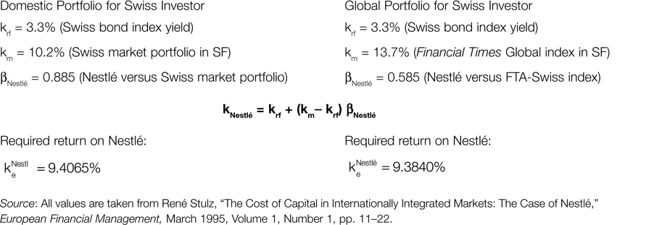
Estimating the Global Cost of Equity for Nestlé (Switzerland)
Notes:
It is important to understand the nuance in this example. When the reference portfolio for the Swiss investors is local portfolio, Nestle’s beta is much higher at 0.885. This is the case because a Swiss investor in Nestle that only holds the Swiss market portfolio, is far more vulnerable to changes in the market portfolio than a Swiss investor holding the global portfolio. Remember that beta measures the sensitivity of the stock return to changes in the market portfolio. Nestle naturally is much more sensitive to changes in the Swiss market portfolio because it makes a good chunk of that portfolio. On the other hand, Nestle stocks are far less sensitive to Global market portfolio because Nestle is only a tiny fraction of that portfolio. The implication of this is that Swiss investors holding only Swiss portfolio view Nestle a lot more riskier than the investors holding global portfolio. Therefore when they price Swiss shares, they discount the cash flows at a much higher rate than the globally diversified investors. This creates a wedge between the share price of Nestle. For instance after Nestle shares were allowed to be invested by international investors, its share price went up, because now a large group of investors viewed Nestle as a lower risk stock.

Slide 14
Global CAPM
Strong assumptions are needed
  Perfect market integration
  Mean-variance analysis implied by utility assumptions
May give unreliable results in smaller, less liquid developed markets
Ok to use in developed markets
Fails in emerging markets when it is not adjusted

Slide 15
Modification in GCAPM
There are some efforts to incorporate relevant risks that are deemed to be systematic into GCAPM.
One such model is the Shramm-Wang model. In this model currency risk is assumed to be a systematic risk factor and it is priced.
There is no adjustment for country risk.

Slide 16
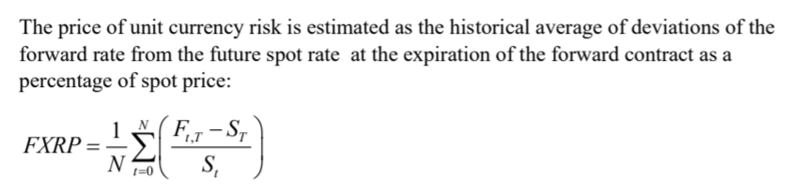
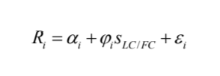
Schramm-Wang-GCAPM
Sensitivity of USD Returns
to exchange Rate
Currency Risk
Premium
Risk Free Return in USD
Global Beta
calculated
by using USD
returns
Global Risk
Premium
R represents asset returns, sLC/FC is the percentage change in the foreign currency the asset has exposure to, and alpha and epsilon are constant and residual errors respectively.

Slide 17
International Cost of Capital
Nestle of Switzerland is revisiting its cost of equity analysis in 2014. As a result of extraordinary actions by the Swiss Central Bank, the Swiss bond index yield (10-year maturity) has dropped to a record low of 0.520%. The Swiss equity markets have been averaging 8.400% returns, while the Financial Times global equity market returns, indexed back to Swiss francs, is at 8.820%. Nestle's corporate treasury staff has estimated the company's domestic beta at 0.825, but its global beta (against the larger global equity market portfolio) at .515.
a. What is Nestle's cost of equity based on the domestic portfolio of a Swiss investor?
b. What is Nestle's cost of equity based on a global portfolio for a Swiss investor?

Slide 18

International Cost of Capital
Nestle of Switzerland is revisiting its cost of equity analysis in 2014. As a result of extraordinary actions by the Swiss Central Bank, the Swiss bond index yield (10-year maturity) has dropped to a record low of 0.520%. The Swiss equity markets have been averaging 8.400% returns, while the Financial Times global equity market returns, indexed back to Swiss francs, is at 8.820%. Nestle's corporate treasury staff has estimated the company's domestic beta at 0.825, but its global beta (against the larger global equity market portfolio) at .515.
What is Nestle's cost of equity based on the domestic portfolio of a Swiss investor?
CAPM:
$$k_{e}= r_{f}+ β∗EMRP$$

Slide 19
International Cost of Capital
Nestle of Switzerland is revisiting its cost of equity analysis in 2014. As a result of extraordinary actions by the Swiss Central Bank, the Swiss bond index yield (10-year maturity) has dropped to a record low of 0.520%. The Swiss equity markets have been averaging 8.400% returns, while the Financial Times global equity market returns, indexed back to Swiss francs, is at 8.820%. Nestle's corporate treasury staff has estimated the company's domestic beta at 0.825, but its global beta (against the larger global equity market portfolio) at .515.
What is Nestle's cost of equity based on the domestic portfolio of a Swiss investor?
Ke = 0.52% + 0.825*(8.4%-0.52%)

Slide 20
International Cost of Capital
Nestle of Switzerland is revisiting its cost of equity analysis in 2014. As a result of extraordinary actions by the Swiss Central Bank, the Swiss bond index yield (10-year maturity) has dropped to a record low of 0.520%. The Swiss equity markets have been averaging 8.400% returns, while the Financial Times global equity market returns, indexed back to Swiss francs, is at 8.820%. Nestle's corporate treasury staff has estimated the company's domestic beta at 0.825, but its global beta (against the larger global equity market portfolio) at .515.
b. What is Nestle's cost of equity based on a global portfolio for a Swiss investor?

Slide 21
International Cost of Capital
Nestle of Switzerland is revisiting its cost of equity analysis in 2014. As a result of extraordinary actions by the Swiss Central Bank, the Swiss bond index yield (10-year maturity) has dropped to a record low of 0.520%. The Swiss equity markets have been averaging 8.400% returns, while the Financial Times global equity market returns, indexed back to Swiss francs, is at 8.820%. Nestle's corporate treasury staff has estimated the company's domestic beta at 0.825, but its global beta (against the larger global equity market portfolio) at .515.
b. What is Nestle's cost of equity based on a global portfolio for a Swiss investor?
Ke = 0.52%+0.515*(8.82%-0.52%)

Slide 22
International Cost of Capital
Senior management at Genedak-Hogan is actively debating the implications of international diversification on its cost of equity. Although both parties agree that the company’s returns will be less correlated with the reference market return in the future, the financial advisors believe that the market will assess an additional 3.0% risk premium for ‘going international’ to the basic CAPM cost of equity. Calculate Genedak-Hogan's cost of equity before and after international diversification of its operations, with and without the hypothetical additional risk premium, and comment on the discussion.
What is the Cost of Capital before and after the diversification?

Slide 23
International Cost of Capital
What is the Cost of Capital before and after the diversification?
STEP 1): Calculate the respective betas:

Slide 24
International Cost of Capital
What is the Cost of Capital before and after the diversification?
STEP 1): Calculate the respective betas:
Before Diversification: After Diversification
0.88*(0.28/0.18) 0.76*(0.26/0.18)

Slide 25
International Cost of Capital
What is the Cost of Capital before and after the diversification?
STEP 2): Calculate the cost of equity before and after (and with and without 3% premium)
Before Diversification: After Diversification:
Beta 1.37 Beta 1.1
RF:
RPM:

Slide 26
International Cost of Capital
What is the Cost of Capital before and after the diversification?
STEP 2): Calculate the cost of equity before and after (and with and without 3% premium)
Before Diversification: After Diversification:
Beta 1.37 Beta 1.1
RF: 3% Rf: 3%
RPM: 5.5% RPM: 5.5%
Ke = 3% + 1.37*5.5%
Ke = 10.53%
Ke = 3% + 1.1*5.5%
Ke = 9.05%
With 3% premium
Ke = 3% + 1.1*5.5% + 3%
Ke = 12.05%
Note: Because Beta fell (less correlation with the home market), diversification benefit, the standard Cost of equity is less.
If market adds additional risk premium for international diversification, cost of equity is higher

Slide 27
International Cost of Capital
What is the is Cost of Debt and WACC before and after the diversification?
Before Diversification: After Diversification:
Ke = 3% + 1.37*5.5%
Ke = 10.53%
Ke = 3% + 1.1*5.5%
Ke = 9.05%
With 3% premium
Ke = 3% + 1.1*5.5% + 3%
Ke = 12.05%

Slide 28
International Cost of Capital
What is the is Cost of Debt and WACC before and after the diversification?
Before Diversification: After Diversification:
Ke = 3% + 1.37*5.5%
Ke = 10.53%
Kd = 7.2%
D/V = 38%
E/V = 62%
Ke = 3% + 1.1*5.5%
Ke = 9.05%
With 3% premium
Ke = 3% + 1.1*5.5% + 3%
Ke = 12.05%
Kd = 7.0%
D/V= 32%
E/V=68%
WACC = 32%*7.0%*(1-35%) + 68%*9.05%
WACC= 7.61%
WACC = 32%*7.0%*(1-35%) + 68%*12.05%
WACC = 9.65%
WACC = 38%*7.2%*(1-35%) + 62%*10.53%
WACC = 8.31%

Slide 29
International Cost of Capital
What is the is Cost of Debt and WACC before and after the diversification?
Before Diversification: After Diversification:
Ke = 3% + 1.37*5.5%
Ke = 10.53%
Kd = 7.2%
D/V = 38%
E/V = 62%
Ke = 3% + 1.1*5.5%
Ke = 9.05%
With 3% premium
Ke = 3% + 1.1*5.5% + 3%
Ke = 12.05%
Kd = 7.0%
D/V= 32%
E/V=68%
WACC = 32%*7.0%*(1-35%) + 68%*9.05%
WACC= 7.61%
WACC = 32%*7.0%*(1-35%) + 68%*12.05%
WACC = 9.65%
WACC = 38%*7.2%*(1-35%) + 62%*10.53%
WACC = 8.31%
Looks like access to debt has improved after diversification (lower cost of debt).
However, full effect does not carry through, because it looks like MNE also chose to reduce debt in capital structure (very common in MNEs)
WACC drops after diversification, if the market does not assess an additional premium for the diversification

Slide 30
International Cost of Capital
Many MNEs have greater ability to control and reduce their effective tax rates when expanding international operations. If Genedak-Hogan was able to reduce its consolidated effective tax rate from 35% to 32%, what would be the impact on its WACC?
Before Diversification: After Diversification:
Ke = 3% + 1.37*5.5%
Ke = 10.53%
Kd = 7.2%
D/V = 38%
E/V = 62%
Ke = 3% + 1.1*5.5%
Ke = 9.05%
With 3% premium
Ke = 3% + 1.1*5.5% + 3%
Ke = 12.05%
Kd = 7.0%
D/V= 32%
E/V=68%
WACC = 32%*7.0%*(1-32%) + 68%*9.05%
WACC= 7.68%
WACC = 32%*7.0%*(1-32%) + 68%*12.05%
WACC = 9.72%
WACC = 38%*7.2%*(1-35%) + 62%*10.53%
WACC = 8.31%

Slide 31
International Cost of Capital
Many MNEs have greater ability to control and reduce their effective tax rates when expanding international operations. If Genedak-Hogan was able to reduce its consolidated effective tax rate from 35% to 32%, what would be the impact on its WACC?
Before Diversification: After Diversification:
Ke = 3% + 1.37*5.5%
Ke = 10.53%
Kd = 7.2%
D/V = 38%
E/V = 62%
Ke = 3% + 1.1*5.5%
Ke = 9.05%
With 3% premium
Ke = 3% + 1.1*5.5% + 3%
Ke = 12.05%
Kd = 7.0%
D/V= 32%
E/V=68%
WACC = 32%*7.0%*(1-32%) + 68%*9.05%
WACC= 7.68%
WACC = 32%*7.0%*(1-32%) + 68%*12.05%
WACC = 9.72%
WACC = 38%*7.2%*(1-35%) + 62%*10.53%
WACC = 8.31%

Slide 32
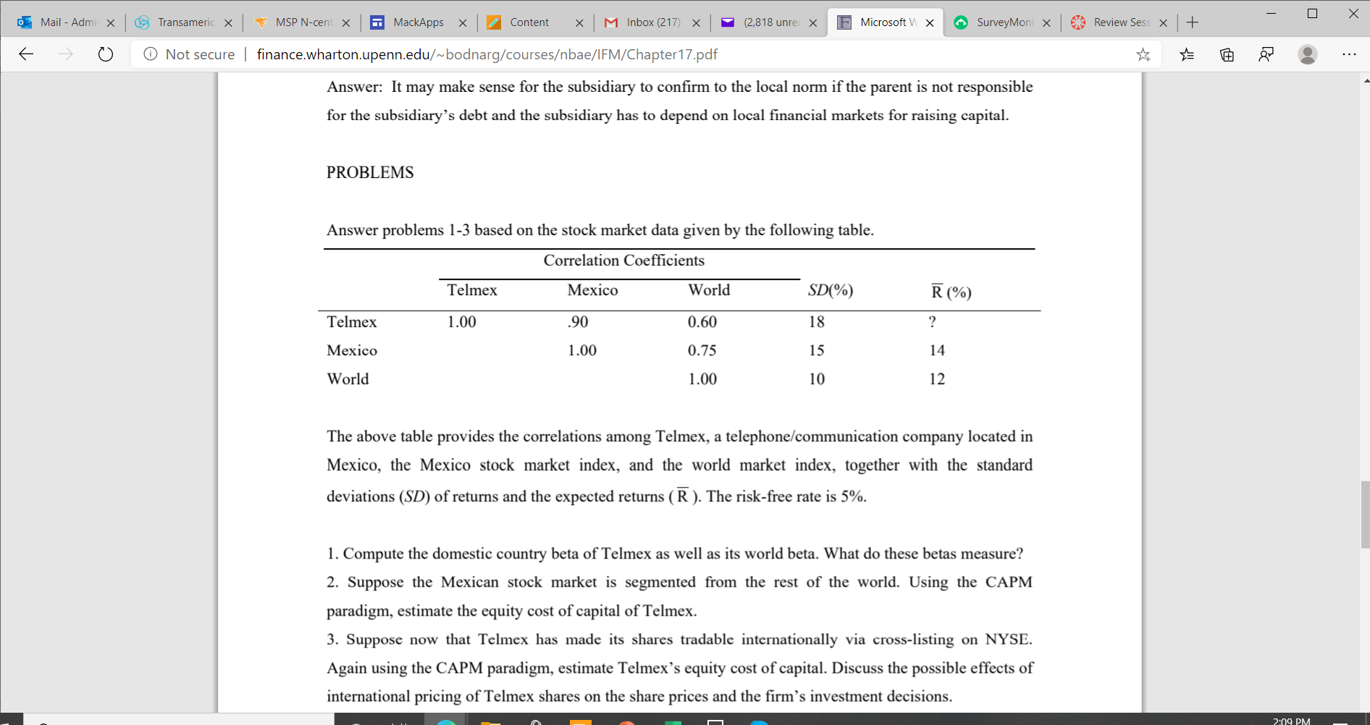

International Cost of Capital

Slide 33
International Cost of Capital

Slide 34
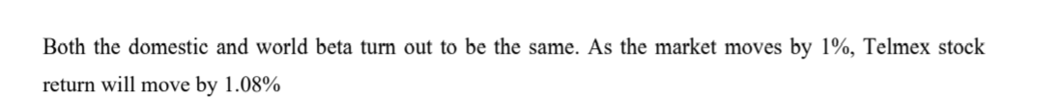
International Cost of Capital
$$Country Beta of Telmex: β= ρ_{i,,M}∗\frac{σ_{i}}{σ_{M}}=0.9∗\frac{0.18}{0.15}=1.08$$
$$World Beta of Telmex: β= ρ_{i,,W}∗\frac{σ_{i}}{σ_{W}}=0.6∗\frac{0.18}{0. 10}=1.08$$

Slide 35
International Cost of Capital

Slide 36
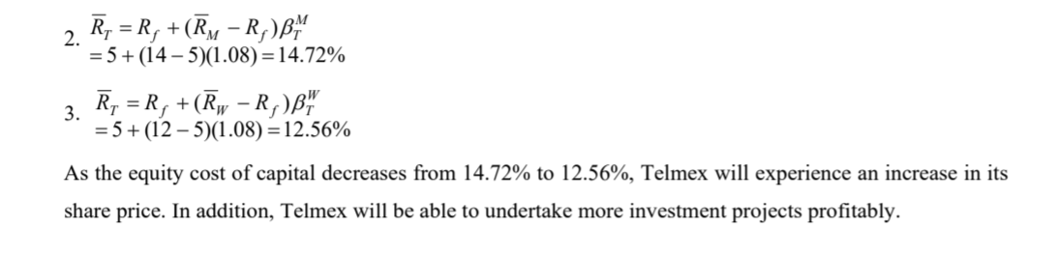
International Cost of Capital
= 5% + 1.08 *(14%-5%) = 14.72%

Slide 37
International Cost of Capital

Slide 38
International Cost of Capital
= 5% + 1.08*(12%-5%) = 12.56%
Since the Cost of Capital decreased, the company’s share price will likely increase. Company will also be able to undertake more projects profitability

