Slide 1
Branding Strategy Experiential Branding Concepts
Brand Identity Is Strengthened By
Strong Brand
Experiences

Slide 2
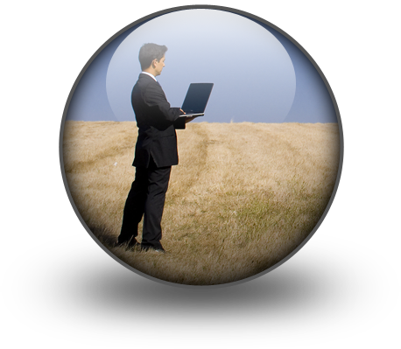
Personalized Branding
Experiential
Marketing
Relationship
Marketing

Slide 3
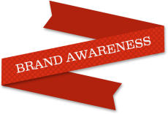
Personalized Brand Programs
Personalized
Branding
=
Experiential
+
Relationship
Customer Connection
Customer Retention
Experiential
Branding
Experiential branding reflects the concept that brands need to focus on the experience they provide to customers and the impact on enriching customer lives.
http://vimeo.com/57026311
=
Relationship branding is focused on programs and activities that build stronger loyalty among existing customers. For service based brands, relationships are based on customized services. For product brands relationships are strengthened through social media marketing
Relationship
Branding
=
BRANDING STRATEGY
4
of
13
Instructor:
Thomas Murphy
P. 978_760_1388/ Tmurphy@clarku.edu

Slide 4
Personalizing Marketing
Experience
Relationship
Mass Custom
Permission

Slide 5
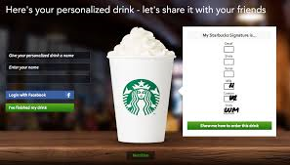
Brand Experience Starbucks

Slide 6
Create your Own Starbucks Signature – New Logo, New Brand Experience
This online application allows you to create your customized drink online, of course displayed in the new Starbucks cup adorning the new logo. After you’re done completing the 8 steps (yes 8 ) of creating your drink (type of drink, size, number of expresso shots, flavour of drink, milk choice, preparation of drink and toppings) you are shown your Starbucks signature – the typical markings on your cup for your customized order. You can then personalize your drinks name, and share it on Facebook with your friends allowing you to show them what you’re drinking (hopefully sparking them to surprise you with a drink in the future) and in turn what their drinking.
brandiary
personal brand journal
It’s a very interactive campaign that allows Starbuckers to directly experience Starbucks’ new brand image. It even helps guide them through the brand experience with the “show me how to order this drink” option for the newbies.
To create your own signature or view this app:
http://www.mystarbuckssignature.com/#step00
https://brandiary.wordpress.com/2011/03/09/create-your-own-starbucks-signature-new-logo-new-brand-experience/

Slide 7
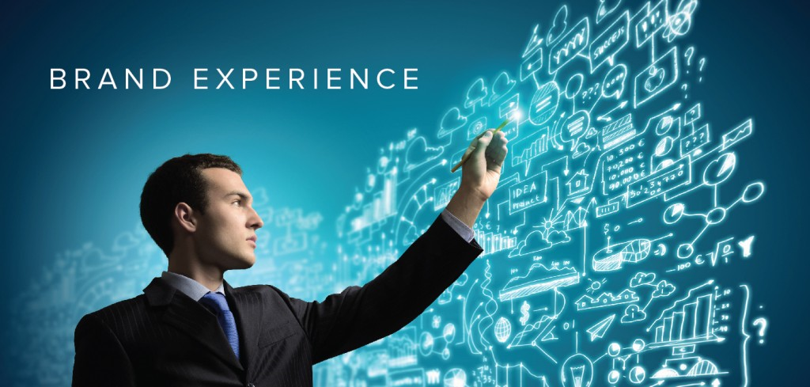
Brand Experience – customers may be aware of you but are they engaged?

Slide 8
Awareness is great, but without a well planned, enticing, unique and consistent brand experience across platforms and mediums, engaging your audience and ultimately making them love you will be a rather futile exercise. The fact of the matter is, consumer touch points must be used more effectively than ever with time pressed consumers bombarded with brand messages on a daily basis.
Read more: http://www.mediavisioninteractive.com/blog/cross-channel-marketing-2/brand-experience-engage-consumers/#ixzz3zOtxWV6e

Slide 9
What Does the Consumer Want in an Effective Brand Experience?
The consumer is increasingly web savvy and becoming more and more used to seamless, elegant and easy to use brand experiences both digitally and in the real world. This is what they have come to expect, and this is what you need to deliver in order to make an impact.
Read more: http://www.mediavisioninteractive.com/blog/cross-channel-marketing-2/brand-experience-engage-consumers/#ixzz3zOtxWV6e

Slide 10
Visually Appealing – Unique and enticing visuals don’t only attract and evoke emotion instantly, but also convey authority and credibility. Up-to-date design implies an easy and effective user journey, and with mobile user numbers soaring, mobile websites and responsive design is a must.
Simplicity – Consumers want intuitive and seamless functionality when interacting with their favourite brands and want to be able to switch between the brand’s online properties easily.
Social Engagement & Personalisation – Consumers want to be able to start a conversation with their favourite brands, not merely be advertised to. They expect personalised interaction with real people that exude the brand voice they have come to love.
Listen – Engagement marketing allows you to actively listen to what your fans or would-be fans are saying and suggesting. Ask the right questions and act on the data to give your audience more of what they want.
Read more: http://www.mediavisioninteractive.com/blog/cross-channel-marketing-2/brand-experience-engage-consumers/#ixzz3zOtxWV6e

Slide 11
Mobile & Accessibility – Your audience wants to be able to follow you wherever they are, so don’t limit them. Give your users the option to switch between viewing your website on their desktop PC or mobile device, build an app and clearly direct users to your social communities online.
Perceived Quality/Value of Being a Follower of the Brand – What are you giving your audience that makes them feel valued and special? Behind the scenes detail reserved just for your groupies, or special offers? Are you giving them information and resources that make them say “I love this, and I’m sharing it with everyone I know”? You should be.
Truly Integrated Brand Experience Includes the Real World – All this value and integration across your digital brand properties means nothing if it doesn’t stay consistent when your ‘underwear-throwing’ fans meet you in real life.
Read more: http://www.mediavisioninteractive.com/blog/cross-channel-marketing-2/brand-experience-engage-consumers/#ixzz3zOtxWV6e

Slide 12
The Good, The Bad and the Boring ….. Experience Brainstorm

Slide 13
Identify brands where you have had a “good” experience
You walked away feeling good
Whether you Bought or Not
You would Go Back Again

Slide 14
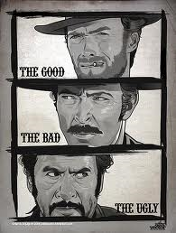
Identify brands where you have had a “Bad” experience
You walked away
feeling bad
You Were Treated
Poorly
The Place you
Shopped was poor

Slide 15
Identify brands where you have had a “Boring” experience
It’s the same
All The time
You can’t remember
What it was like
“Whatever”

Slide 16
Brands build customer experiences in 3 different areas
Physical
Sound
Light
Emotional
Personal
Warm
Cognitive
Status
Enlighten
Design
Peaceful
Excitement
Speed
Engaged
Connected

Slide 17
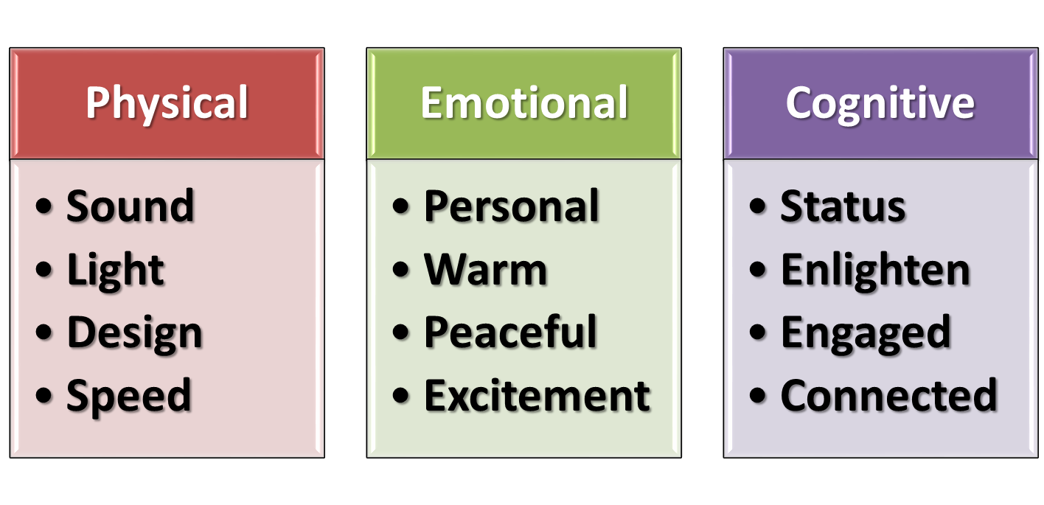
Take a BaD EXPERIENCE AND IMPROVE EMOTIONALLY AND COGNITIVELY

Slide 18
Take a BORING EXPERIENCE AND IMPROVE EMOTIONALLY AND PHYSICALLY

Slide 19
Branding Principle

Slide 20
Branding Principle
To “Reinforce” a brand’s Identity …
give customers the experience they expect
Reinforce
Build
To “Build” a brand’s identity…give them experiences they cannot get anywhere else

Slide 21
The Experience Economy
Commodity
Goods
Service
Experience
Stuff
Activity
Time
Tangible
Quality of Time is the New Value

Slide 22
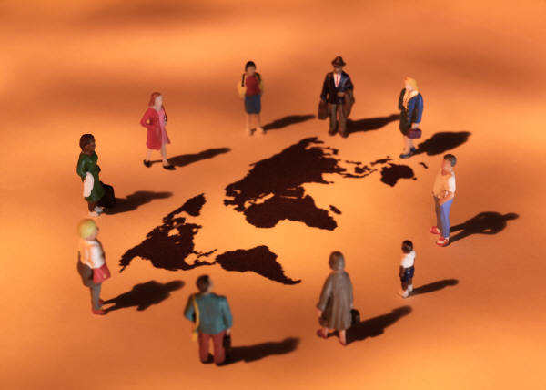
Brand Experience Touch Points
Events
Online
Blogs
Point of
Sale
Social
Media
Service

Slide 23
Actions That Enhance the Customer Experience
F Buying
Enjoyment
Friendly
Service
Retail
Comfort
Surprising
Value
Peer
Positive
Inputs
8
of
13
Instructor:
Thomas Murphy
P. 978_760_1388/ Tmurphy@clarku.edu

Slide 24
THE CUSTOMER EXPERIENCE CYCLE
Seek
Consider
Trial
Purchase
Discuss

Slide 25
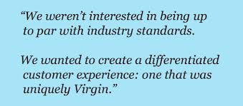
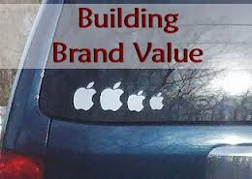

Slide 26
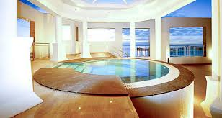
Servicescapes
Servicescape is a concept that was developed by Booms and Bitner^{[1]} to emphasize the impact of the physical environment in which a service process takes place.
Booms and Bitner defined a servicescape as "the environment in which the service is assembled and in which the seller and customer interact, combined with tangible commodities that facilitate performance or communication of the service. From Wikipedia, the free encyclopedia

Slide 27
Servicescapes
The servicescape includes the facility's exterior (landscape, exterior design, signage, parking, surrounding environment) and interior (interior design and decor, equipment, signage, layout, air quality, temperature and ambiance). From Wikipedia, the free encyclopedia
Signage
Design
Land
Scape
Exterior
Ambiance

Slide 28
Customers’
Experiences and Behavior
As a message-creating medium
Using symbolic cues to communicate to the audience about the nature and quality of the service experience
As an attention-creating medium
Make the servicescape stand out from competing establishments, attract customers from target segments
As an affect-creating medium
Colors
Textures
Sounds
Scents
Spatial design

Slide 29
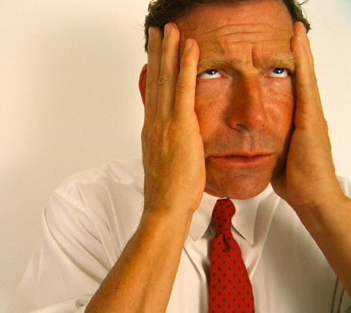
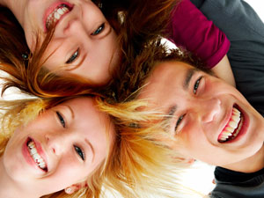
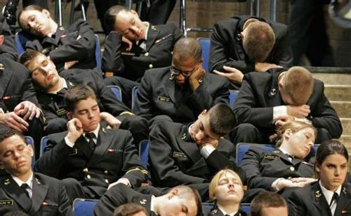
The Russell Model of Affect
Arousal
Distress
Excited
Unpleasant
Pleasant
Bored
Relaxed
Sleepy
People avoid situations of distress or boredom

Slide 30
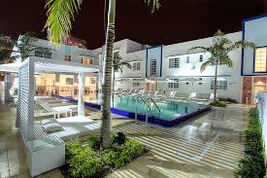
Service Environment Dimensions

Slide 31
Consumer Responses to Service Environments
Customers tend to view the environmental items holistically, hence the key to effective design is how well each individual dimension fits together with everything else.
Ambient Conditions
Spacial Layout
Signs, Symbols, Artifacts
Exterior Design

Slide 32
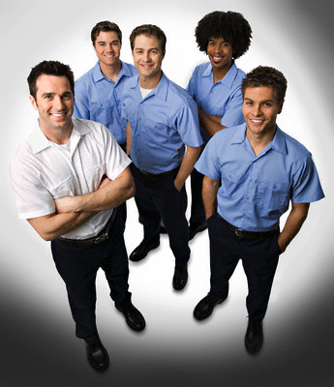
Consumer Responses to Service Environments
There are customer and employee response moderators (Cognitive, emotional and psychological). This means that the same service environment can have different effects on different customers, depending on what they like. It is now recognized that productivity of frontline personnel and quality of service they deliver is also affected by the environment.

Slide 33
Consumer Responses to Their Environments
Internal customer and employee responses can be categorized into cognitive responses, emotional responses and psychological responses (pain and comfort).
These internal responses lead to overt behavioral responses such as avoiding a crowded store or responding positively to a relaxed environment by spending more time and extra money on impulse purchases
Cognitive
Quality
Beliefs
Emotional
Feelings
Moods
Psychological
Pain
Discomfort

Slide 34
Ambient Conditions
Are composed of hundreds of design elements and details that have to work together to create the desired service environment. The resulting atmosphere creates a mood that is perceived and interpreted by the customer.
Lighting
Colors
Size and shape
Sounds
Music
Temperature
Air Quality
Scents
Textures

Slide 35
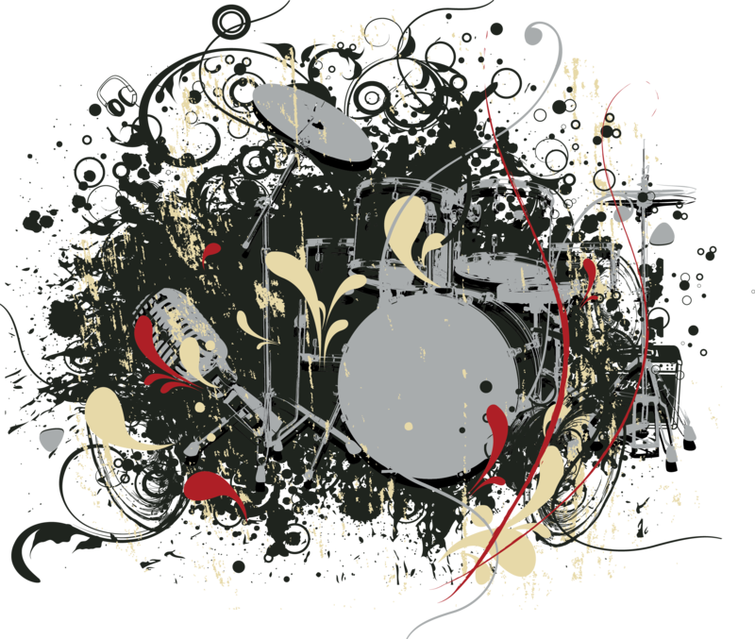
Music
Even barely audible music can have powerful effect on perceptions and behaviors in service settings. Tempo, volume, harmony are perceived holistically and their effect on different age groups differs widely.
Fast tempo music and high volume music increases arousal levels and causes people to walk faster and talk and eat more quickly in restaurants. People tend to adjust their pace voluntarily or involuntarily to match the music.

Slide 36
Scent
An ambient smell is one which pervades an environment, may or may not be consciously perceived by a customer and is not related to any particular product.
Presence of scent can have a strong impact on mood, affective and even evaluative responses and even purchase intentions and in - store behaviors. Service marketers realize the importance of using scent to make customers hungry and thirsty in a restaurant, relax customers in a dentist's waiting room, and energize customers to work out harder in a gym, makes gamblers gamble more and so on.

Slide 37
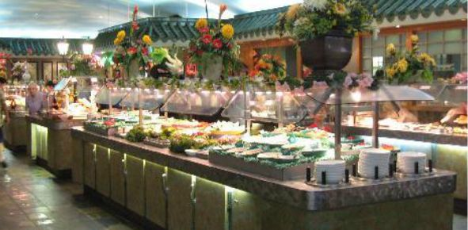
Spatial Layout and Functionality
Spatial layout refers to how furnishings, counters, machinery and equipment etc. are arranged. Functionality refers to their ability to facilitate the performance of service transactions. Both affect buying behavior, customer satisfaction and hence the business performance of the service facility.
Signs, symbols and artifacts Customers automatically try to draw meanings from them. They also draw cues from them to help them form expectations about the type and level of service that is being offered. They use them to guide them through the service environment and service process.
Customers get angry and frustrated if they cannot get clear signals from a services cape. They must be used appropriately to guide customers through the service delivery process.

Slide 38
Signage, Symbols & Artifacts
Directions
Instructions
Facilities
Company Symbols
Welcome
Employee
Roles
Customers become distracted, confused and frustrated when they do not have clear signals to indicate how to navigate and participate in their service experience.
Strong service environments place signs and instructions that blend with the landscape but provide clear direction

Slide 39
Exterior Design Elements
Landscape
Parking
Entry & Walkways
Exterior Signage
Guards & Sign In
Architecture
Surroundings
Many service areas are defined and enhanced by the exterior design of their buildings and locations.
These areas include Hotels, Resorts, Consulting, Restaurants and Universities
It is similar to the landscape and outside condition of a home to set the stage for anticipation of what is inside

Slide 40
People as a Part of the Environment
The appearance and behavior of both service staff and customers can reinforce or detract from the impression created by the service environment.
Marketing communications may seek to attract customers who will not only appreciate the ambience created by the service provider but also actively enhance it by their behavior and appearance.

Slide 41
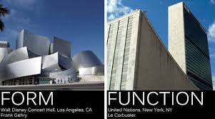
Form vs Function

Slide 42
The Tools of Service Landscapes
Form versus Function
FORM: Design elements that inspire, create imagery and emotional connection between customers and the service experience
FUNCTION: Design elements that assist in the delivery of quality service experiences through efficiency, consistency, security and convenience

Slide 43
The Tools of Service Scape Form
Form
Stimuli
Decor
Imagery
Space

Slide 44
The Tools of Service Scape Function
Function
Mobility
Comfort
Security
Access

Slide 45
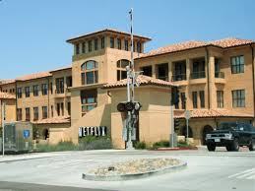
Netflix Servicescape Design
Design a new striking corporate headquarters for Netflix
Design Netflix Experience Stores

Slide 46
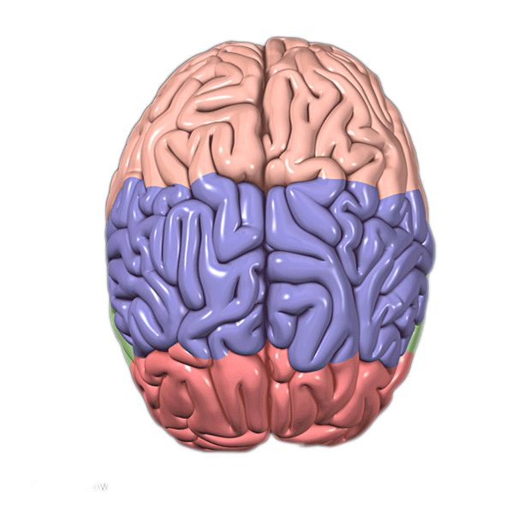
Experiential Branding Impact Zones
Self
Worth
Left Brain
Programs
That
Influence
More
Tactical
Experience
Action
Right Brain
Programs
That
Influence
Emotional and Less
Tangible
Experience
Sensory
Social
Think
Emotion
BRANDING STRATEGY
5
of
13
Instructor:
Thomas Murphy
P. 978_760_1388/ Tmurphy@clarku.edu

Slide 47
Experience Branding Brainstorm
For each of the Experiential Branding Areas, Identify an example of a brand activity or strategy
Action | Sensory | Think | Self Worth | Social Connect | Emotional
http://www.jaguarusa.com/ | http://www.bellagio.com/ | http://www.mckinsey.com/insights/mgi | http://worldwildlife.org/threats | http://www.facebook.com/llbean | https://disneyworld.disney.go.com/destinations/magic-kingdom/
BRANDING STRATEGY
6
of
13
Instructor:
Thomas Murphy
P. 978_760_1388/ Tmurphy@clarku.edu

Slide 48
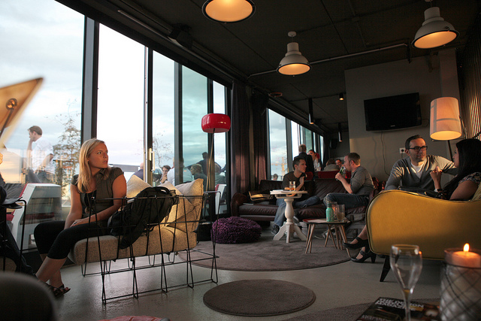
Building a Hotel Brand

Slide 49
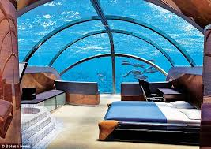
The Personal Experience Factor
ABOVE THE SURFACE
The key to creating a hotel brand is building a unique customer experience
That experience needs to be personal for each customer
BELOW THE SURFACE
While also being consistent in certain key areas of expectation aka the Invisible element
Wi-Fi
Room comfort
Meals
Front Desk Service
Lighting & Safety

Slide 50
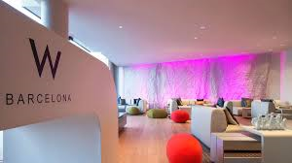
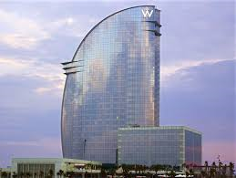
“How to Brand a Hotel” chapter 23 text
Storytelling
Create “moments of memory”
Make each experience unique
“The Heavenly Bed”
Constantly innovate
Build around a Theme aka the“W” hotels
Consistency
Starwood Loyalty Program
Don’t just give away free stuff
Loyalty can be measured by willingness to pay a little more for the experience of your brand
Make sure wherever they stay under your brand roof .. They have a consistent experience

Slide 51
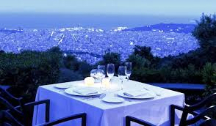
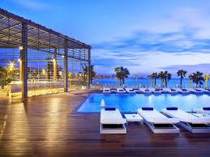
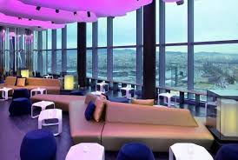

Slide 52
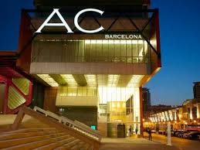

Slide 53
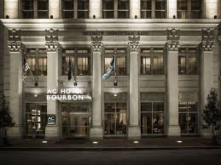

Slide 54
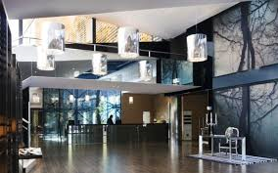

Slide 55
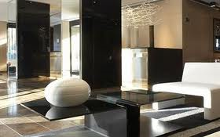
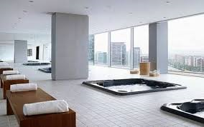

Slide 56
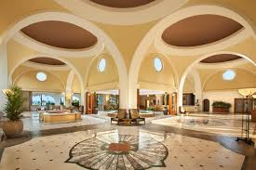

Slide 58
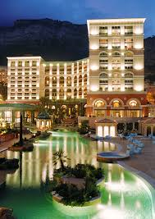
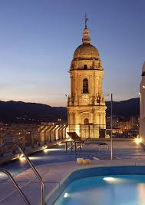

Slide 59
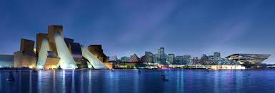

Slide 60
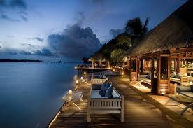
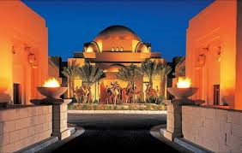

Slide 61
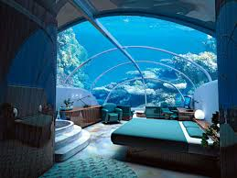

Slide 62
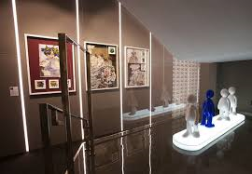

Slide 63
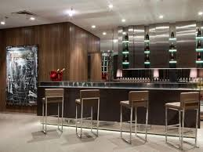

Slide 64
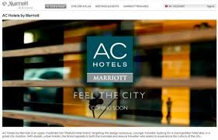

Slide 65
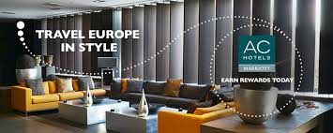
Marriott is making another bid for Millennial travelers as it announces plans to import its European-based hotel chain, AC, to America. Earlier this year, Marriott introduced a partnership with IKEA for a new hotel brand called Moxy, which will cater to Millennials across Europe.
AC Hotels, which is based in Madrid, was bought by Marriott back in 2010 and rechristened AC Hotels by Marriott, HotelChatter.com reports. The hope was that it would help Marriott expand its footprint across that continent, USA Today reports. That’s resulted in 79 AC Hotels by Marriott across Spain, Portugal, France and Italy. Now it’s looking to do the same in the States with a plan for 200 more in the next 10 years
Marriott Importing European
Hotel Brand to US to Entice Millennials
http://www.brandchannel.com/home/post/2013/06/03/Marriott-AC-Hotels-060313.aspx

Slide 66
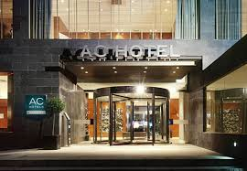
It's the right time to bring it to the US," says Brian King, global brand officer for Marriott Endorsed Brands, according to USA Today. "You import wine and you import cars. We're going to import a hotel brand."
If Marriott can lock up a good portion of Millennial business travelers, it could mean a big boost to revenue. According to research done by the hotelier, “business travelers ages 21 to 49 who make three or more business trips a year spend $34 billion on hotel rooms,” USA Today notes.

Slide 67
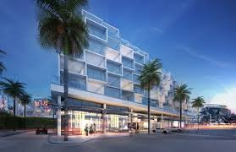
The way AC designers see it, Millennials like a sleek design, free WiFi and communal eating and working areas. Each hotel will feature the AC Library, “offering wide communal tables for working and socializing along with locally relevant reading materials” as well as a lounge. Folks who aren’t staying at the hotel can even use the AC Library if they book space ahead of time on Marriott’s new Workspace on Demand.
Of course, other hoteliers are after that demographic as well, such as Starwood's Aloft, IHG's Hotel Indigo, and Tommie, which was announced by Commune Hotels & Resorts last week. "There are multiple brands that are capitalizing on the Millennial demand growth with smart design and advanced technology," Chekitan Dev, an associate professor at Cornell University's School of Hotel Administration, told USA Today. "This space is expected to grow

Slide 68
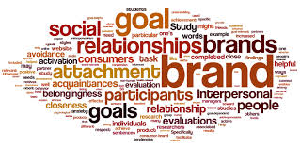
Relationship Branding

Slide 69
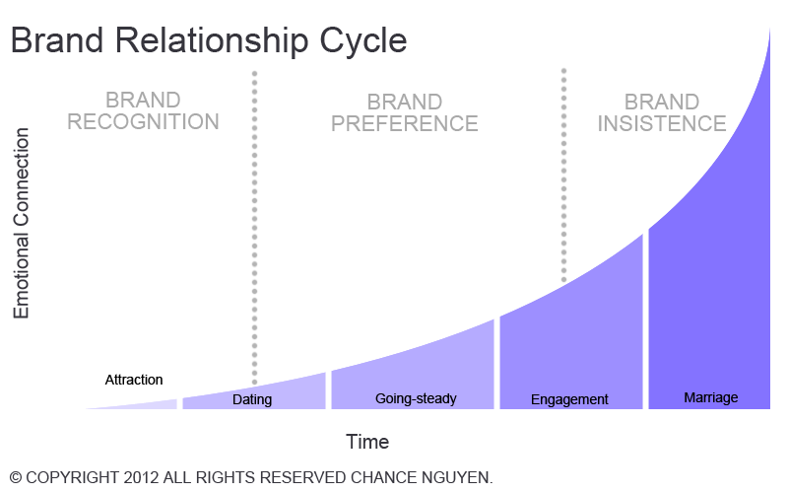
Brand Relationship Cycle

Slide 70
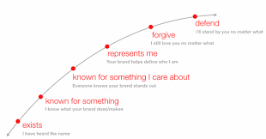
The Brand Relationship Arc
http://knowledge.wharton.upenn.edu/article/pg-moved-brand-arc-win-gold-medal-sochi/

Slide 71
The Brand Relationship Arc
The Brand Relationship Arc
To help simplify the shift in thinking that brands must employ to build emotional connections with their users, we talk about this relationship from a human-centric perspective. We employ the Brand Relationship Arc as a construct to bring this to life and to foster conversations with Google’s clients
http://knowledge.wharton.upenn.edu/article/pg-moved-brand-arc-win-gold-medal-sochi/

Slide 72
The Brand Relationship Arc
The underlying principle of the Brand Arc is that there are specific milestones or feelings that arise for users along the branding journey, similar to other relationships. When a brand first breaks into consciousness, they only exist for users — people know the name. After time, some brands take on deeper meaning for people, becoming known for something, or known for something unique or meaningful for them; something that people care about
http://knowledge.wharton.upenn.edu/article/pg-moved-brand-arc-win-gold-medal-sochi/

Slide 73
The Brand Relationship Arc
Where things start to get really interesting is further up the Arc when users begin to incorporate brands as part of their lives, something that shapes or defines them.
Very few brands are able to take the relationship beyond that, to a place where people would forgive that brand no matter what, or even defend that brand at all costs.
http://knowledge.wharton.upenn.edu/article/pg-moved-brand-arc-win-gold-medal-sochi/

Slide 74
The Brand Relationship Arc
“Brands can no longer simply “interrupt” us. They need to provide relevant, contextual, compelling content that actually means something to people.”
http://knowledge.wharton.upenn.edu/article/pg-moved-brand-arc-win-gold-medal-sochi/

Slide 75
The Brand Relationship Arc
Conversations around the Brand Arc are especially rich when we start to explore the dynamic nature of the tool. For example, our clients are quick to point out that while they may only “exist” for some of their users, others would “defend” them in heartbeat. Or, maybe they’re “known for something” in one market, but don’t “exist” at all in another. The Brand Arc helps us get to the root of many of our clients’ core branding challenge: Can I build meaningful relationships with people who know and use my brand?
http://knowledge.wharton.upenn.edu/article/pg-moved-brand-arc-win-gold-medal-sochi/

Slide 76
The Brand Relationship Arc
The reality, of course, is that only a handful of brands are able to build relationships that rise to the “forgive,” or “defend” territory. Getting that high up on the Arc is something that takes time, focus and commitment to standing for something.
For a sense of the kinds of brands that are “forgiven” or “defended,” consider those which brand super-fans are willing to tattoo on their bodies.
By and large these are lifestyle brands that have established an emotional role in some peoples’ lives. Not everyone would “defend” these brands, but those who would might do so passionately.
http://knowledge.wharton.upenn.edu/article/pg-moved-brand-arc-win-gold-medal-sochi/

Slide 77
The Brand Relationship Arc
Of course, for the majority of brands, the point is not to be forgiven or defended at all costs. Rather, it’s to move up the Arc from where they are now; to go from just “existing” to being “known for something;” to go from being “known” to being “known for something I care about.”
Each point on the Arc is an exponential leap, so a seemingly small move actually represents a fundamental difference in the way a user relates to that brand.
http://knowledge.wharton.upenn.edu/article/pg-moved-brand-arc-win-gold-medal-sochi/

Slide 78
The Brand Relationship Arc
For example, Dove built a viral sensation based on the core insight that most women underestimate how attractive they are, affecting their self image. Other buzzed-about brands like Red Bull and GoPro speak directly to to users who are engaged by the exhilarating content that makes up the bulk of their brand communications.
Both of these brands take a clear position on where they stand which allows them to be “known for something I care about” or even “represent me” for the millions who opt in.
http://knowledge.wharton.upenn.edu/article/pg-moved-brand-arc-win-gold-medal-sochi/

Slide 79
The Brand Relationship Arc
“Ultimately, brands need to ask: What content I can provide to entertain, educate or provide a utility for my users?”
http://knowledge.wharton.upenn.edu/article/pg-moved-brand-arc-win-gold-medal-sochi/

Slide 80
How P&G Moved Up the Brand Arc to Win a Gold Medal at Sochi
Along with athletes, brand marketers also competed for attention at the recent winter Olympic Games in Sochi — and by many accounts, Procter & Gamble’s “Thank you, Mom” campaign came out on top. Eric Solomon, head of the strategy and insights for ZOO, the creative team at Google that works with firms to build their brands, explains how other companies can learn from the experience of P&G and other firms to build emotional connections with their customers.

Slide 81
About the Author
Eric Solomon is the Head of Strategy & Insights for the ZOO, the creative team within Google that helps brands creatively and effectively exploit the potential of the Google | YouTube platform, technologies and creative resources. Eric entered the world of branding through the door of academia, earning his Ph.D. in psychology. He has spent the last decade plus studying the intersection between motivation, persuasion, brands and human behavior. Somewhere in between he wrote a food column for a small newspaper in Boston. These days he enjoys eating even more than writing about eating.

Slide 82
How P&G Moved Up the Brand Arc to Win a Gold Medal at Sochi
Along with athletes, brand marketers also competed for attention at the recent winter Olympic Games in Sochi — and by many accounts, Procter & Gamble’s “Thank you, Mom” campaign came out on top. Eric Solomon, head of the strategy and insights for ZOO, the creative team at Google that works with firms to build their brands, explains how other companies can learn from the experience of P&G and other firms to build emotional connections with their customers.

Slide 83
Relationship Branding Platforms
Partnership
Loyalty
Social Media
After Marketing
One to One
Mass Customization
BRANDING STRATEGY
7
of
13
Instructor:
Thomas Murphy
P. 978_760_1388/ Tmurphy@clarku.edu

Slide 84
Mass Customization and One to One Marketing
Service
Experience
Disney
Netflix
Service Selection
Ritz Carlton
Colleges
Personalized
Products
Nike ID
Lands End

Slide 85
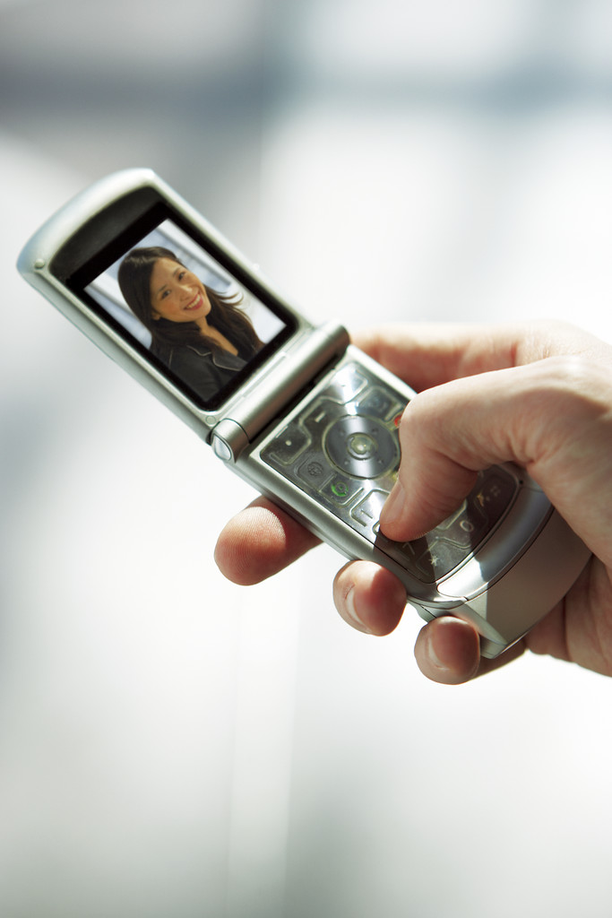
The Conflict of Permission vs Participation Based Marketing
Incentive Based – Does It Escalate Discounting
Just Pushing Products vs Building Relationship
How Much Will Customers Want to Share

Slide 86
Product Actions That Build Brand Relationships
Loyalty Programs
Customized
Solutions
Social Media Connection
BRANDING STRATEGY
9
of
13
Instructor:
Thomas Murphy
P. 978_760_1388/ Tmurphy@clarku.edu

Slide 87
Five Human Aspirations That Hold the Future for Brands
June 19, 2015
by Raphael Bemporad
BRAND INNOVATION
Abundance Without Waste
Aspirationals are redefining the idea of abundance, seeking more experiences in ways that use fewer resources and produce less waste. It’s a shift from a scarcity mentality to a new reality, where our creativity is an infinite resource.
Aspirationals are leading the way from an ownership economy to one driven by access, sharing and collaboration. Aspirationals don’t necessarily want more material possessions but rather more meaningful experiences that help them live better.

Slide 88
Five Human Aspirations That Hold the Future for Brands
June 19, 2015
by Raphael Bemporad
BRAND INNOVATION
In virtually every product category, brands are meeting this aspiration with new business models and delightful brand experiences.
Le Tote is an apparel subscription service that delivers on-trend clothing and accessories to your door, allowing you to rent full outfits for as long as you want and return them when you’re ready.
Similarly, Patagonia is redefining the rules of apparel with Worn Wear, a platform encouraging people to think about the enduring quality of what they buy and to repair, share or recycle their clothes so that the stories and experiences live on and on.

Slide 89
Five Human Aspirations That Hold the Future for Brands
June 19, 2015
by Raphael Bemporad
BRAND INNOVATION
2. Truly as You Are
The explosion of mobile technology and data has fueled new expectations for transparency and new dynamics of trust. The very fact that “the truth will out” is accepted by the Aspirational generation, and whether it plays out in their lives or in their expectations of brands, it’s no longer about perfection, but honesty.

Slide 90
Five Human Aspirations That Hold the Future for Brands
June 19, 2015
by Raphael Bemporad
BRAND INNOVATION
2. Truly as You Are
Aspirationals are leading the shift from flawless to honest, from hiding imperfections to revealing realities and from controlling the conversation to inviting others in to help solve challenges together.

Slide 91
Five Human Aspirations That Hold the Future for Brands
June 19, 2015
by Raphael Bemporad
BRAND INNOVATION
2. Truly as You Are
The fearless fashion house Everlane is making radical transparency an essential part of its brand promise, providing detailed information and costs on every step of its manufacturing process and inviting customers to “know your factories, know your costs and always ask why.”
Dove has inspired a cultural movement by celebrating our Real Beauty, and The Honest Company is disrupting the baby and personal care industry by uniting healthier ingredients; honest, mom-friendly answers; and a social goodness platform designed to help us make a difference together.

Slide 92
Five Human Aspirations That Hold the Future for Brands
June 19, 2015
by Raphael Bemporad
BRAND INNOVATION
3. Get Closer
Increasingly, we’re purchasing from peer networks, seeking to “meet the makers” and moving from “made by machines” to “made by people
Like never before, peers have become the new face of brands. We’ve always desired human connection, but today people like us are the actual providers of the products, services and brand experiences. From Airbnb to Uber to Getaround, the marketplace is shifting from selling products to engaging peers and from generating transactions to building relationships..”

Slide 93
Five Human Aspirations That Hold the Future for Brands
June 19, 2015
by Raphael Bemporad
BRAND INNOVATION
4. All of IT
The Aspirational generation wants to be, do and have it all. Rooted in a deep desire for freedom, the rejection of limiting binary choices and a reimagination of the American Dream without finish lines, Aspirationals are fueling a cultural shift from fixed answers to fluid options, from having a clear destination to enjoying the journey and from reacting to others’ ideas of success to seeking happiness on our own terms.

Slide 94
Five Human Aspirations That Hold the Future for Brands
June 19, 2015
by Raphael Bemporad
BRAND INNOVATION
4. All of IT
Shifting the paradigm from fixed to fluid means refusing to be trapped by predetermined categories such as age, gender or yesterday’s expectations.
Tapping this new reality, Urban Outfitters has created Without Walls, a new brand and curated collection that takes you from morning workout to the workplace to an evening with friends, living seamlessly through the roles, opportunities and adventures that each day brings.

Slide 95
Five Human Aspirations That Hold the Future for Brands
June 19, 2015
by Raphael Bemporad
BRAND INNOVATION
5. Do Some Good
Aspirationals represent a refreshing optimism and a new sense of agency born from the belief that their purchases, votes and actions matter, especially when joining with others to create change together.
However, the lens for social impact is shifting from narrowly defined political issues to broad lifestyle values, from bold stands to everyday behaviors and from rallying toward some distant goal to taking action today in ways that help move us all forward.

Slide 96
Five Human Aspirations That Hold the Future for Brands
June 19, 2015
by Raphael Bemporad
BRAND INNOVATION
5. Do Some Good
Aspirationals want something to believe in and they want brands to stand for something bigger than incremental product benefits. They want brands to embody an inspiring ethos, to bring a strong point of view and put a flag in the ground.

Slide 97
Five Human Aspirations That Hold the Future for Brands
June 19, 2015
by Raphael Bemporad
BRAND INNOVATION
5. Do Some Good
Inspired by pioneering social brands such as TOMS and Warby Parker,
Target is delivering on the desire to do some good with Made to Matter, a handpicked collection of 31 brands that are better for your health and give back to the community.
This new tribe of brands including Method, Happy Family and KIND is projected to generate $1 billion in sales for Target this year.

Slide 98
Five Human Aspirations That Hold the Future for Brands
June 19, 2015
by Raphael Bemporad
BRAND INNOVATION
The Takeaway for Brands
These five human aspirations represent a profound cultural shift in the marketplace and a tremendous opportunity for brands. It’s no longer about asking consumers to buy something. It’s about inspiring them to be something by helping us reveal our best selves and realize a better world.

Slide 99
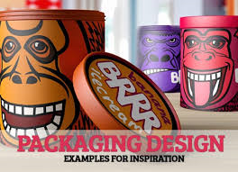
Mgt. 230
Clark University
Graduate School Of Management
Week 3 - Packaging
Instructor:
Thomas Murphy
P. 978_760_1388/ Tmurphy@clarku.edu

Slide 100
The Concept of Packaging
Packaging
Makes
The
Brand

Slide 101
Branding Principle “Packaging”
Function
Meaning
Form
Packaging is
one part Form,
one part Function
and one part
Meaning

Slide 102
Elements of Form
Design
Shape
Texture
Environment
Sound

Slide 103
Elements of Function
Labels
Instructions
Enablers of Use
Convenience
Signage

