Slide 1
Islamic Sainthood? An Introduction to sufism
CB51
19 April 2016

Slide 2
What is sufism?
All of these definitions of Sufism given by Sufis who lived in the 9th and 10th centuries (CE) are provided by al-Sarraj (d. 988 CE) in the earliest comprehensive book on Sufism, the Kitab al-Luma' (The Book of Flashes)
Muhammad ibn 'Ali al-Qassab--the master of Junayd--said, "Sufism consists of noble behavior that is made manifest at a noble time on the part of a noble person in the presence of a noble people.“
When he was asked about Sufism, Junayd said, "Sufism is that you should be with God--without any attachment."
Ruwaym ibn Ahmad said, "Sufism consists of abandoning oneself to God in accordance with what God wills."
Samnun said, "Sufism is that you should not possess anything nor should anything possess you."
Abu Muhammad al-Jariri said, "Sufism consists of entering every exalted quality and leaving behind every despicable quality."
'Amr ibn 'Uthman al-Makki said, "Sufism is that at each moment the servant should be in accord with what is most appropriate at that moment."
'Ali ibn 'Abd al-Rahim al-Qannad said, "Sufism consists of extending a 'spiritual station‘ and being in constant union.”
Notes:
What do you think of when you hear “sufi”?

Slide 3
Tasawwuf (تصوف): Islamic Mysticism
Inner, esoteric, mystical dimension of Islam
Islam (إسلام) = peace through surrendering to God (Allah, الله)
Practitioners of Tasawwuf = Sufi (صوفي)
Sunnism vs. Shi’ism, and Sufism
Sufi orders are largely Sunni and follow one of its four legal schools
However, Sufi orders have been influenced by and adopted into various Shi‘ite movements
Tawhid (توحيد)= metaphysical essential oneness
Comportment and adherence to hadith
Inheritance (through bloodlines)
Direct connection to “the real” (haqiqa) + emulation of “the greatest man” (al-Insān al-Kāmi lلإنسان الكامل‎)
“Mystics' delight in paradox acknowledges that in states of spiritual enthusiasm, we enter a region where the logic of common experience is perceived to be false”
Notes:
Renard, p. 33: “Knowing that “the Real” was ultimately one, aspirants on the path of knowledge of God sought to actualize the knowledge of the ultimate oneness of God that was at once veiled and yet manifest in multiplicity. The Sufis sought therefore to actualize the knowledge of this oneness through a total commitment to God, or in Sufi terminology, the Real. This commitment to God entailed submission to the Law (sharia’), application of spiritual disciplines (riyada), and spiritual education (adab). The totality of this commitment, submission, and education was referred to as “traveling the Path” (suluk). A tripartite division of Law, Path, and Divine Reality– or Sharia, Tariqa, and Haqiqa– gave expression to the essential elements of Sufism that from the earliest times of the community had defined Islamic spirituality until the triad eventualy cam to be seen as the cultural heritage of the Islamic peoples wherever they might be found.

Slide 4
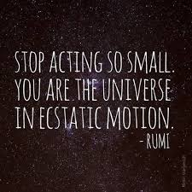
Approximate chronology
Late 8th century – beginning of 10th century: renunciatory modes of piety emerged
mid-9th century: Sufis of Bagdad came into full view as members of a distinct mode of mystical piety
10th century: internal self-differentiation into orders
11th century: New pattern of religious life
supported by mass piety
reinforced through Sufi heroes of high Caliphal times
early 12th century: scholars began to adopt the Sufism of the masses
partly in order to try to discipline it
Mid-13th century: Sufism is a “Frame for popular piety”
"Unitive speculation," and the mystical life more broadly, justified a more expansive Sufi outlook

Slide 5
Tariqa (طريق): Sufi orders
Tariqa (طريق, plural: turuq طرق) = literally path, but also in the Sufi context, “order”
loosely organized bodies of teachers and disciples following well-definied (sometimes hierarchically controlled) “paths" of mystical discipline
the master-disciple relationship which proved the mechanism of passing authority from one generation to the next
Silsilah (سلسلة)= sequence of "heredity"
amounted to an isnad of organizational practice
Form the basis for Sufi society, which is organized into congregations formed around a master (pir or mawla مولى) who maintains a direct chain of knowledge transmission originating with Muhammad
Student is known as a murid (مريد)
A congregation meets for spiritual sessions (majalis مجالس, literally “sittings”) in meeting places known as khanaqahs (خانقاه, roughly “monastery”)
Also known as zawiyahs in North Africa and as tekke in formerly Ottoman areas

Slide 6
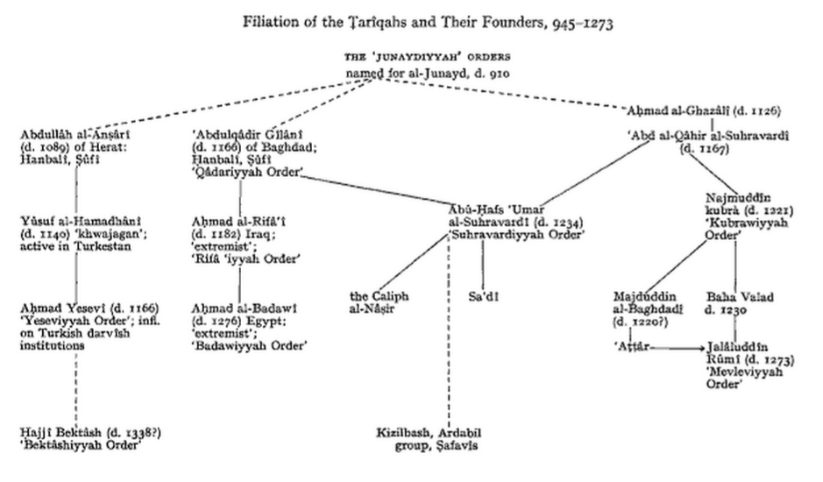
Notes:
From Venture of Islam, p. 215

Slide 7
Modern-day sufi orders
Akbari
Alevi
Alians
Ashrafia
Azeemia
Ba 'Alawi
Bayrami
Bektashi
Burhaniyya
Chishti
Galibi
Gulshani
Haqqani Anjuman
Hurufi
Idrisi
Issawiyya
Jelveti
Jerrahi
Khalidi (İskenderpaşa and İsmailağa)
Khalwati
Kubrawi
Madari
Malamati
Mevlevi
Mouridi
Noorbakshia
Naqshbandi
Naqshbandi Haqqani
Nasuhi
Ni'matullāhī
Nuqtavi
Qadiri
Qalandari
Rifa'i
Safavi
Sarwari Qadiri
Shadhili
Shattari
Suhrawardi
Sunbuli
Sülaymaniyya
Tijani
Ussaki
Uwaisi
Zahedi
Zikris

Slide 8
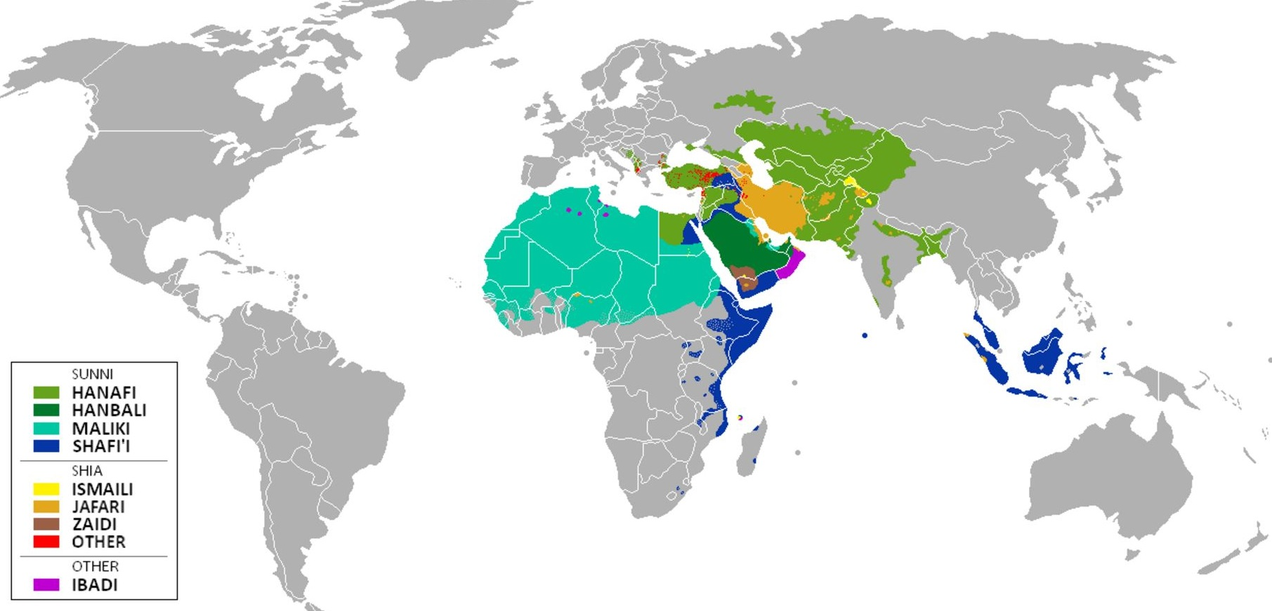
Regionalism and Sufi networks
Proselytizing
Pir-Murid relationship
Naqshbandi Order
Regional Idiosyncracies
khanaqahs often found adjoined to shrines of saints, mosques and madrasas
Berber asceticism

Slide 9
What Makes a sufi saint? asceticism
Discernment
clarity of thought/spiritual vision
“the Moroccan rural Sufi tradition” vs. “the urban Sufi tradition of Andalusia”
Abu Ya’za: “unlettered reclusive Berber ascetic and Friend of God whose supplication was heard and answered by God” vs. “Mystical teaching of the eastern lands of Iraq and Persia”
How else is Abu Ya’za described?
Does asceticism (“extreme piety” or “severe asceticism”) relate to an “elevated spiritual state” and/or the ability to enact “miracles”?

Slide 10
What makes a sufi saint? Veneration
“Friends of God”
How does veneration relate to emulation?
Is this "peasant nonsense"?
What is the role of images?
Compare with Bernard in last week’s readings

Slide 11
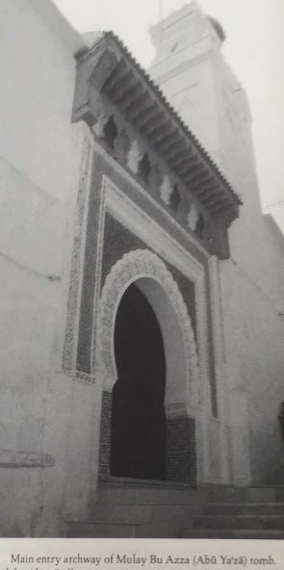
What makes a sufi saint? Cult status
Stories
Khanaqas vs. tombs
Pilgrimages
Feast Days and Celebration
slippery slope towards polytheism
In Muslim polemic, Christians were portrayed as polytheist (both because of belief in trinity as well as saint cults)

Slide 12
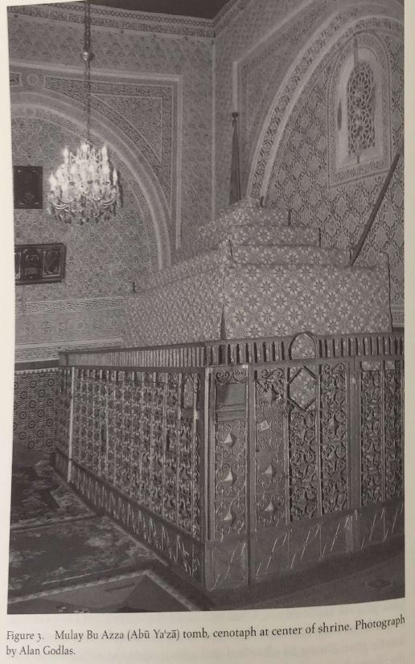
What makes a sufi saint? Localism
Tombs
Reliquaries
Pilgrimage
Bodily healing

Slide 13
What makes a sufi saint? mediation
conduit vs. intercession
proximity to God
Is merit transferable? Can merit compensate for the sins of ordinary people?
In Christianity, yes
In Islam, no

