Slide 1
Peter Senge
Week 3
The Fifth Discipline The Art and Practice of the Learning
ENG-SCI 26: Humanity and its Futures: Systems Thinking Approaches

Slide 2
Appendix 1-The Learning Disciplines
Each of the five disciplines can be thought of in three levels:
-Practices: what you do
-Principles: guiding ideas and insights
-Essences: the state of being of those with high levels of mastery in the discipline

Slide 3
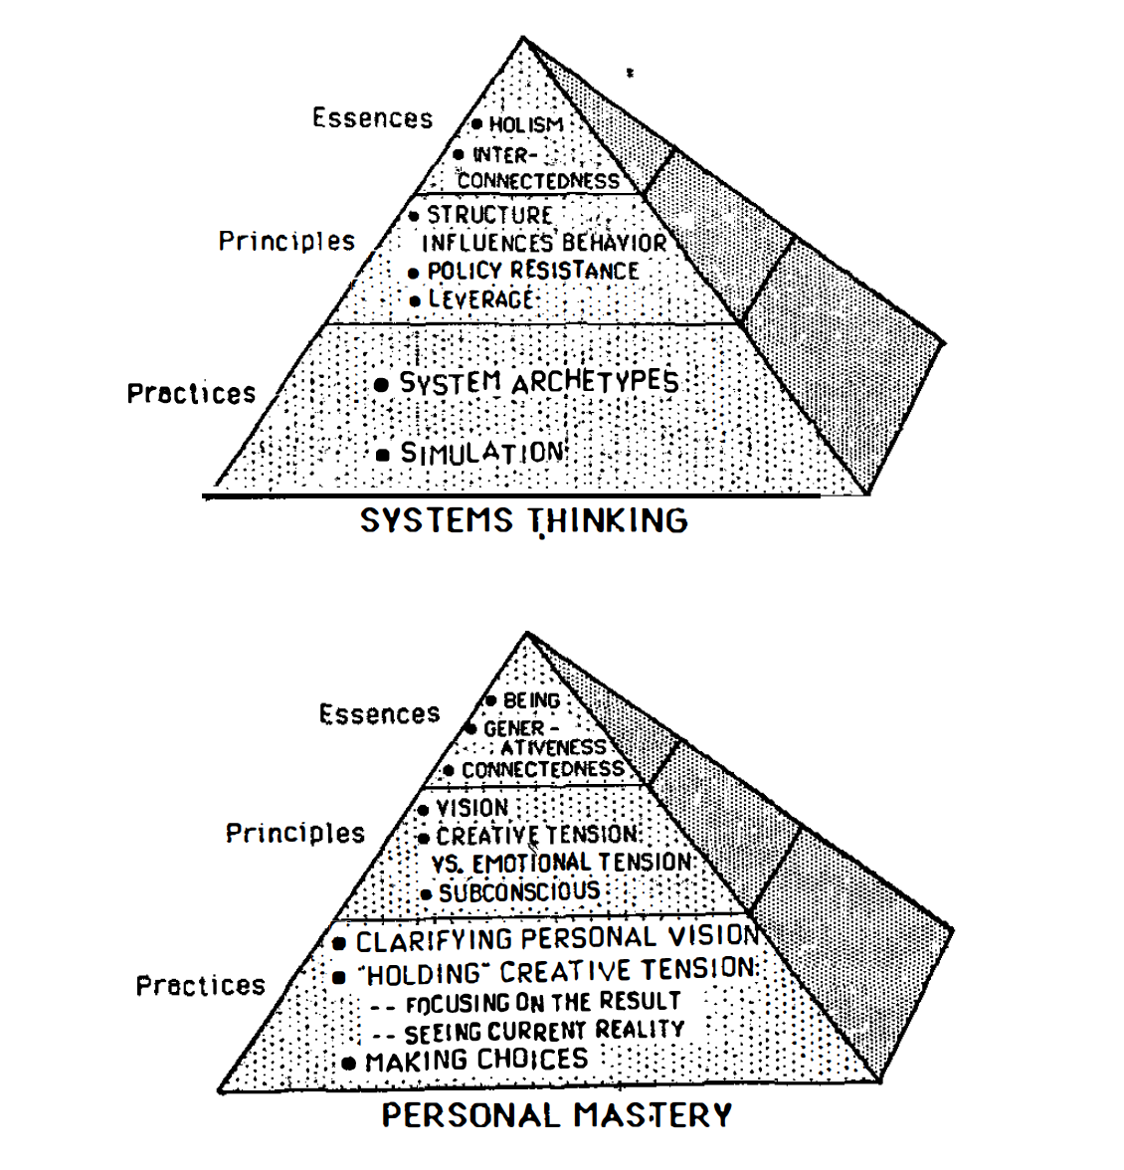
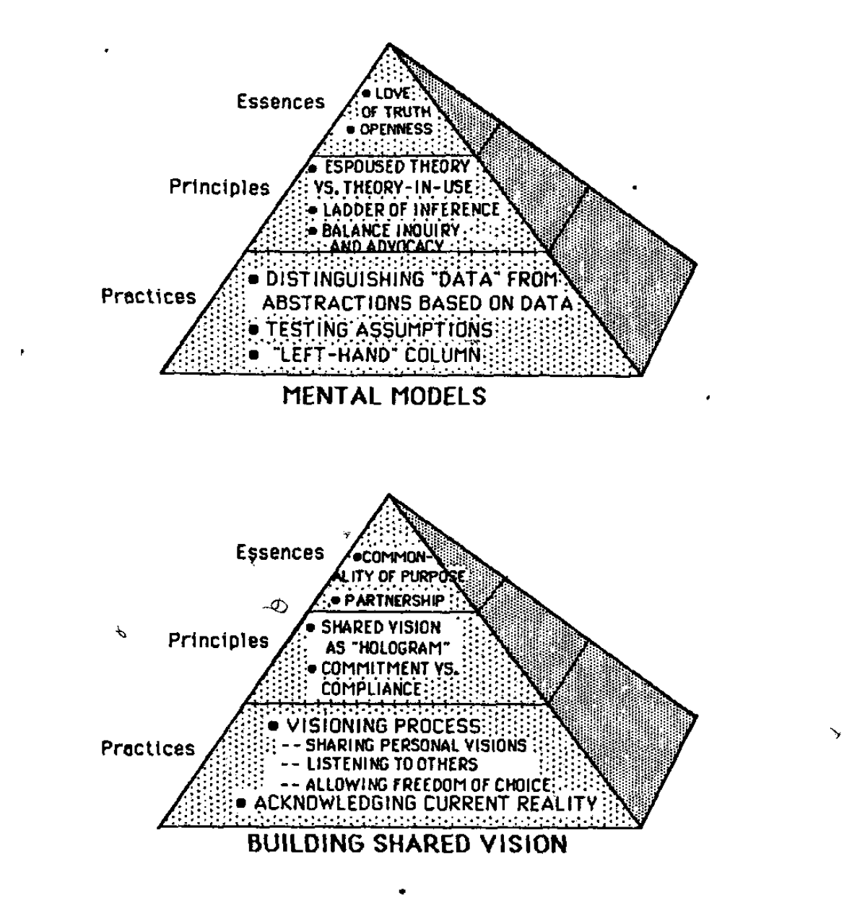
ENG-SCI 26: Humanity and its Futures: Systems Thinking Approaches

Slide 4
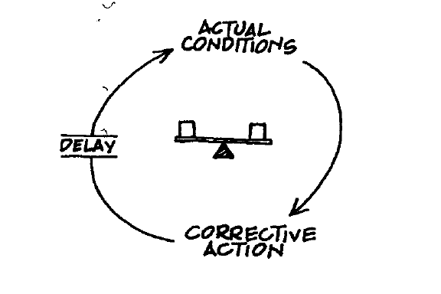
Appendix 2-Systems Archetypes
BALANCING PROCESS WITH DELAY
Notes:
“Description: A person a group, or an organization, acting toward a goal, adjusts their behavior in response to delayed feedback. If they are not conscious of the delay, they end up taking more corrective action than needed, or (sometimes) just giving up because they cannot see that any progress is being
made.”

Slide 5
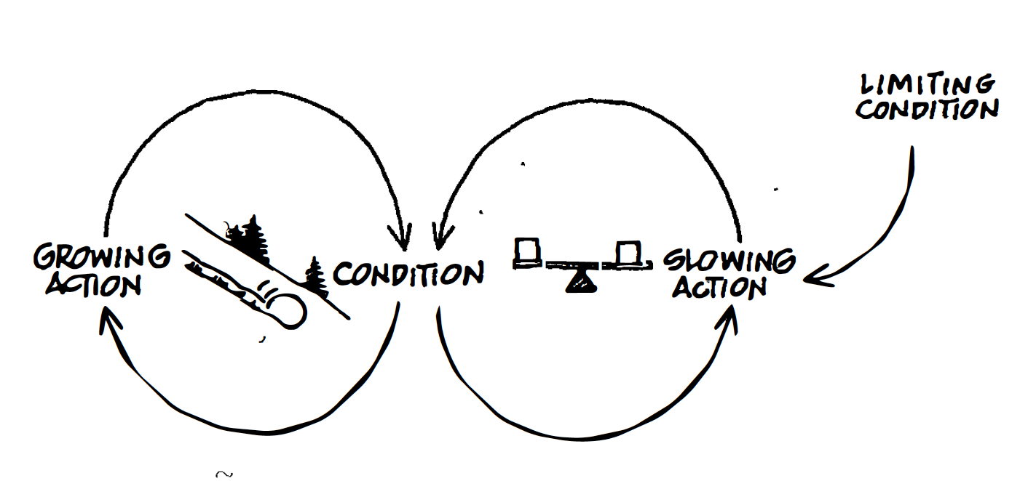
Appendix 2-Systems Archetypes
LIMITS TO GROWTH
Notes:
“Description: A process feeds on itself to produce a period of accelerating
growth or expansion. Then the growth begins to slow ( often inexplicably to the
participants in the system) and eventually comes to a halt, and may even
reverse itself and begin an accelerating collapse.
The growth phase. is caused by a reinforcing feedback process ( or by several
reinforcing feedback processes). The slowing arises due to a balancing process
brought into play as a "limit" is approached. The limit cart be a resource constraint,
or an external or internal response to growth. The accelerating collapse
(when it occurs) arises from the reinforcing process operating in reverse, to generate
more and more contraction.”

Slide 6
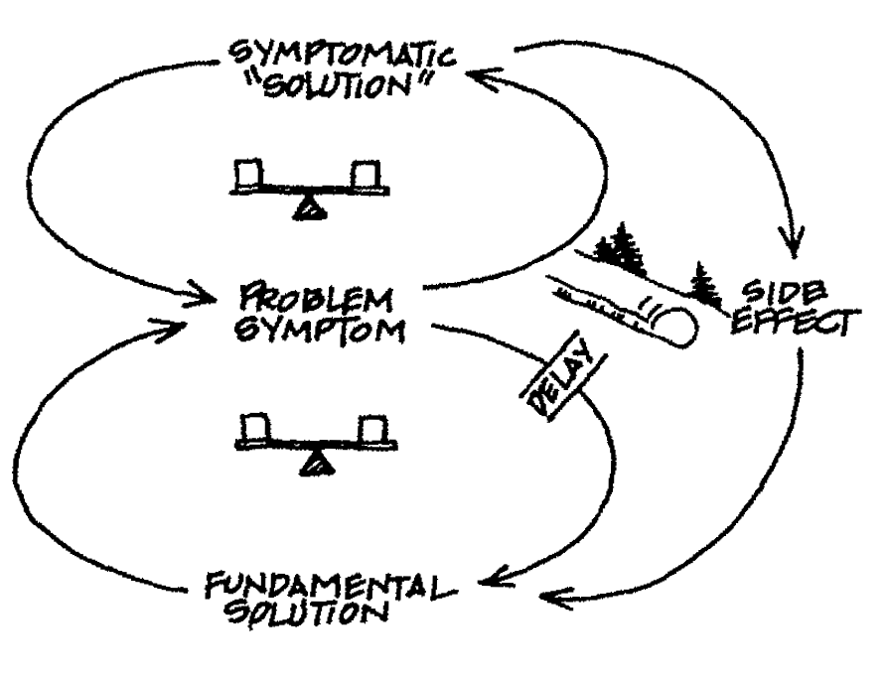
Appendix 2-Systems Archetypes
SHIFTING THE BURDEN
Notes:
“Description: A short-term "solution" is used to correct a problem, with seemingly
positive immediate results. As this correction is used more and more,
more fundamental long-term corrective measures are used less and less. Over
time, the capabilities for the fundamental solution may atrophy or become disabled,
leading to even greater reliance on the symptomatic solution.”

Slide 7
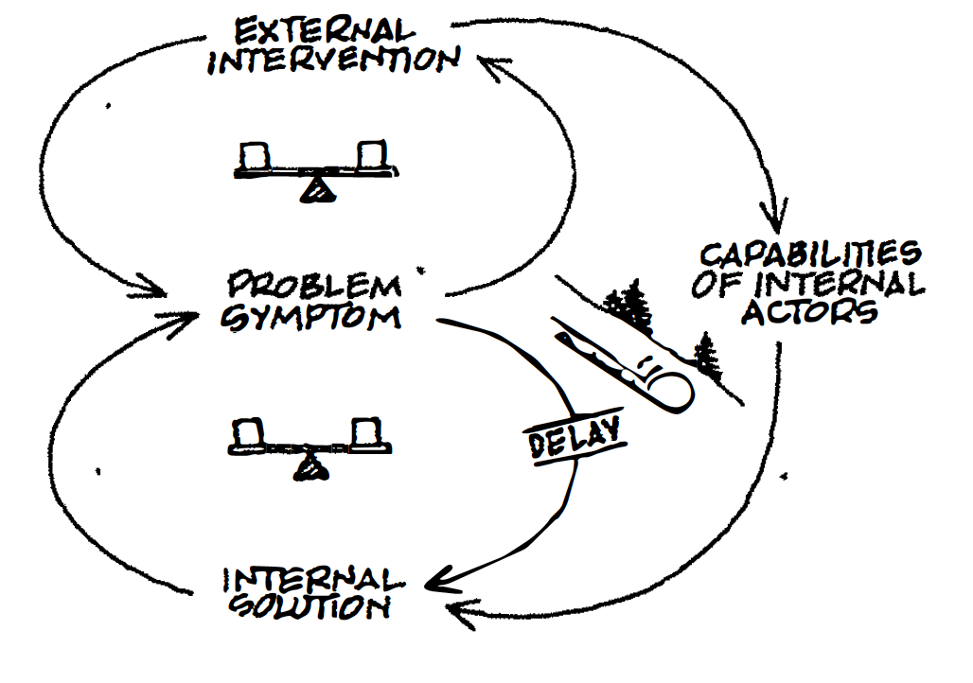
Appendix 2-Systems Archetypes
SHIFTING THE BURDEN TO THE INTERVENOR
Notes:
“One area where shifting the burden structures are so common and so pernicious
that it warrants special notice is when outside "intervenors" try to help
solve problems. The intervention attempts to ameliorate obvious problem
symptoms, and does so so successfully that the people within the system never
learn how to deal with the problems themselves.”

Slide 8
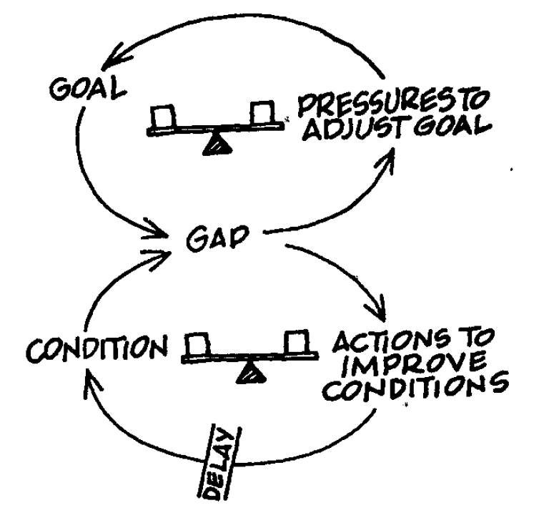
Appendix 2-Systems Archetypes
ERODING GOALS
Notes:
“Description: A shifting the burden type of structure in which the short-term
solution involves letting a long-term, fundamental goal decline.”

Slide 9
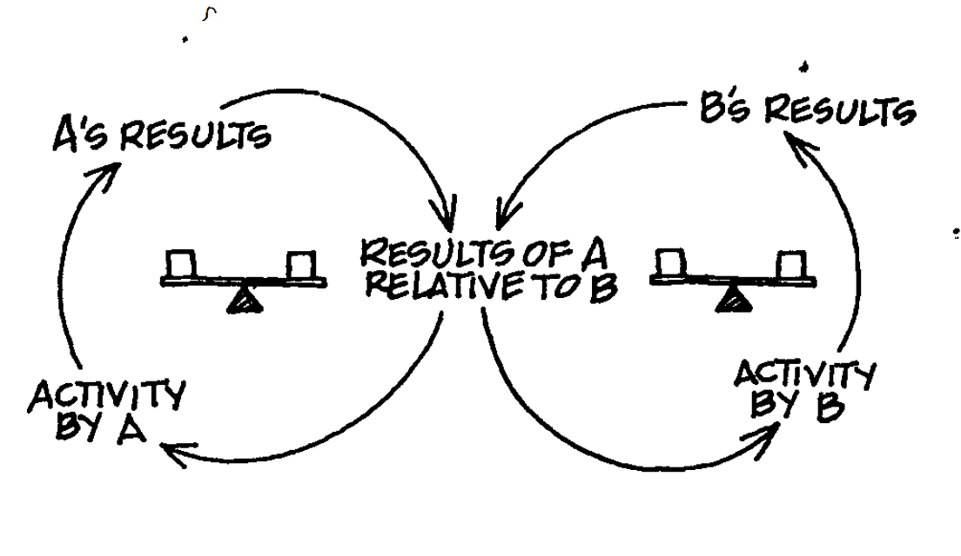
Appendix 2-Systems Archetypes
ESCALATION
Notes:
“Description: Two people or organizations each see their welfare as depending on a relative advantage over the other. Whenever one side gets ahead, the other is more threatened, leading it to act more aggressively to reestablish its advantage, which threatens the first, increasing its aggressiveness, and so on. Often each side sees its own aggressive behavior as a defensive response to the other’s aggression; but each side acting “in defense” results in a buildup that goes far beyond either side’s desires. “

Slide 10
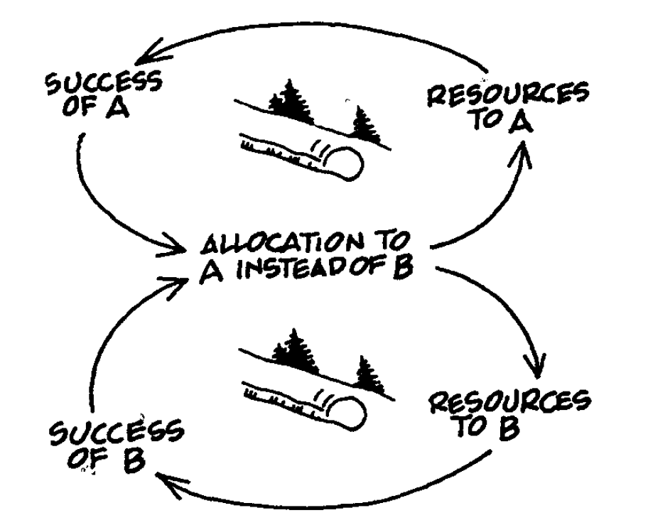
Appendix 2-Systems Archetypes
SUCCESS TO THE SUCCESSFUL
Notes:
“Description: Two activities compete for limited support or resources. The more successful one becomes, the more support it gains, thereby starving the other.”

Slide 11
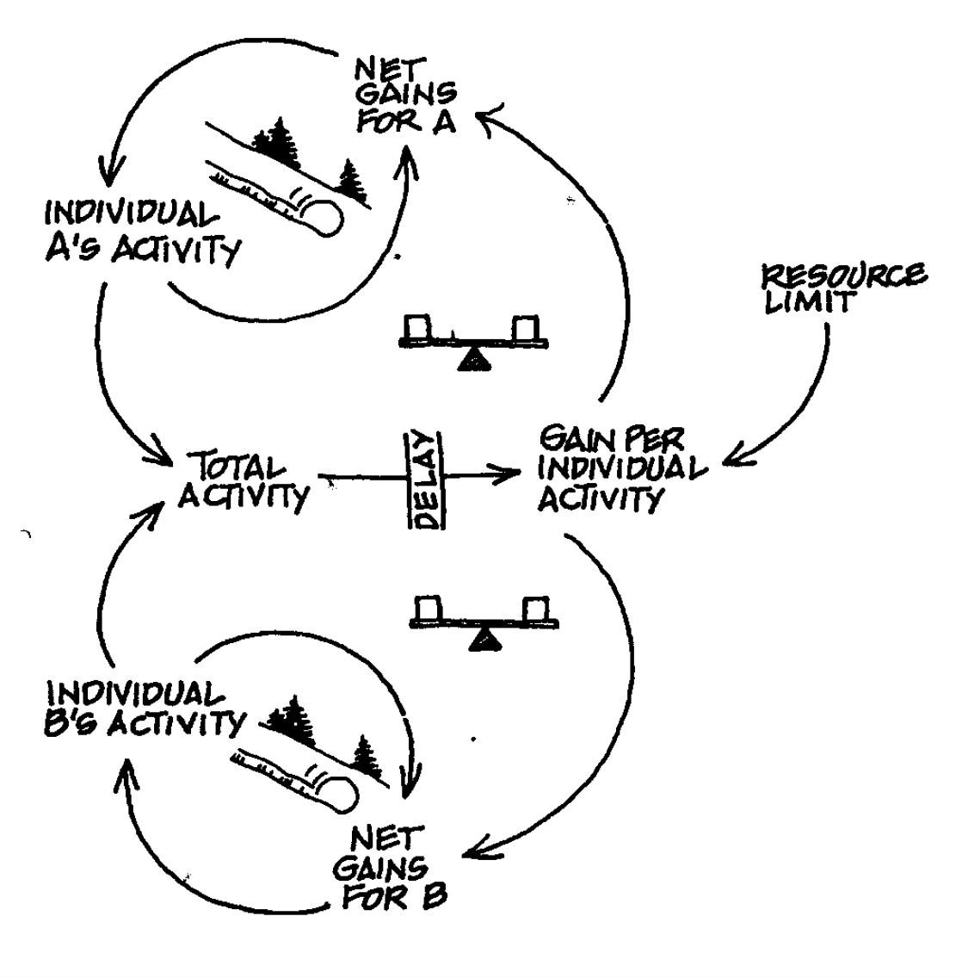
Appendix 2-Systems Archetypes
TRAGEDY OF THE COMMONS
Notes:
“Description: Individuals use a commonly available but limited resource solely
on the basis of individual need. At first they are rewarded for using it; eventually,
they get diminishing returns, which causes them to intensify their efforts.
Eventually, the resource is either significantly depleted, eroded, or entirely used
up.”

Slide 12
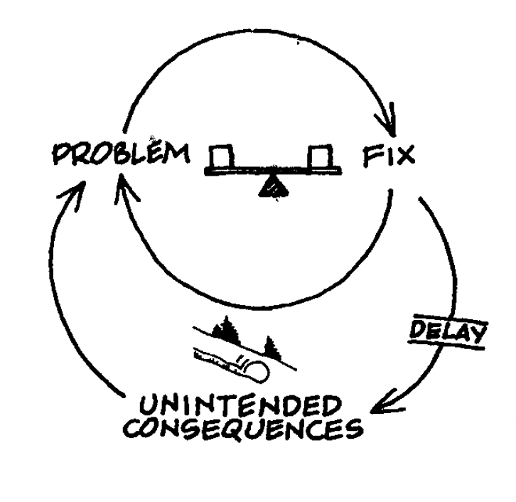
Appendix 2-Systems Archetypes
FIXES THAT FAIL
Notes:
“Description: A fix, effective in the short term, has unforeseen long-term consequences
which may require even more use of the same fix.”

Slide 13
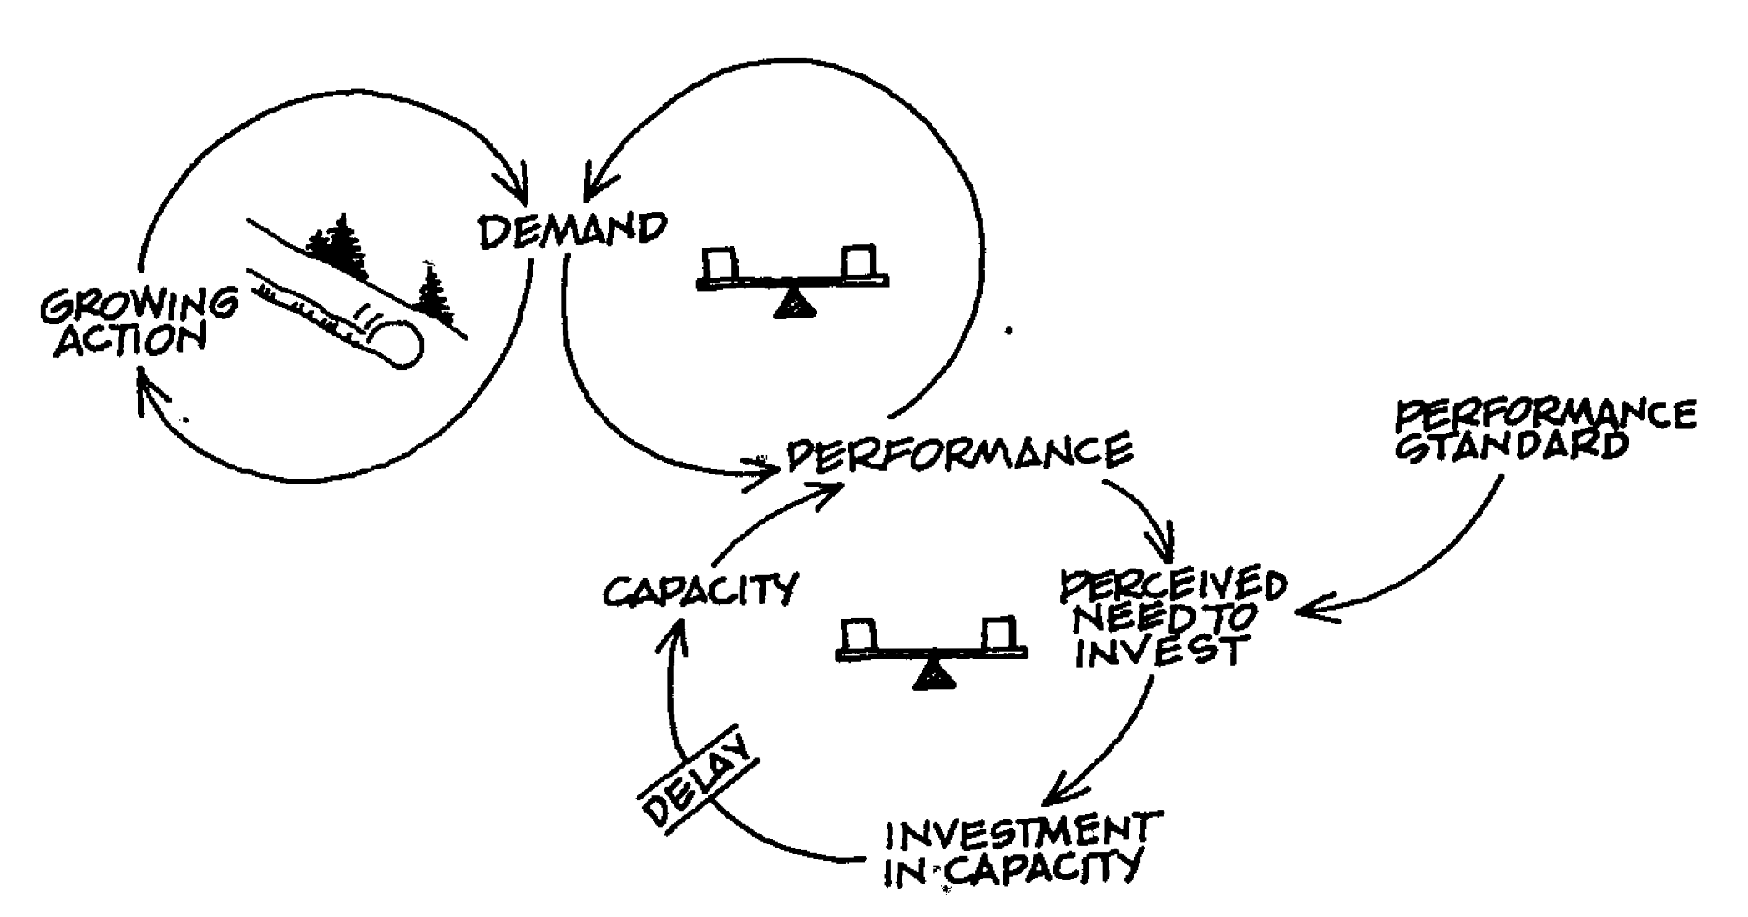
Appendix 2-Systems Archetypes
GROWTH AND UNDERINVESTMENT
Notes:
“Description: Growth approaches a limit which can be eliminated or pushed into the future if the firm, or individual, invests in additional "capacity." But the investment must be aggressive and sufficiently rapid to forestall reduced growth, or else it will, never get made. Oftentimes, key goals or performance standards are lowered to justify underinvestment. When this happens, there is a self-fulfilling prophecy where lower goals lead to lower expectations; which are then borne out by poor performance caused by underinvestment."

